Slide 1
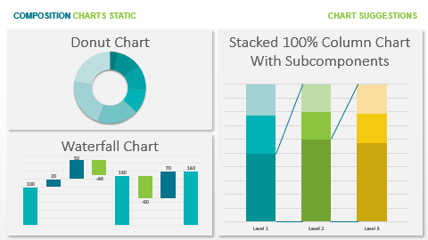
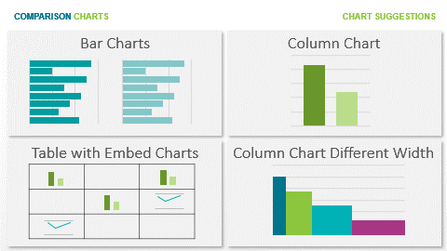
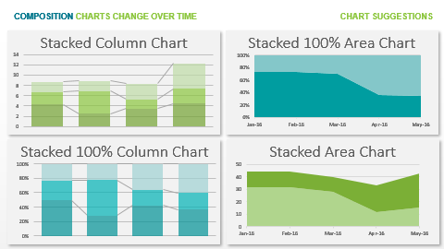
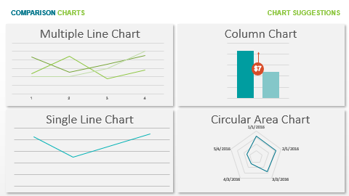
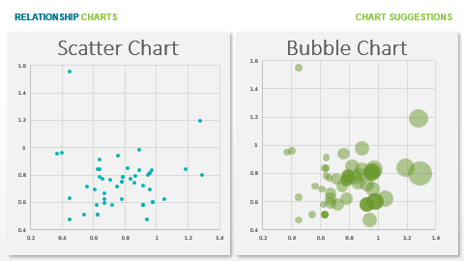
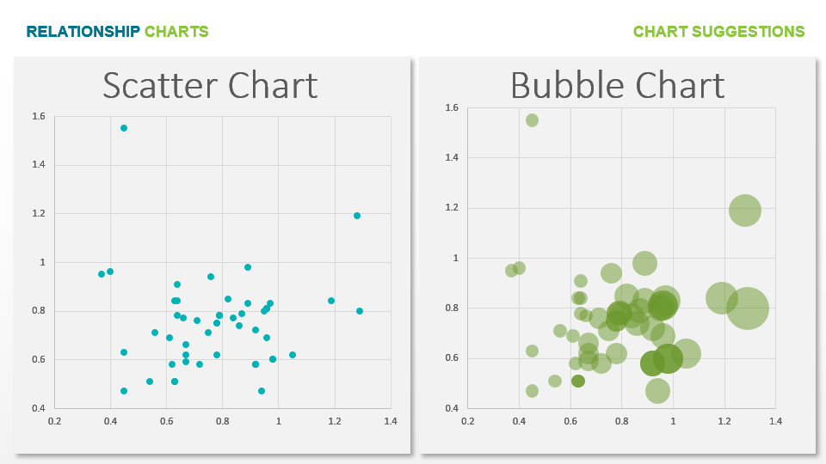
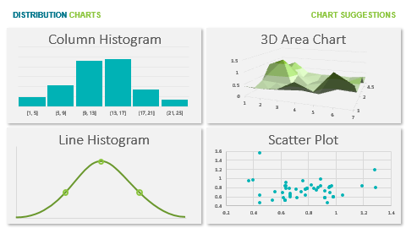
Many Items
Few Items
Many Categories
Few Categories
Few Categories
Many Periods
Among Items
Over Time
Many Categories
Few Periods
Two Variables
Non-Cyclical Data
Cyclical Data
Many Categories
Three Variables
COMPARISON
Three Variables
Few
Points
What would you like to show?
RELATIONSHIP
DISTRIBUTION
Single
Variable
Many
Points
Two
Variables
COMPOSITION
Two
Variables
Few Periods – Relative and Absolut Difference
Relative Difference
Simple
Share of Total
Change over time
Static
over
time
Many Periods
Relative and Absolut
Difference
Accumulation
Subst. of Total
Components of Components
Few Periods – Relative Difference

Slide 2
RELATIONSHIP CHARTS
CHART SUGGESTIONS
Scatter Chart
Bubble Chart

Slide 3
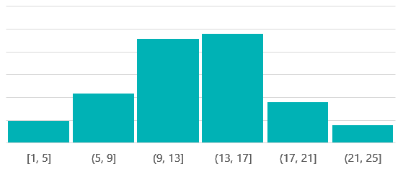
DISTRIBUTION CHARTS
CHART SUGGESTIONS
Column Histogram
3D Area Chart
Line Histogram
Scatter Plot

Slide 4
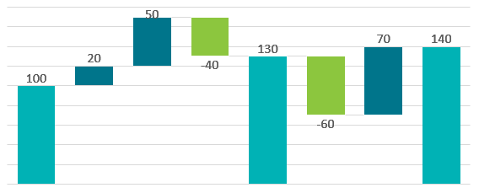
COMPOSITION CHARTS STATIC
CHART SUGGESTIONS
Donut Chart
Stacked 100% Column Chart With Subcomponents
Waterfall Chart

Slide 5
COMPOSITION CHARTS CHANGE OVER TIME
CHART SUGGESTIONS
Stacked Column Chart
Stacked 100% Area Chart
Stacked 100% Column Chart
Stacked Area Chart

Slide 6
COMPARISON CHARTS
CHART SUGGESTIONS
Multiple Line Chart
Column Chart
$7
Single Line Chart
Circular Area Chart

Slide 7
COMPARISON CHARTS
CHART SUGGESTIONS
Bar Charts
Column Chart
Table with Embed Charts
Column Chart Different Width

Slide 8
RELATIONSHIP ADDITIONS
CHART SUGGESTIONS
Flow Chart
Hierarchy
Networks
Quadrants

Slide 9

Get 15% discount from regular price
Coupon Code:
FREEBUNDLE15
Apply this coupon code during sign up
Download PowerPoint templates and save hours of work.
SUBSCRIBE NOW
Easy to use
Fully customizable
Cutting edge designs
Visit slidemodel.com
Notes:
You can safely remove this slide. This slide design was provided by SlideModel.com – You can download more templates, shapes and elements for PowerPoint from http://slidemodel.com/

Slide 10
Notes:
You can safely remove this slide. This slide design was provided by SlideModel.com – You can download more templates, shapes and elements for PowerPoint from http://slidemodel.com

