Slide 1
CGB1201 – JAVA PROGRAMMING
Department of Artificial Intelligence and Data Science
Academic Year: 2024 – 2025 (Odd Semester)
Register Number :2303811724321091
Name :ROSHITH S
Year : II
Semester : III
Section : B
Date : 03/12/2024

Slide 2
HOUSE RENTAL SYSTEM

Slide 3
Problem Identification
The house rental system faces inefficiencies in connecting property owners with tenants due to manual processes, scattered listings, and poor communication. These issues lead to delays, errors, and mismatched preferences. A streamlined digital solution is needed to enhance accessibility, transparency, and efficiency for seamless rental management.

Slide 4
Objective
The objective of the house rental system is to develop a user-friendly digital platform that connects property owners with tenants, streamlines property listing and searching, provides real-time availability, and automates rental agreements, payments, and communication for efficient and seamless transactions.

Slide 5
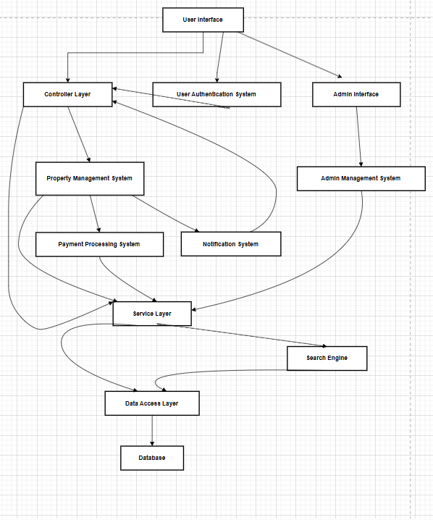
Proposed Architecture

Slide 6
Java Programming - Concepts Used
Object-Oriented Programming (OOP):
Used to model real-world entities like properties, tenants, and landlords as objects with attributes and behaviors.
Encapsulation:
Protects data by hiding internal details and providing access through methods, ensuring secure management
Arrays/Lists:
Used to store multiple property listings, tenant records, and payment histories for easy retrieval and management.
File Handling:
The system can save data such as tenant details and property listings to files for persistent storage.
GUI (Graphical User Interface):
A user-friendly interface (using Swing or JavaFX) allows interaction with the system, enabling users to view, add, and manage properties.

Slide 7
List of Modules
Property Module
Landlord Module
Tenant Module
Admin Module
Main Program (HouseRentalSystem)

Slide 8
Module Description
1)Property Module:
Manages property details (location, rent, availability).
Allows updating and displaying property information.
2)Landlord Module:
Allows landlords to list properties and view their listings.
3) Tenant Module:
Allows tenants to search properties and request to rent them.

Slide 9
Module Description (Cont..)
4)Admin Module:
Manages and views all property listings in the system.
5)Main Program (HouseRentalSystem):
Displays the main menu and routes users to appropriate modules.

Slide 10
Source Code
import java.awt.*;
Import java.util.ArrayList;
Import javax.swing.*;
import javax.swing.table.DefaultTableModel;
public class HouseRentalSystem {
private static ArrayList<House> houseList = new ArrayList<>(); //
Stores house details public static void main(String[] args) {
SwingUtilities.invokeLater(() -> new LoginPage());
static class LoginPage extends
JFrame { LoginPage() {
setTitle("Login");
setSize(300,150);
setDefaultCloseOperation(JFrame.EXIT_ON_CLOSE);
setLocationRelativeTo(null);
// Layout and Components
setLayout(new
GridLayout(3, 2));
JLabel lblUsername = new
JLabel("Username:"); JTextField
txtUsername = new JTextField();
JLabel lblPassword = new
JLabel("Password:");
JPasswordField txtPassword = new
JPasswordField(); JButton btnLogin = new
JButton("Login");

Slide 11
Source Code
add(lblUsername);
add(txtUsername);
add(lblPassword);
add(txtPassword);
add(new JLabel()); //
Empty cell add(btnLogin);
// Login Action
btnLogin.addActionListene
r(e -> {
String username = txtUsername.getText();
String password = new String(txtPassword.getPassword());
if (username.equals("admin") &&
password.equals("admin")) { dispose();
new MainMenu();
} else {
JOptionPane.showMessageDialog(this, "Invalid credentials!");
}
});
setVisible(true);
}
}

Slide 12
Source Code
// Main Menu
static class MainMenu extends
JFrame { MainMenu() {
setTitle("Main
Menu");
setSize(300, 200);
setDefaultCloseOperation(JFrame.EXIT_ON_C
LOSE); setLocationRelativeTo(null);
// Layout and Buttons
setLayout(new
GridLayout(3, 1));
JButton btnAddHouse = new JButton("Add
House"); JButton btnViewHouses = new
JButton("View Houses"); JButton btnExit =
new JButton("Exit");
// Adding Buttons
add(btnAddHouse
);
add(btnViewHous
es); add(btnExit);
// Button Actions
btnAddHouse.addActionListener(e -> new AddHouse());
btnViewHouses.addActionListener(e -> new ViewHouses());
btnExit.addActionListener(e -> System.exit(0));
setVisible(true);
}

Slide 13
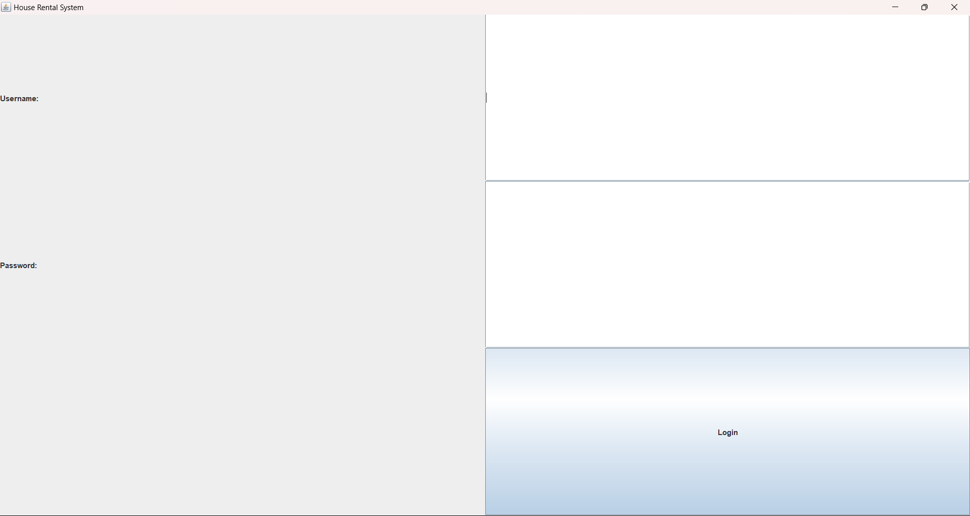
Results

Slide 14
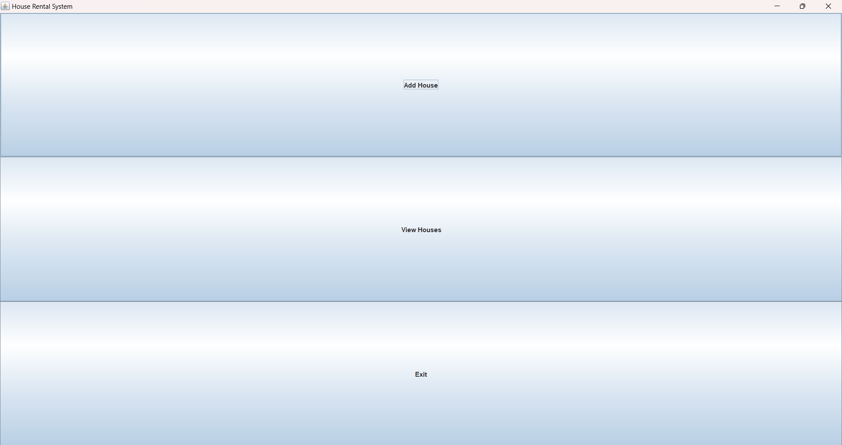
Results

Slide 15
Conclusion
The House Rental System manages property listings, enabling landlords to list, tenants to rent, and admins to oversee properties. Its modular design ensures scalability, though current in-memory storage limits multi-tenant management. Future enhancements include database integration, payment processing, and advanced features, providing a solid foundation for a scalable rental system.

Slide 16
Thank You
Any queries???

