Slide 1
AMAZON ALEXA REVIEWS SENTIMENT ANALYSIS
Guide by: Ms.Arpita Roy
Project by: Roshni Verma.

Slide 2
TITLE
Problem Statement
Project Overview
Why we need this?
How it will help people?
Solution
How its unique
Modelling (Analysis Model)and Visualization
Live Demo- Analysis Dashboard
Result(prediticion Model)

Slide 3

Amazon Alexa is a cloud-based voice service developed by Amazon that allows customers to interact with technology. There are currently over 40 million Alexa users around the world, so analyzing user sentiments about Alexa will be a good data science project. So, if you want to learn how to analyze the sentiments of users using Amazon Alexa, this article is for you. In this article, I’ll walk you through the task of Amazon Alexa Reviews Sentiment Analysis Using Python.

Slide 4
PROJECT OVERVIEW
Our goal is to check the Amazon Alexa Reviews Statement. As per my csv file I have to take the feedback ,verified reviews of people that is good or not.
so we started with jupyter notebook and gathered data, filtered it, then moved on to visualization, and eventually created a prediction model for this data set.

Slide 5
Why we need this?
Amazon Alexa is a cloud-based voice service developed by Amazon that allows customers to interact with technology. There are currently over 40 million Alexa users around the world, so analyzing user sentiments about Alexa will be a good data science project. So, if you want to learn how to analyze the sentiments of users using Amazon Alexa, this article is for you. In this article, I’ll walk you through the task of Amazon Alexa Reviews Sentiment Analysis Using Python.

Slide 6
How it will help people?
Alexa lives in the cloud and is happy to help anywhere there's internet access and a device that can connect to Alexa.
Making Alexa part of your day is as simple as asking a question.
Alexa can play your favorite song, read the latest headlines, dim the lights in your living room, and more.

Slide 7
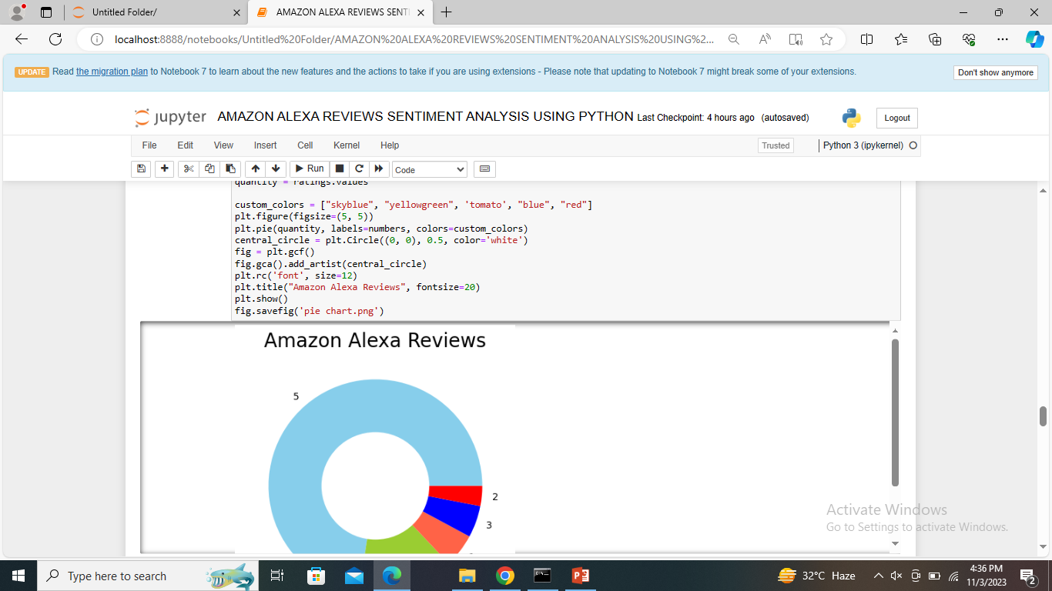
People see this and buy it . Because people saw the ratings ,feedback of others and then to decide to buy or its uses also understand.
SOLUTION

Slide 8
What makes your concept unique?
Alexa is approachable, efficient, trustworthy, and natural.
These unique personality characteristics make Alexa, Alexa.

Slide 9
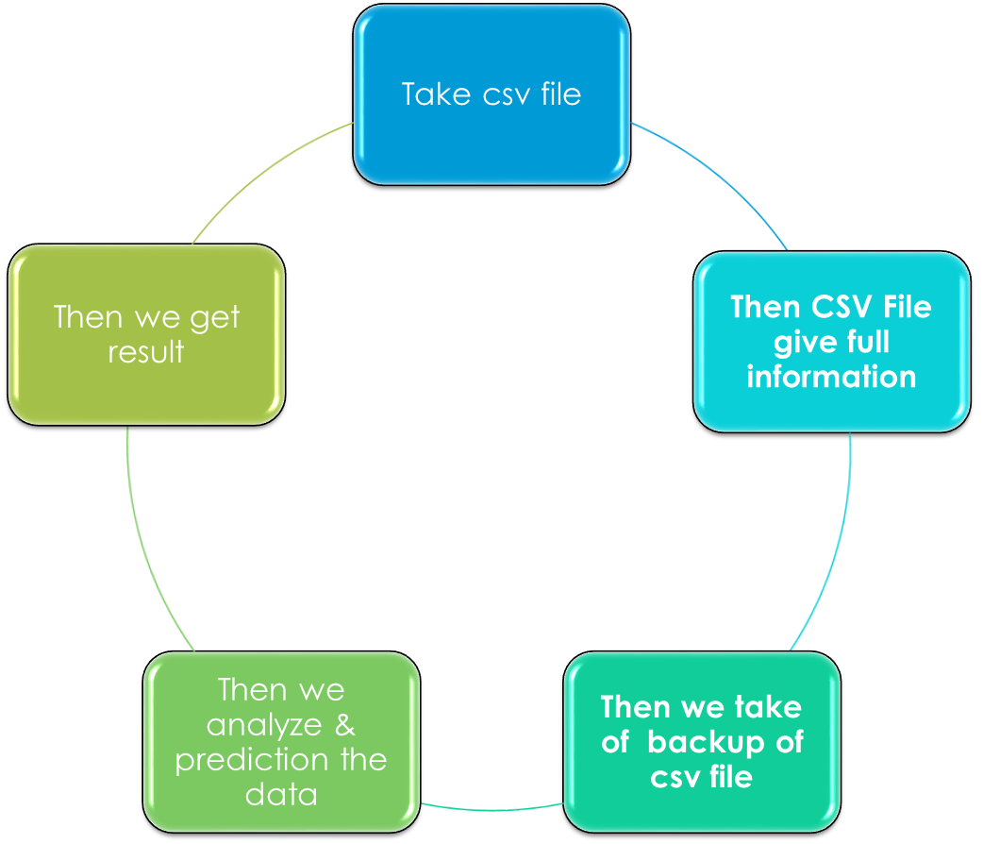
Modelling (Analysis Model) And Visualization

Slide 10
Live demo- analysis dashboard
https://github.com/roshni-verma/-Amazonian-Mermaids.git

Slide 11
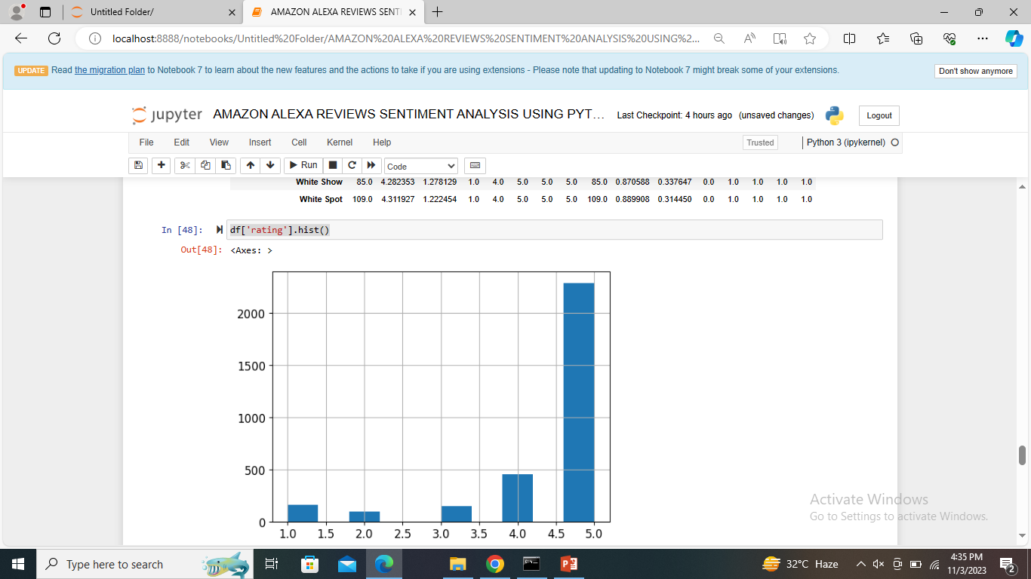
RESULT(PREDICTION MODEL)
Rating
Variance
Feedback
reviews

Slide 12
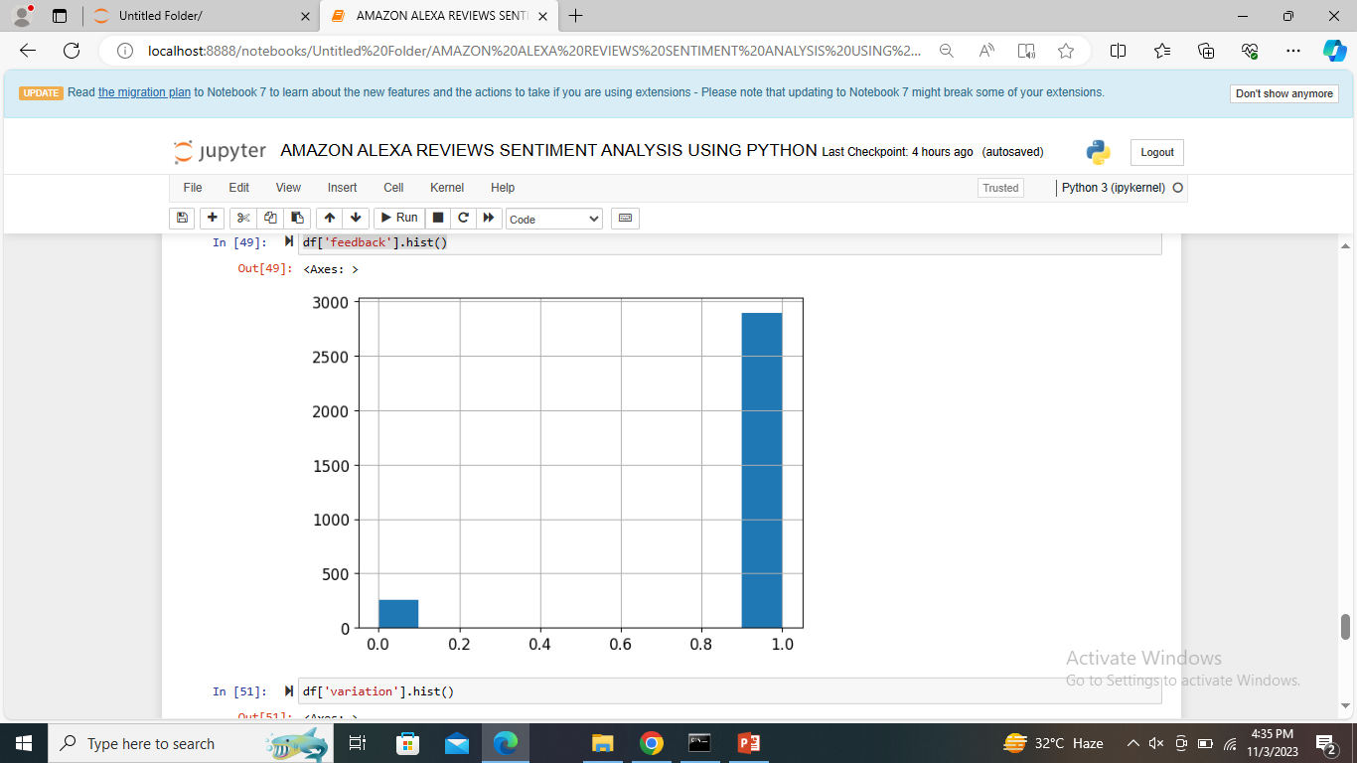
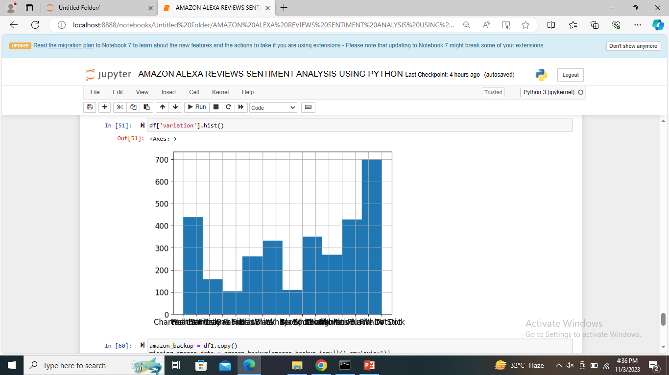

Slide 13
Thank You
Credit Goes to:
• Mentor : Ms.Arpita Roy
• Youtube channel
• Google

