Slide 1
Web hosting Static​​ File in IBM Cloud​
CREATED BY – ROSHNI VERMA

Slide 2
AGENDA​
​ | Title​
1​ | Problem Statement​
2​ | Project Overview​
3​ | Why we need this?​
4​ | How it help people?​
5​ | Solution​
6​ | Modelling​
7​ | Result​

Slide 3
Problem Statement​
Host static files on IBM Cloud using IBM Cloud Object Storage. ​
Create a storage instance, upload files to a bucket, note API key and endpoint. ​
Deploy a simple web app on IBM Cloud Foundry with the static file build pack. ​
This can help protect against outages, safeguard against data loss, and help support disaster recovery strategies

Slide 4
Project Overview​
Object Storage starts with creating a bucket and configuring it for public access.​
upload your website content to your bucket.​
IBM Cloud Object Storage is a parallel storage system and provides concurrent access from anywhere with an any-to- any-to any architecture.​

Slide 5
Why we need this?
Object-based storage has emerged as the preferred method for data archiving and backup.​
It offers a level of scalability not possible with traditional file- or block-based storage.​
Efficiently host static files on IBM Cloud to ensure reliable, scalable, and globally accessible storage, optimizing web application performance and user experience.​​

Slide 6
How it will help people?​​
Hosting static files on IBM Cloud ensures fast, reliable, and globally accessible content delivery, enhancing user experience, and optimizing web application performance. ​
It provides a scalable solution with robust storage infrastructure, benefiting developers and businesses in delivering content seamlessly to end-users.​​

Slide 7
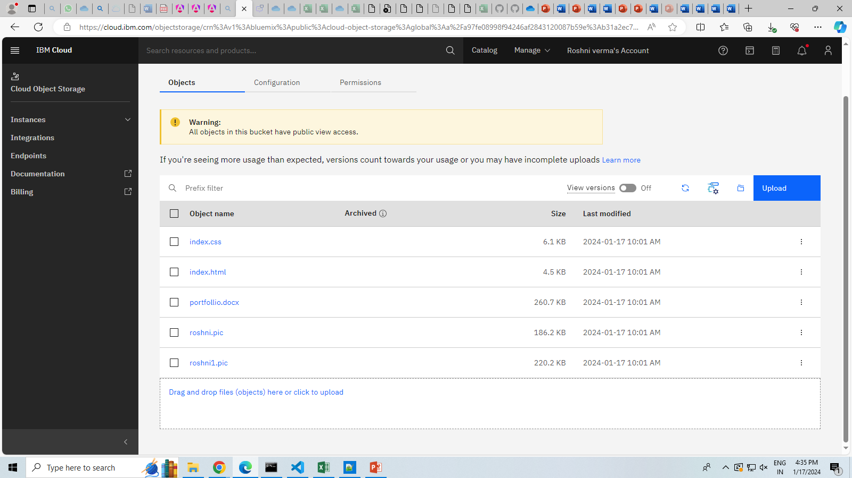
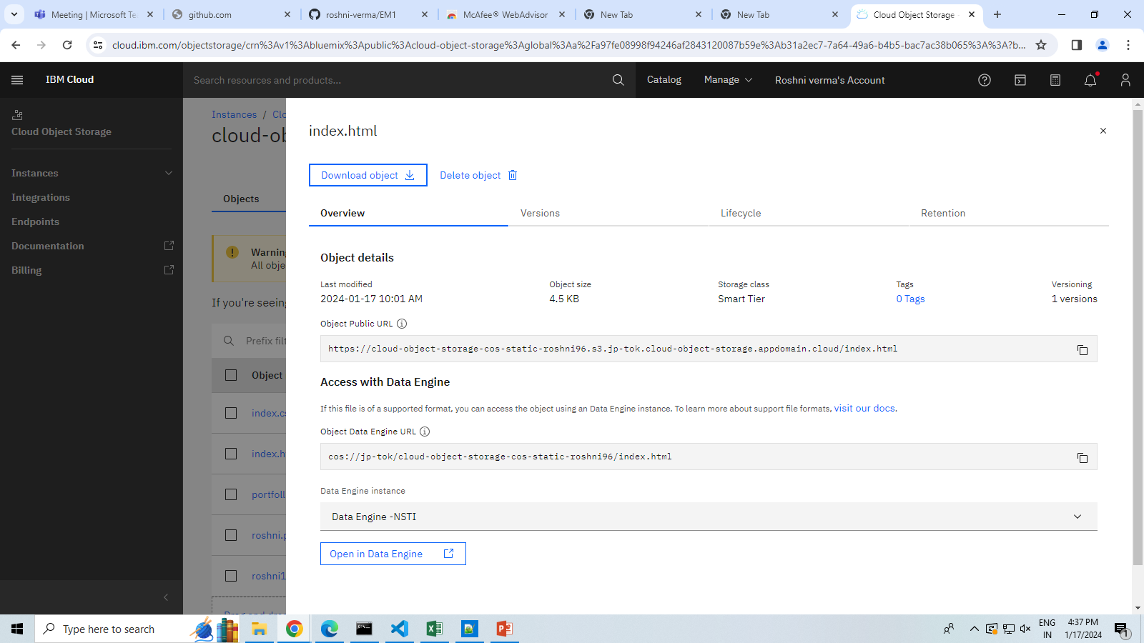
Solution​

Slide 8
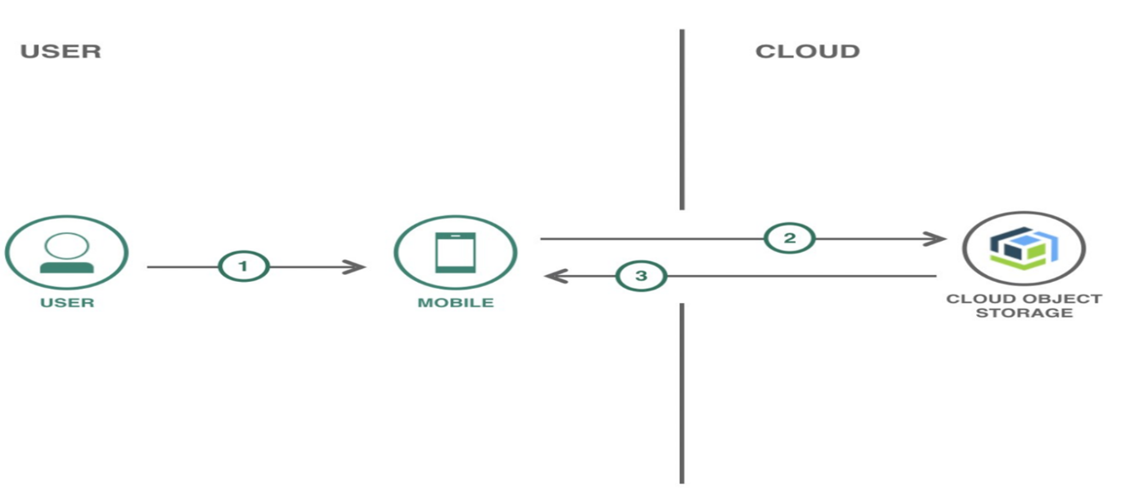
Modelling​

Slide 9
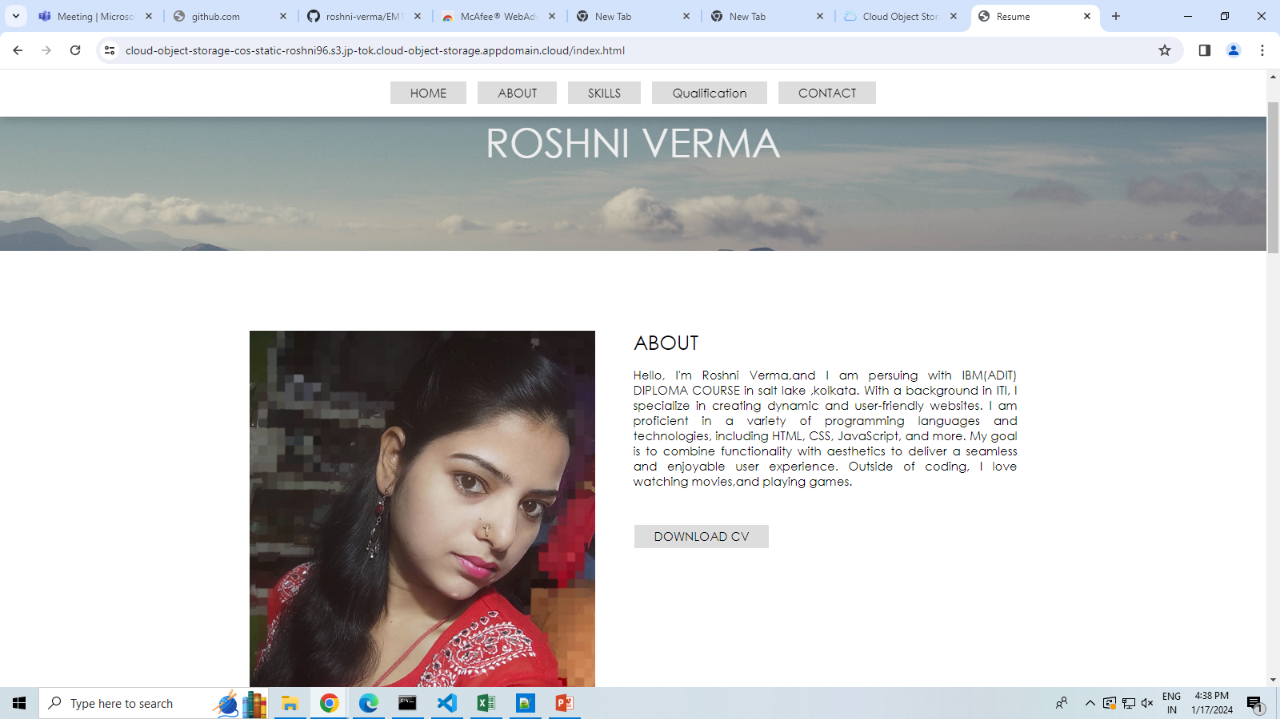
Result​
This results in a performant, secure, and scalable infrastructure for hosting static files, supporting diverse use cases from simple websites to complex web applications and web hosting in IBM cloud object storage projects.​​
​
HOSTING WEBSITE: https://cloud-object-storage-cos-static-roshni96.s3.jp-tok.cloud-object-storage.appdomain.cloud/index.html

Slide 10
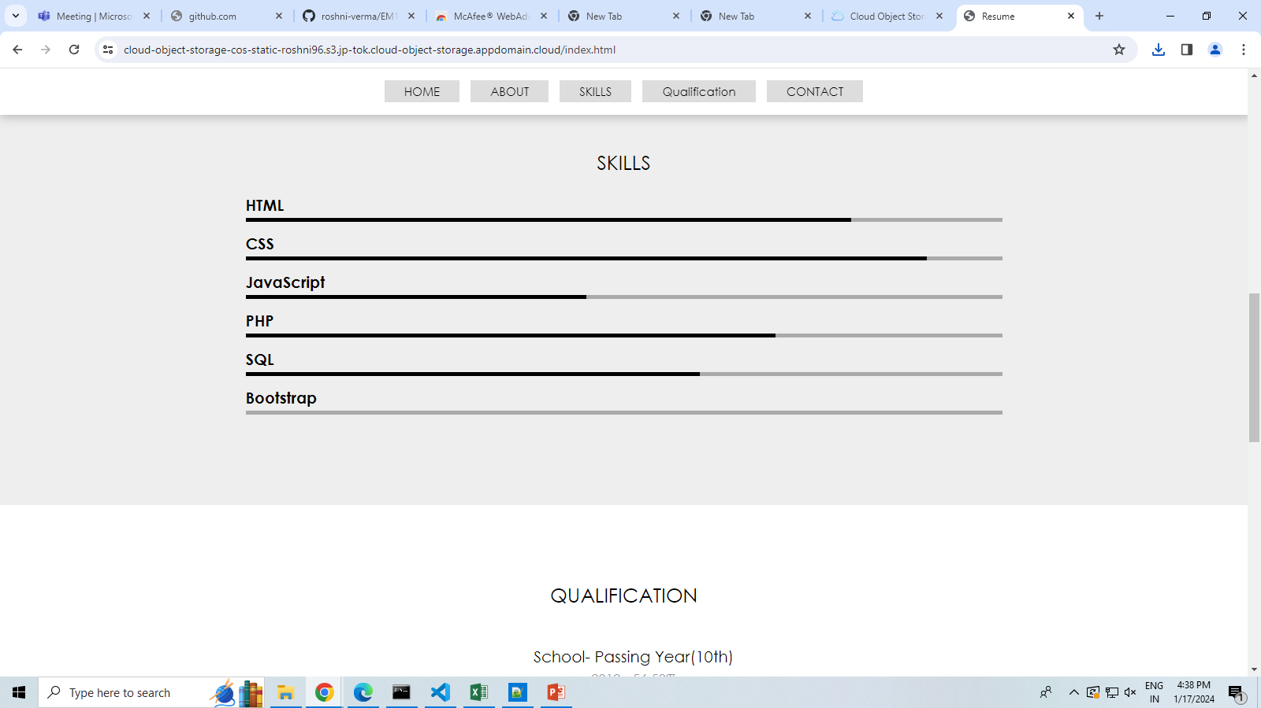
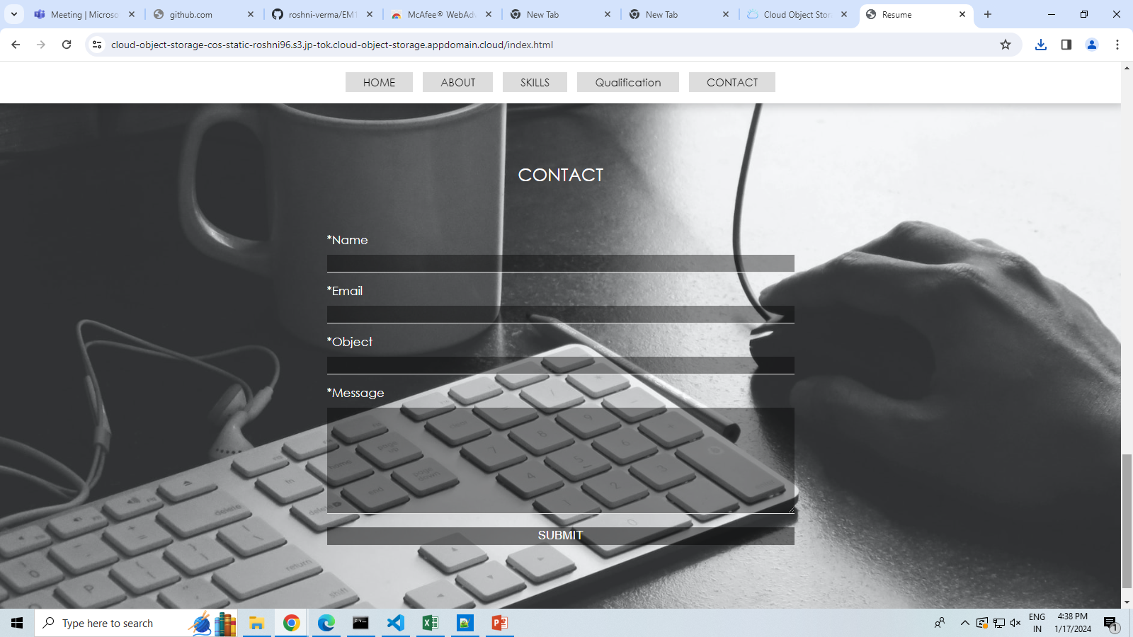
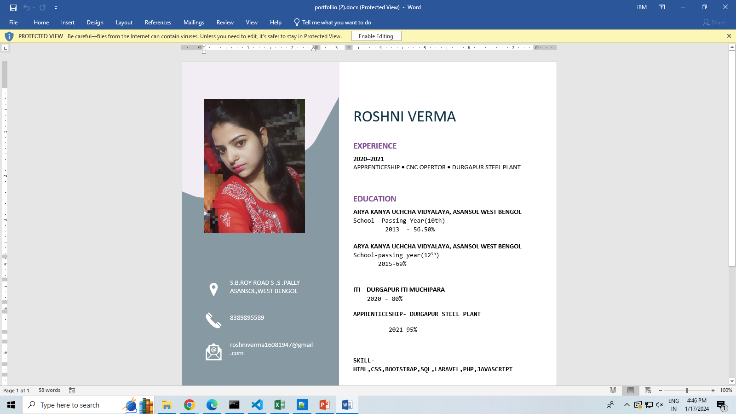

Slide 11
THANK YOU

