Slide 1
QUALCOMM TRACK · AI INFRA SUMMIT HACKATHON 2026
PEMA
Personal Environmental Memory Agent
A private, on-device memory of your room for people with low vision or memory loss. Arduino UNO Q (Qualcomm Dragonwing) + Snapdragon Hexagon NPU via GenieX + STM32.
Done by Roshni
PEMA · Qualcomm track · AI Infra Summit Hackathon 2026 · Roshni
1

Slide 2
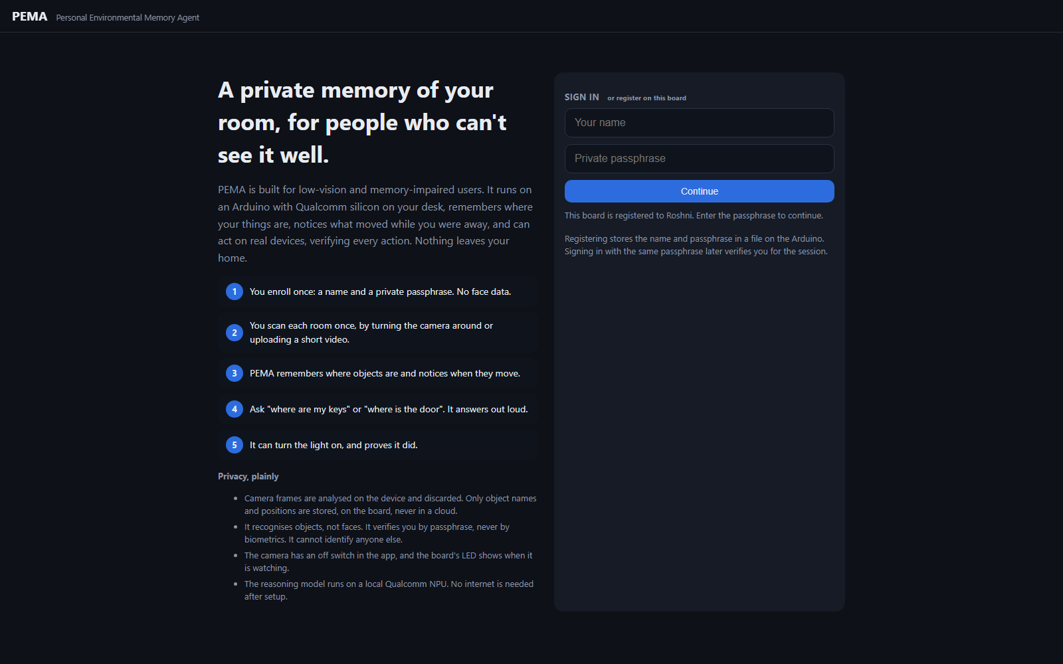
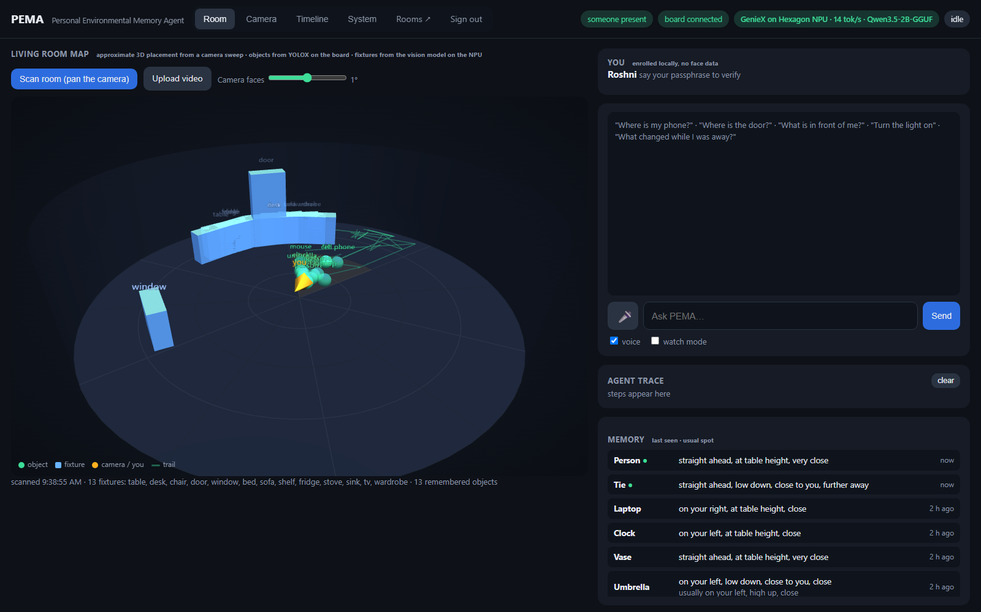
What it is: one loop, not a feature list
For 2 billion people with vision impairment, 55 M with dementia
1 Identify locally: name + passphrase on the board. No face data.
2 Remember: YOLOX on the Arduino's Qualcomm chip; where each object was, its usual spot.
3 Notice change: leave and return → "your keys moved from your left to your right."
4 Act: a planner on the Hexagon NPU picks tools: memory, vision, hardware, speech.
5 Verify: every action is read back from the STM32 before it is claimed.
PEMA · Qualcomm track · AI Infra Summit Hackathon 2026 · Roshni
2

Slide 3
Architecture
Qualcomm silicon does perception, memory and reasoning · the Arduino STM32 does real-time sensing and verified actuation · everything on the local network
Browser (laptop / phone)
Arduino UNO Q · Qualcomm Dragonwing QRB2210 (Linux)
Snapdragon X Elite · Hexagon NPU · GenieX
Arduino STM32U585 (Zephyr)
dashboard: 3D room map, camera, timeline
webcam → 480 px JPEG frames
voice in / voice out
sign in · rooms · video upload
sensors every 1 s
LED matrix · buzzer
relay · servo · LED
get_state readback
over-temp interlock
PERCEPTION YOLOX-nano int8, 80 classes
MEMORY last seen · usual spot · trail (JSON)
PRESENCE left / returned → what changed
SAFETY rules + action whitelist (veto)
PLANNER LOOP orchestrates the agents
ROOM MAP fixtures from scans, per room
HISTORY SQLite: sightings, events, actions
WebUI server (socket.io)
Qwen3.5-2B Q4_0, text + vision
PLANNER 1 tool per step, GBNF grammar
VISION scene questions, room fixtures
OpenAI-compatible server (npu_server.py)
profile per call: HTP0 · tok/s · TTFT
frames · commands
board ↔ laptop over USB (adb reverse + relay). Swap the URL to run on a Dragonwing board with its own NPU.
actions only through the whitelist; MCU state read back before any claim
snapshot + frame ↔ plan
Bridge RPC ↔ verified
Agents per request
SAFETY
PLANNER
MEMORY
VISION
HARDWARE
SPEECH
safety runs first and can veto · planner loops up to 4 steps, one tool each · memory and hardware are deterministic code · planner and vision run on the NPU · every step is shown in the trace
PEMA · Qualcomm track · AI Infra Summit Hackathon 2026 · Roshni
3

Slide 4
The pipeline
Camera (laptop / phone)
Arduino UNO Q · Qualcomm Dragonwing
Snapdragon X Elite · Hexagon NPU · GenieX
Arduino STM32U585
sensors every second
matrix · buzzer · relay · servo
get_state readback = verified
local over-temp interlock
480 px JPEG every ~1.5 s
browser, local network only
YOLOX-nano int8, 80 classes
object memory + usual spots
presence + change detection
safety rules + whitelist
SQLite history, dashboard
Qwen3.5-2B Q4_0, text + vision
planner: 1 tool per step, GBNF grammar
vision: scene questions, room fixtures
profile per call: device, tok/s, TTFT
Agents, each step visible in the trace: safety → planner → memory / vision / hardware → speech
Board ↔ laptop over USB. Nothing leaves the local network. Same code runs with the model on a Dragonwing board with its own NPU (one URL).
PEMA · Qualcomm track · AI Infra Summit Hackathon 2026 · Roshni
4

Slide 5
Checking the NPU: measured, not assumed
Per-request proof (GenieX profile)
Benchmark, same 0.8B Q4_0 model
device = HTP0 (Hexagon), backend = llama.cpp, on every planner step
tokens/s, first token, prompt tokens shown live on the dashboard
Task Manager NPU graph spikes during each answer
NPU prefill 297 tok/s · TTFT 0.13 s · decode 17.7
GPU prefill 316 tok/s · TTFT 0.12 s · decode 51.5
CPU prefill 24 tok/s · TTFT 1.60 s · decode 65.9
Agent steps are prompt-heavy: the NPU wins where it matters
Inference optimisation
Smaller model: a 4-bit version of Qwen3.5-2B, so it fits and runs on the NPU.
Fixed answer format: the model can only produce a valid command, so no broken answers, no retries, short outputs.
Less work per question: one model for thinking and seeing, short inputs, at most 4 steps and one camera look, smaller images one at a time.
Measured, not assumed: every answer shows the chip and speed on screen; NPU vs GPU vs CPU benchmarked, and Qualcomm's faster pre-built model tested but not shipped because it can't use the fixed format yet.
PEMA · Qualcomm track · AI Infra Summit Hackathon 2026 · Roshni
5

Slide 6
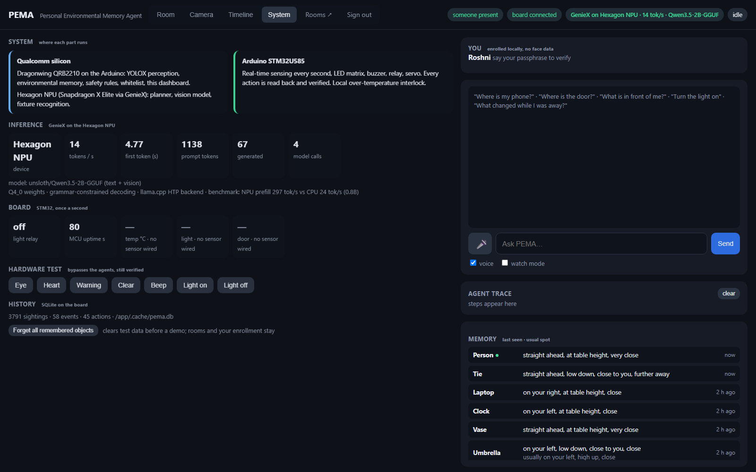
Agents involved
Six agents handle every request, in order, and the trace panel shows each step.
Safety runs first: plain rules, can act or veto, no AI.
Planner: the AI model on the Hexagon NPU, picks one helper at a time, up to four steps.
Memory: the notebook on the Arduino, answers "where is it" without AI.
Vision: the model on the NPU looks at the camera frame when asked.
Hardware: the STM32 acts, then is read back to confirm it happened.
Speech: says the final answer out loud.
Two are AI, four are code: the AI decides, the code guarantees.
PEMA · Qualcomm track · AI Infra Summit Hackathon 2026 · Roshni
6

Slide 7
GenieX, what it does here
It's the engine that runs the AI model on the Qualcomm NPU. Without it, the model would run on the CPU, slowly, or in the cloud.
I use its Python SDK to load Qwen3.5-2B in 4-bit onto the Hexagon NPU, and I wrapped it in a small OpenAI-style server so the Arduino can call it over USB.
It gives me the grammar feature that forces the model to output only valid commands, which is what made the agent reliable.
It returns a profile with every answer, which chip, how fast, so the dashboard can prove the NPU is doing the work.
It also runs the vision side: the same model answers "what is in front of me" and finds doors and windows during a room scan.
It's portable: point it at a different device and the same code runs on a Dragonwing board with its own NPU.
PEMA · Qualcomm track · AI Infra Summit Hackathon 2026 · Roshni
6

Slide 8
GenieX, what it does here
I
It notices your keys moved while you were gone, tells you, turns the light on, and proves it did.
Private. On-device. On Qualcomm silicon.
Privacy by design: frames discarded on-device, objects not faces, passphrase not biometrics, camera off switch, no cloud.
Honest limits: the UNO Q's chip has no supported NPU, so the model runs on the laptop's Hexagon; the 3D map is approximate placement from a sweep.
Thank you · Roshni
PEMA · Qualcomm track · AI Infra Summit Hackathon 2026 · Roshni
6

