Slide 1
QUALCOMM TRACK · AI INFRA SUMMIT HACKATHON 2026
PEMA
Personal Environmental Memory Agent
A private, on-device memory of your room for people with low vision or memory loss. Arduino UNO Q (Qualcomm Dragonwing) + Snapdragon Hexagon NPU via GenieX + STM32.
Done by Roshni
PEMA · Qualcomm track · AI Infra Summit Hackathon 2026 · Roshni
1

Slide 2
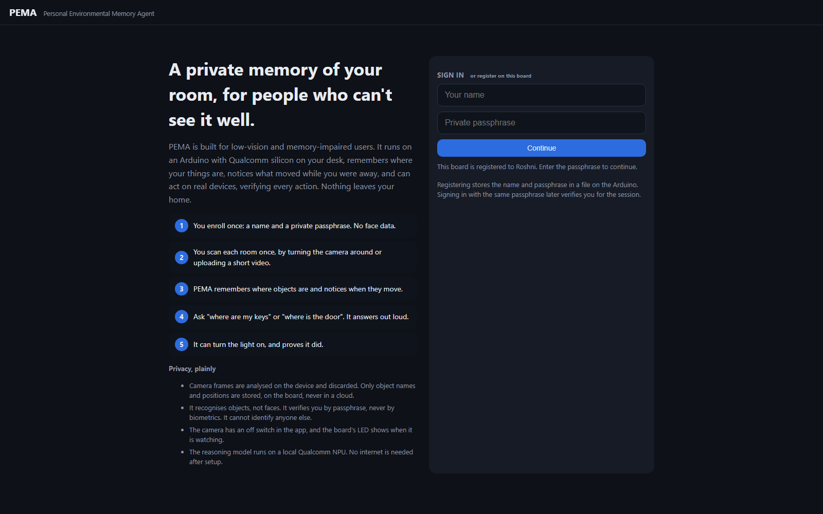
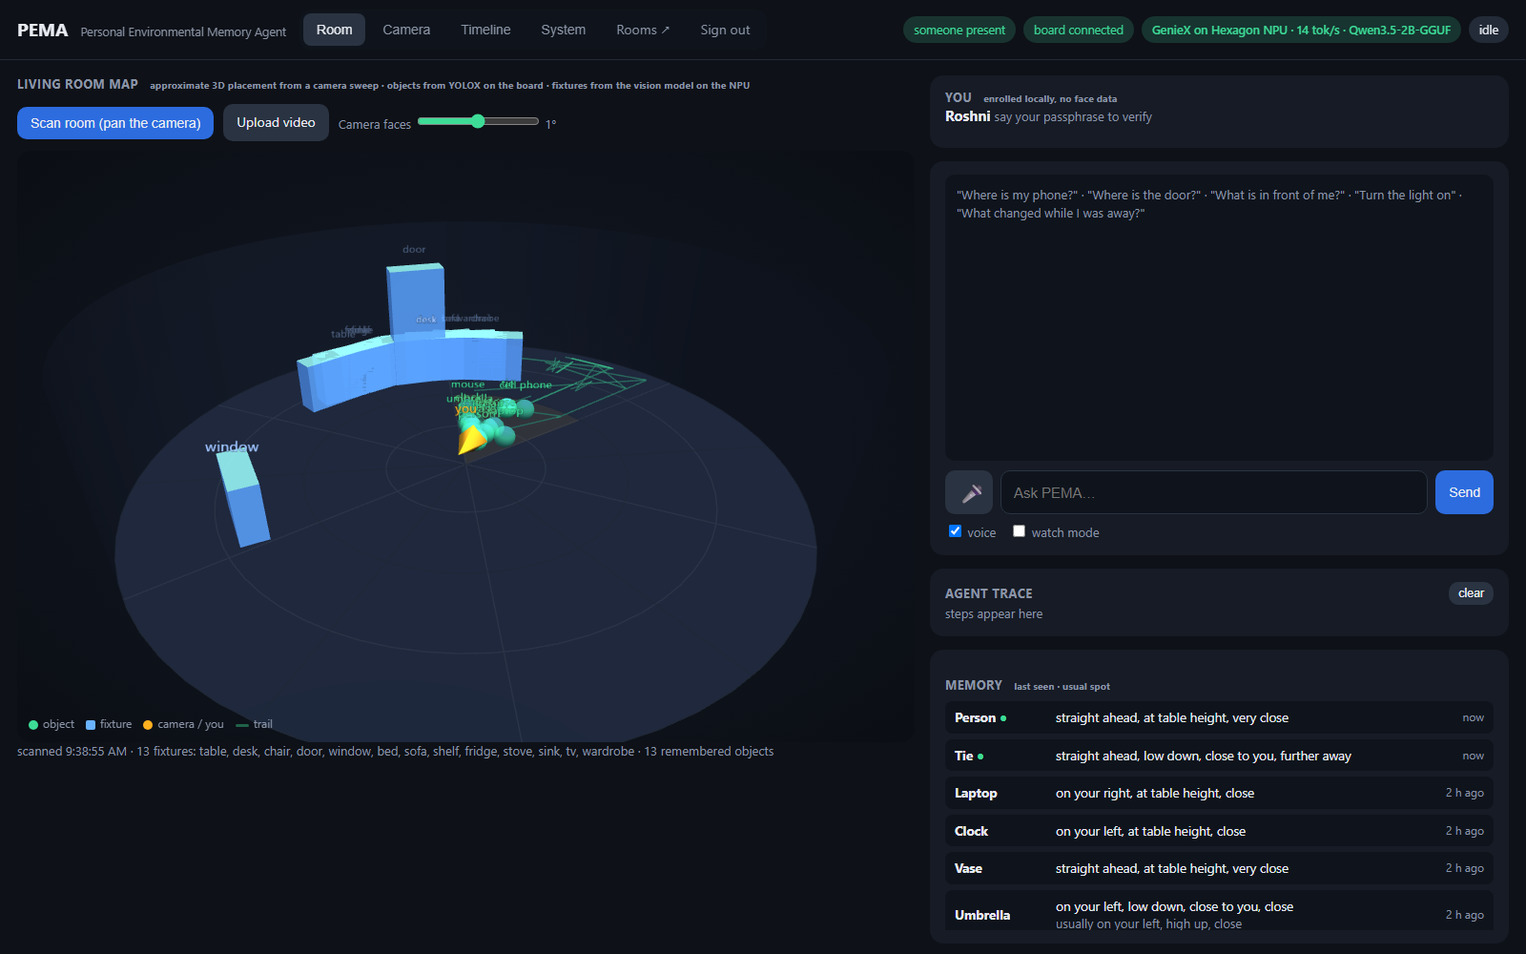
What it is: one loop, not a feature list
For 2 billion people with vision impairment, 55 M with dementia
1 Identify locally: name + passphrase on the board. No face data.
2 Remember: YOLOX on the Arduino's Qualcomm chip; where each object was, its usual spot.
3 Notice change: leave and return → "your keys moved from your left to your right."
4 Act: a planner on the Hexagon NPU picks tools: memory, vision, hardware, speech.
5 Verify: every action is read back from the STM32 before it is claimed.
PEMA · Qualcomm track · AI Infra Summit Hackathon 2026 · Roshni
2

Slide 3
Architecture
Qualcomm silicon does perception, memory and reasoning · the Arduino STM32 does real-time sensing and verified actuation · everything on the local network
Browser (laptop / phone)
Arduino UNO Q · Qualcomm Dragonwing QRB2210 (Linux)
Snapdragon X Elite · Hexagon NPU · GenieX
Arduino STM32U585 (Zephyr)
dashboard: 3D room map, camera, timeline
webcam → 480 px JPEG frames
voice in / voice out
sign in · rooms · video upload
frames · commands
PERCEPTION YOLOX-nano int8, 80 classes
MEMORY last seen · usual spot · trail (JSON)
PRESENCE left / returned → what changed
SAFETY rules + action whitelist (veto)
PLANNER LOOP orchestrates the agents
ROOM MAP fixtures from scans, per room
HISTORY SQLite: sightings, events, actions
WebUI server (socket.io)
Qwen3.5-2B Q4_0, text + vision
PLANNER 1 tool per step, GBNF grammar
VISION scene questions, room fixtures
OpenAI-compatible server (npu_server.py)
profile per call: HTP0 · tok/s · TTFT
sensors every 1 s
LED matrix · buzzer
relay · servo · LED
get_state readback
over-temp interlock
snapshot + frame ↔ plan
Bridge RPC ↔ verified
board ↔ laptop over USB (adb reverse + relay). Swap the URL to run on a Dragonwing board with its own NPU.
actions only through the whitelist; MCU state read back before any claim
Agents per request
SAFETY
PLANNER
MEMORY
VISION
HARDWARE
SPEECH
safety runs first and can veto · planner loops up to 4 steps, one tool each · memory and hardware are deterministic code · planner and vision run on the NPU · every step is shown in the trace
PEMA · Qualcomm track · AI Infra Summit Hackathon 2026 · Roshni
3

Slide 4
The pipeline
Camera (laptop / phone)
Arduino UNO Q · Qualcomm Dragonwing
Snapdragon X Elite · Hexagon NPU · GenieX
Arduino STM32U585
480 px JPEG every ~1.5 s
browser, local network only
YOLOX-nano int8, 80 classes
object memory + usual spots
presence + change detection
safety rules + whitelist
SQLite history, dashboard
Qwen3.5-2B Q4_0, text + vision
planner: 1 tool per step, GBNF grammar
vision: scene questions, room fixtures
profile per call: device, tok/s, TTFT
sensors every second
matrix · buzzer · relay · servo
get_state readback = verified
local over-temp interlock
Agents, each step visible in the trace: safety → planner → memory / vision / hardware → speech
Board ↔ laptop over USB. Nothing leaves the local network. Same code runs with the model on a Dragonwing board with its own NPU (one URL).
PEMA · Qualcomm track · AI Infra Summit Hackathon 2026 · Roshni
4

Slide 5
Checking the NPU: measured, not assumed
Per-request proof (GenieX profile)
Benchmark, same 0.8B Q4_0 model
device = HTP0 (Hexagon), backend = llama.cpp, on every planner step
tokens/s, first token, prompt tokens shown live on the dashboard
Task Manager NPU graph spikes during each answer
NPU prefill 297 tok/s · TTFT 0.13 s · decode 17.7
GPU prefill 316 tok/s · TTFT 0.12 s · decode 51.5
CPU prefill 24 tok/s · TTFT 1.60 s · decode 65.9
Agent steps are prompt-heavy: the NPU wins where it matters
Inference optimisation: what we did and what it bought
4-bit weights (Q4_0): the 2B model fits in 1.2 GB and runs on the NPU. Grammar-constrained decoding: the NPU can only output a valid tool call, so no retries and 60-120 output tokens.
One multimodal model for planning and vision: nothing to swap in memory. Short prompts: 8 memory items, 4 steps max, one vision call per request, repeat detection. Frames at 480 px, one in flight.
Result: first token 2-4 s on a 1,100-token prompt, 20 tok/s, and every call shows its NPU profile on screen. Tested Qualcomm's pre-compiled Qwen3-4B: 3.6x faster prompt reading, but no grammar support yet, so not shipped.
PEMA · Qualcomm track · AI Infra Summit Hackathon 2026 · Roshni
5

Slide 6
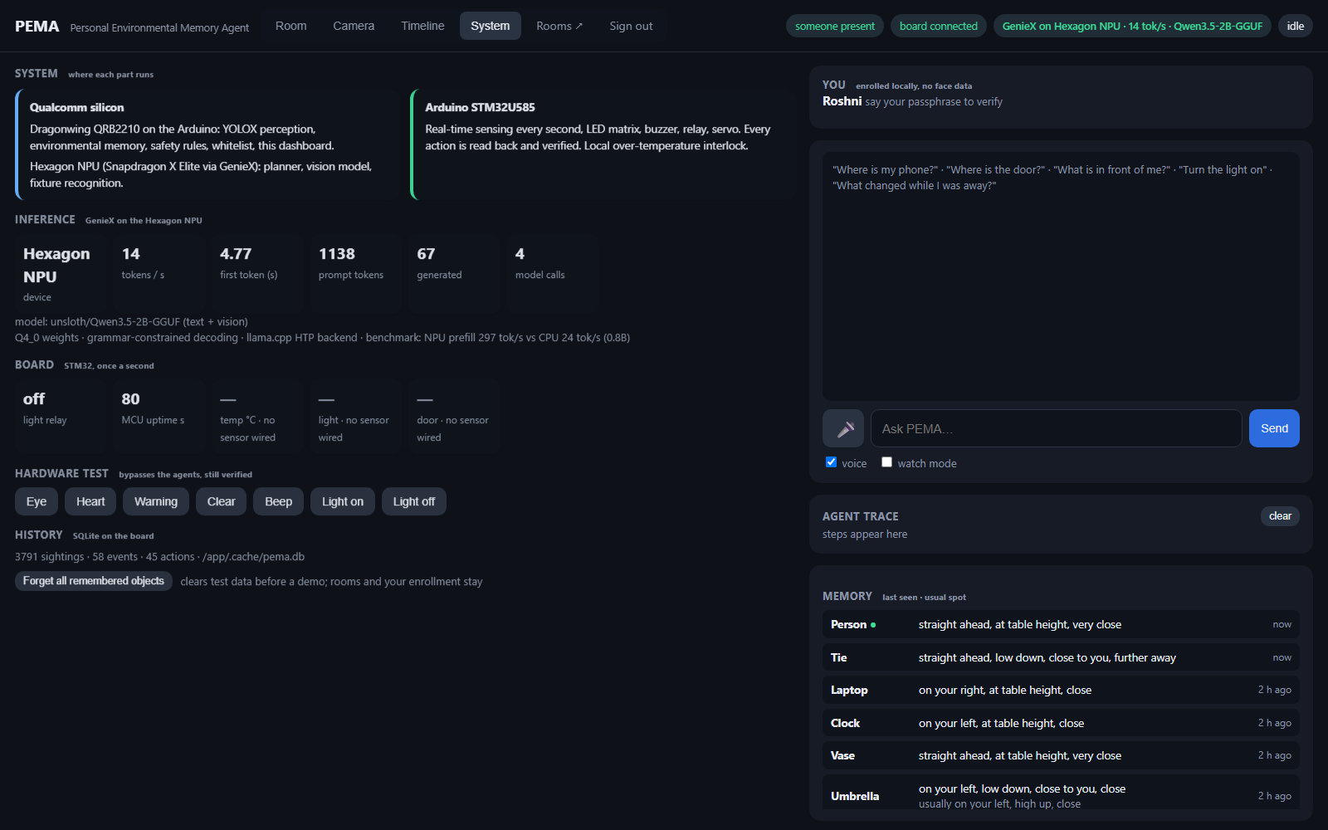
It notices your keys moved while you were gone, tells you, turns the light on, and proves it did.
Private. On-device. On Qualcomm silicon.
Privacy by design: frames discarded on-device, objects not faces, passphrase not biometrics, camera off switch, no cloud.
Honest limits: the UNO Q's chip has no supported NPU, so the model runs on the laptop's Hexagon; the 3D map is approximate placement from a sweep.
Thank you · Roshni
PEMA · Qualcomm track · AI Infra Summit Hackathon 2026 · Roshni
6

