Slide 1
Delivery Operations Analysis
with Crude Oil Price Correlation
Open Avenues Foundation | Industry Project with 84 Lumber
Roshni | Boston University M.S. Computer Science
Build Fellow: Samuel Castilla-Haddad, Business Operations Analyst
April 22, 2026
Notes:
Good [morning/afternoon], everyone. My name is Roshni, and I'm excited to walk you through my project for this industry engagement with 84 Lumber. The project is titled "Delivery Operations Analysis with Crude Oil Price Correlation." Over the past eight weeks, I've taken two very different data sources — 84 Lumber's internal truck-scheduling data and external crude oil futures pricing — and investigated whether oil market movements actually show up in day-to-day delivery operations. I want to thank Samuel, our Build Fellow, for guiding this project. The data here is real operational data, and the analysis is designed to mimic the kind of report a data analyst at 84 Lumber would present to their operations or supply-chain leadership. I'll spend about ten minutes walking through the business context, the data, the methodology, the key findings, and my recommendations. Then I'll open it up for questions.

Slide 2
Executive Summary
The four findings that matter most
r = 0.56
54%
Oil price ↔ Reschedules
Predictable variance
Strong, statistically significant link between WTI crude and daily delivery disruptions
Random forest model explains over half of reschedule variability using oil + ops signals
-20%
17.4%
Volume decline 2022→2025
Type A trucks over capacity
Daily delivery weight fell from 15.1M to 12.1M lbs as construction cooled
Structural under-provisioning forces costly outside truck sourcing
Roshni | Open Avenues x 84 Lumber | Final Presentation
2 / 16
Notes:
Before I get into the methodology, I want to land the four headline findings. First: there's a strong, statistically significant correlation of 0.56 between crude oil prices and the number of deliveries that get rescheduled each day. That's not a coincidence — oil directly feeds into diesel, and diesel is one of the largest variable costs in trucking. Second: when I built a random forest model using oil and operational features, I could explain 54% of the day-to-day variance in reschedules. In a noisy logistics environment, that's a meaningful amount of signal — enough to build a daily risk score. Third: delivery volume has declined 20% from 2022 to 2025, from 15 million pounds a day down to 12 million. That's the macroeconomic backdrop — interest rates have cooled housing starts — and we have to interpret every other finding in light of that. Fourth: Type A trucks — which are the bread-and-butter large delivery vehicles — exceed capacity on about one in six business days. That's a structural issue: the yard is systematically under-provisioned and has to pay a premium for outside trucks. Those four findings drive all of my recommendations at the end. Now let me show you how I got there.

Slide 3
Business Context: Why Oil Prices Matter for a Lumber Company
The core insight:
84 Lumber runs a daily truck fleet to deliver building materials to construction sites. Diesel fuel — priced off crude oil — is one of the largest variable costs in that operation.
Crude Oil Price ↑
WTI futures move
Diesel Cost ↑
When oil goes up:
Pass-through in days
Diesel gets expensive → per-mile delivery cost climbs
Margins tighten → dispatch prioritizes higher-margin loads
Lower-priority deliveries get pushed → reschedules rise
Capacity planning becomes harder → outside trucks needed
Delivery Cost ↑
Per-mile rises
Reschedule Rate ↑
What we measure
Roshni | Open Avenues x 84 Lumber | Final Presentation
3 / 16
Notes:
Let me ground this in the business first. 84 Lumber is a national building materials supplier. Every business day, yards across the country dispatch fleets of trucks delivering lumber, drywall, and other materials to construction sites. That delivery operation is the revenue engine. Now, diesel is one of the single largest variable costs in trucking, and diesel prices track crude oil with very short lag. So when crude oil moves up, a few things happen in sequence: diesel gets more expensive within days, per-mile delivery cost climbs, margins on each delivery tighten, and dispatch has to make harder prioritization calls. The ones that get pushed to later days show up in the data as reschedules. That's the hypothesis going in — that oil price is a leading indicator of operational stress. My job on this project was to test whether the data actually supports that story, quantify the relationship, and turn it into something the operations team could use. The diagram on the right captures the causal chain: oil up → diesel up → delivery cost up → reschedules up. Everything in this presentation is testing the strength of each link.

Slide 4
Research Questions
Five operational questions grounded in the business
01
How do crude oil price levels and volatility affect total delivery volume and truck utilization?
02
Do oil price spikes lead to higher reschedule rates as transportation costs increase?
03
Is there a lag effect between oil price changes and delivery operational adjustments?
04
Are there seasonal patterns in delivery demand that align with oil cycles and construction peak seasons?
05
Can oil price movements predict days with elevated reschedule risk for proactive fleet planning?
Roshni | Open Avenues x 84 Lumber | Final Presentation
4 / 16
Notes:
I started by defining five concrete questions. These aren't academic — they're the questions an operations leader would actually ask. One: how do oil prices affect volume and truck utilization? This is the demand side — are we moving more or less material when oil moves? Two: do oil spikes cause reschedule rates to go up? This is the disruption side — is oil a stressor on the operation? Three: is there a lag? If yesterday's oil close predicts today's reschedules, we have something actionable — we can plan for tomorrow using data we already have. Four: seasonality. The construction industry has strong seasonal patterns — peak building season is April through September. Does our data confirm that, and do oil cycles line up with it? And five: the predictive question. Can we build a model that flags high-risk days in advance? This is where the analysis turns from descriptive to prescriptive. Every finding I present tracks back to one of these five questions.

Slide 5
Datasets
Internal operations data joined with external market data
DELIVERY_TRACK
Crude Oil Futures (WTI)
Internal — 84 Lumber operations system
Kaggle — isaaclopgu/crude-oil-historical-data
Records
763 business days
Records
6,367 trading days
Date range
Jan 3, 2022 – Mar 17, 2025
Date range
Aug 2000 – Dec 2025
Fields
14 columns
Fields
8 columns
Granularity
Daily (weekdays)
Granularity
Daily (market days)
What's in it:
What's in it:
Truck scheduling (3 types), actual operations, delivery weights and quantities (large + small), reschedules
OHLC prices, trading volume, ticker symbol (CL=F). Filtered to project window for the join.
Roshni | Open Avenues x 84 Lumber | Final Presentation
5 / 16
Notes:
Two datasets powered this analysis. The first is DELIVERY_TRACK — internal to 84 Lumber. It covers 763 business days spanning January 2022 through March 2025, with 14 columns. For each day, we know how many trucks of each type were scheduled, how many actually ran, how much weight and how many units were delivered split into large and small categories, and critically, how many deliveries got rescheduled. That reschedule field is the primary operational pain point I'm trying to explain. The second is WTI Crude Oil Futures data from Kaggle — 6,367 trading days going back to 2000. It's daily open-high-low-close plus volume. I filtered it down to the overlap with the delivery window. Why WTI specifically? It's the benchmark North American crude price, and 84 Lumber is a US operation. Brent would have been the wrong reference for this use case. And why futures and not spot? Because futures prices are what diesel hedging is actually written against — they're closer to what propagates into fuel cost.

Slide 6
Methodology
CRISP-DM inspired workflow executed in Python
1
2
3
4
5
Understand
Prepare
Explore
Model
Deliver
Map business problem
to analytical questions
Clean, join, engineer
14 derived features
EDA + correlations
+ seasonal t-tests
Linear regression +
Random Forest
Insights, dashboard
business recs
Tools & Techniques
Data pipeline
Python, pandas, openpyxl — left join on DATE, forward-fill for market holidays
Statistics
scipy.stats — Pearson correlation, Welch's t-test for seasonal effects
Modeling
scikit-learn — Linear Regression (baseline) + Random Forest (non-linear)
Visualization
matplotlib, seaborn — publication-ready charts for stakeholder reporting
Roshni | Open Avenues x 84 Lumber | Final Presentation
6 / 16
Notes:
I followed a CRISP-DM inspired workflow — the industry-standard data mining framework. Step one was business understanding — the work I showed you on the previous two slides. Step two was data preparation: cleaning, joining, and feature engineering. Step three was exploratory analysis and statistical testing. Step four was modeling. And step five was translating the findings into a business narrative and recommendations — which is what we're doing right now. The whole pipeline is Python. Pandas for data manipulation, scipy for statistical tests — specifically Welch's t-test for the seasonal comparisons because it doesn't assume equal variances, which is the right call when comparing sample sizes that differ. Scikit-learn for the two models. And matplotlib and seaborn for the charts. One design choice I want to call out: I built two models — a linear regression and a random forest — rather than just one. The linear model gives me interpretable coefficients, which is great for storytelling. The random forest handles non-linearities and gives me feature importance, which is great for prioritization. The two together give a more complete picture than either alone. Everything I did is reproducible from the Jupyter notebook I'll share with you.

Slide 7
Data Preparation
Merging two datasets into a single analytics-ready table
Join strategy
14 engineered features
Left join on DATE — delivery as primary
750 of 763 days matched directly (98.3%)
13 market-holiday gaps forward-filled
Result: 763 rows × 33 columns, zero nulls
Temporal (4)
DAY_OF_WEEK · MONTH · QUARTER · YEAR
Seasonal flags (2)
IS_WINTER · IS_PEAK_CONSTRUCTION
Cleaning steps
Stripped embedded newlines in column names
Prefixed oil columns with OIL_ to disambiguate
Validated zero duplicate dates
IQR outlier review — all retained (real events)
Oil metrics (2)
OIL_DAILY_CHANGE · OIL_DAILY_RANGE
Operational (6)
TYPE_A/B/C_UTILIZATION · TOTAL_LBS · TOTAL_QTY · RESCHEDULE_RATE
Honest disclosure: Source data has a 47-day gap in July–August 2023. All retained rows are complete; the gap is flagged in the dictionary as a known limitation.
Roshni | Open Avenues x 84 Lumber | Final Presentation
7 / 16
Notes:
Data preparation was the biggest chunk of my time on this project — probably 40% of the work. I want to walk you through the key decisions. On the join: I used a left join with delivery as primary, keyed on DATE. 750 of the 763 delivery days matched directly to an oil trading day. The 13 that didn't were days when the oil market was closed — MLK Day, Presidents' Day, Good Friday, Memorial Day, the usual market holidays. For those I forward-filled from the prior trading day's close. That's the standard approach in financial time-series work — you use the last known price because that's the price that was "in effect" going into the weekend or holiday. On cleaning: the raw column names had embedded newline characters that would have broken downstream code, so I stripped those. I prefixed oil columns with OIL_ so there's no ambiguity later. I validated no duplicate dates. On outliers: I used the IQR method to flag them but kept all of them in the analysis. Why? Because the outliers ARE the signal. The 51 oil price outliers correspond to the 2022 spike driven by Russia-Ukraine. The reschedule outliers are the disruption events we're trying to explain. Throwing them out would mean throwing out the data we most need. I engineered 14 features in four groups — temporal, seasonal flags, oil-derived metrics like daily volatility, and operational ratios like utilization and reschedule rate. One honest disclosure: there's a 47-day gap in July-August 2023 in the source data. I didn't try to impute it — the rows I have are complete, and I flagged the gap in the data dictionary. Hiding it would be worse than disclosing it.

Slide 8
Descriptive Statistics
Baselining 763 business days of operations and market data
Delivery Operations
Crude Oil Market (WTI)
Metric | Mean | Median | Min | Max
Total Delivery LBS | 14.5 M | 14.7 M | 2.0 M | 85.1 M
Total Delivery QTY | 645 | 640 | 110 | 1,291
Reschedules (count) | 5.3 | 5.0 | 0.0 | 19.0
Reschedule Rate | 0.9% | 0.8% | 0.1% | 4.3%
Metric | Mean | Median | Min | Max
Oil Close ($/bbl) | $82.32 | $79.19 | $65.75 | $123.70
Oil Daily Range ($) | $3.01 | $2.51 | $0.89 | $23.21
Oil Daily Change ($) | -$0.01 | $0.04 | -$12.78 | $8.69
Oil Volume (K) | 307 K | 286 K | 82 K | 852 K
Read-outs at a glance
Typical day moves about 14.5 million pounds of material across roughly 645 deliveries
Reschedule rate averages under 1% but spikes to 4.3% on the worst days — 50× the median
Oil averaged $82 over the window but ranged from $66 to $124 — a 2× peak-to-trough swing
Daily oil volatility averaged ~$3 but hit $23 on a single day — geopolitical shock windows matter
Roshni | Open Avenues x 84 Lumber | Final Presentation
8 / 16
Notes:
Before diving into findings, I want to ground you in the scale of what we're looking at. On the delivery side: a typical business day moves about 14.5 million pounds of building materials — that's over 7,000 tons — across 645 deliveries. The reschedule rate averages under 1%, which sounds great, but the worst days hit 4.3% — fifty times the median. So when it goes wrong, it really goes wrong. On the oil side: WTI averaged $82 over the three-year window, but it ranged from $66 to $124. That's a 2X peak-to-trough. And daily volatility — the range within a single trading session — averages about three dollars but hit $23 once. Those extreme days are the ones that correlate most strongly with operational stress. These baselines matter because every finding I'm about to show should be interpreted against this backdrop. A five-dollar oil move sounds small — but at 645 deliveries a day with diesel pass-through, it's not small at all.

Slide 9
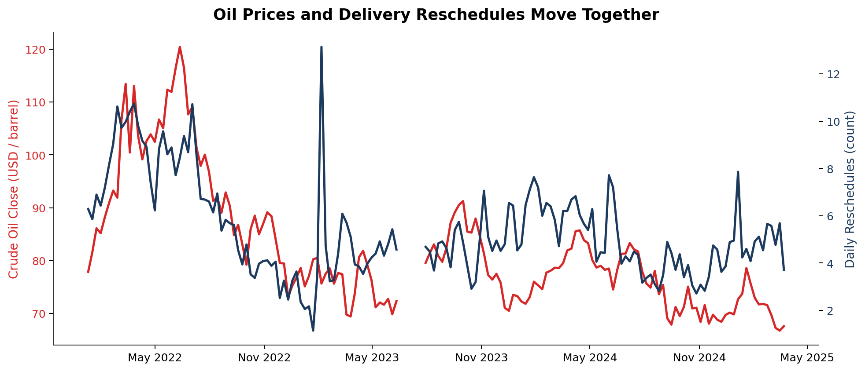
Finding 1 — Oil Prices and Reschedules Move Together Over Time
Peak oil period
Spring 2022 oil spike (Russia–Ukraine) coincided with peak reschedule disruption
Cooling period
As oil normalized through 2023–24, reschedule levels came down in tandem
Data gap
47-day hole in source data — Jul–Aug 2023
The pattern is visual before it's statistical: oil and reschedules rise and fall together across the whole window. This motivates the quantitative test on the next slide.
Roshni | Open Avenues x 84 Lumber | Final Presentation
9 / 16
Notes:
This is where the story starts to come together. I want you to look at this chart and just see the pattern before I put any numbers on it. The red line is weekly average crude oil close price. The blue line is weekly average reschedules. They're on different y-axes because they're in different units — dollars per barrel versus count of deliveries. Look at the left side — spring and summer of 2022. Russia invaded Ukraine in late February 2022, and crude spiked to $120-plus within weeks. Reschedules tracked right along with it, peaking at a weekly average around ten per day. Then oil came down through the second half of 2022 as supply adjusted and recession fears kicked in. Reschedules came down with it. You can also see the data gap in July-August 2023 — that's the 47 days I flagged earlier. It's not a plotting error, it's actually missing source data. And through 2024 and into 2025, oil stays in a narrower band around $70-80, and reschedules stay more subdued. The point of this chart isn't rigor — it's to show that the relationship is visible to the naked eye. That motivates the statistical test I'm about to show you.

Slide 10
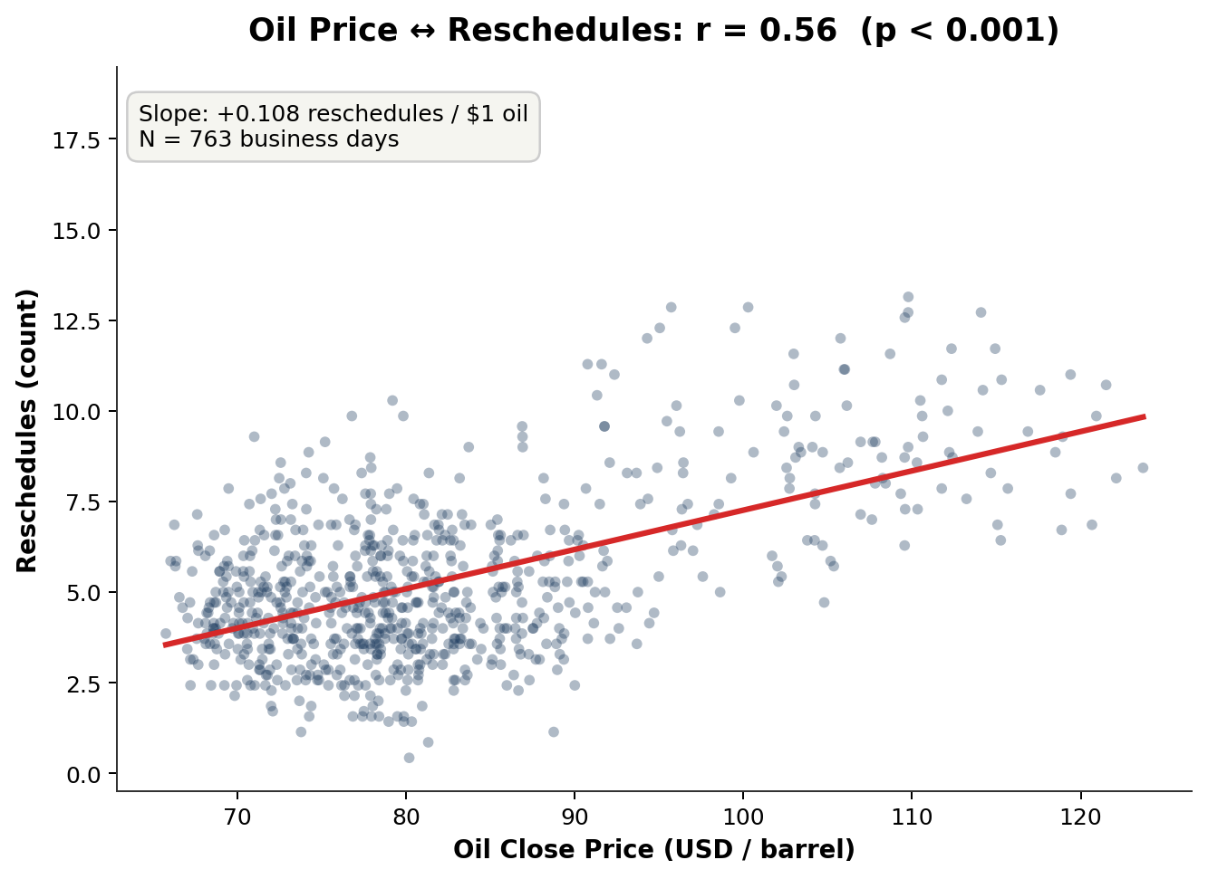
Finding 2 — The Correlation is Strong and Statistically Significant
Key statistics
Pearson r
0.561
p-value
< 0.001
Slope
+0.108 / $1 oil
Sample size
N = 763 days
What it means in operations terms
A $10/barrel move in oil is associated with ~1 extra reschedule per day. Over a year with 250 business days, that's ~250 additional disruption events per yard.
Correlation does not equal causation — but it does equal actionable signal.
Roshni | Open Avenues x 84 Lumber | Final Presentation
10 / 16
Notes:
Now the rigorous version of that visual. I computed the Pearson correlation between oil close price and daily reschedule count: r equals 0.561. The p-value is effectively zero — less than one in a thousand — so this is not a chance result. Each dot on the chart is one business day. The x-axis is that day's oil close price, the y-axis is that day's reschedule count. The red line is the least-squares regression fit. The slope is the number I'd highlight most: plus 0.108 reschedules per dollar of oil. So if crude moves up ten dollars — which happens routinely over a quarter — you get about one extra reschedule per day. Over a year of 250 business days, that's 250 additional disruption events. Per yard. That's material. Now, let me be careful with causation here. Correlation of 0.56 doesn't prove oil causes reschedules. Both could be driven by a third factor — broader macroeconomic stress, for example. But for operational planning purposes, the signal is actionable regardless. If I can use oil as a leading indicator of reschedule risk — even if the mechanism isn't pure causation — I can still make better dispatch decisions. That's the key practitioner move: treat the correlation as a tool, not a theory.

Slide 11
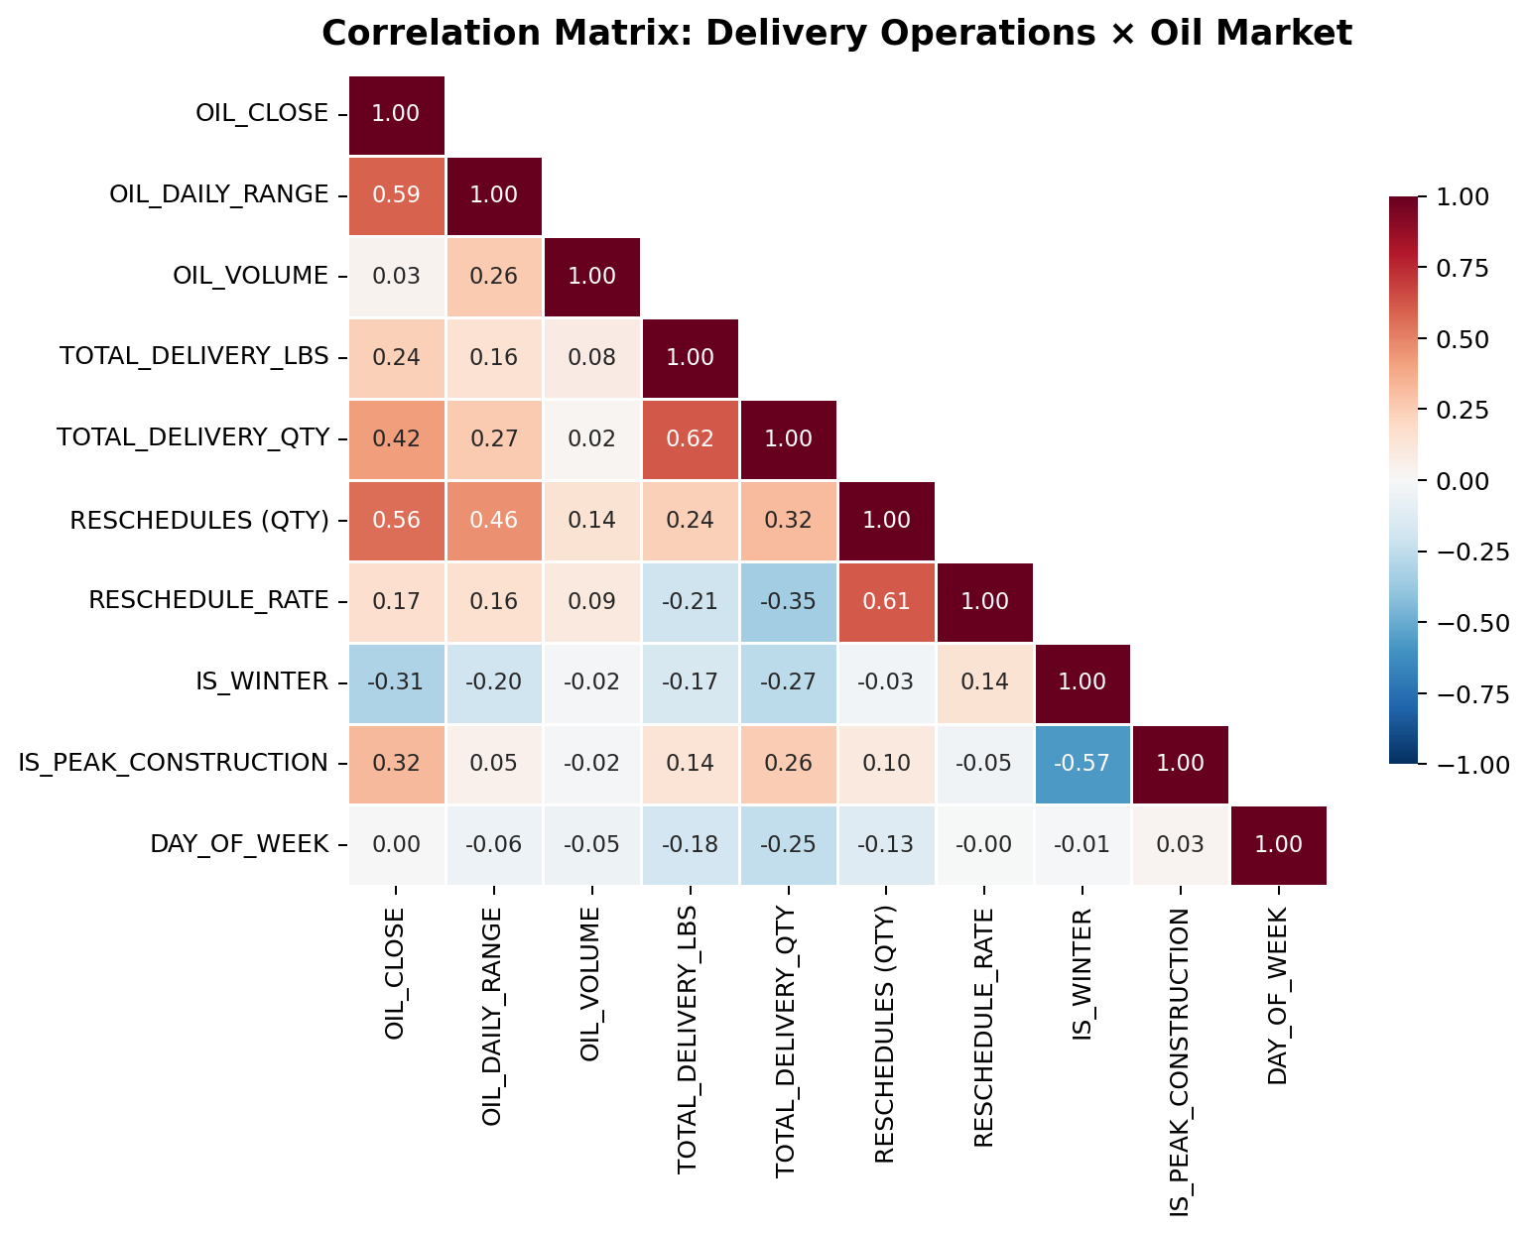
Finding 3 — Oil Effects Are Consistent Across Price, Volatility, and Volume
Top insights from the matrix
0.56
Oil Close → Reschedules
0.46
Oil Volatility → Reschedules
0.61
Reschedules → Reschedule Rate
-0.31
Winter ↔ Oil (cold correlates down)
0.42
Oil Close → Total Delivery Qty
Roshni | Open Avenues x 84 Lumber | Final Presentation
11 / 16
Notes:
I pulled back to look at the full correlation matrix. This is a triangular heatmap — each cell is the correlation between the row variable and the column variable. Red means positive correlation, blue means negative, and the darker the color, the stronger the relationship. The left column — oil close — is where most of the action is. Oil close correlates at 0.56 with reschedules, 0.42 with delivery quantity, and 0.24 with delivery weight. So oil isn't just tied to one thing — it's tied to the whole operation. A few specific reads I want to flag. First, oil volatility — that's OIL_DAILY_RANGE — correlates at 0.46 with reschedules. That's actually separate information from the price level. So it's not just expensive oil that disrupts operations, it's also choppy oil. Days where crude swings wildly tend to be days dispatch struggles. Second, reschedules correlate 0.61 with reschedule rate. That's almost definitional — both are reschedule-related — but it's a sanity check that the data is internally consistent. Third, winter flag correlates minus 0.31 with oil. That's a real pattern: oil tends to be weaker in deep winter because transportation demand dips. And it correlates minus 0.17 with delivery weight, confirming construction slows in winter. Fourth, day of week correlates minus 0.18 with delivery quantity — which tracks our finding that Mondays are busiest and Fridays slowest. We'll see that in a couple slides. The takeaway: oil isn't a single signal, it's three correlated signals — price, volatility, and trading volume — that all point the same direction.

Slide 12
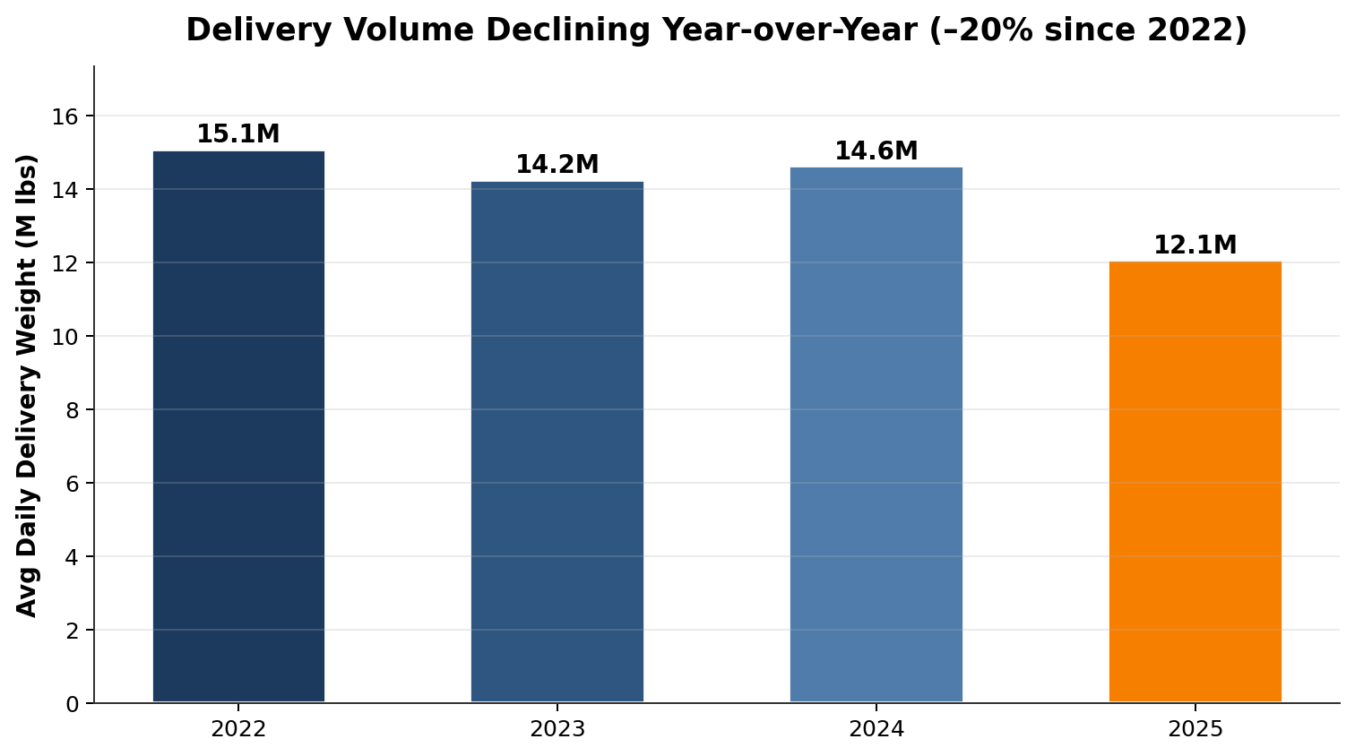
Finding 4 — Delivery Volume Has Declined 20% Since 2022
The macro context
Daily volume dropped from 15.1M lbs in 2022 to 12.1M lbs in early 2025 — a 20% contraction.
Why this matters analytically:
Construction volume tracks interest rates with a lag of ~12 months
Fed raised rates sharply in 2022–23 → housing starts fell → material demand fell
The oil-reschedule signal we found holds despite this macro headwind — meaning it's even stronger than it looks
Implication: fleet sizing needs to rightsize to new demand — not just absorb it.
Roshni | Open Avenues x 84 Lumber | Final Presentation
12 / 16
Notes:
I need to address the broader trend in the data before I move on, because it shapes how to read everything else. Daily delivery weight has declined from 15.1 million pounds in 2022 to 12.1 million in early 2025 — about 20% lower. You can see the bar chart on top and the monthly trend at the bottom of the slide. The downward slope is unmistakable. Why is this happening? Macroeconomics. The Federal Reserve raised interest rates dramatically in 2022 and 2023 to fight inflation. Higher rates make mortgages more expensive, which slows housing starts, which reduces demand for building materials. The effect usually lags by about twelve months because construction projects already in progress finish regardless of rates. By 2024 and into 2025, that lag effect was fully visible in 84 Lumber's delivery volume. Here's the important analytical implication: the oil-to-reschedule signal that I found holds despite this macro headwind. If I were ONLY seeing the correlation in the 2022 peak period and it disappeared in 2024-25, I'd worry the correlation was a one-off driven by the Russia-Ukraine shock. But it persists through 2023, 2024, and into 2025. That means it's a genuine structural relationship, not a one-time event. The business implication is actually tougher than it sounds: fleet capacity was sized to 2022 demand. As demand has declined 20%, a fixed fleet size is now structurally over-provisioned during most periods — EXCEPT during oil-stress periods where it's under-provisioned. That's a dynamic capacity problem, not a static sizing problem.

Slide 13
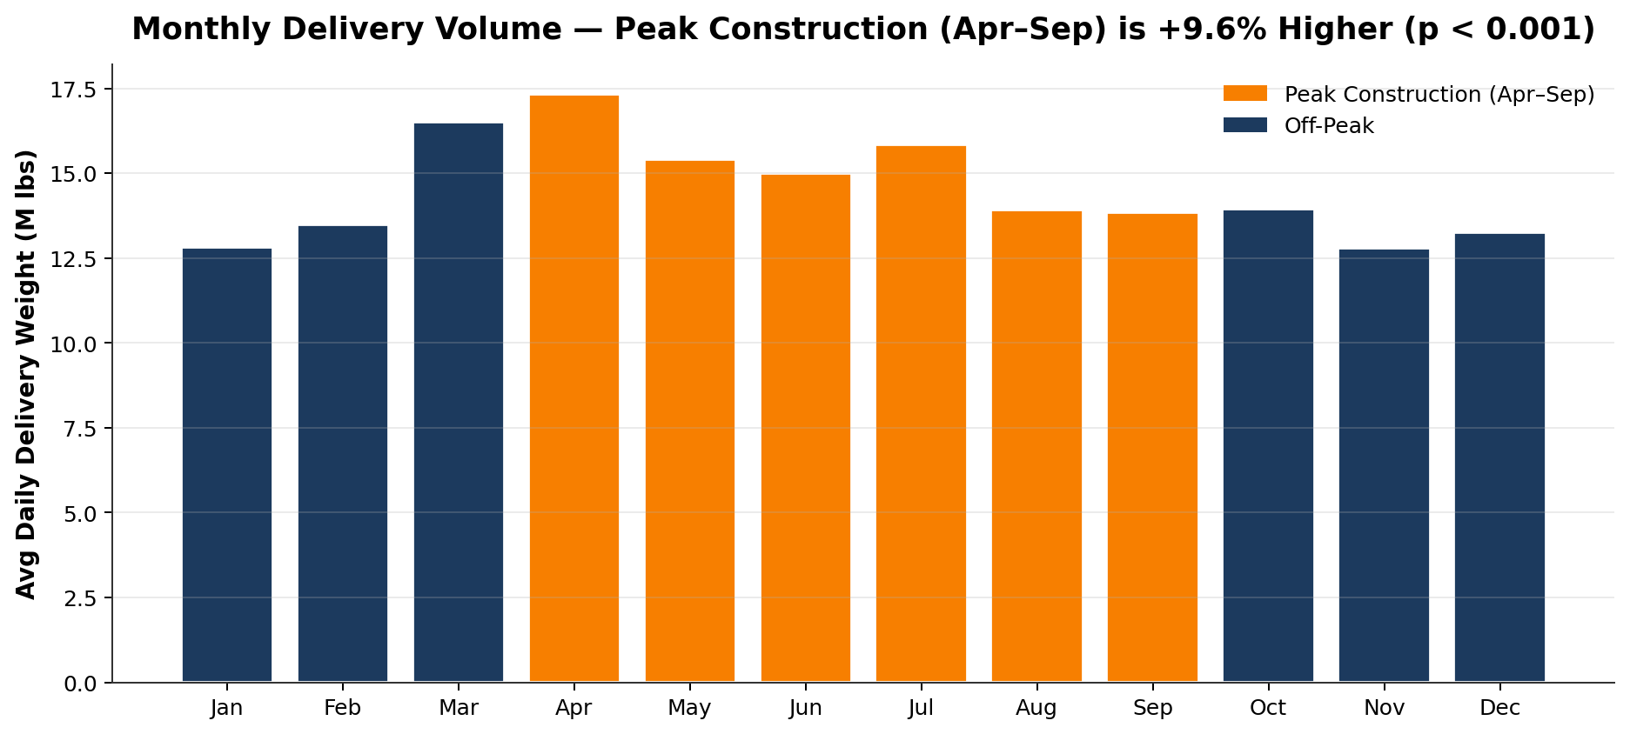
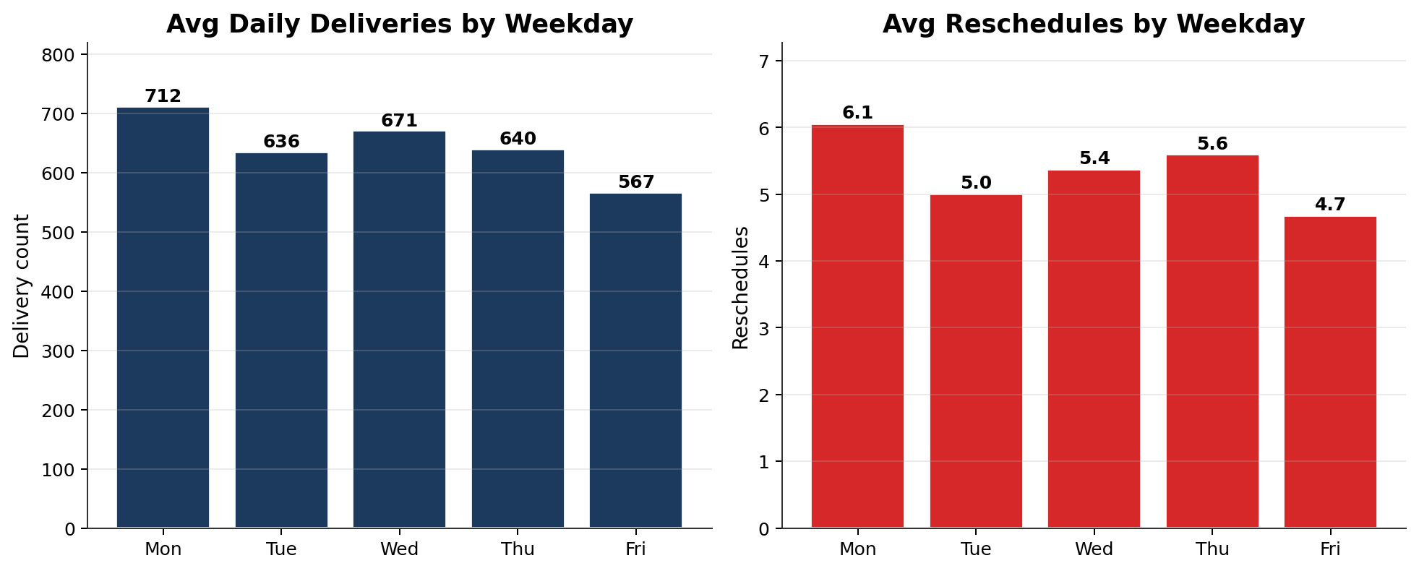
Finding 5 — Seasonality: Peak Construction Matters, Winter Does Not
Hypothesis tests
Peak vs Off-Peak volume
t = 3.93
p = 9.4 × 10⁻⁵ (highly significant)
Peak: 15.2M lbs/day
Off-peak: 13.9M lbs/day
+9.6% higher during Apr–Sep
Winter reschedule effect
t = -0.93
p = 0.35 (not significant)
Cold weather alone doesn't
drive reschedules — oil does
Monday vs Friday
Monday: 712 deliveries/day
Friday: 567 deliveries/day
+26% Monday peak
Roshni | Open Avenues x 84 Lumber | Final Presentation
13 / 16
Notes:
Seasonality split into two stories. On top: the monthly pattern. Peak construction season — April through September, shaded amber — averages 15.2 million pounds per day. Off-peak — the blue bars — averages 13.9 million. That's a 9.6% lift during the building season. I ran a Welch's t-test to confirm this isn't noise. The t-statistic is 3.93 with a p-value of 9.4 times ten to the negative five. That's a very strong result — well below the 0.001 threshold. So yes, peak construction is a real, statistically significant demand driver. Interestingly, the winter effect on reschedules is NOT significant. I ran a separate t-test on winter versus non-winter reschedules, and the p-value is 0.35 — nowhere close to significant. That was surprising to me initially. You'd think cold weather would cause more operational friction. But the data says no — the real driver of reschedules is oil price volatility, not weather. Cold days without oil stress are fine; mild days with oil stress are not. On the bottom: day of week. Monday averages 712 deliveries, Friday averages 567. That's a 26% gap. The operational interpretation is classic — Monday is catching up on orders placed over the weekend, while Friday is closing out the week. This has direct implications for how you structure dispatch capacity through the week. So the seasonality story is: lean into peak construction months with extra capacity, lean into Mondays with extra capacity, and don't bother over-staffing for winter because that's not where the pain is.

Slide 14
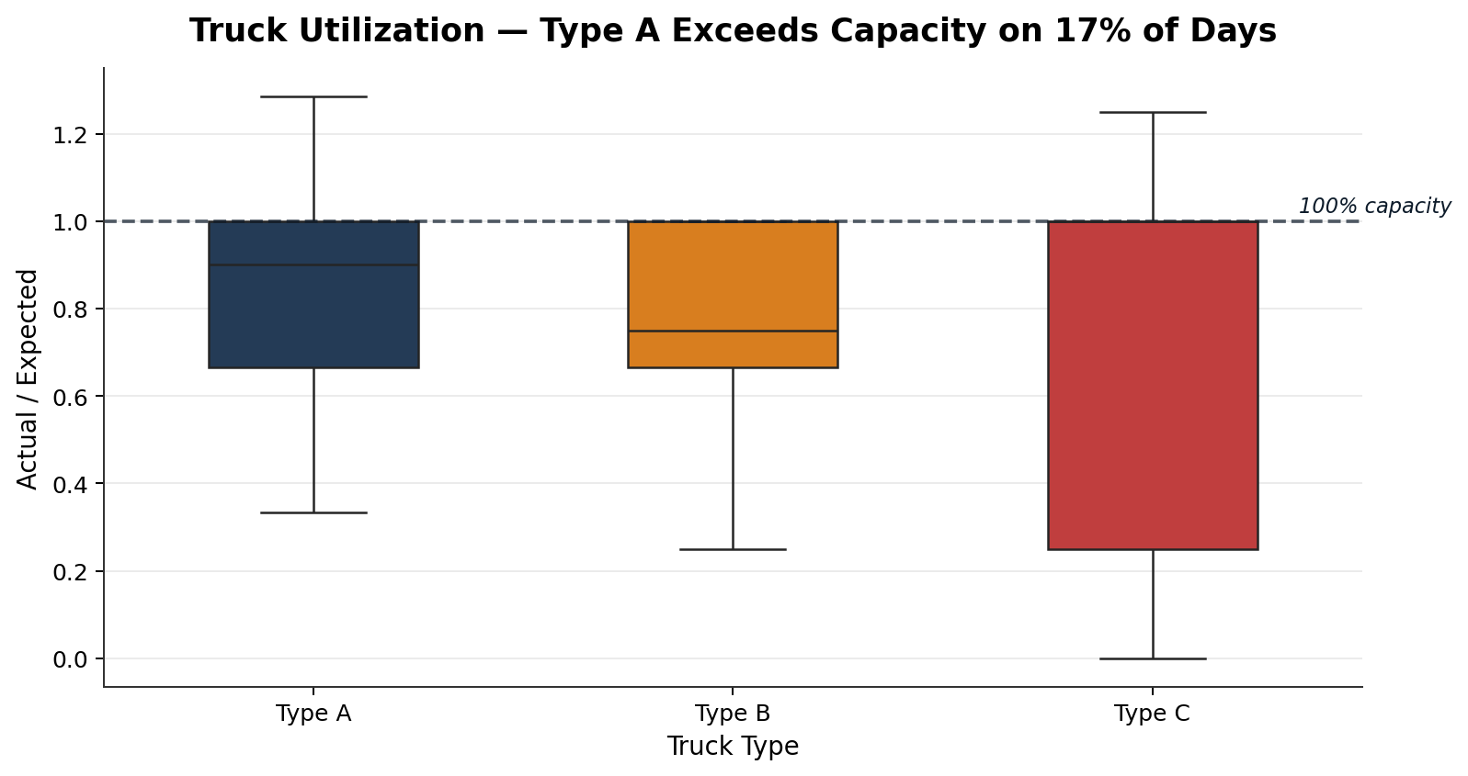
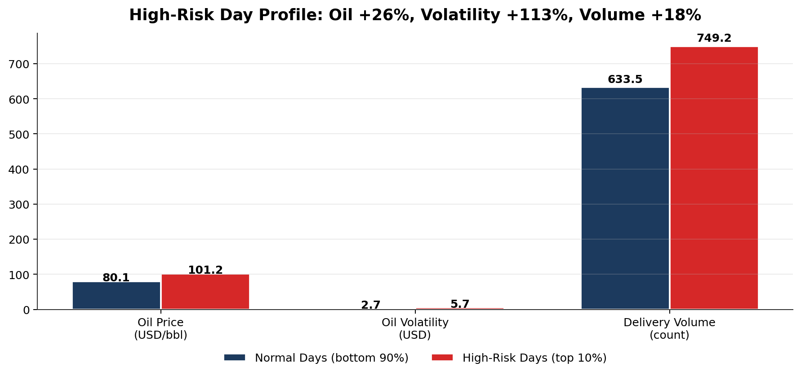
Finding 6 — Structural Capacity Stress on Type A Fleet
Utilization breakdown
17.4%
Type A (large)
Over capacity on 1-in-6 days
0.0%
Type B (fork)
Never exceeds — well-sized
9.2%
Type C (small)
Periodic peak stress
Bottom chart: on the worst 10% of reschedule days, every driver stacks up.
Roshni | Open Avenues x 84 Lumber | Final Presentation
14 / 16
Notes:
Two findings on this slide, both operational. Top chart: truck utilization by type. Utilization is the ratio of actual trucks used to expected trucks scheduled. The dashed horizontal line at 1.0 marks full capacity. Anything above that line means the yard ran more trucks than it planned — which in practice means calling in outside trucks at premium rates. Type A trucks — the big delivery vehicles — exceed capacity on 17.4% of days. One in six business days. That's not a rare event, that's a structural pattern. The fleet is systematically under-sized for Type A demand. Type B fork trucks never exceed capacity — they're well-sized or over-sized. You could argue some could be repurposed. Type C trucks exceed capacity on 9.2% of days, less severe than Type A but still meaningful. And Type C shows this interesting bimodal pattern in the box plot — a lot of days at either 0% or 100% utilization. That suggests an all-or-nothing deployment pattern worth investigating further. Bottom chart is the high-risk day profile. I segmented the top 10% of reschedule days — the P90 and above — versus everything else, and looked at what's different about them. Oil price on bad days: $101 per barrel versus $80 on normal days — 26% higher. Oil volatility on bad days: $5.70 intraday range versus $2.70 normal — 113% higher, more than double. Delivery volume on bad days: 749 deliveries versus 633 — 18% higher. So the worst days are a compound event: expensive oil, volatile oil, AND high demand all stacking up. This is exactly the profile you'd want to predict in advance, which brings us to the next slide.

Slide 15
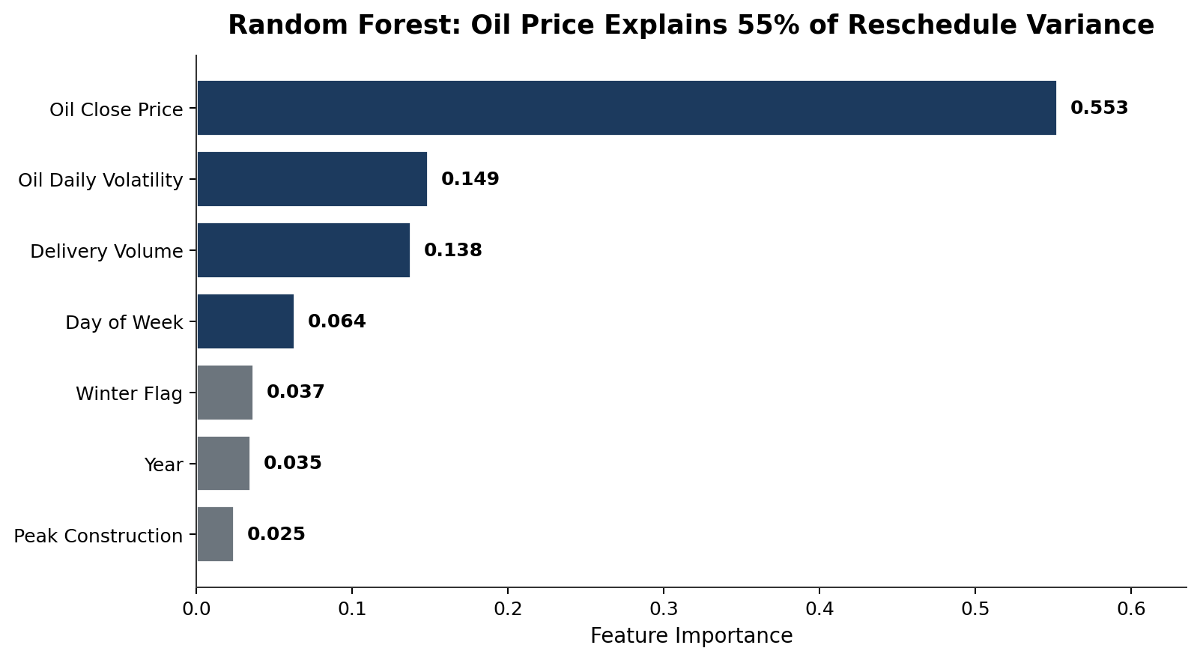
Finding 7 — Predictive Model: Oil is the Dominant Driver
Two models compared
Linear Regression
R² = 0.42
MAE = 1.37 reschedules
Interpretable coefficients
Random Forest ← winner
R² = 0.54
MAE = 1.22 reschedules
Handles non-linear effects
Oil Close alone accounts for 55% of model importance — more than all other features combined.
This is a highly actionable result: a single publicly-available daily data point carries the majority of the predictive signal.
Roshni | Open Avenues x 84 Lumber | Final Presentation
15 / 16
Notes:
To translate these findings into something operational, I trained two models to predict daily reschedule count. First, a linear regression as an interpretable baseline. It gets to an R-squared of 0.42 on held-out test data, with a mean absolute error of 1.37 reschedules. Respectable. Then a random forest with 200 trees to capture non-linear effects. It outperforms the linear model meaningfully — R-squared 0.54, MAE 1.22. So we can explain 54% of the day-to-day variance in reschedules using just oil and some operational features. In a noisy supply-chain environment, that's a lot of signal. The feature importance chart on the left is the key read. Each bar is one feature's contribution to the model's predictions. Oil close price sits at 0.55 — meaning it accounts for 55% of the model's predictive power. That's more than all six other features combined. Oil daily volatility comes in at 0.15 — so oil contributes 70% combined when you include both price and volatility. Delivery volume is 0.14, and then day of week, winter, year, and peak construction are each around 2-6%. The business interpretation: the single most valuable piece of information you can put into a daily dispatch decision, outside of your own operational numbers, is yesterday's crude oil close. And crude oil is a free, publicly available data feed that updates every weekday before your yard opens. That's a very usable signal.

Slide 16
Recommendations & Next Steps
01
Build a daily oil-indexed risk score
Known limitations
Use the random forest model as a dispatch input. Above a threshold, flag the day as high-risk and trigger proactive capacity actions.
47-day gap in Jul–Aug 2023 source data
Single yard — not national-level
Correlation ≠ causation
Model R² = 0.54 — 46% of variance is other factors
02
Rightsize Type A fleet from fixed to dynamic
With 17% over-capacity days, there's a business case for flex Type A contracting tied to WTI ≥ $90 trigger.
03
Pre-position extra capacity on Monday + peak-season days
Monday is 26% busier than Friday; Apr–Sep is 9.6% higher than off-peak. Both are known in advance — plan for them.
Next steps with more time
Diesel retail prices (more direct signal)
Multi-yard comparison for regional effects
Weather data integration
Time-series forecasting (ARIMA / Prophet)
04
Proactive customer communication during oil-stress windows
Soft-flag high-risk deliveries early rather than firefighting on the day — preserves customer trust.
Thank you — questions welcome
Roshni · M.S. Computer Science, Boston University
Thanks to Samuel Castilla-Haddad and Open Avenues Foundation for the opportunity.
Roshni | Open Avenues x 84 Lumber | Final Presentation
16 / 16
Notes:
Let me land this with four concrete recommendations, each traceable back to a specific finding. One: build a daily oil-indexed risk score using the random forest model as an operational input. Every morning at 7 AM, the model ingests yesterday's oil close, yesterday's volatility, the day-of-week, the season, and expected volume, and outputs a reschedule risk estimate. If it's above a threshold — say, predicted reschedules over 8 — flag the day and trigger proactive actions. This is the direct productization of Finding 7. Two: move Type A fleet planning from fixed to dynamic capacity. The 17% over-capacity rate tells us the current fixed fleet is under-sized at peak. A better model is a core fleet plus a flex contract — and the flex contract triggers when WTI goes above a threshold, say $90. This is Finding 6 translated into action. Three: pre-position extra capacity on Mondays and during peak construction season. Both patterns are predictable in advance — you don't need oil data, you just need a calendar. This is the simplest recommendation and probably the highest ROI because it requires no modeling infrastructure. Four: proactive customer communication during oil-stress windows. If I know today is a high-risk day, I'd rather soft-flag a delivery to the customer at 8 AM — "we may need to reschedule your afternoon delivery" — than firefight it at 2 PM. This preserves customer trust and turns an operational problem into a communication advantage. On the right I've been honest about the limitations. There's a data gap. We're working with one yard, not the whole national footprint. Correlation isn't causation. And the model explains 54% of variance, which means 46% of the story is outside this data. And if I had more time, I'd add diesel retail pricing as a more direct signal, bring in weather data, expand to multi-yard comparisons, and build a proper time-series forecasting model using ARIMA or Prophet. Thank you to Samuel and Open Avenues for this opportunity. I'd love to take your questions.

