Slide 1
String Matching Algorithms
Chaitanya, Roshni, Meenakshi, Prajith
December 3, 2024
String Matching Algorithms

Slide 2
Problem Statement
You are given a text T [1 : n] of length n and a pattern P[1 : m] of length m (m ≤ n). You must find the occurences of the pattern P as a substring of the text T .
Formally, you have to find indices i such that T [i : i + m − 1] = P[1 : m], i.e., for every i ≤ j ≤ i + m − 1, T [j] = P[j − i + 1]. In such a case, i is said to be a valid shift.
String Matching Algorithms

Slide 3
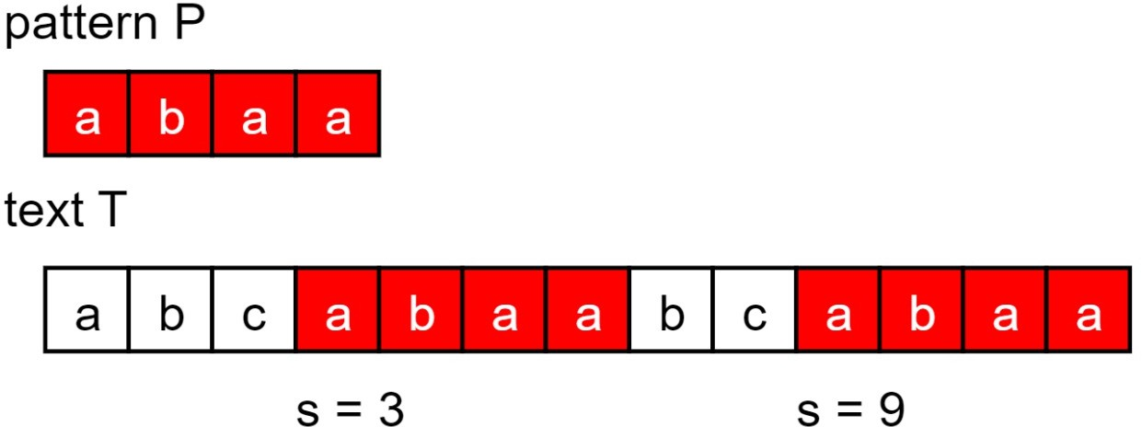
Example
Hence, s = 3 and s = 9 are valid shifts.
String Matching Algorithms

Slide 4
Naive Algorithm
The NAIVE-STRING-MATCHER algorithm finds all valid shifts using a loop that checks the condition T [s : s + m − 1] = P[1 : m] for every
1 ≤ s ≤ n − m + 1. Here’s the pseudocode for reference:
for s = 1 to n − m + 1:
if T [s : s + m − 1] == P[1 : m]
print " Pattern found at shift s"
Time complexity = O((n − m + 1)m)
String Matching Algorithms

Slide 5
Rabin Karp Algorithm
In Rabin Karp Algorithm, we utilise a hash function to quickly eliminate invalid shifts. Consider a hash function h which maps strings of length m to integers. We compute hashes for the pattern P (let h(P) = p) and every shift of the text T (denoted by t_{s} for a shift s).
If t_{s} ̸= p, then that shift is definitely invalid. Otherwise, we naively check the shift to see if its a valid shift.
Worst case Time complexity = O((n − m + 1) ∗ m).
However, the expected Time complexity in most cases is O(n).
String Matching Algorithms

Slide 6
Rabin Karp Algorithm
p = hash value of pattern P
t₀ = hash value of first m characters of T for s = 0 to n − m
if p = t_{s} // if valid shift if P[1 : m] == T [s + 1 : s + m]
print " Pattern occurs
in T at shift s."
if s < n − m
compute the value of shift) using t_{s}
ts+1
( hash for next
String Matching Algorithms

Slide 7
String Matching with Finite Automaton
We build a finite automaton for a string S. The automaton has states {0, 1, . . . , m}. The starting state is 0 and accepting state is m. Current state being i denotes that the prefix of length i of the pattern has been matched so far.
After building the automata for the pattern P, we iterate over the characters of the text T and update current state accordingly.
Time Complexity for building the Finite Automata : O(m³|Σ|). Time Complexity for Matching : O(n).
Overall Time Complexity : O(n + m³|Σ|)
String Matching Algorithms

Slide 8
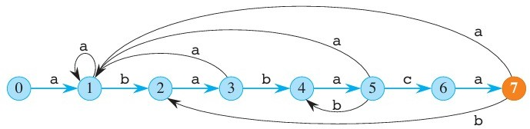
Example
Figure: Finite Automaton for ababaca
String Matching Algorithms

Slide 9
Knuth-Morris-Pratt (KMP) Algorithm
Here, we precompute the prefix function π for pattern P where π[i ] is the length of longest prefix which is suffix of the substring P[1 : i ] for all
1 ≤ i ≤ m and use this array to eliminate invalid shifts.
Time complexity for precomputing π : O(m) Time Complexity for Matching : O(n).
Overall time complexity : O(m + n).
The prefix function π can be used to decrease the time taken to build the Finite Automata to O(m|Σ|).
String Matching Algorithms

Slide 10
Suffix Trees
Suffix Tree is a data structure which stores information about a string (of length m) efficiently. It can be represented as a rooted directed tree with each edge having a corresponding ”label” (i.e. a string). They have the following properties:
The tree has exactly m leaves. The concatenation of the labels from the root to the i -th leaf results in the i -th suffix of the string.
Every internal node has atleast two children, and no two outgoing edges of a node can have labels starting with the same letter.
String Matching Algorithms

Slide 11
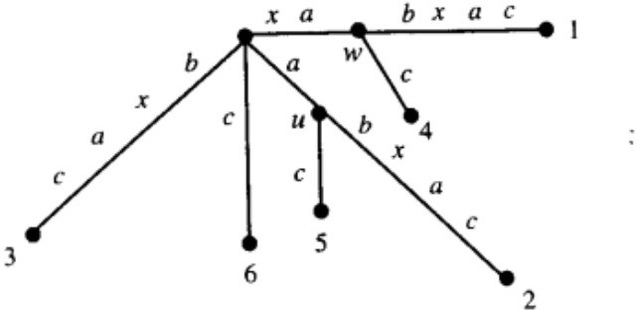
Example
Given a text, we construct its suffix tree in O(n²) naively (or O(n) using Ukkonen’s algorithm). Using its properties, we can find all valid shifts.
Figure: Suffix Tree for xabxac
String Matching Algorithms

