Slide 1

AMERICAN INTERNATIONAL UNIVERSITY- BANGLADESH
-Where Leaders Are Created
PROJECT TITLE: Autonomous Navigation Car Using Arduino Uno with Triple Ultrasonic Sensors.
COURSE TEACHER: TAHSEEN ASMA MEEM
GROUP MEMBERS:
NAME | ID
MD ABU BAKOR SIDDIK SHAAD | 22-49434-3
SANJOY CHANDRA KARMOKAR | 22-47114-1
NAZNIN AKTER ROSHMNY | 22-46092-1
SHAKIB AL HASAN | 22-47136-1
M. ABDULLAH | 22-47284-1

Slide 2
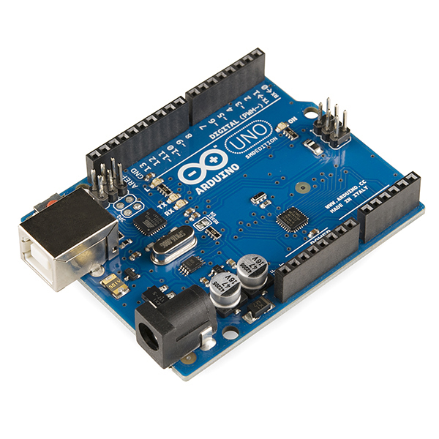
Smart Pathways: Building an Obstacle-Avoiding Car
A Journey into Autonomous Navigation Using Arduino, Ultrasonic Sensors, and Real-Time Obstacle Avoidance

Slide 3
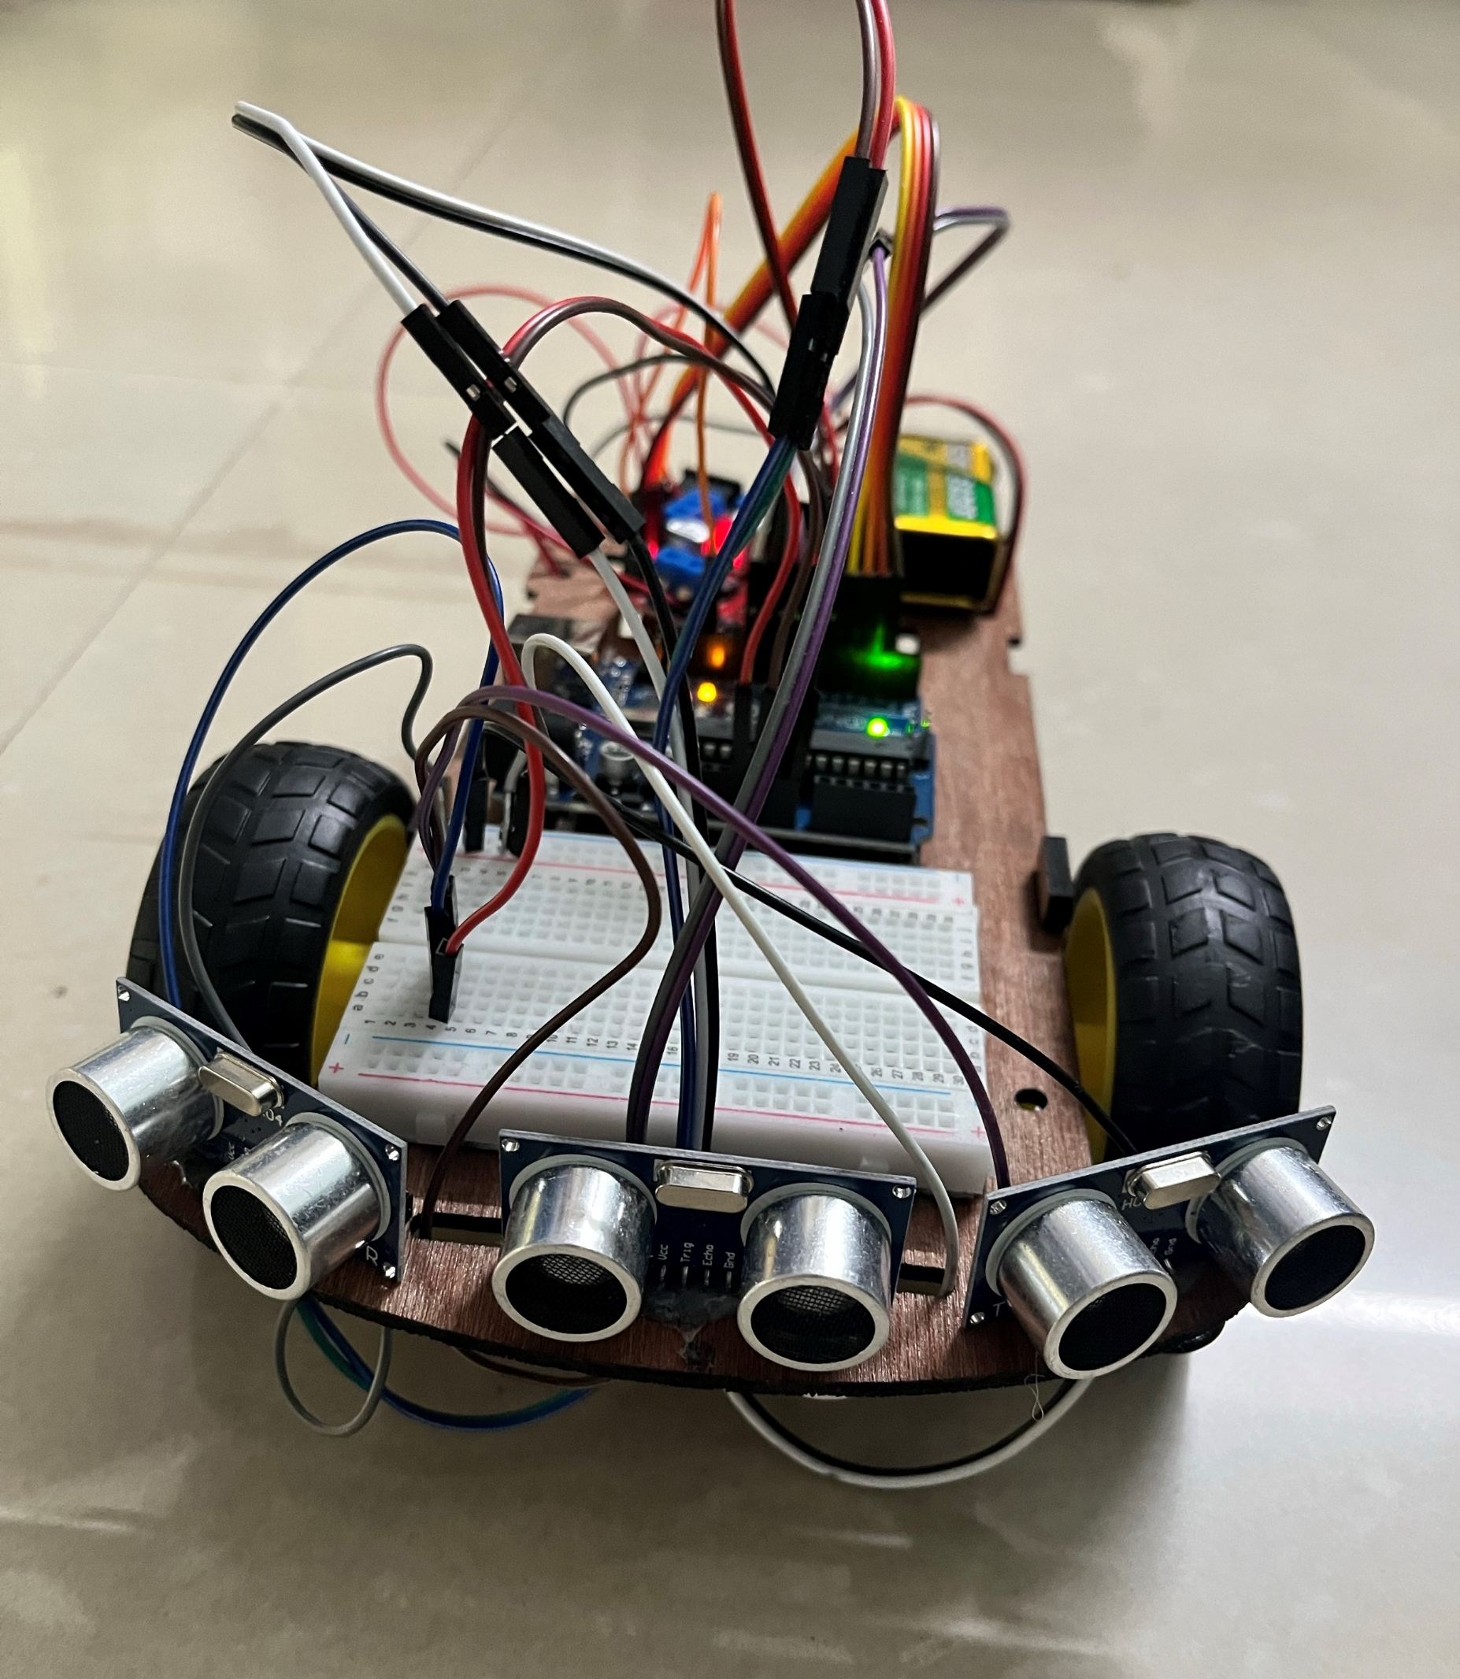
INTRODUCTION
This project focuses on creating an obstacle-avoiding car using the Arduino Uno microcontroller. Equipped with ultrasonic sensors and DC motors, the car detects obstacles in real time and adjusts its path to navigate efficiently without collisions. It showcases a cost-effective and practical approach to autonomous vehicle technology, with applications in automation, logistics, and exploration.

Slide 4
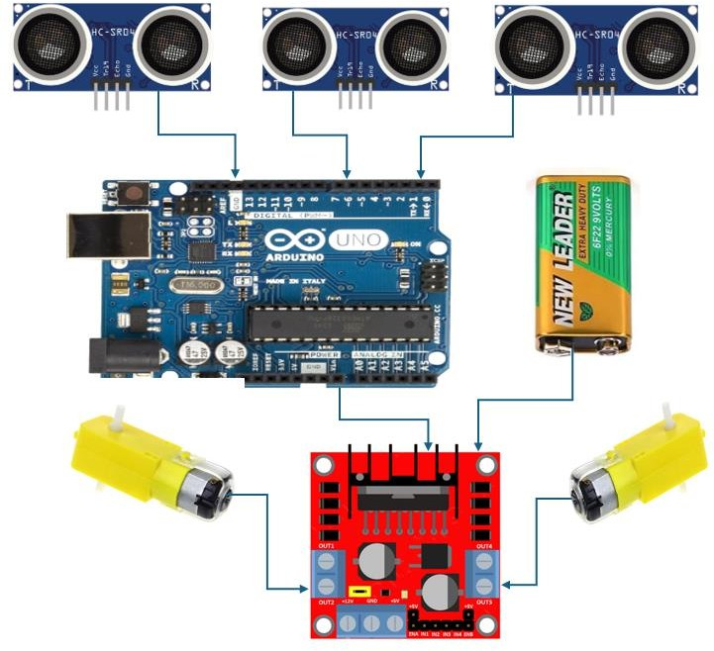
OBJECTIVE
Design and develop an obstacle-avoiding car using Arduino Uno.
Utilize ultrasonic sensors for real-time obstacle detection.
Implement a motor control system for precise and responsive navigation.
Demonstrate a cost-effective and scalable solution for autonomous vehicle technology.
Explore applications in robotics, automation, and practical real-world scenarios.

Slide 5
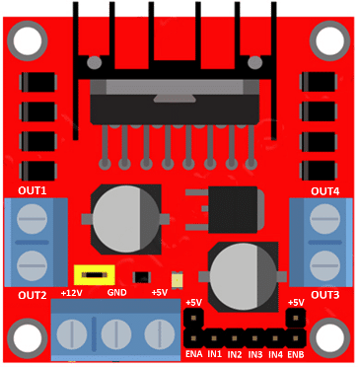
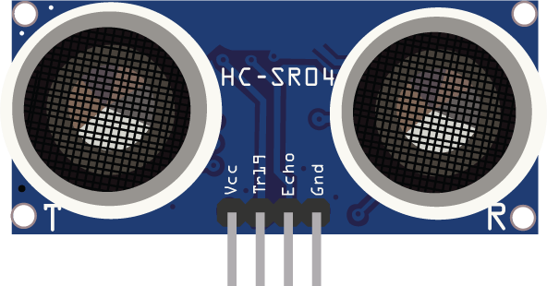
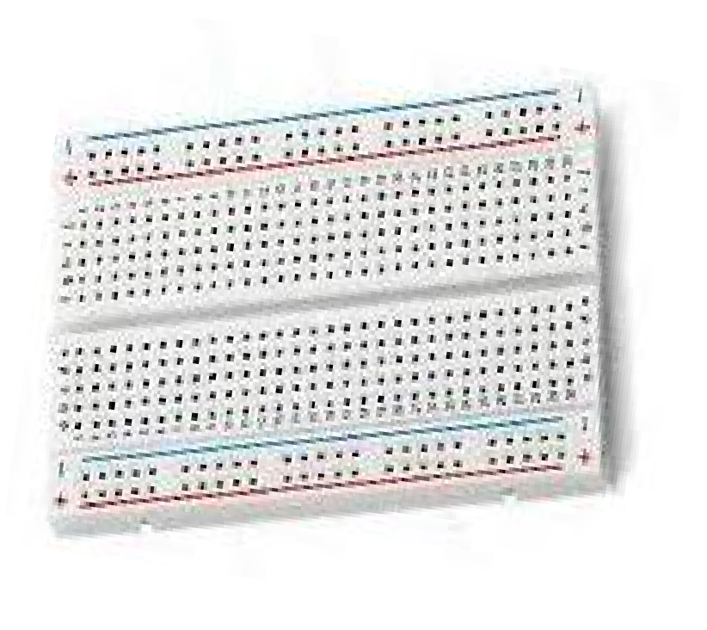
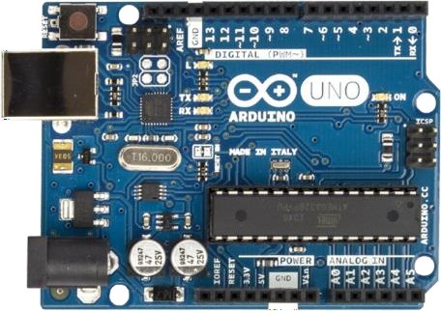
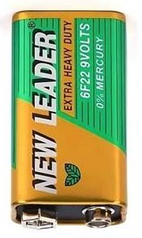
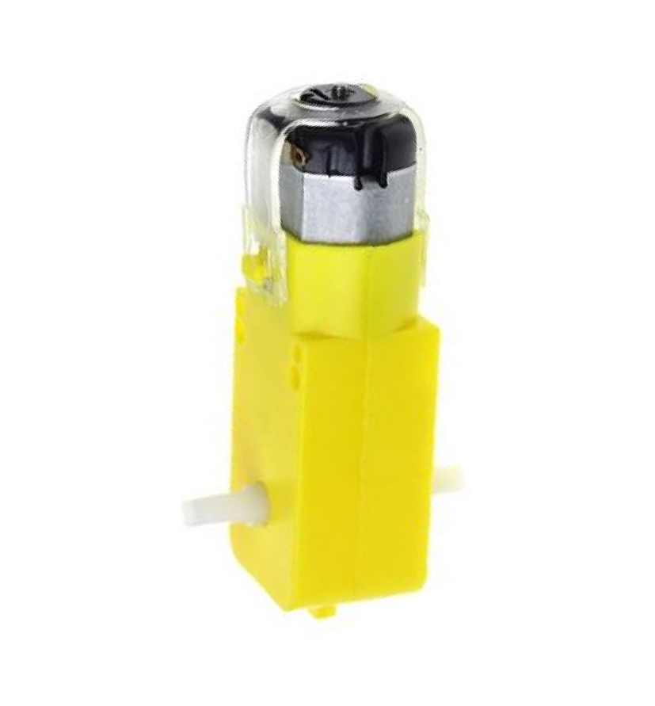
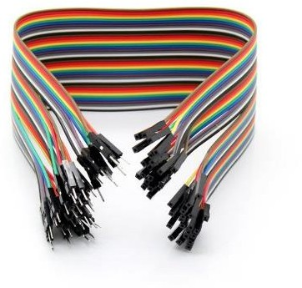
COMPONENTS
Main Components:
Arduino Uno
Ultrasonic Sensors (3)
DC Motors
Motor Driver (L298N)
Power source and connecting hardware.

Slide 6
WORKING PRINCIPLE
Three ultrasonic sensors detect obstacles at the front, left, and right.
The Arduino Uno processes sensor data to calculate distances.
If an obstacle is detected, the car stops and decides whether to turn left or right based on available space.
The motor driver controls the DC motors to adjust the car’s direction for obstacle-free movement.
Enables smooth and autonomous navigation in real-time.

Slide 7
METHODOLOGY
System Design: The car uses an Arduino Uno, three ultrasonic sensors, and a motor driver to control movement.
Sensor Integration: Sensors measure obstacle distance via sound wave reflection.
Motor Control: The motor driver adjusts the direction of DC motors based on sensor data.
Real-time Processing: The Arduino processes data and adjusts movement if an obstacle is detected.
Testing: The system is tested virtually and physically for optimal performance and accuracy.

Slide 8
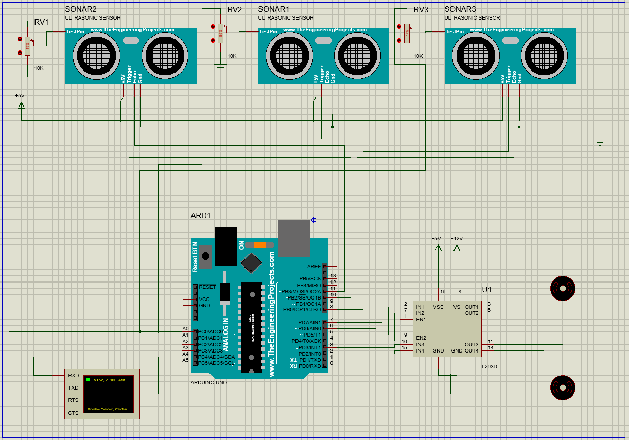
KEY FEATURES
Autonomous Navigation: The car can detect and avoid obstacles in real-time without human intervention.
Ultrasonic Sensors: Three sensors (front, left, and right) for precise obstacle detection.
Motor Control: Uses a motor driver to control the speed and direction of the DC motors for smooth movement.
Cost-effective: Utilizes Arduino Uno for an affordable and practical solution.
Real-Time Response: Quickly adjusts its path based on sensor input to ensure continuous navigation.
Flexible Design: Can be adapted to different environments or expanded with more sensors for improved functionality.

Slide 9
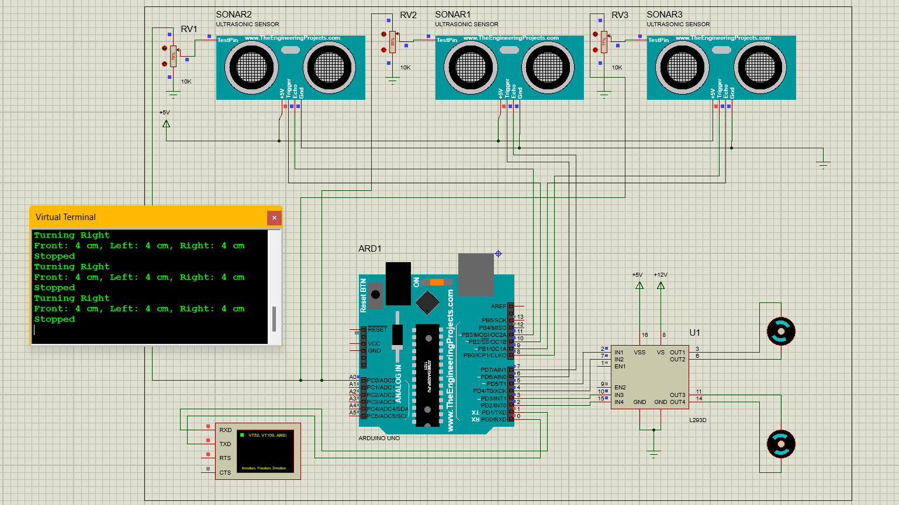
TESTING AND RESULT
Simulation Testing: The system was first tested using Proteus software to validate the logic and sensor readings in a controlled environment.

Slide 10
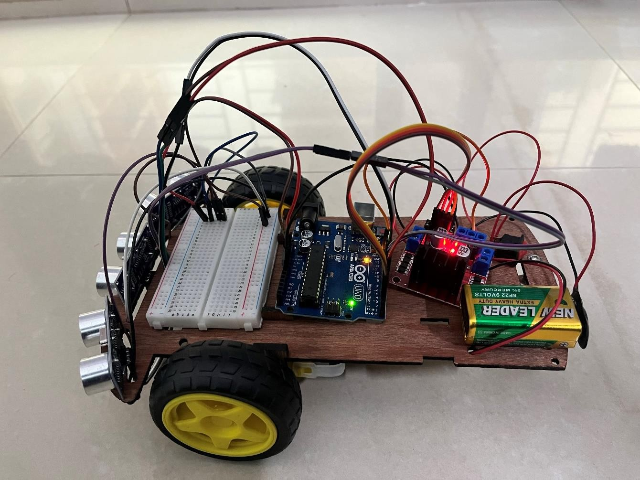
TESTING AND RESULT
Physical Testing: After successful simulations, the car was built and tested in real-world conditions to assess obstacle detection, path adjustment, and movement accuracy.

Slide 11
TESTING AND RESULT
Results:
Obstacle Detection: The system accurately detected obstacles within a 15 cm range and stopped to avoid collisions. The average response time for obstacle detection and movement adjustment was approximately 0.2 seconds, demonstrating efficient real-time navigation.
Test Case | Obstacle Distance (cm) | Left Distance (cm) | Right Distance (cm) | Detected Direction | Car Action | Delay (ms)
1 | 20 | 25 | 30 | Clear Path | Move Forward | 100
2 | 12 | 18 | 10 | Obstacle Front | Turn Left | 500
3 | 14 | 10 | 20 | Obstacle Front | Turn Right | 500
4 | 8 | 5 | 30 | Obstacle Front | Turn Right | 500
5 | 20 | 10 | 12 | Clear Path | Move Forward | 100
6 | 13 | 15 | 15 | Obstacle Front | Stop (Decision Time) | 100

Slide 12
COST ANALYSIS
Component | Quantity | Cost (BDT)
Arduino Uno | 1 | 1500
Ultrasonic Sensors | 3 | 500
DC Motors | 2 | 1000
Motor Driver (L298N) | 1 | 800
Breadboard | 1 | 200
Battery | 2 | 300
Wires | - | 100
Total |  | 4400

Slide 13

CONCLUSION
The obstacle-avoiding car successfully integrates Arduino Uno, ultrasonic sensors, and DC motors for autonomous navigation. It efficiently detects obstacles and adjusts its path, demonstrating a cost-effective solution for robotics and automation. The system performed well in both simulations and physical testing, with potential for further enhancements like better sensors and advanced algorithms.

Slide 14
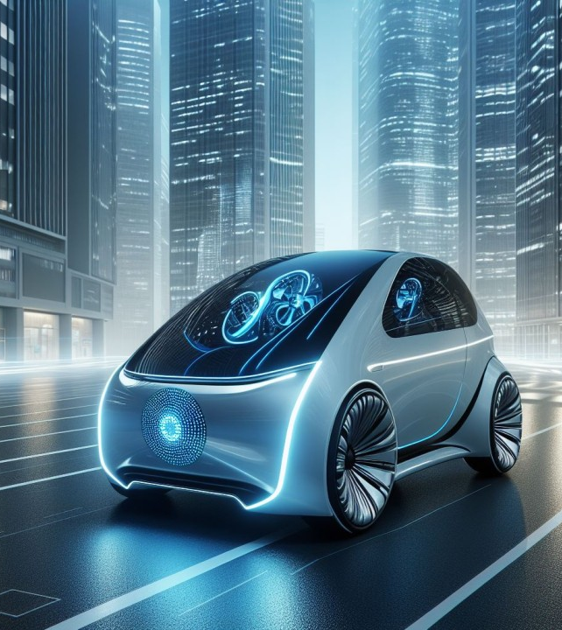
FUTURE SCOPE
Improved Sensor Range: Adding more sensors or using advanced models to detect obstacles at greater distances.
Path Planning Algorithms: Implementing intelligent algorithms for efficient navigation in complex environments.
Outdoor Navigation: Integrating GPS for location-based navigation in outdoor settings.
Energy Efficiency: Optimizing battery usage to extend the system’s runtime.
AI Integration: Implementing AI techniques for dynamic decision-making and adaptive learning. These improvements will enhance the system's versatility and potential applications in robotics, automation, and autonomous vehicles.

Slide 15

REFERENCES
"Low-Cost Autonomous Vehicles Using Arduino," Journal of Robotics, 2021.
"Obstacle Detection Techniques in Robotics," Robotics and Automation Review, 2022.
"DC Motor Control in Robotic Systems," International Journal of Mechatronics, 2023.
"Real-Time Path Planning for Mobile Robots," AI in Robotics, 2020.
"Applications of Microcontrollers in Robotics," Embedded Systems Journal, 2024.

Slide 16

THANK YOU EVERYONE FOR YOUR TIME

