Slide 1
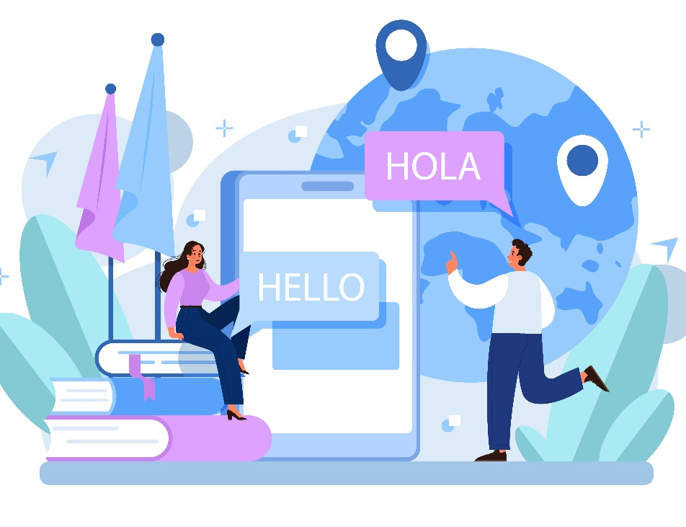
MULTILINGUAL TRANSLATOR
AIDI 2003- CONSULTING AND PROFESSIONAL COMMUNICATION
FINAL PROJECT
Student Name: Roshni RAVEENDRAN
ID: 100896105

Slide 2

INTRODUCTION
In this presentation, we'll explore a powerful tool for seamless language translation.
Discover how the app leverages state-of-the-art machine translation to break down language barriers.

Slide 3

How It Works
The Multilingual Translator app simplifies translation:
Input your text in the source language.
Select the source and target languages.
The app handles the rest, delivering accurate translations

Slide 4
Model and Tokenizer
Behind the scenes, the app relies on the MarianMT model and tokenizer.
The model's dynamic loading ensures optimal translations for each language pair.
Accurate translations owe their success to the intricacies of tokenization.

Slide 5
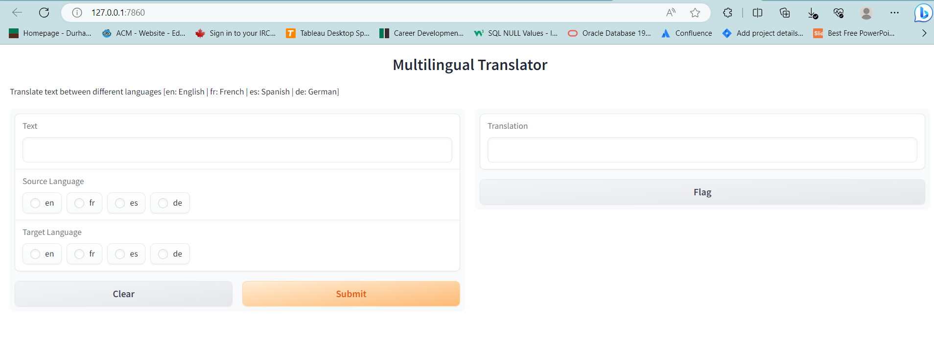
Interface Preview
The intuitive interface streamlines the translation process.
Each element, from input to output, is designed with user-friendliness in mind.

Slide 6
LANGUAGES
Source Language Selection
Target Language Selection
Choose between English (en), French (fr), Spanish (es), or German (de).
Enter you’re the text to be translated in the source language
Opt for English (en), French (fr), Spanish (es), or German (de).
Witness the app convert languages seamlessly.

Slide 7

Translation Output
Witness translations come to life:
The translated output appears in the output text box.
Enjoy translations with a maximum length of 100 characters.

Slide 8
Use Cases
Uncover a world of possibilities with the app
Language learning made engaging and interactive.
Effortless communication with non-native speakers.
Simplified translation for research, work, or personal needs.

Slide 9

Benefits
Instantaneous translations ensure efficient communication.
Leverage cutting-edge machine translation models.
Transform multilingual challenges into opportunities.

Slide 10

Conclusion
The Multilingual Translator app revolutionizes language translation.
It is an effective means of breaking down language barriers and promoting intercultural communication
It helps to elevate communication and expand horizons.

Slide 11

THANK YOU

