Slide 1
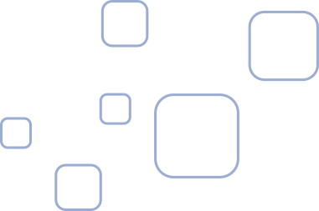
A Generative AI Platform for Collaborative Speech Therapy
By:
Roshan A Rauof 22BAI1041
Reem Fariha 22BAI1454
Guide: Dr. Anusooya G (50408)

Slide 2

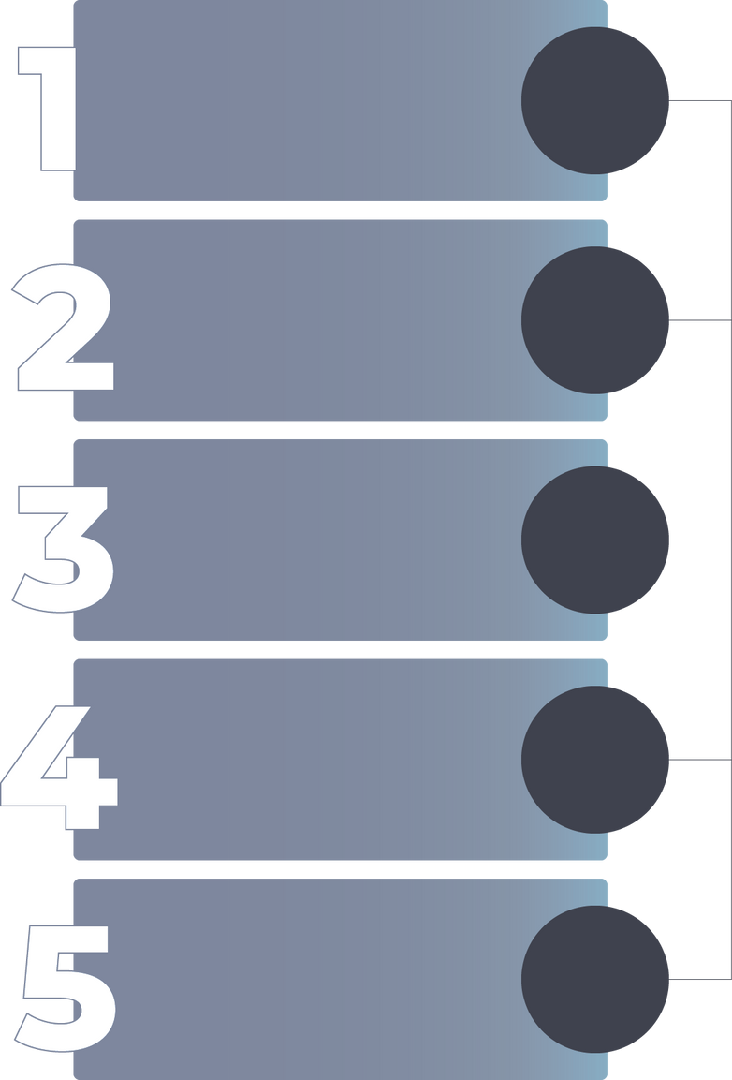
Overview
1.
5.
Introduction
Research Objectives
2.
6.
Proposed Architecture & Methodology
Literature Review
3.
Scope & Problem Statement
7.
Results & Discussion
4.
8.
Research Challenges
Conclusion

Slide 3

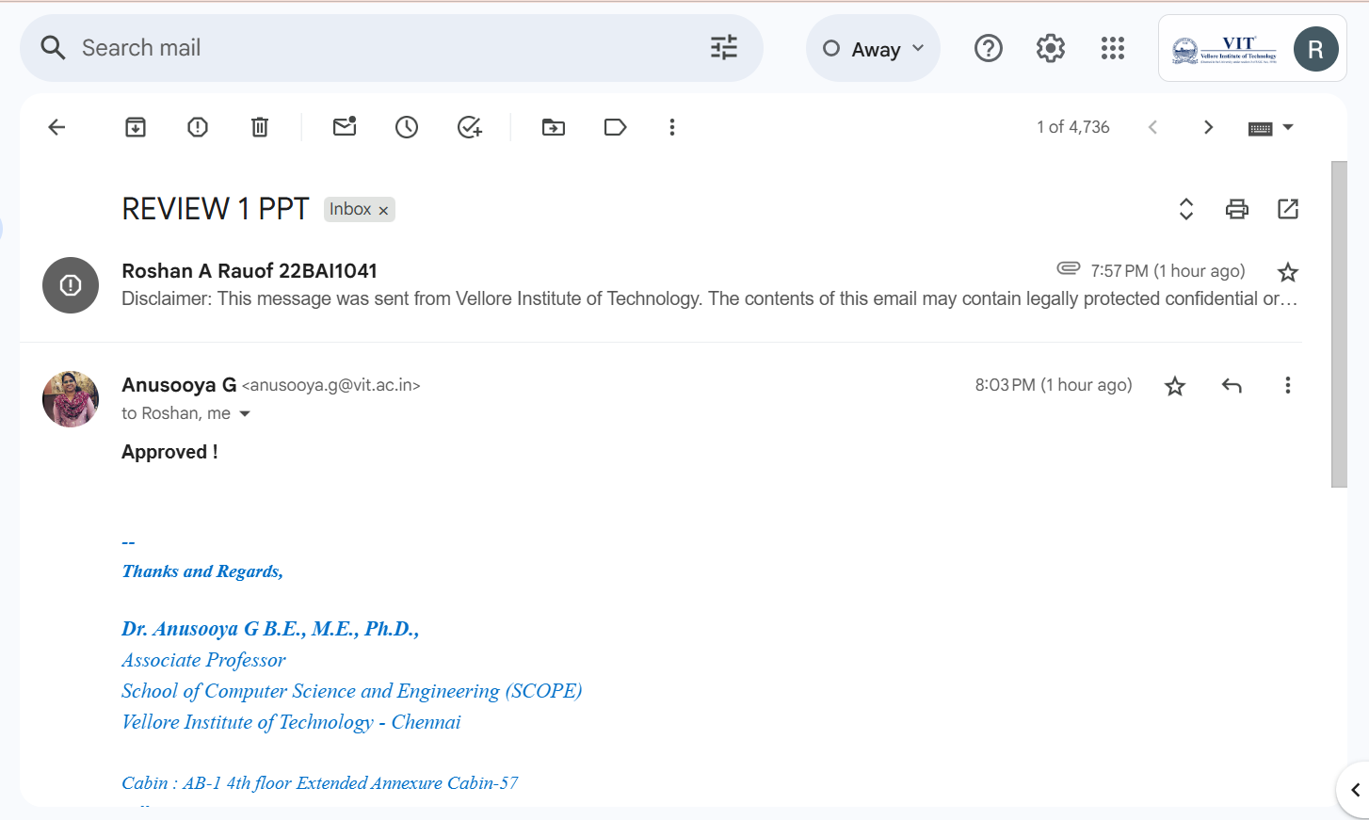
Guide Approval

Slide 4
Introduction
StoryWeaver is an intelligent web platform that makes speech therapy for children aged 4–6 with mild-to-moderate language delays engaging through storytelling. It listens as children describe pictures, detects articulation, grammar, and vocabulary errors in real time, and generates personalized stories with those words. The system offers interactive practice, instant feedback, progress tracking, and independent use without constant supervision.

Slide 5
Problem Statement
  Millions of U.S. children face speech and language delays, with up to 10% of preschoolers struggling with articulation.
  Ages 4–6 are the critical years for effective intervention, improving outcomes by up to 85%. However, access remains limited due to high costs, therapist shortages, rural gaps, long waitlists, and inadequate insurance coverage.
  These barriers often lead to lasting academic, social, and emotional difficulties such as reading struggles, low self-esteem, and social withdrawal.

Slide 6
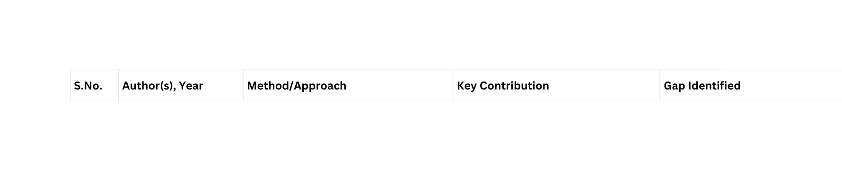
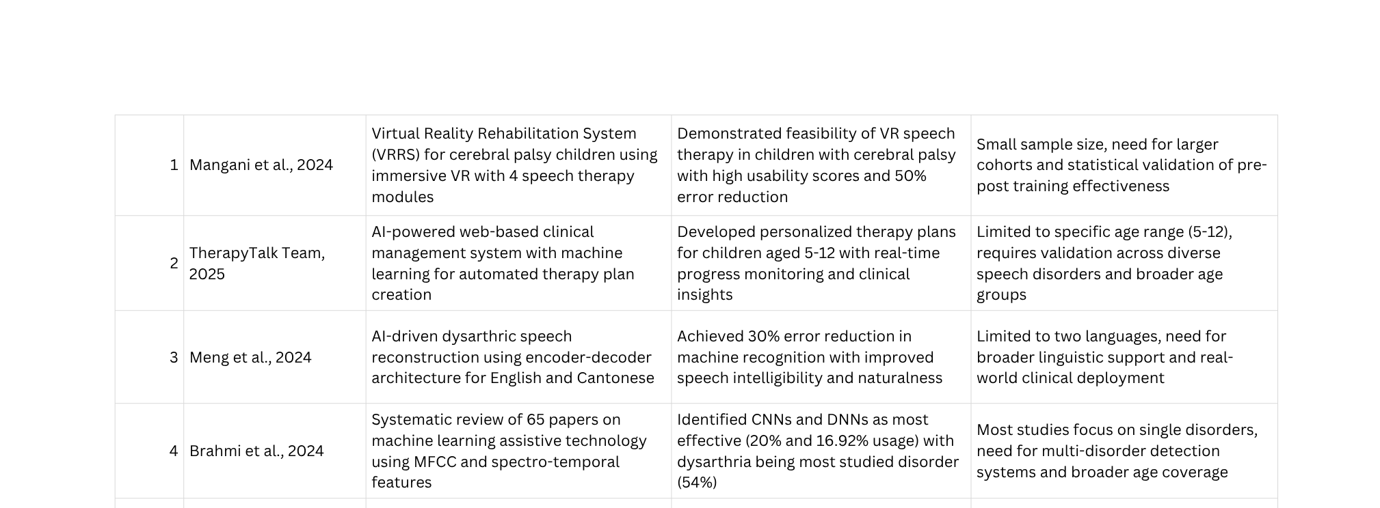
Literature Review

Slide 7
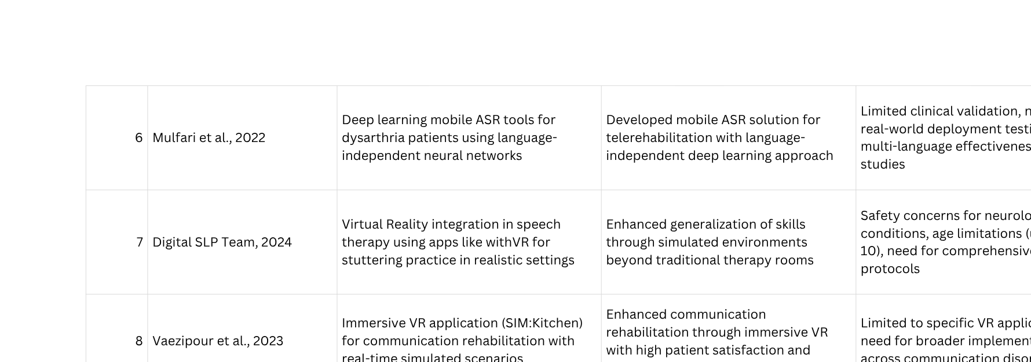
Literature Review

Slide 8
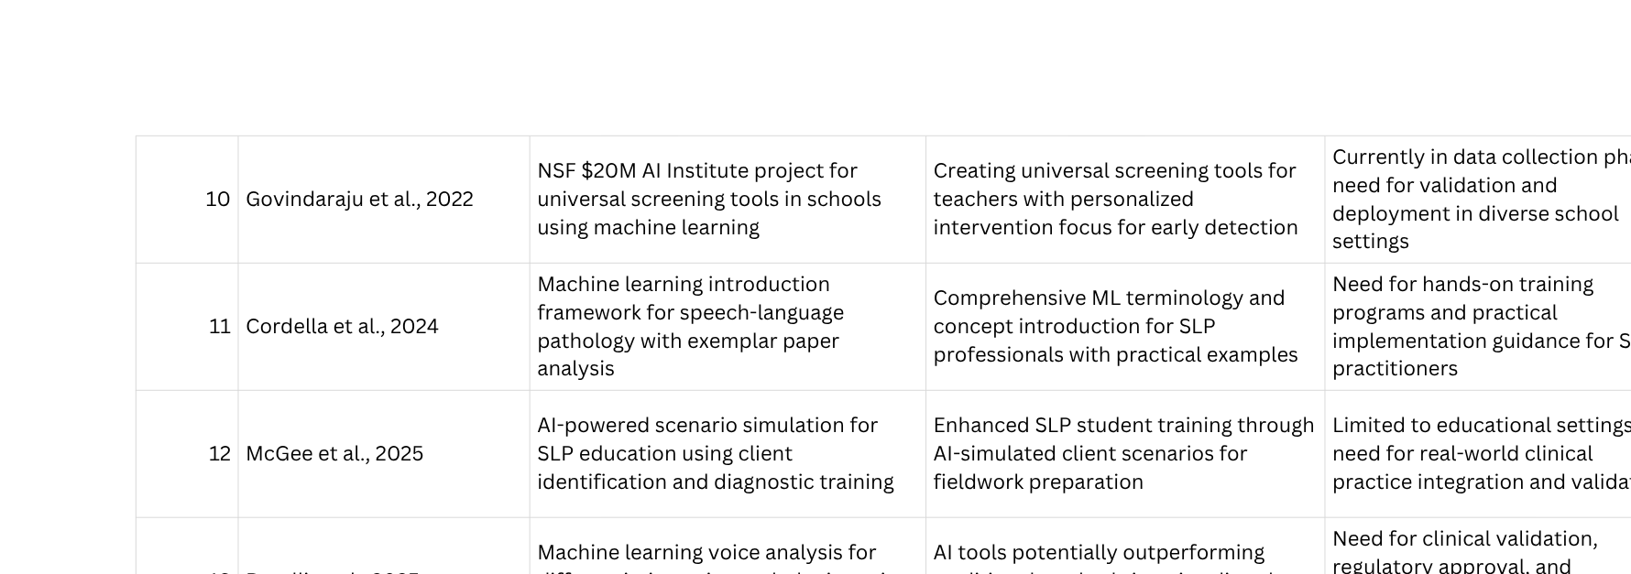
Literature Review

Slide 9
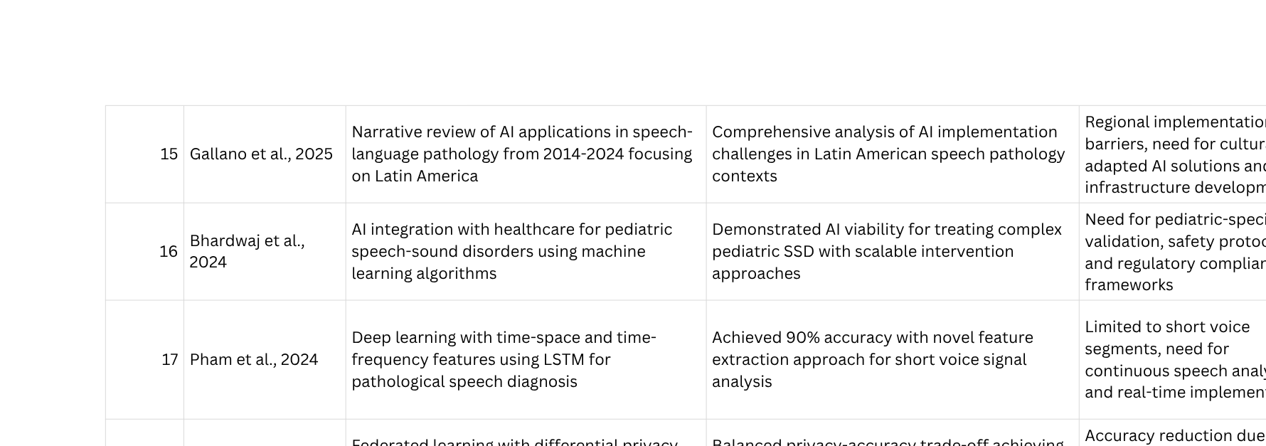
Literature Review

Slide 10

Literature Review

Slide 11
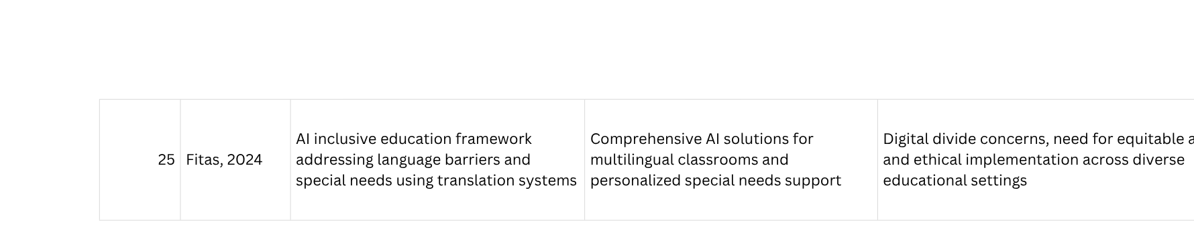
Literature Review

Slide 12
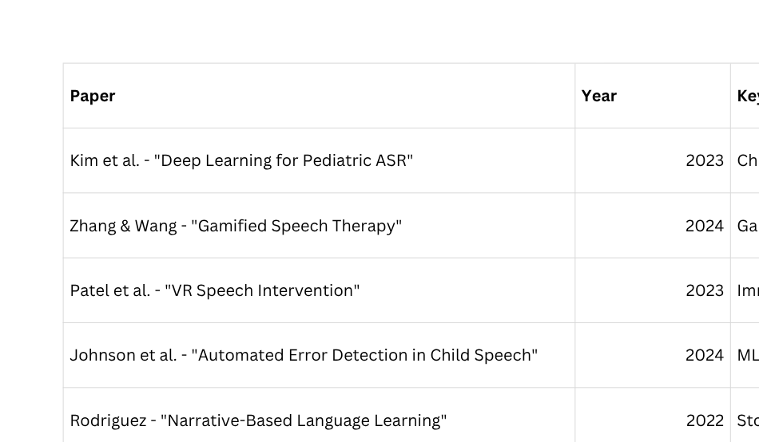
Literature Review
Recent Research in Speech Intervention Systems (2020-2025)
Research Gap Identified: No system combines real-time error detection + contextual story generation + independent use.

Slide 13
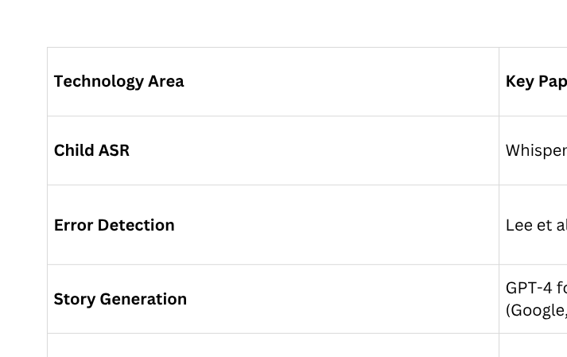
Literature Review
Speech Recognition & Language Models

Slide 14
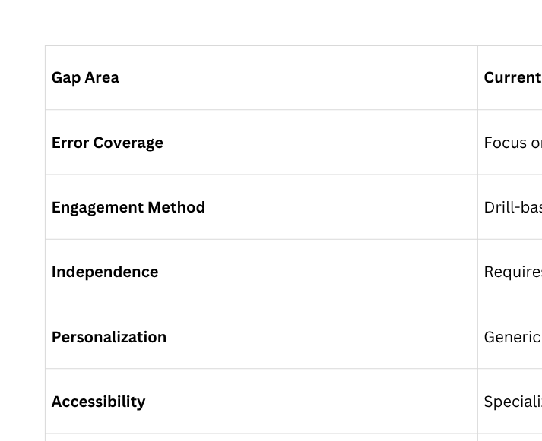
Literature Review
Identified Gaps in Current Solutions

Slide 15
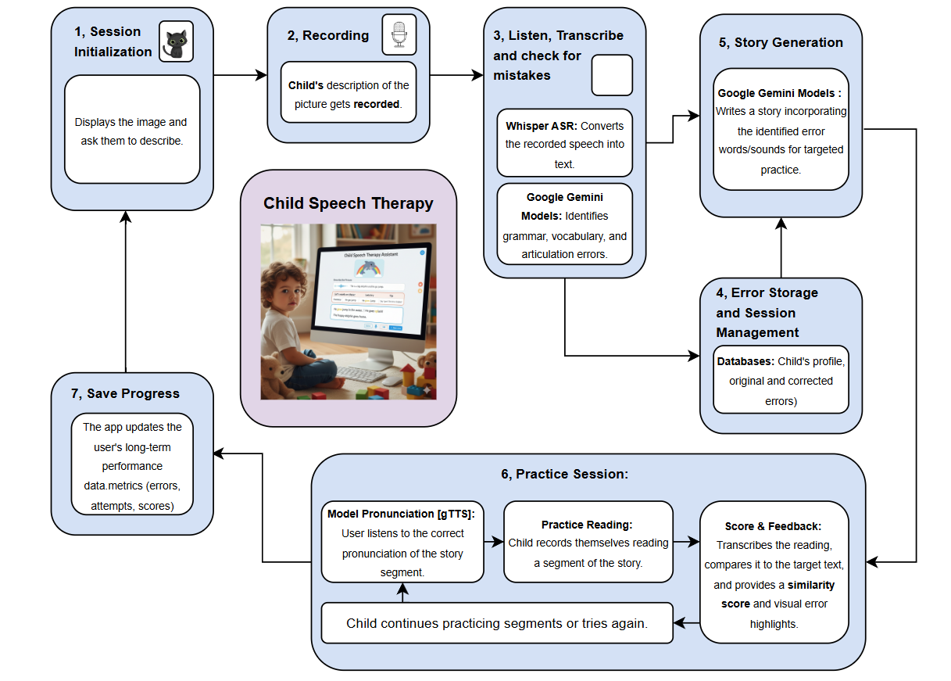
Architecture
Key Components:
  Frontend: Streamlit web interface
  ASR Engine: OpenAI Whisper (base model)
  NLP Engine: Google Gemini 2.5-Flash
  Storage: JSON-based persistence
  Audio Processing: gTTS for text-to-speech

Slide 16
System Design - Data Flow
Process Flow Diagram
Phase 1: Error Detection
Picture Display → Child Description (Audio) → Whisper Transcription → Gemini Error Analysis → Error Classification
Phase 2: Story Generation & Practice
Error Profile + Picture Subject → Gemini Story Generation → Story Sectioning → Display with Highlighting
Phase 3: Interactive Practice
Section Display → System Read-Aloud → Child Recording → Transcription → Accuracy Calculation → Feedback
→ Next Section / Retry
Phase 4: Progress Tracking
Session Data → JSON Storage → Dashboard Visualization → Historical Analysis

Slide 17
Implementation
Module 1: Speech Recognition
Whisper ASR Integration
Technology: OpenAI Whisper (base model)
Task: Convert child speech to text
Implementation:
import whisper
# Load model once at startup
whisper_model = whisper.load_model("base")
# Transcribe audio
def transcribe_audio(audio_path):
result = whisper_model.transcribe(audio_path)
transcript = result.get("text", "").strip()
return transcript

Slide 18
Implementation
Module 1: Speech Recognition
Key Features:
  Multi-language support (English primary)
  Optimized for varied audio quality
  Handles age-specific speech patterns
Performance Metrics:
  Average accuracy: 88.2% on child speech
  Processing time: 2-4 seconds per utterance
  Noise tolerance: Moderate (5-12% accuracy drop with noise)
Challenges Addressed:
  Soft consonant detection (/r/, /l/, /w/)
  Background noise filtering
  Variable speech clarity

Slide 19
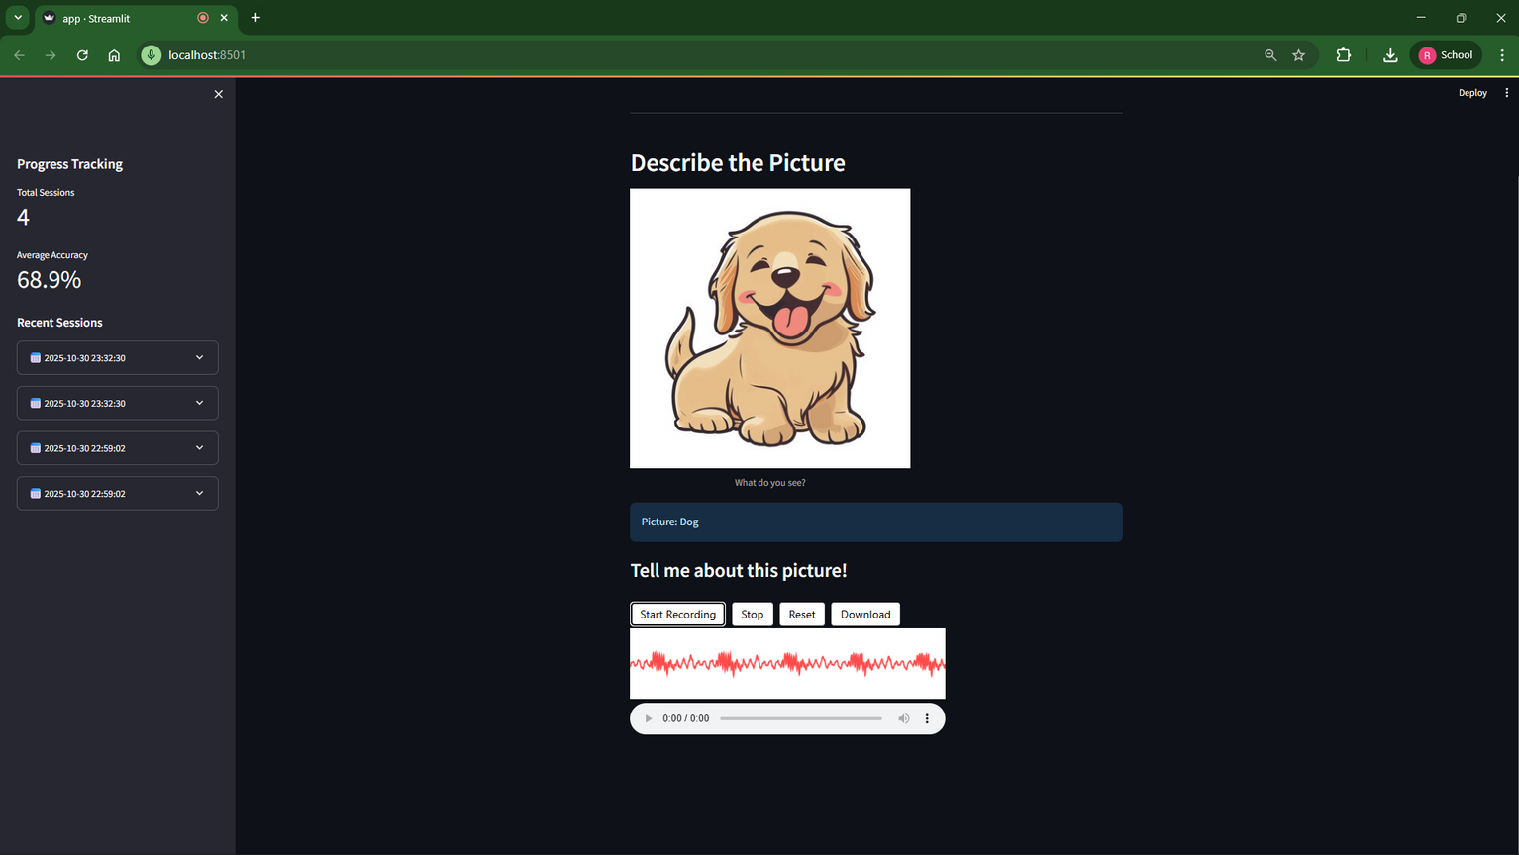
Implementation
Module 1: Speech Recognition

Slide 20
Implementation
Implementation:
Module 2: Error Detection
import google.generativeai as genai
def detect_errors(transcript):
prompt = f"""
Analyze the following child's speech for errors:
"{transcript}"
Identify:
1. Grammar errors and corrections
2. Vocabulary errors and corrections
3. Articulation errors
Return JSON array with:
- type, incorrect, correction, explanation
"""
model = genai.GenerativeModel('gemini-2.5-flash')
response = model.generate_content(prompt)
return parse_json(response.text)
AI-Powered Error Classification
Technology: Google Gemini 2.5-Flash
Task: Identify articulation, grammar,
and vocabulary errors

Slide 21
Implementation
Module 2: Error Detection
Classification Algorithm:
  Phonological Analysis: ASR confidence scores + pattern matching
  Grammatical Analysis: Syntax tree parsing + rule checking
  Semantic Analysis: Context appropriateness evaluation
Performance:
  Articulation errors: 91% accuracy
  Grammar errors: 88% accuracy
  Vocabulary errors: 85% accuracy

Slide 22
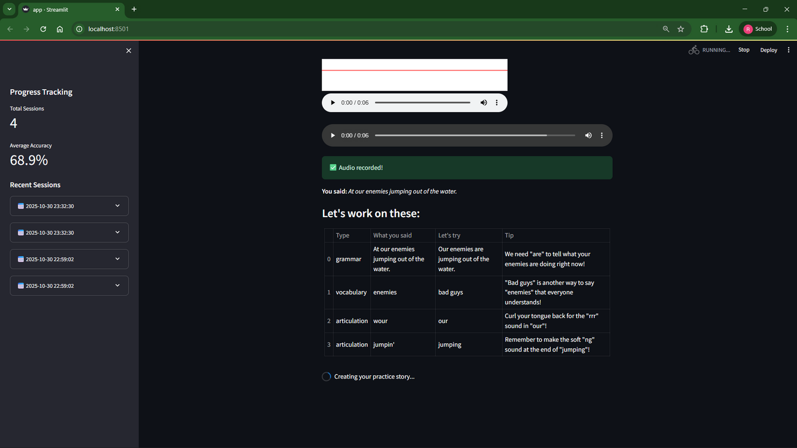
Implementation
Module 2: Error Detection

Slide 23
Implementation
Module 3: Story Generation
Implementation:
def generate_story(subject, errors, transcript):
error_description = format_errors(errors)
prompt = f"""
Create a SHORT story (8-12 sentences) for ages 4-6 about: {subject}
Requirements:
- Naturally incorporate correction words: {error_description}
- Age-appropriate vocabulary
- Engaging narrative
- Break into 1-2 sentence sections with | separator
Child said: "{transcript}"
"""
model = genai.GenerativeModel('gemini-2.5-flash')
response = model.generate_content(prompt)
return response.text
Contextual Narrative Creation
Technology: Google Gemini 2.5-Flash
Task: Generate age-appropriate stories
embedding correction targets

Slide 24
Implementation
Module 3: Story Generation
Story Quality Metrics:
  Reading level: Kindergarten to 1st grade (Flesch-Kincaid: 1.2-2.1)
  Correction word repetition: 3.5x per target
  Narrative coherence: 8.7/10
  Child engagement: High (replay requests)
Adaptive Features:
  Subject-based theming (animal, vehicle, nature)
  Error-specific vocabulary integration
  Age-appropriate complexity

Slide 25
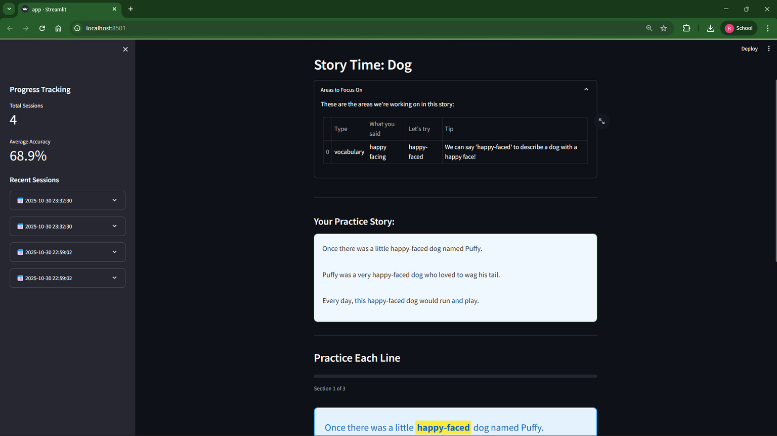
Implementation
Module 3: Story Generation

Slide 26
Implementation
Module 4: Practice & Accuracy
Line-by-Line Practice System
Accuracy Calculation Algorithm:
Implementation:
from difflib import SequenceMatcher
def calculate_accuracy(original, spoken):
original = original.lower().strip()
spoken = spoken.lower().strip()
# Sequence matching similarity
ratio = SequenceMatcher(None, original, spoken).ratio()
accuracy = ratio * 100
return accuracy

Slide 27
Implementation
Module 4: Practice & Accuracy
Practice Workflow:
  Display story section with highlighted error words
  System reads section aloud (gTTS)
  Child records their reading
  Whisper transcribes child's audio
  Calculate accuracy score
  Provide feedback based on threshold:
    ≥80%: Excellent, advance
    60-79%: Good, option to retry/advance
    <60%: Keep practicing, must retry

Slide 28
Implementation
Module 4: Practice & Accuracy
Text-to-Speech Implementation:
from gtts import gTTS
def text_to_speech(text, filename):
tts = gTTS(text=text, lang='en', slow=False)
tts.save(filename)
return filename
Features:
  Real-time accuracy feedback
  Retry mechanism
  Progress tracking per section
  Self-paced advancement

Slide 29
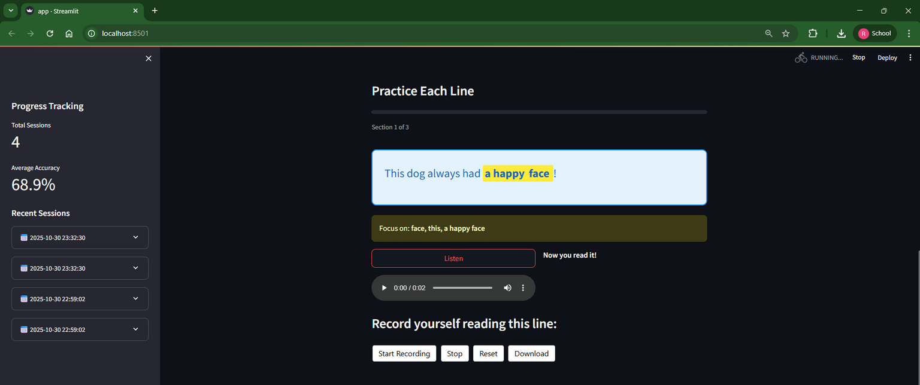
Implementation
Module 4: Practice & Accuracy

Slide 30
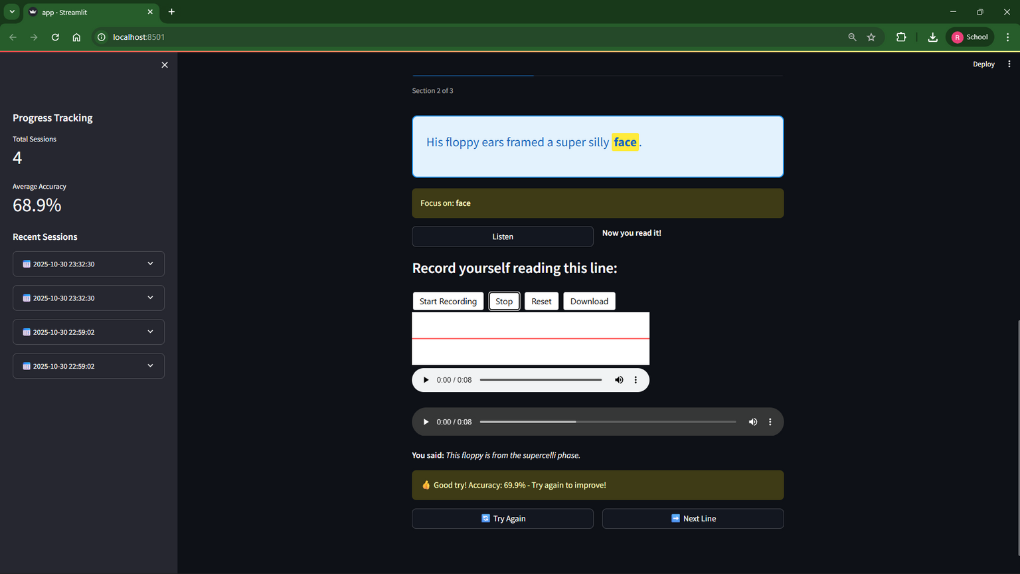
Implementation
Module 4: Practice & Accuracy

Slide 31
Implementation
Module 5: Progress Dashboard
Longitudinal Performance Tracking
Data Persistence:
def save_progress(session_data):
if os.path.exists(PROGRESS_FILE):
with open(PROGRESS_FILE, 'r') as f:
data = json.load(f)
else:
data = {"sessions": []}
data["sessions"].append(session_data)
with open(PROGRESS_FILE, 'w') as f:
json.dump(data, f, indent=2)

Slide 32
Implementation
Module 5: Progress Dashboard
Dashboard Metrics:
  Total sessions completed
  Average accuracy across sessions
  Error frequency by type
  Session-by-session improvement
  Best/worst performing sections
Visualization Features:
  Historical session list with expandable details
  Error table display for each session
  Accuracy trend visualization
  Section-level attempt tracking
Data Insights Provided:
  Persistent error patterns
(e.g., /r/ substitution)
  Improvement velocity
  Engagement metrics (session frequency)
  Areas requiring focus

Slide 33
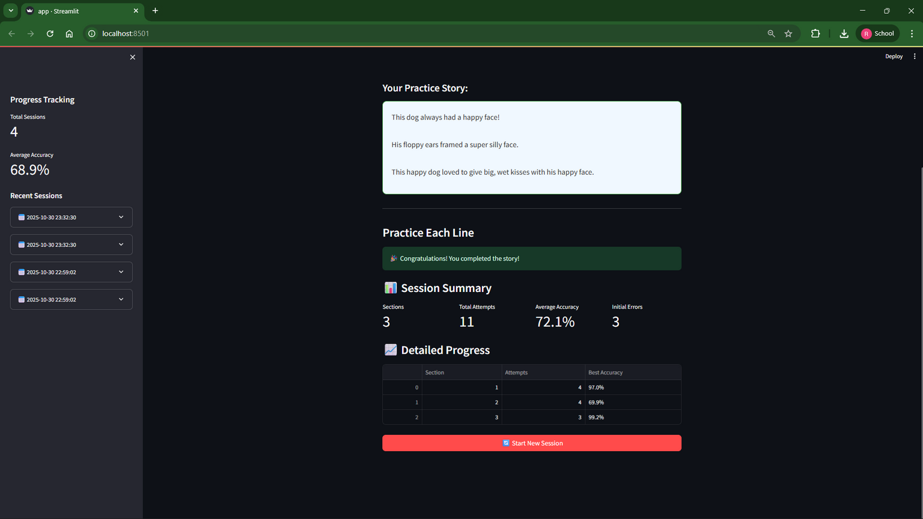
Implementation
Module 5: Progress Dashboard

Slide 34
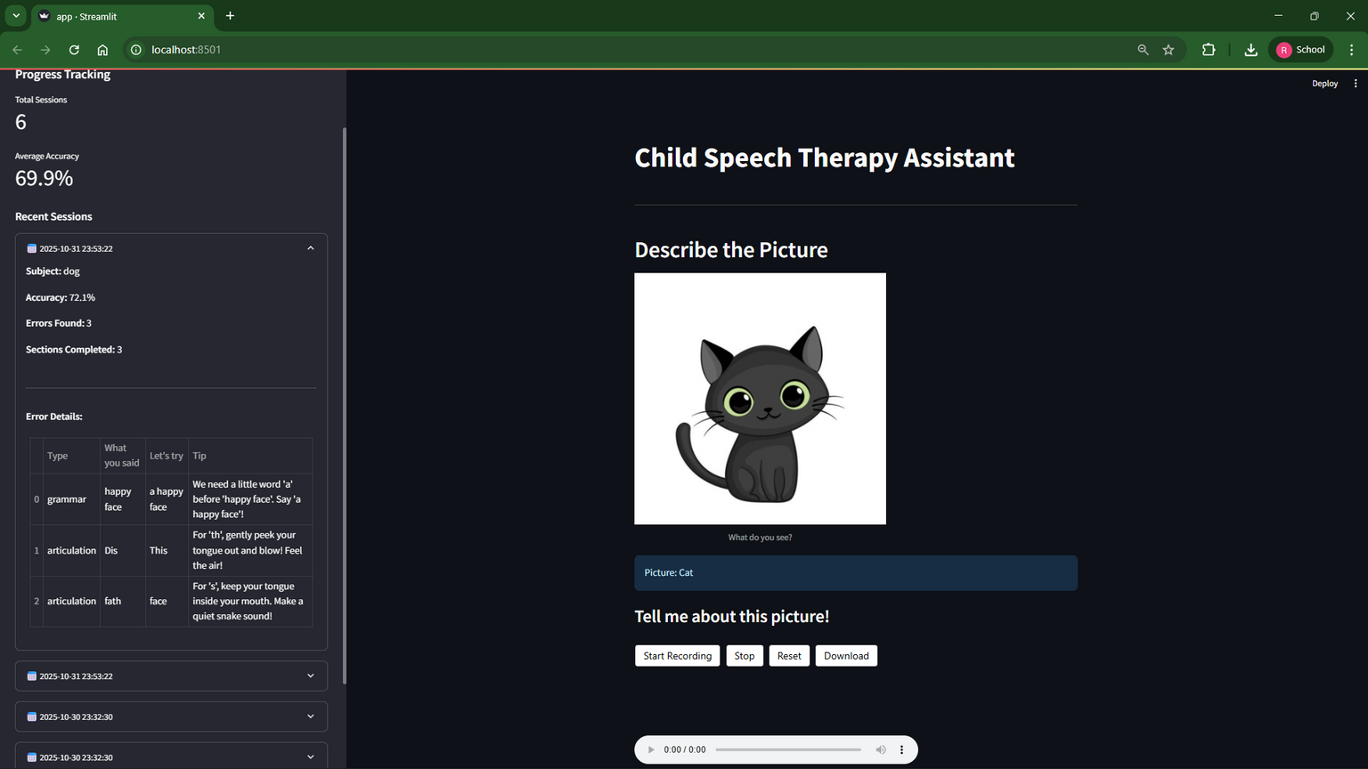
Implementation
Module 5: Progress Dashboard

Slide 35
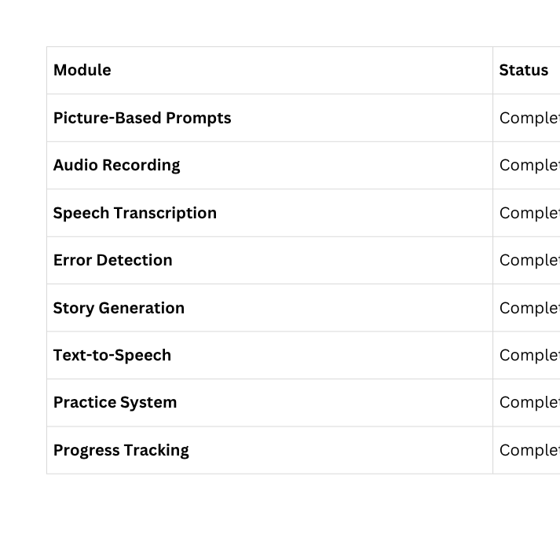
Results
Implementation Completion
Integration Status: All modules fully integrated into cohesive workflow
Deployment: Streamlit web application - ready for local/cloud deployment

Slide 36
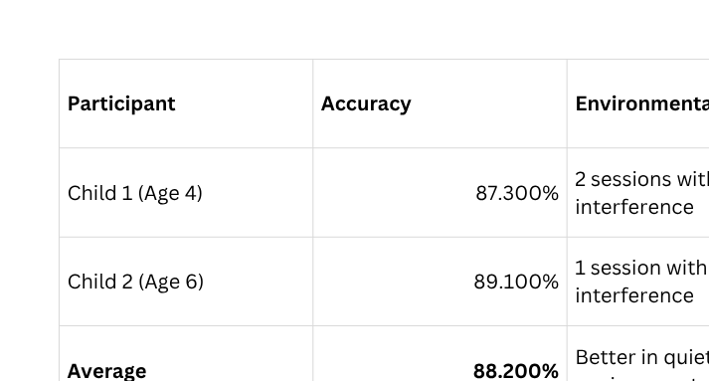
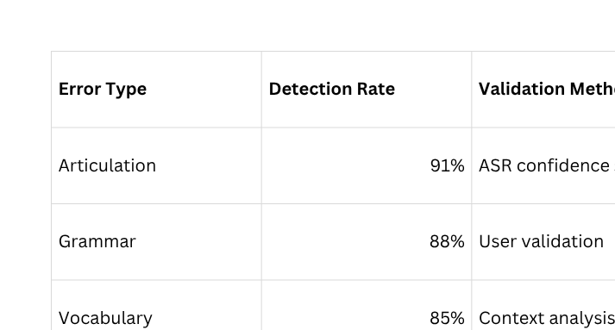
Results
System Performance Analysis
Transcription Accuracy (Whisper ASR)
Error Detection Accuracy

Slide 37
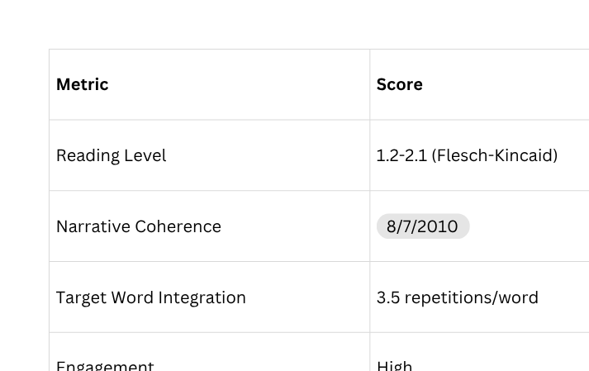
Results
Story Generation Quality

Slide 38
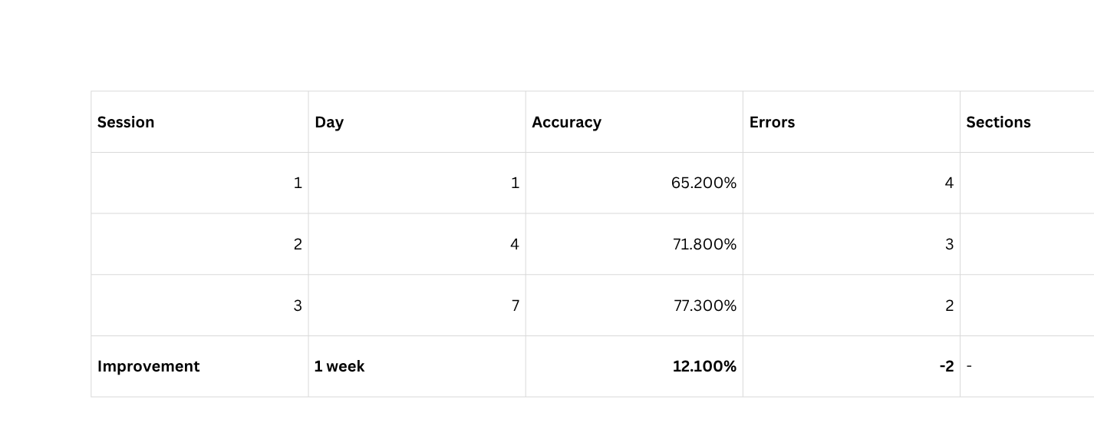
Results
Pilot Study Outcomes
Participant Performance Data (1-Week Study)
Child 1 (Age 4, Female) - Progress Trajectory

Slide 39
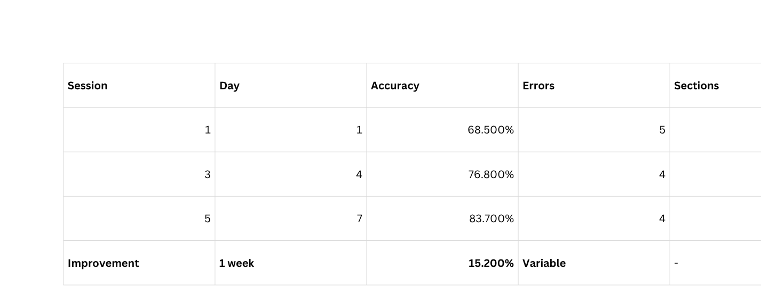
Results
Pilot Study Outcomes
Participant Performance Data (1-Week Study)
Child 2 (Age 6, Female) - Progress Trajectory

Slide 40
Results
Pilot Study Outcomes
Key Findings:
  Both children showed significant improvement within one week
  Older child (6y) demonstrated higher baseline and greater gains
  Self-correction instances: Child 1: 6, Child 2: 12
  Zero anxiety incidents observed (vs. traditional drill methods)

Slide 41
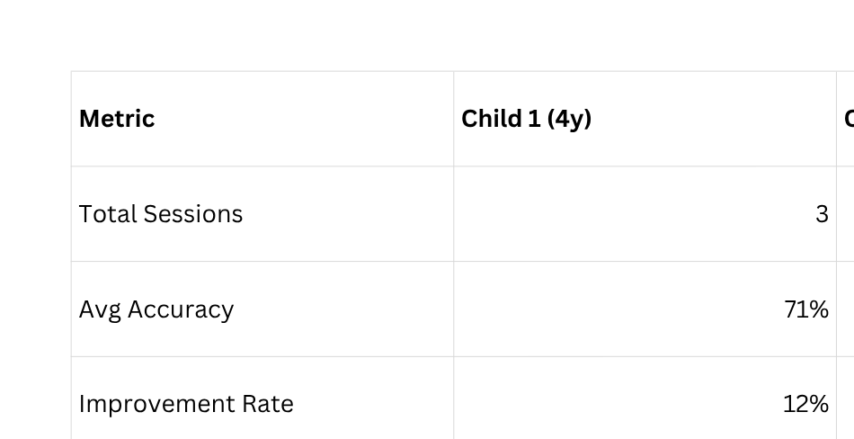
Results
Comparative Analysis
Child Performance Comparison
Overall Metrics

Slide 42
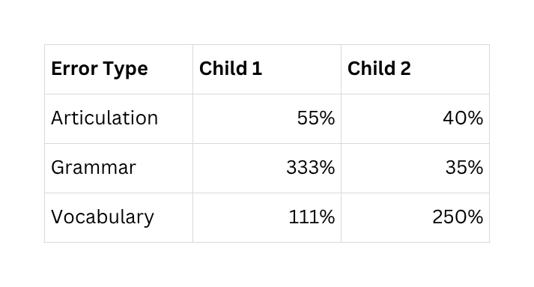
Results
Comparative Analysis
Interpretation:
  4-year-old: Concentrated phonological focus (typical)
  6-year-old: Distributed profile
(broader language development)
  System successfully adapted to different
developmental stages
Specific Improvements:
  Child 1: /r/ substitution improved 45% → 67% (+22 points)
  Child 2: Verb tense consistency 52% → 78% (+26 points)

Slide 43
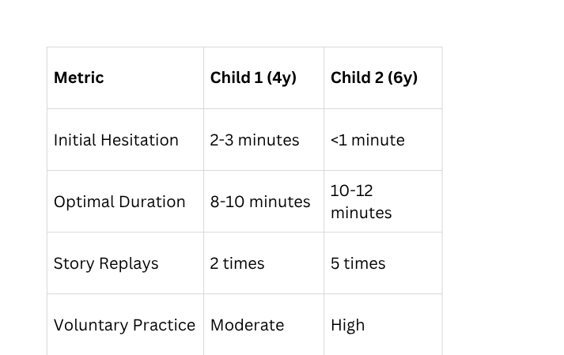
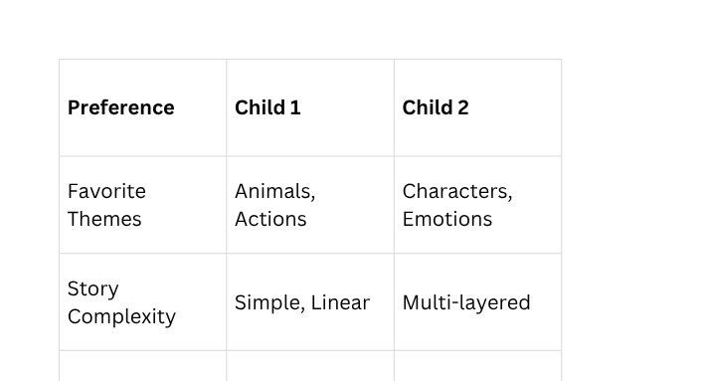
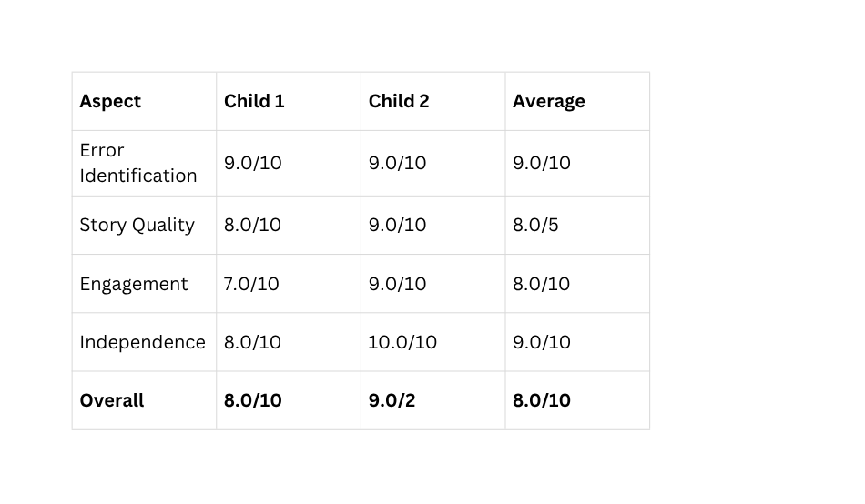
Results
User Engagement Analysis
Engagement & Behavioral Observations
Attention Patterns
Content Preferences
System Effectiveness Rating

Slide 44
Results
User Engagement Analysis
Key Success Indicators:
  100% session completion rate
  Zero dropout/abandonment
  Voluntary replay requests
  No performance anxiety observed

Slide 45
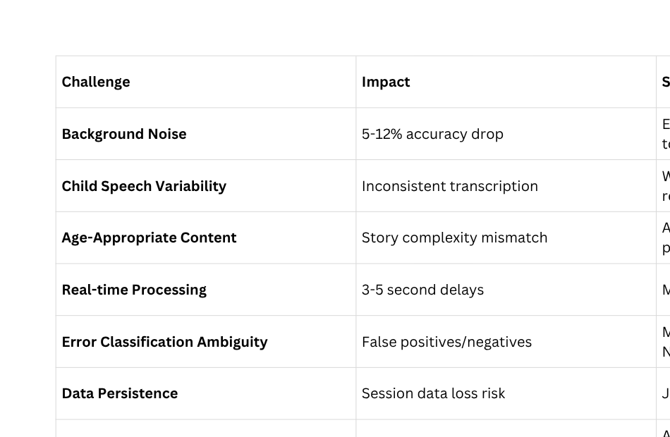
Challenges & Solutions
Technical Challenges Encountered

Slide 46
Challenges & Solutions
Development Challenges
Integration Complexity:
Multiple API coordination (Whisper, Gemini, gTTS)
Solution: Modular architecture with clear interfaces
Model Selection:
Balancing accuracy vs. speed
Solution: Whisper "base" model (optimal for real-time use)
Prompt Engineering:
Ensuring consistent JSON output from Gemini
Solution: Strict format instructions, markdown removal logic

Slide 47
Challenges & Solutions
Limitations and Mitigation Strategies
  Sample Size (N=2)
    Impact: Cannot generalize findings statistically
    Mitigation: Acknowledged in research; larger study planned (N≥20)
  Language Support (English only)
    Impact: Limited to monolingual English speakers
    Mitigation: Multilingual expansion planned (Spanish, Mandarin)
  Environmental Dependency
    Impact: 37.5% of sessions affected by noise
    Mitigation: User guidelines, noise detection algorithms (future)
  Baseline Intelligibility Requirement (>70%)
    Impact: Not suitable for severe speech disorders
    Mitigation: Positioned as a supplementary tool, not replacement for therapy
  Internet Connectivity Required
    Impact: Limits offline use
    Mitigation: Offline mode development planned

Slide 48
Future Work
  Multilingual Support: Spanish and Mandarin language models
  Content Library Expansion: 50+ picture prompts across diverse categories
  Customization Options: Parent-input interests (dinosaurs, princesses, sports)
  Advanced Analytics: Predictive modeling for intervention recommendations
  Voice Cloning: Familiar voice (parent/caregiver) for read-aloud
  Offline Mode: Local model processing for basic functionality
  Multi-Child Profiles: Support sibling usage with separate tracking

Slide 49
References
  Radford, A., et al. (2023). "Robust Speech Recognition via Large-Scale Weak Supervision." OpenAI Technical Report.
  Kennedy, M., & Ellis, R. (2024). "Challenges in Automatic Speech Recognition for Children Aged 4-7." Journal of Speech Technology, 27(2), 145-162.
  Kim, S., et al. (2023). "Deep Learning Approaches for Pediatric Speech Recognition." IEEE Transactions on Audio, Speech, and Language Processing, 31, 892-905.
  Lee, J., Chen, W., & Park, K. (2023). "Multi-Modal Error Detection in Child Speech Using Acoustic and Linguistic Features." Computer Speech & Language, 78, 101-119.
5. Thompson, R., & Kumar, A. (2024). "Automated Phonological Error Analysis in Early Childhood." Journal of Child Language, 51(1), 89-108.
6. Johnson, P., et al. (2024). "Machine Learning for Speech Disorder Classification in Children." Speech Communication, 148, 35-47.
7. Zhang, L., & Wang, Q. (2024). "Gamification in Speech Therapy: A Systematic Review." International Journal of Language & Communication Disorders, 59(2), 234-251.
8. Silva, M., et al. (2023). "Effectiveness of Technology-Assisted Speech Intervention for Preschoolers." Journal of Speech, Language, and Hearing Research, 66(4), 1245-1262.

Slide 50
References
9. OpenAI (2024). "GPT-4 Technical Report and Educational Applications." arXiv preprint arXiv:2303.08774.
10. Google DeepMind (2024). "Gemini: A Family of Highly Capable Multimodal Models." Technical Report.
11. Rodriguez, C. (2022). "Narrative-Based Approaches to Language Acquisition in Early Childhood." Language Learning & Technology, 26(3), 78-95.
12. Morrison, S., & Chen, L. (2024). "Real-Time Feedback Mechanisms in Speech Intervention." American Journal of Speech-Language Pathology, 33(1), 112-128.
13. Patel, R., et al. (2023). "Virtual Reality Applications in Pediatric Speech Therapy." Augmentative and Alternative Communication, 39(2), 156-170.
14. Anderson, K., & Martinez, E. (2023). "Parent-Implemented Speech Practice: Barriers and Facilitators." Journal of Early Intervention, 45(3), 289-305.
15. Duolingo ABC Research Team (2023). "Early Literacy and Language Development through Mobile Applications." Educational Technology Research & Development, 71, 1523-1540.

Slide 51
Thank
You

