Slide 1

3Ps (Parents & Pupils Portal) School Management Application
?!
Phase 2: Flowchart and Storyboard
Rosh Hashana S. Torres

Slide 2
!!
FLOWCHART

Slide 3
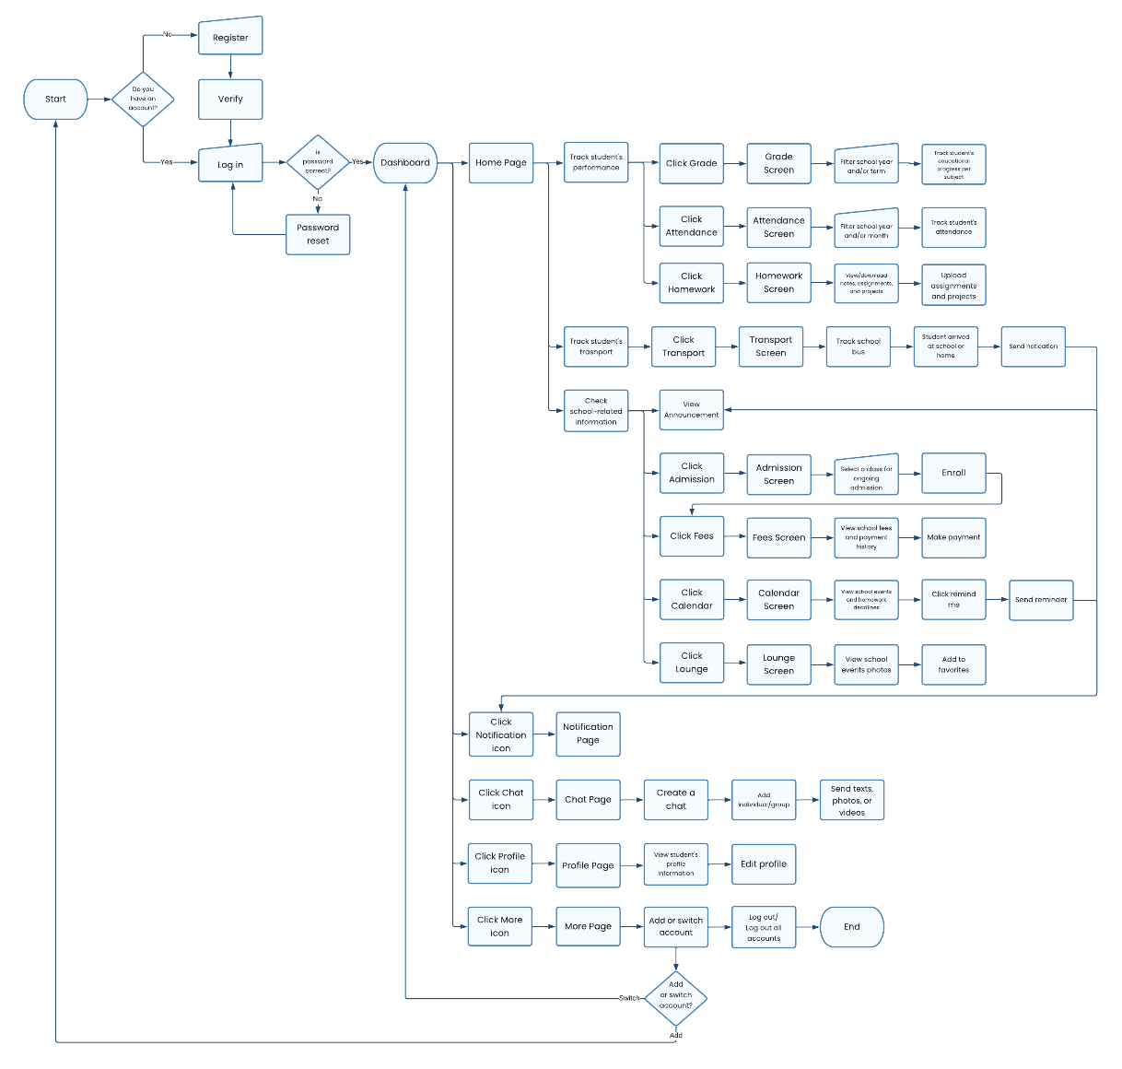
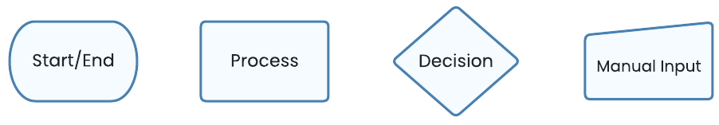
Legend:

Slide 4
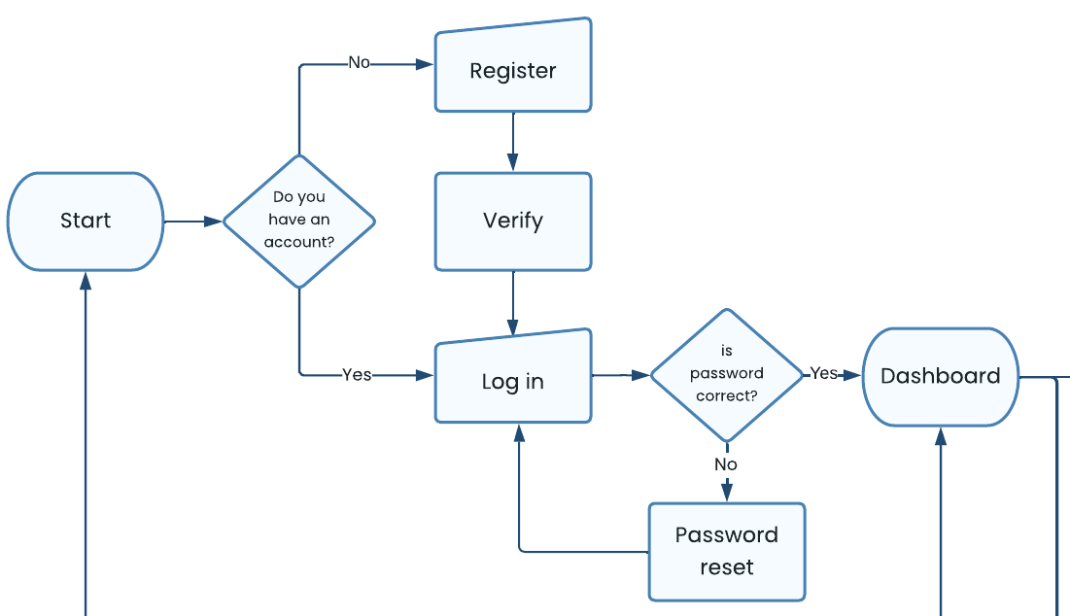

Slide 5
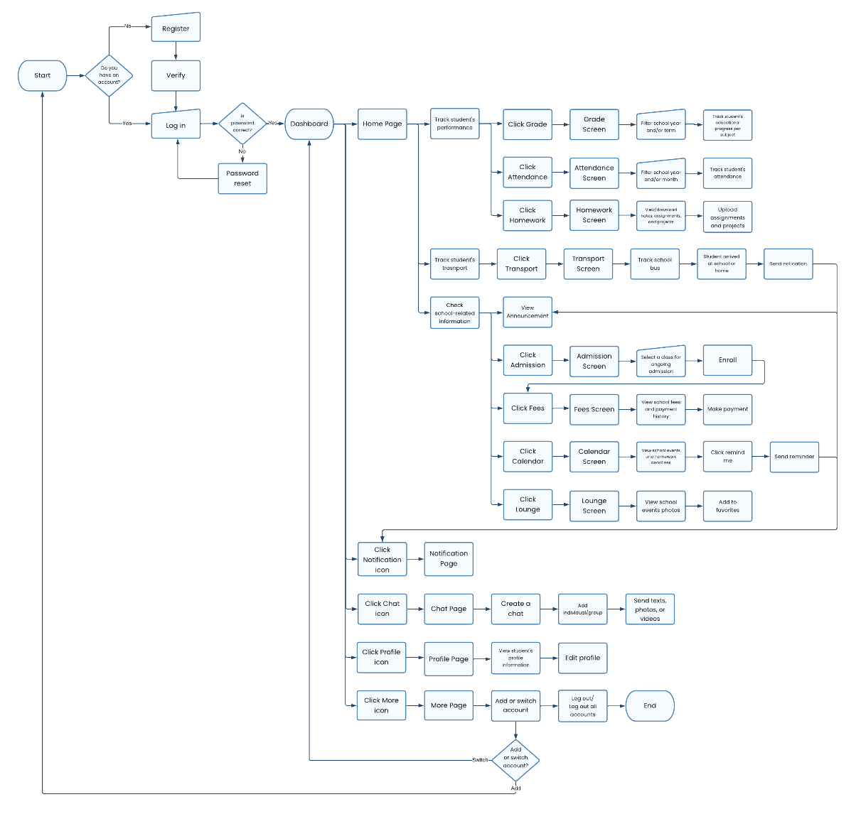

Slide 6


Slide 7


Slide 9
!!
PROBLEM AND GOAL STATEMENT

Slide 10

?!
Problem Statement
Parents who are busy at work need an application to easily track students’ performance and check school-related information because they lack free time to visit school.
Parents who are anxious need an application to quickly track the routes of students’ transport vehicle because they are tensed about their child’s security.
Students who are forgetful needs an application to keep track of school happenings and announcement because they always missed important updates.

Slide 11
?!
Goal Statement
Our school management application will let users track students’ performance and check school-related information. This will affect how the school connects with students and parents by giving them convenience to access relevant school-related information faster and easier. We will measure effectiveness by looking how frequent users utilize the application.

Slide 12
!!
STORYBOARD

Slide 13
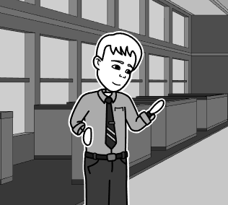
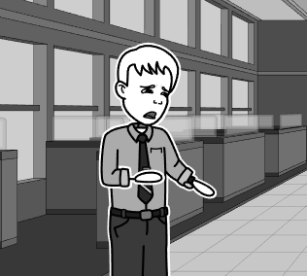
A father who is frequently away from home due to business trips in another city decided to call his son to check how his school performance was so far.
He tried to call his son but to no avail, he wondered why he is not answering his phone.

Slide 14
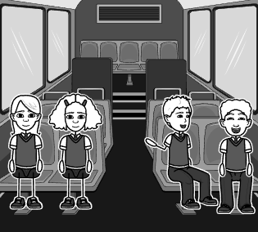
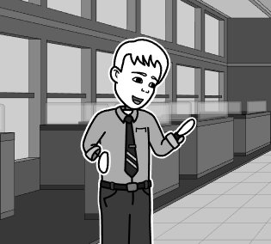
The son did not notice that his father was calling since he was chatting with his seatmate on the school bus on their way home.
The father suddenly remembered the school management application that was mentioned by his son.

Slide 15

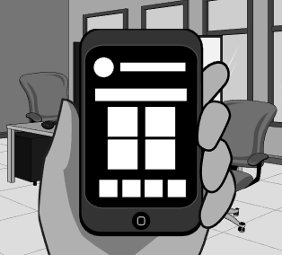
He installed the application and created an account.
He logged in to the application and sees a list of menu options on the home page.

Slide 16
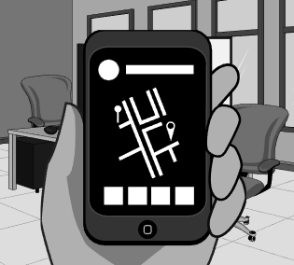
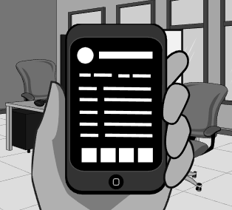
He clicked the Transport option to track whether his son is home or not. He confirmed from the application tracker that his son is still on the way home.
He continued to explore the application and clicked the Grade option. He filtered the previous grading period to check his son’s educational progress.

Slide 17
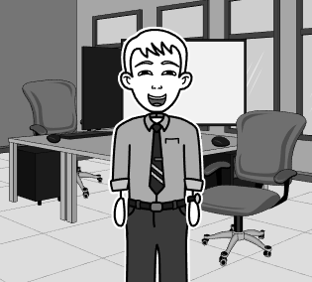
The father was happy to know his son is doing a great job. He also felt relieved knowing his son’s whereabouts.

Slide 18
Thank you.

