Slide 1

3Ps (Parents & Pupils Portal) School Management Application
?!
Phase 3: Site Map and
Persona-based Task Flow Diagram
Rosh Hashana S. Torres

Slide 2
!!
SITE MAP

Slide 3
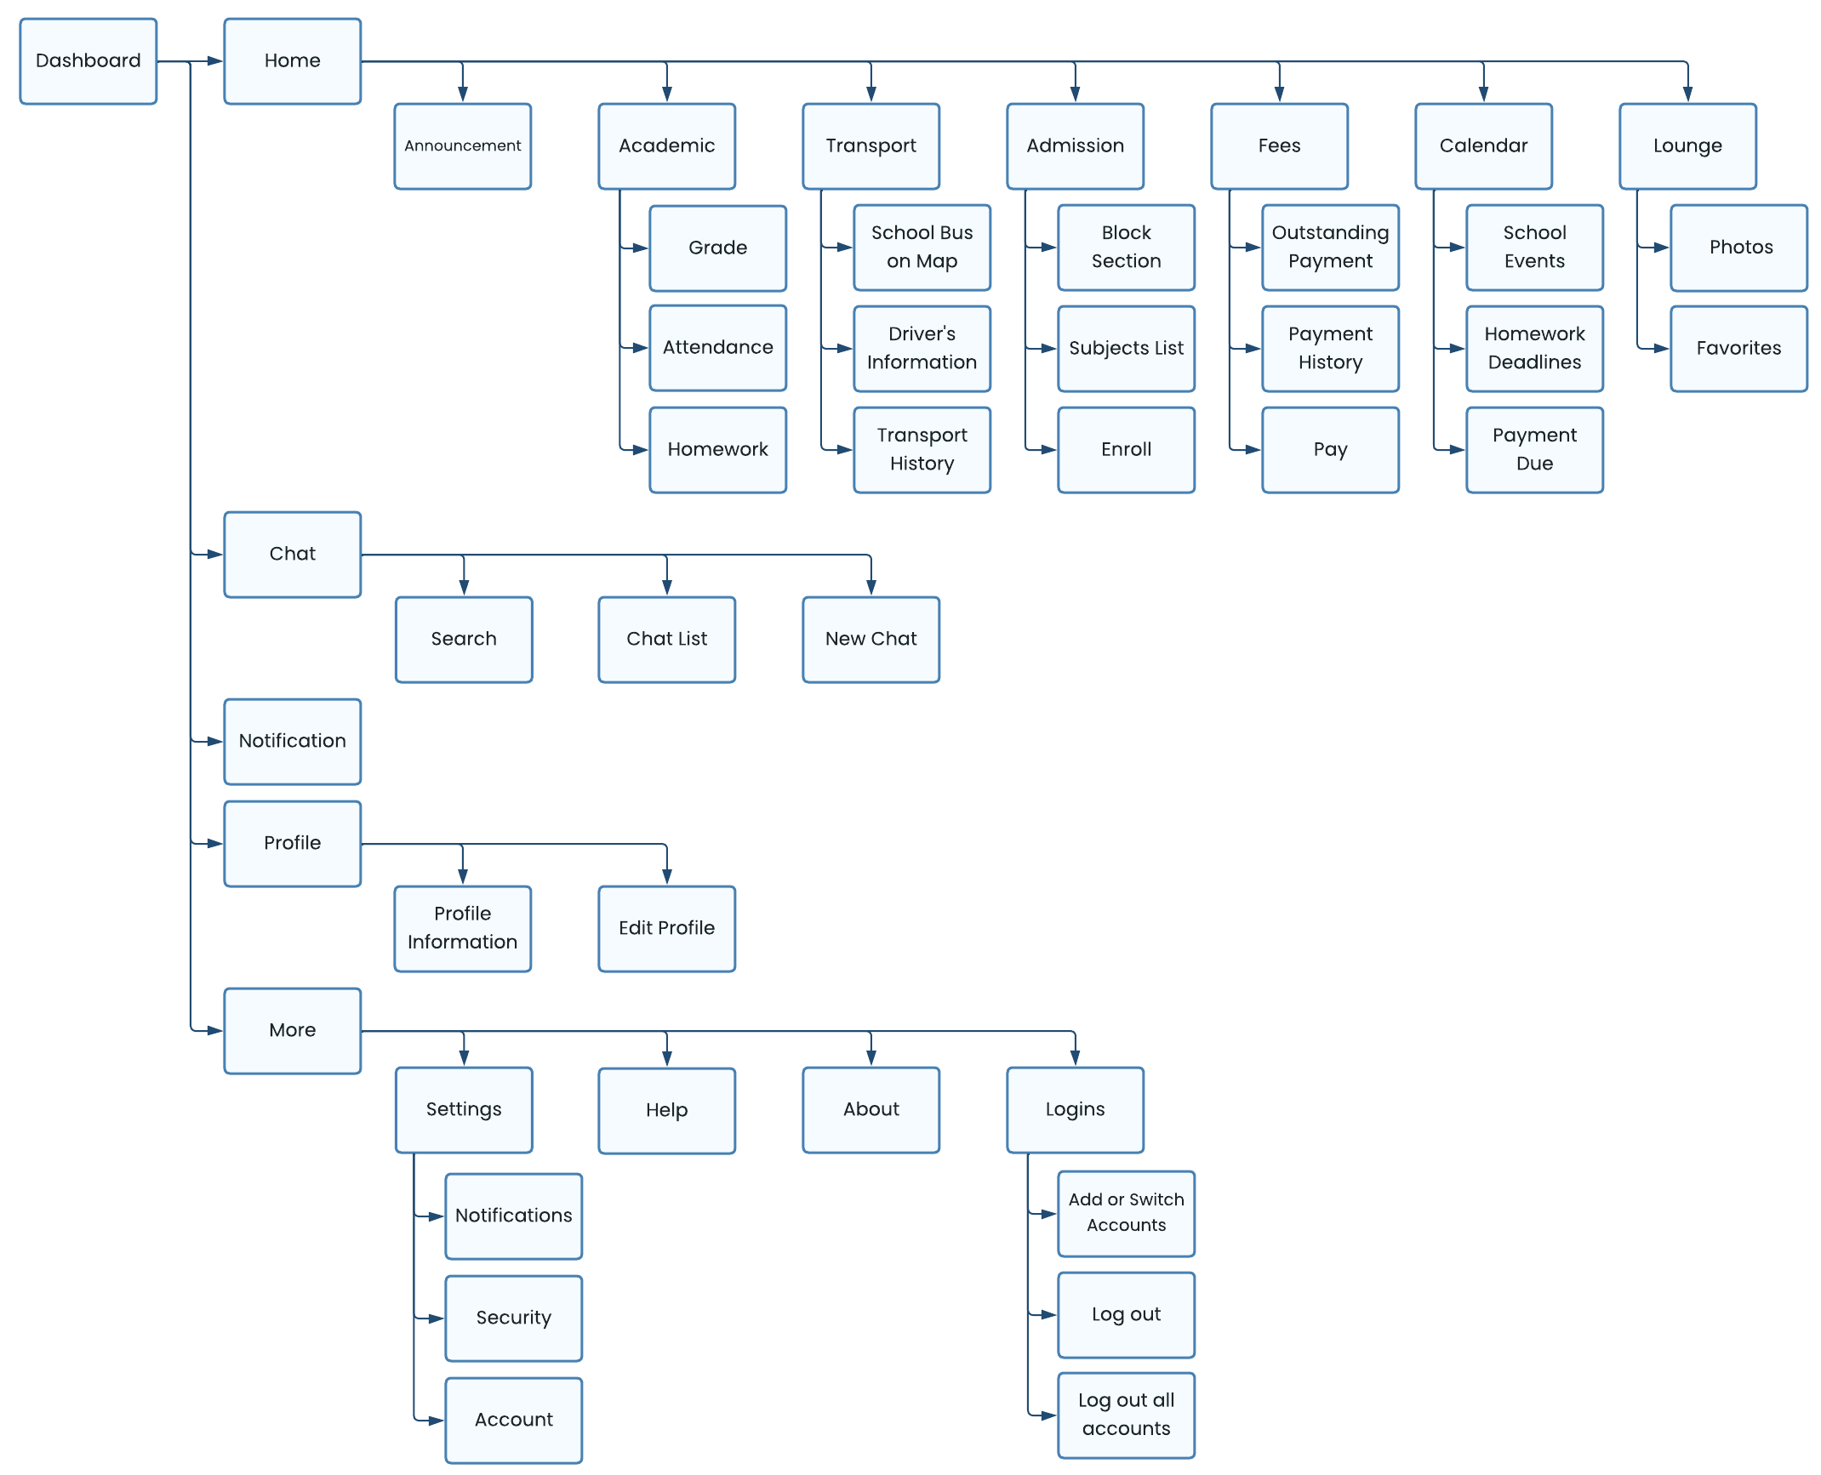

Slide 4
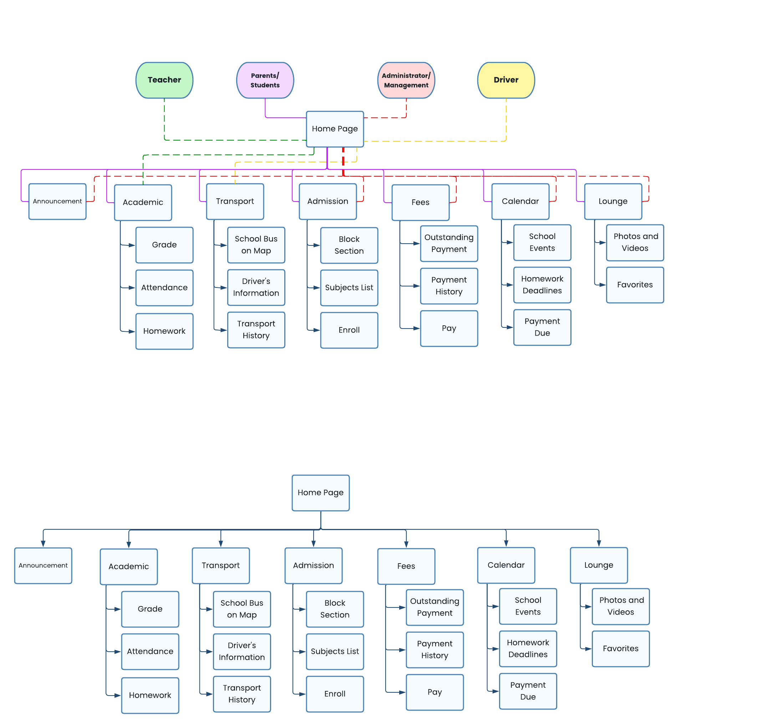

Slide 5
!!
PERSONA-BASED
TASK FLOW DIAGRAM

Slide 7
Thank you.

