Slide 1

3Ps (Parents & Pupils Portal) School Management Application
?!
Phase 4: Wireframe (Traditional and Digital)
and Interaction Map
Rosh Hashana S. Torres

Slide 2
!!
WIREFRAME

Slide 3
!!
WIREFRAME
(TRADITIONAL)

Slide 4
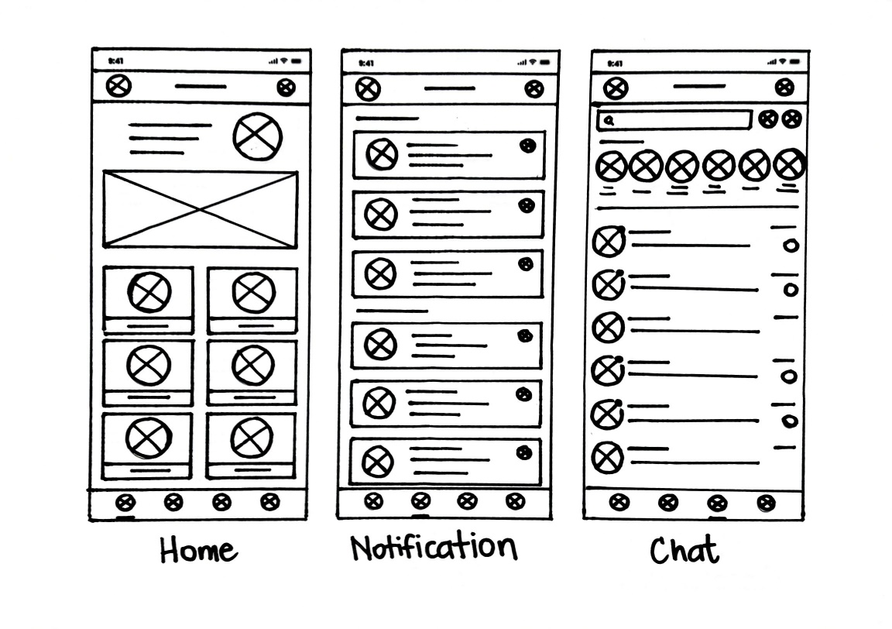

Slide 5
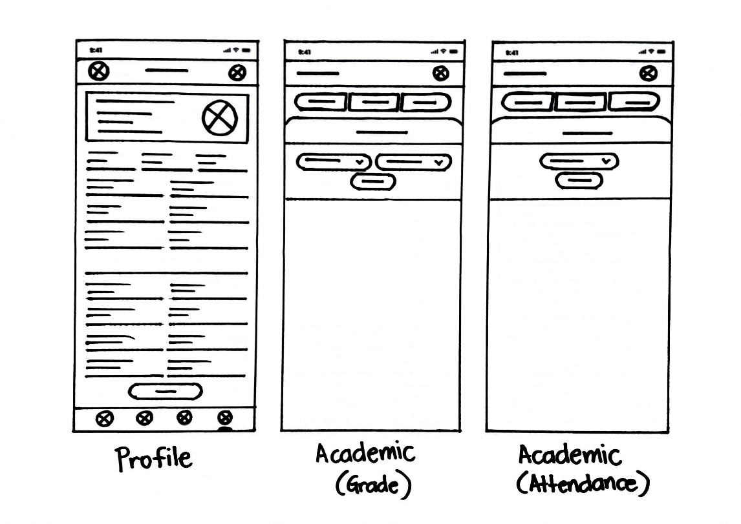

Slide 6
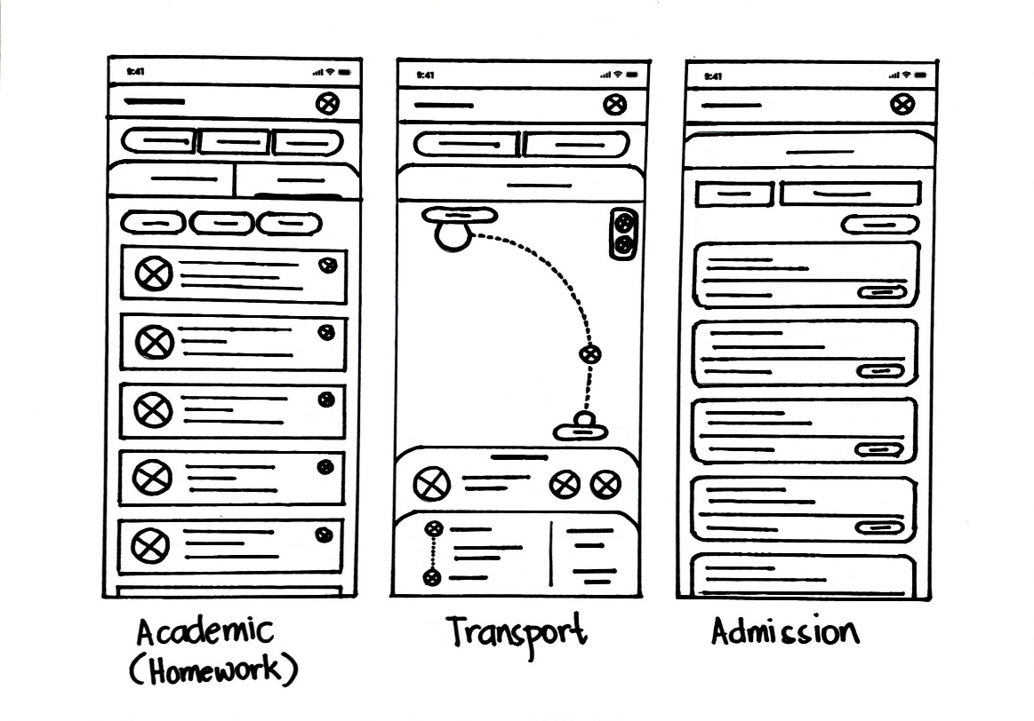

Slide 7
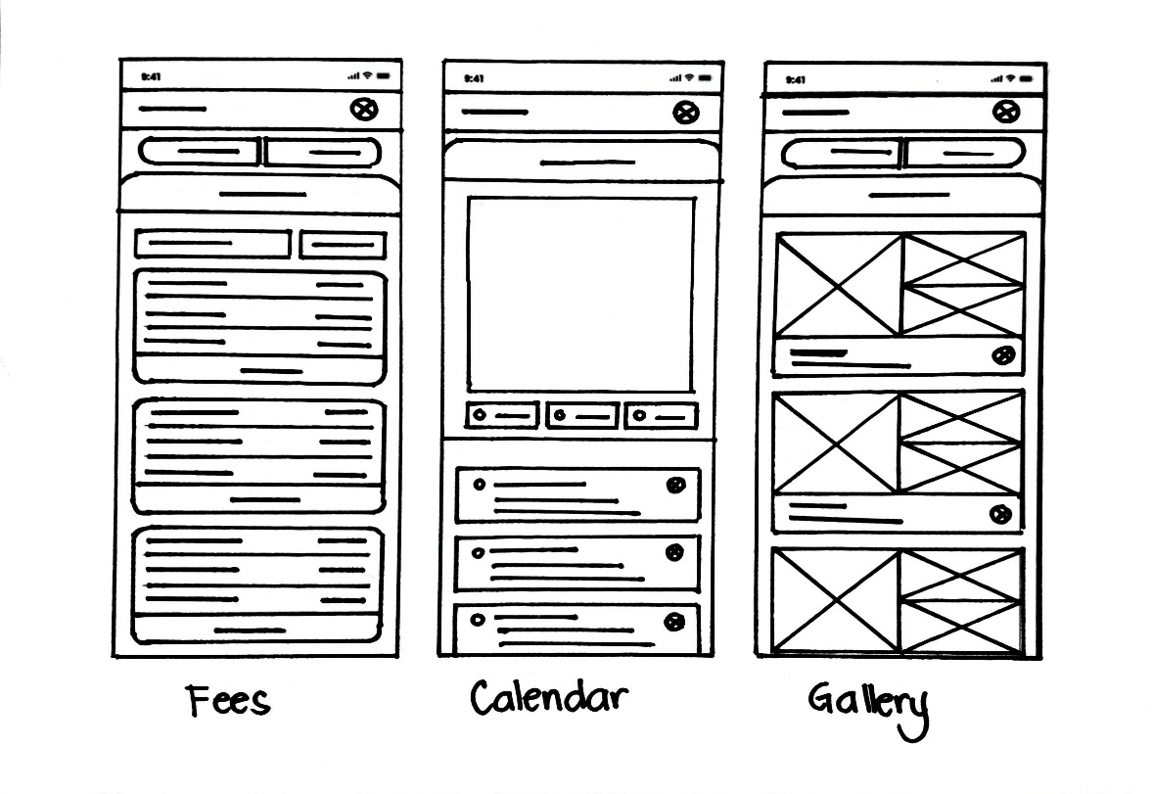

Slide 8
!!
WIREFRAME
(DIGITAL)

Slide 9
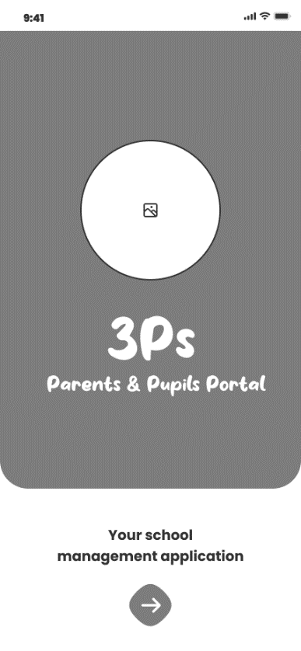
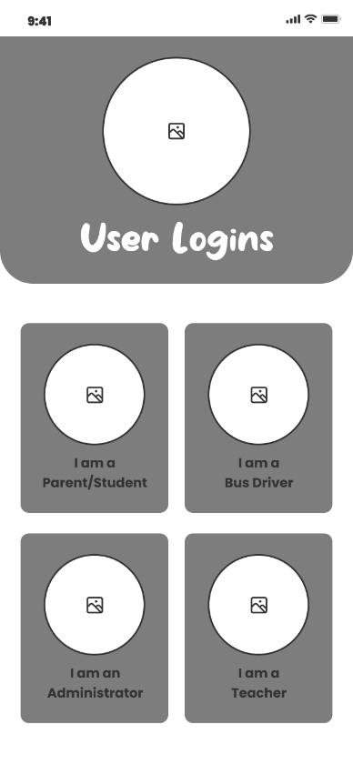
SPLASH
USER LOGINS

Slide 10
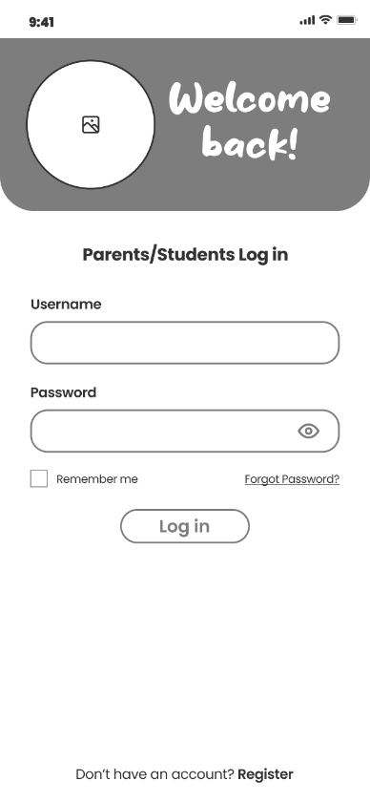
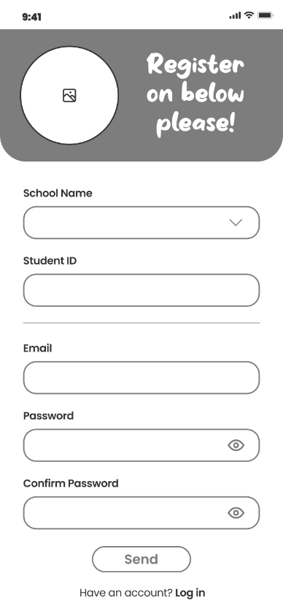
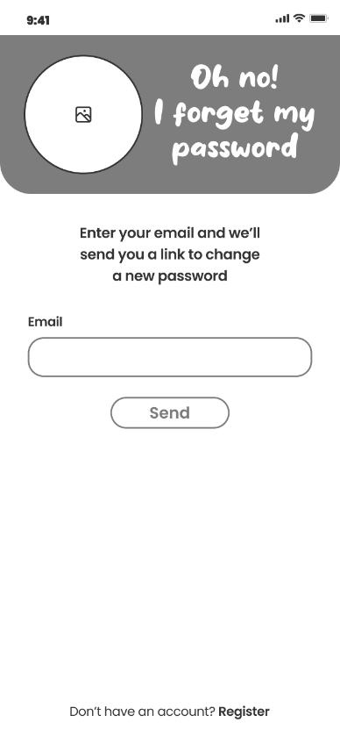
FORGOT PASSWORD
LOG IN
REGISTER

Slide 11
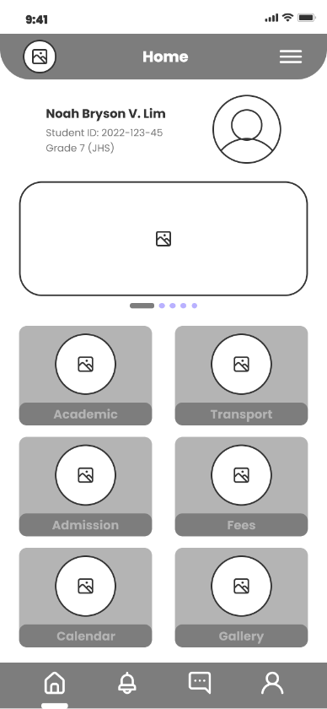
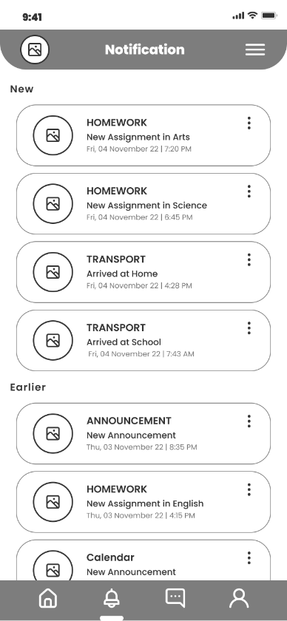
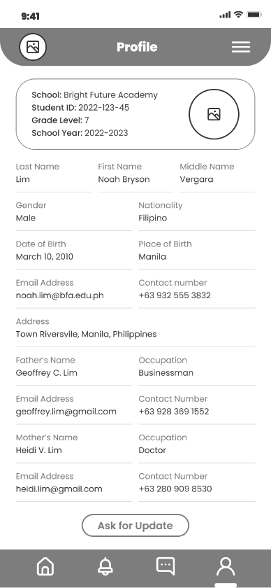
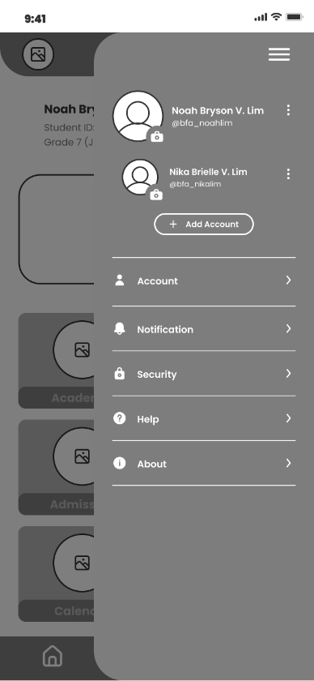
HOME
NOTIFICATION
PROFILE
MORE

Slide 12
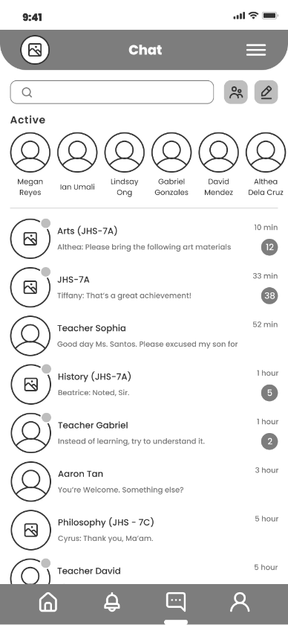
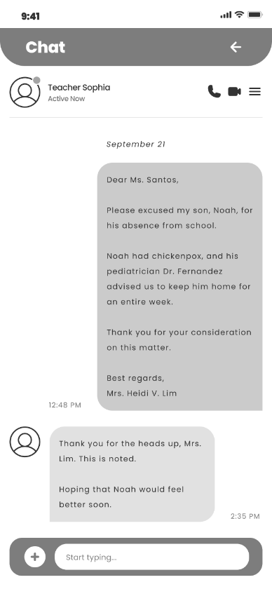
CHAT

Slide 13
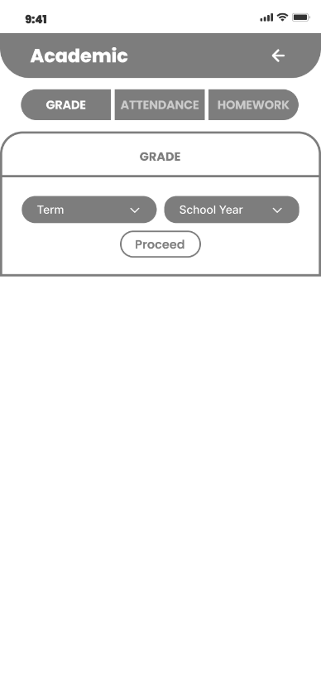
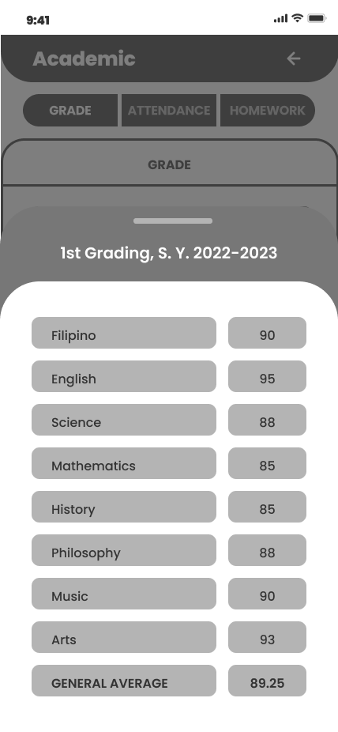
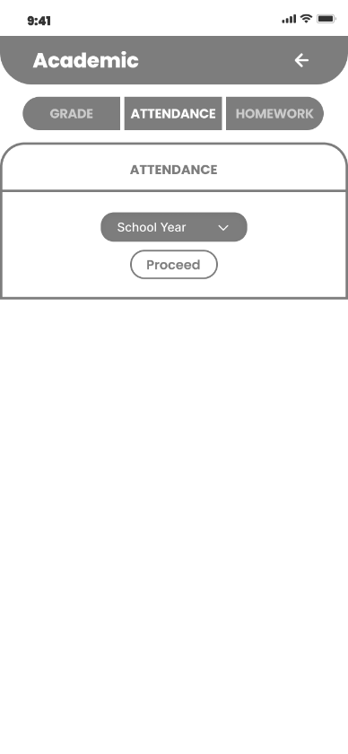
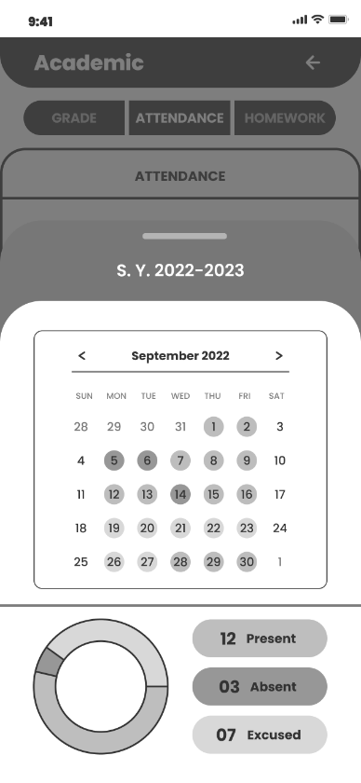
ACADEMIC
GRADE
ATTENDANCE

Slide 14
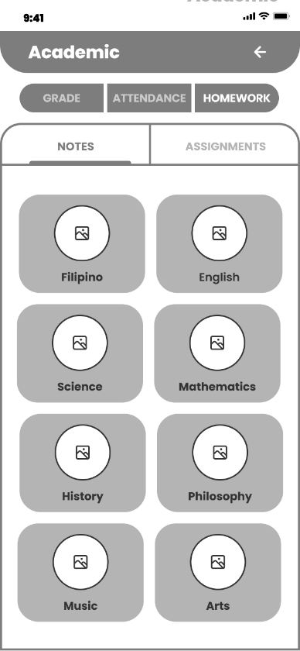
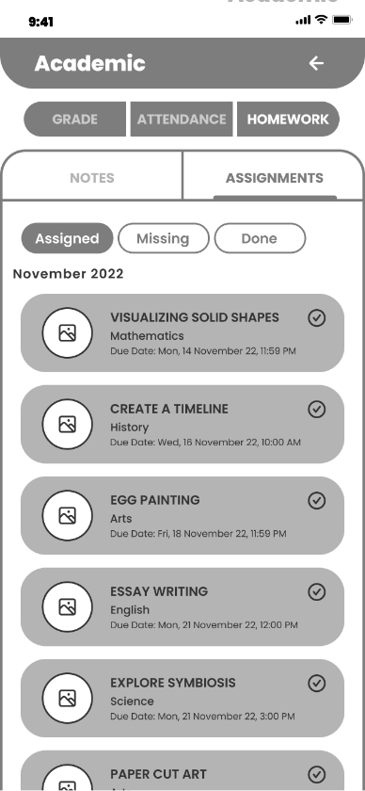
ACADEMIC
HOMEWORK

Slide 15
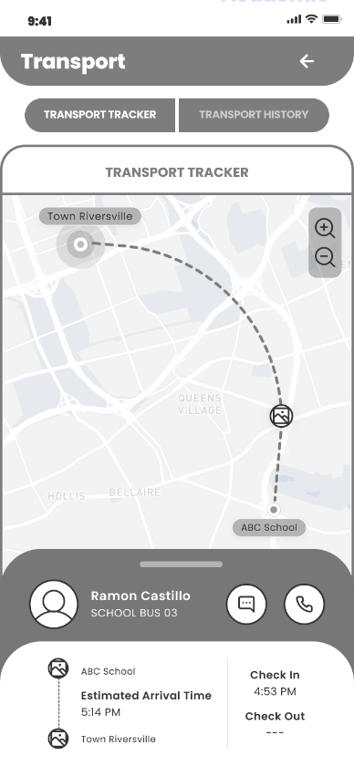
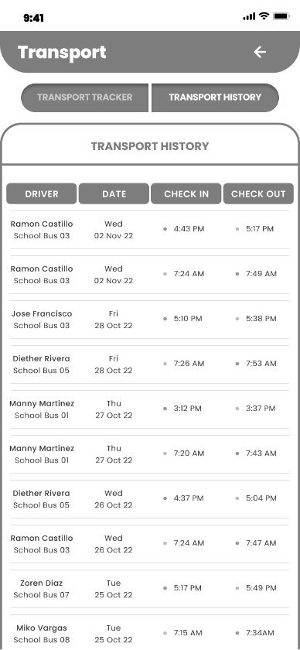
TRANSPORT
TRACKER
HISTORY

Slide 16
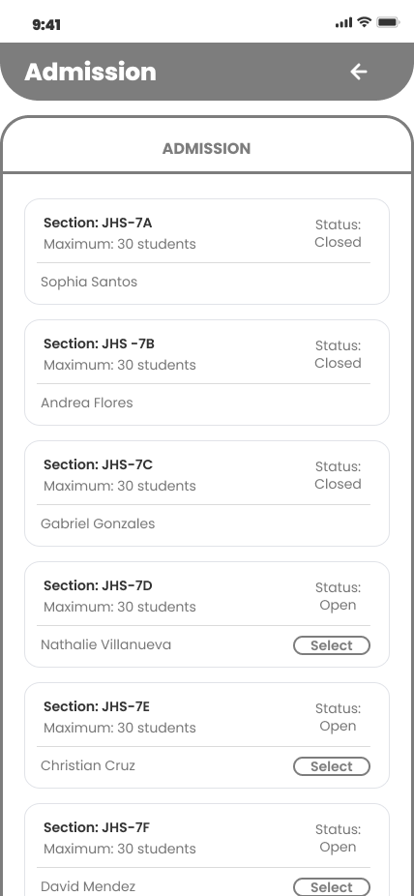
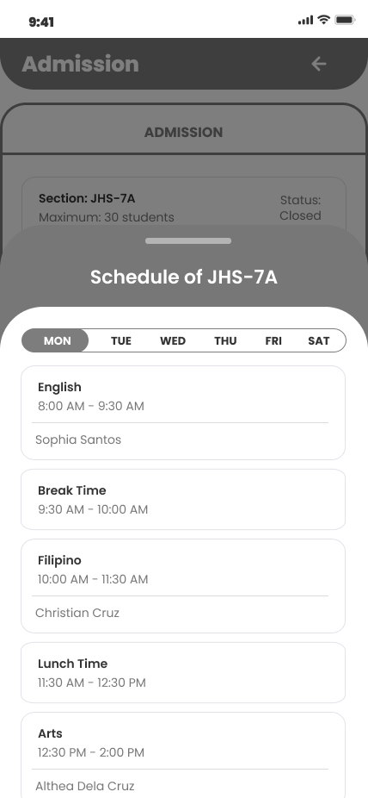
ADMISSION

Slide 17
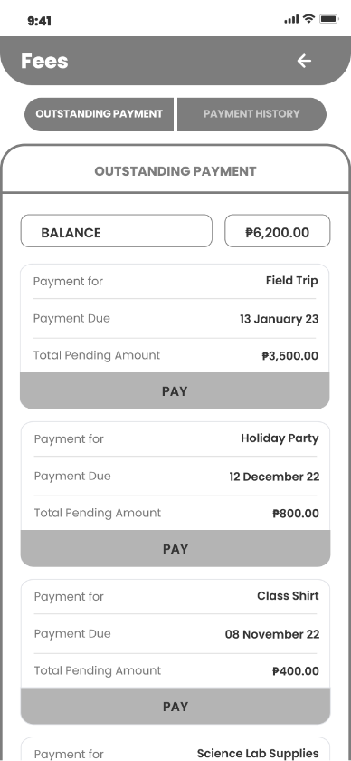
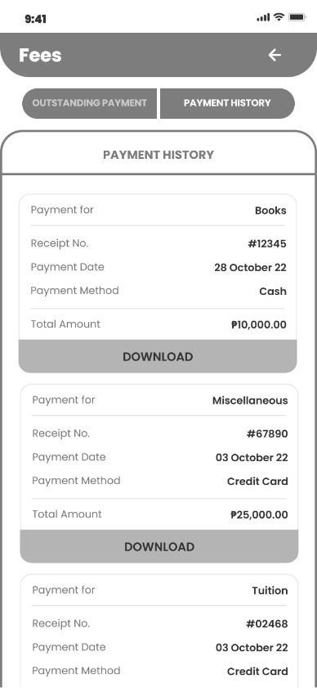
FEES
OUTSTANDING
HISTORY

Slide 18
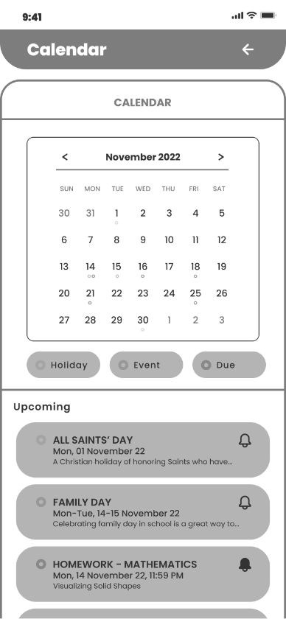
CALENDAR

Slide 19
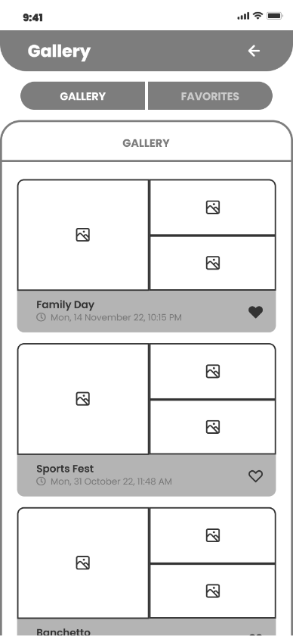
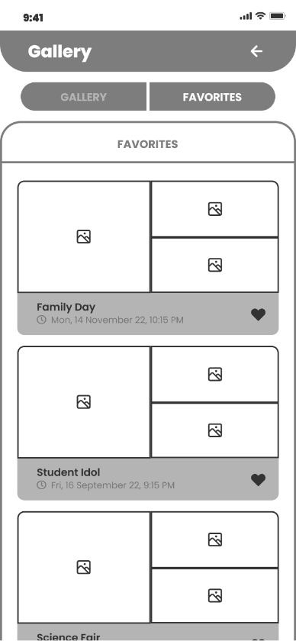
GALLERY

Slide 20
!!
INTERACTION
MAP

Slide 21
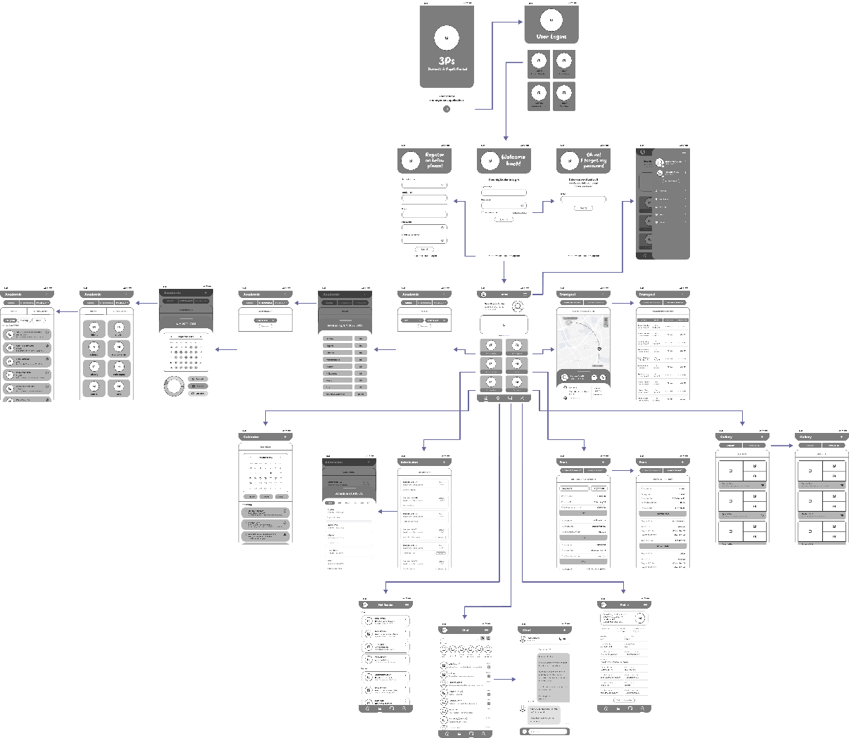

Slide 22
!!
Interaction Map Link:
Interaction Map
For clearer copy

Slide 23
Thank you.

