Slide 1
Unlocking Financial Futures: Harnessing Machine Learning and Deep Learning Model to Predict Loan Status
Name : Roshni Solanki
Student Id : 10608946
Supervisor : Prof. Anesu Nyabadza

Slide 2
Introduction
Loan approvals are critical for financial institutions, affecting both profitability and macroeconomic stability.
Traditional credit scoring models like logistic and linear regression struggle with the complex, non-linear nature of modern financial data.
Recent advancements emphasize using machine learning and deep learning techniques to improve loan status prediction.
This research aims to leverage these advanced algorithms for more accurate predictions, enhancing risk management and decision-making processes.

Slide 3
Research Question
How do state-of-the-art machine learning and deep learning models, such as Gradient Boosting, XGBoost, LSTM, and CNN, compare in terms of accuracy and effectiveness in predicting loan status?
Which features play the most significant role in influencing the accuracy of loan status predictions across different models?
How can the findings from model performance and feature importance analyses be used to improve loan approval processes and reduce financial risks in financial institutions

Slide 4
Literature Review
Authors | Models Used | Results
Anand et al. (2022) | Logistic Regression, Decision Tree, Random Forest, Gaussian Naive Bayes, SVM | Random Forest: 86.17% accuracy, Extra Trees Classifier: 85.55% accuracy
Viswanatha et al. (2023) | Random Forest, Naive Bayes, Decision Tree, K-Nearest Neighbors (KNN) | Naive Bayes: 83.73% accuracy
Mahbobi et al. (2021) | Neural Networks | 89.3% accuracy, highlighting the effectiveness of deep learning models for large datasets
Arora et al. (2021) | KNN, Ensemble Techniques, Neural Networks | Neural Network: 93% accuracy in credit card default prediction
Gupta et al. (2020) | Logistic Regression, Random Forest, Django Framework | Random Forest: 85% accuracy
Kadam et al. (2021) | SVM, Naive Bayes | Naive Bayes: 78% accuracy, beneficial for categorical financial data

Slide 5
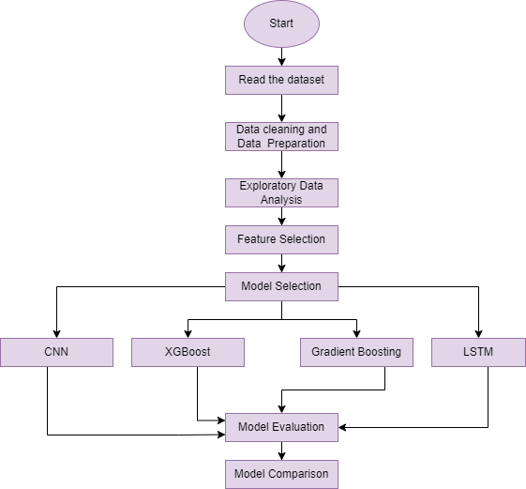
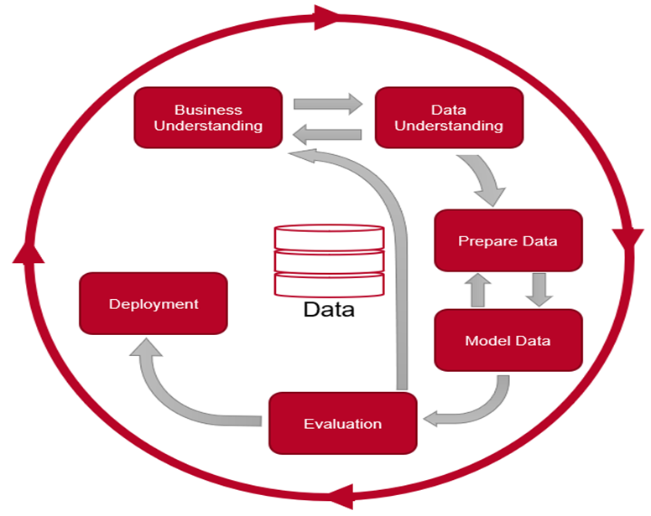
Methodology
Figure 1: CRISP-DM Methodology
Figure 2: Project Methodology

Slide 6
Methodology
Data Description:
Dataset link: https://www.kaggle.com/datasets/zaurbegiev/my-dataset
It contains19 Columns and 100514 Rows
Data Collection: Gather loan-related datasets from reliable sources like Kaggle, including features such as borrower characteristics, income, loan amount, and credit history.
Data Preprocessing: Clean and preprocess the data by handling missing values, normalizing data, and encoding categorical variables.
Model Selection: Implement machine learning models like Gradient Boosting, XGBoost, CNN, and LSTM, and compare their performance.
Model Evaluation: Assess model performance using metrics like accuracy, precision, recall, and F1 score.

Slide 7
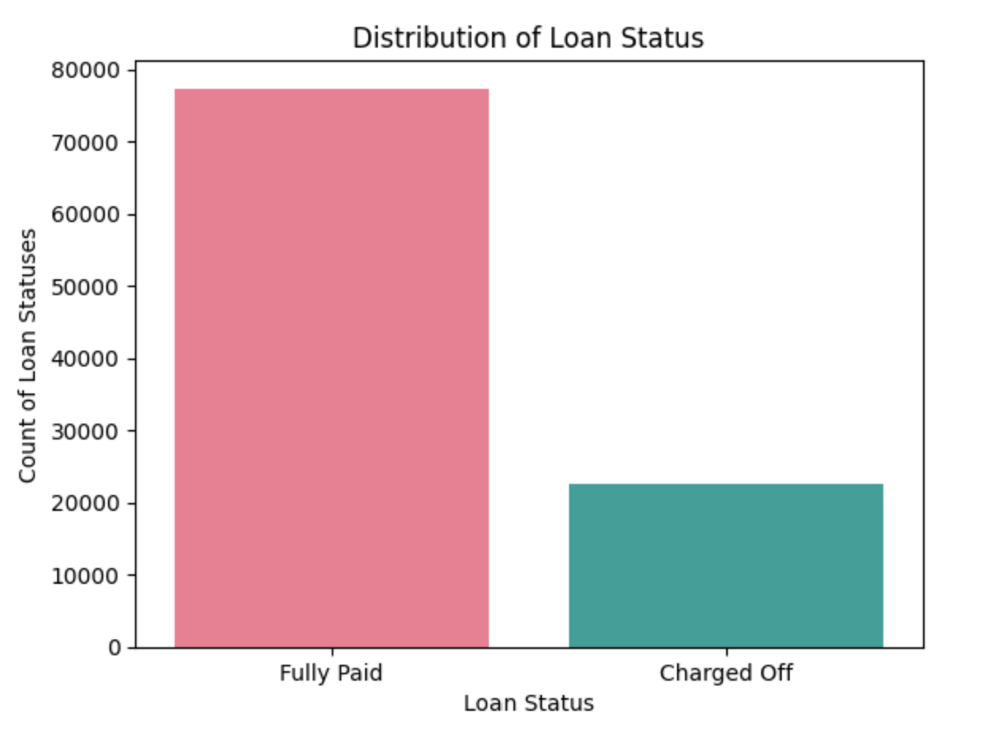
Exploratory Data Analysis
Exploratory Data Analysis (EDA) is the process of analyzing and visualizing data to uncover patterns, trends, and insights before applying formal modeling techniques.
Figure 3: Distribution of Loan Status
Loan amounts distribution - This visualization helps to quickly understand the distribution and imbalance, if any, in loan status categories within the dataset.

Slide 8
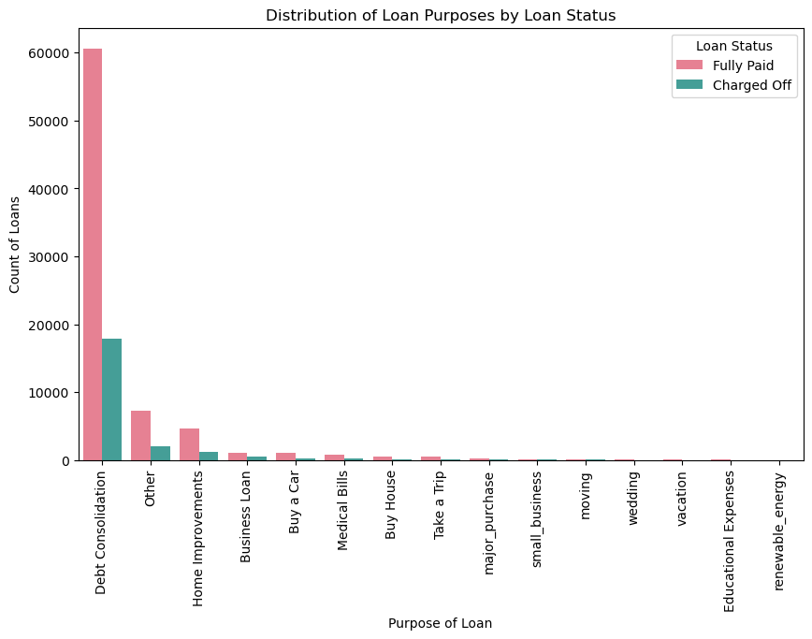
Exploratory Data Analysis
Figure 4: Purpose Of Loans
Visual representation of the loans, disbursed across different applications for various loan status. This visualization will show you the Most Common Value of Loan Purpose and how it impacts the loan status this insight might help to understand, various borrowing trends significant risk factors.

Slide 9
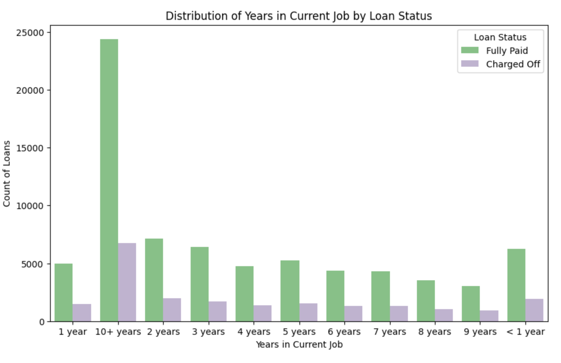
Exploratory Data Analysis
Figure 5: Years in current year
This count plot from Seaborn visualizes the distribution of loan statuses (Loan Status) across different categories of 'Years in current job' in the Loan_data_train dataset

Slide 10
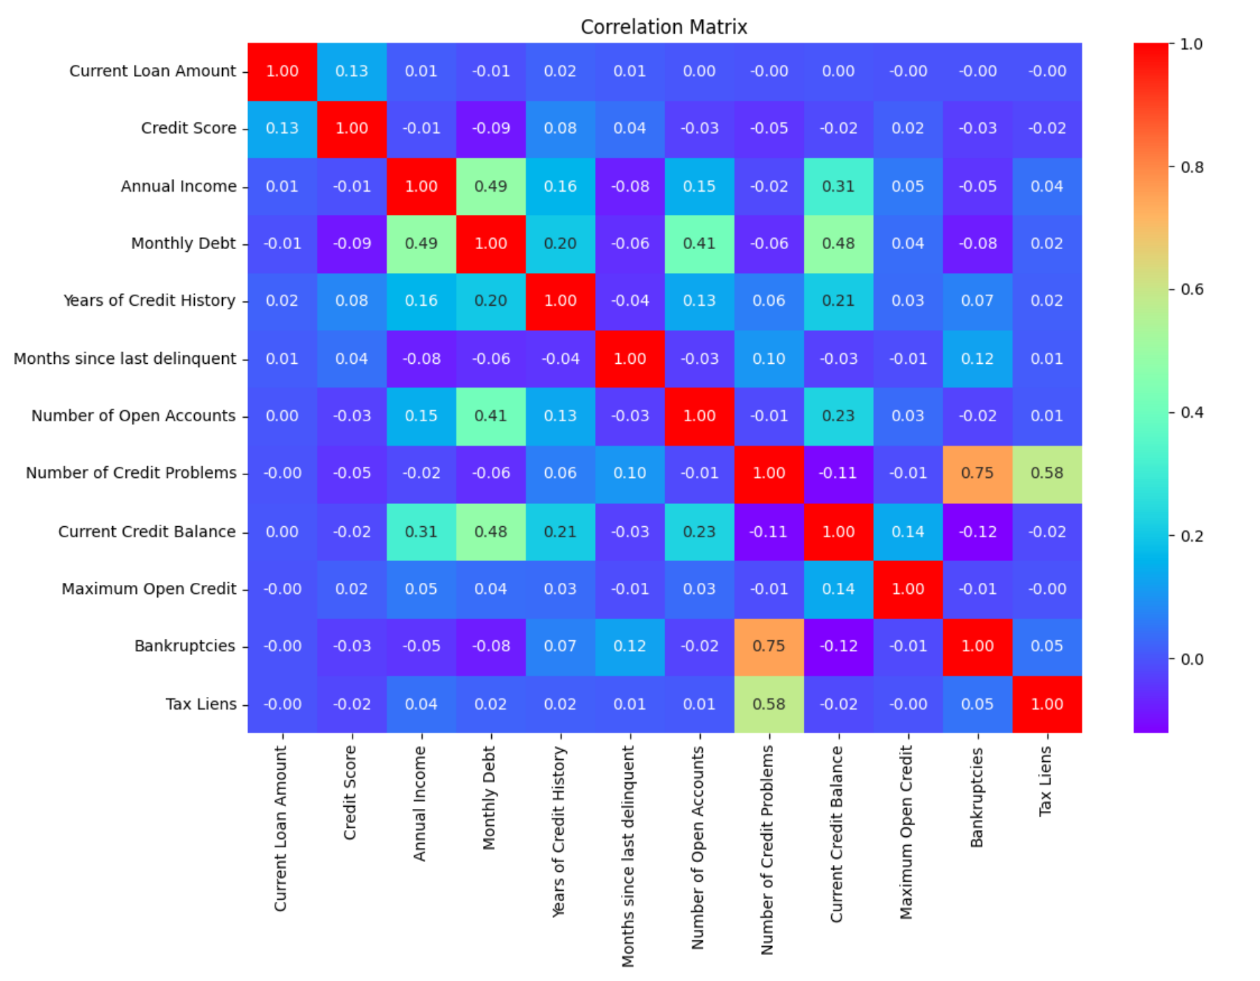
Exploratory Data Analysis
Figure 6: Correlation Matrics

Slide 11
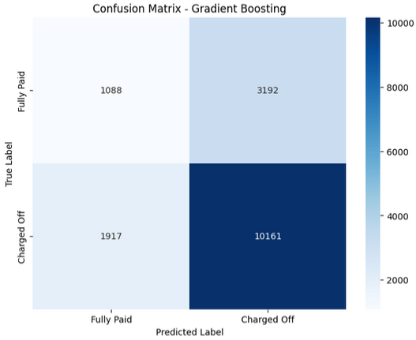
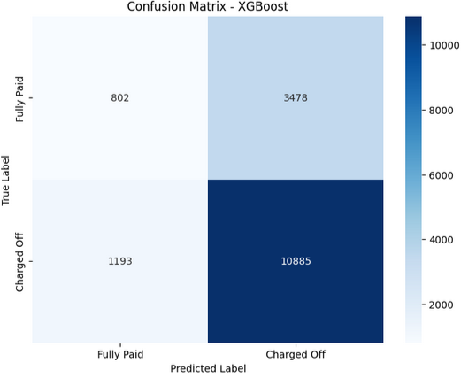
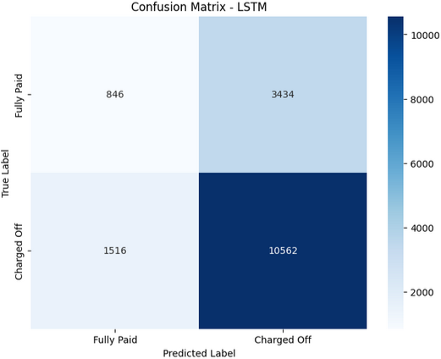

RESULTS
Model | Accuracy | Precision | Recall | F1 Score
Gradient Boosting | 0.69 | 0.66 | 0.69 | 0.67
XGBoost | 0.71 | 0.66 | 0.71 | 0.67
CNN | 0.70 | 0.76 | 0.88 | 0.82
LSTM | 0.70 | 0.75 | 0.87 | 0.81

Slide 12
Conclusion
This analysis tells us that in this classification task deep learning models working better than classical ensemble methods like Gradient Boosting or XGBoost. The CNN model has demonstrated the best performance in terms of precision, which also suggests that it is good at reducing false positives. CNN and LSTM models show high recall (the ability to find positives) along with F1 Scores suggesting that they correctly identify positive cases further maintaining decent trade-off with precision.

Slide 13
References
Anand, M., Velu, A., & Whig, P. (2022). Prediction of Loan Behaviour with Machine Learning Models for Secure Banking. Journal of Computer Science and Engineering, 3(1), 1-13.
Arora, S., Bindra, S., Singh, S., & Nassa, V. K. (2021). Prediction of credit card defaults through data analysis and machine learning techniques. Materials Today: Proceedings
Gupta, A., Pant, V., Kumar, S., & Bansal, P. (2020). Bank Loan Prediction System using Machine Learning. In Proceedings of the 9th International Conference on System Modeling & Advancement in Research Trends (SMART-2020), IEEE, pp. 423-426.
Kadam, A.S., Nikam, S.R., Aher, A.A., Shelke, G.V., & Chandgude, A.S. (2021). Prediction for Loan Approval using Machine Learning Algorithm. International Research Journal of Engineering and Technology, 8(4), 4089-4092.
Mahbobi, M., Kimiagari, S. and Vasudevan, M., 2023. Credit risk classification: an integrated predictive accuracy algorithm using artificial and deep neural networks. Annals of Operations Research, 330(1), pp.609-637.
Viswanatha, V., Ramachandra, A.C., Vishwas, K.N., & Adithya, G. (2023). Prediction of Loan Approval in Banks using Machine Learning Approach. International Journal of Engineering and Management Research, 13(4), 7-9.

Slide 14
Thank You

