Slide 1
留学分享
刘梦祺
16 April, 2022

Slide 2
目录
个人经历
DS硕可以干什么
如何申请

Slide 3
个人经历
标化成绩：92+(10%)，TOEFL 104(22)，GRE 326+3.5
三段科研（本基，HKUST，ZJU）+一段狗熊会实习
某中介半包+fiverr
STAT项目：UCHI(25%), DUKE, UW, COLUMBIA…;
DS项目：DUKE, Brown, Umich, JHU(10%), NYU(WL), …

Slide 4
DS硕可以干什么
1.data analyst (no ML)
2.data scientist (some ML, rarely DL) [analyst in Tech/Medical/345]
3.applied scientist / applied researcher / research scientist
(ML, mostly DL, more modeling, research(CV/NLP/recommendation))
[build models, improvement and maintenance, pipeline]
4.machine learning engineer / sde ml (ML, mostly DL, more coding).
[more pipeline, more for start-ups]
5.sde/swe (No ML/DL, or ML infra only) [CS]
* requirement of coding ability, salary, majors
*参考一亩三分地

Slide 5
Data analyst:
1. Product analyst/DS (AB-testing, SQL, domain knowledge
(product sense…), clinical design…) [->PM]
2. risk/fraud analyst, quant [fintech]
3. BA->BIE/BIA (business intelligent engineer)
(mining, database, analysis, forecast, decision support, visualization)
4. marketing DS/pre-sales DS [better for data-driven, 传统行业]
5. consulting
…
*参考一亩三分地

Slide 6
是否应该读DS硕？
1-2：biostat/stat/BA/fintech/mfe/OR/DS/HDS… master
3-4: prefer phd/standout master/experience
3-5: CS [Umich DS, DUKE ECE, USC CS, NEU CS…]
去哪里读？(HKU,US…) location vs title vs expense vs curriculum
卷王思维？

Slide 7
如何申请
!标化成绩! + !实习! + 科研
选课（研究生的课?CS?数学?）
实习（内容/title/方向）
科研（Statistics/biostatistics/CS/ECE/media/business/liberal arts…）
选校（DS看方向和位置，stat可根据排名+是否phd，是否回国等）

Slide 8
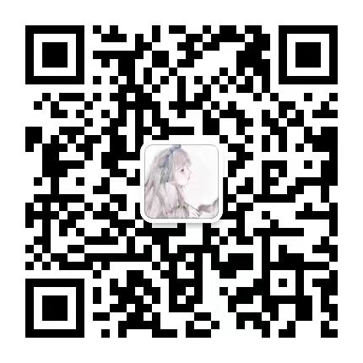
Thanks

