Slide 1
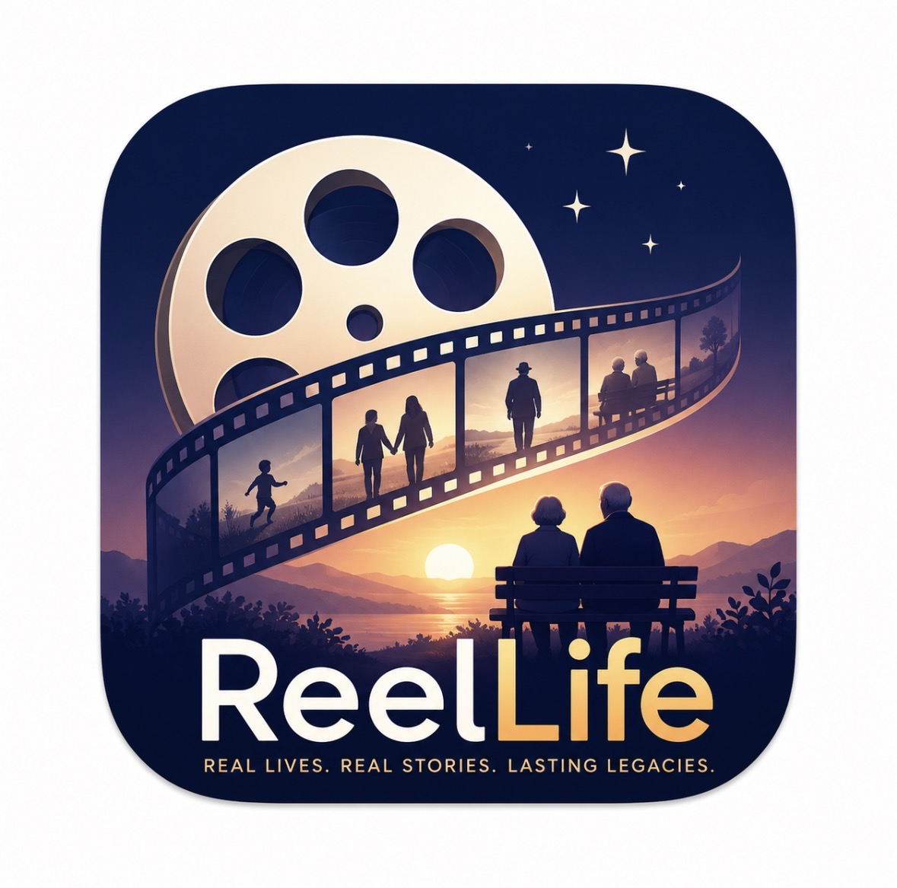
ReelLife
An AI-powered Family and Community
Storytelling Platform
By Rosie, Jason

Slide 2
INTRODUCTION
Most family stories disappear not because they are unimportant, but because they are never properly recorded in time. ReelLife is an AI-powered storytelling platform that preserves life experiences and makes them accessible across generations and communities. It transforms personal memories into meaningful, structured, meaningful structured narratives that can be explored, shared, and preserved forever.
The AI acts as a documentary-style interviewer, asking natural follow-up questions, organizing fragmented memories, and transforming them into a coherent life narrative. The result is not just raw recordings, but a living family legacy.
Within each family, ReelLife turns conversations into rich, organized outputs, such as life timelines, family trees, and narrative chapters like “Immigrating to America” or “Building Our First Home.” For younger generations, this becomes an interactive way to explore their heritage, making family history into an immersive storytelling experience.
Beyond families, ReelLife also enable a broader community archive of human experience. Users can choose to share their stories publicly or contribute them to curated collections that document important human narratives, including immigration, military service, disaster survival, and local community histories. In some cases, contributors may be supported or compensated, helping ensure that valuable narratives are not lost due to lack of resources or storytelling support.
ReelLife bridges the gap between memory and preservation. By combining conversational AI with narrative structuring, it makes storytelling more accessible and more complete—allowing anyone, anywhere, to become the author of their own legacy.

Slide 3
INSPIRATION
My interest in memory preservation came from several personal experiences.
Looking through old photos, I realized many childhood memories had already faded.
I’m curious about my family history, but much of it exists only in scattered conversations, and I often struggle to trace my family tree in a clear way.
My grandparents have fascinating life stories, but they do not have confidence or ability to turn them into well-written stories.
These experiences made me wonder: how many important stories are lost simply because people never had an easy way to document them.

Slide 4
PROBLEM
After investigating, I realized it is a common challenge faced by many families and communities.
Important family stories are lost because they are not recorded in time.
Older generations may have rich life experiences but lack the tools to document them.
Younger generations often don’t know what questions to ask to uncover meaningful stories.
There is no accessible system to capture community-level stories at scale. Professional interviews or documentation are expensive.
Many people are willing to share their stories, but lack the guidance, recognition, or incentives to do so.
As a result, both personal family memory and broader cultural history are gradually disappearing.

Slide 5
APP FEATURE MAP

Slide 6
FUNCTIONALITIES
Story Capture
1. AI-guided conversation: supports voice conversation, AI follow-up questions
2. multi-modal input
3. one-click structured content generation: Timeline, family tree, narrative chapters
Story Display
1. Private
2. Family circle
3. Community

Slide 7
TECHNOLOGY

Slide 8
Technical problems

Slide 9
APP MAINTENANCE

Slide 10
FUTURE DEVELOPMENT

