Slide 1
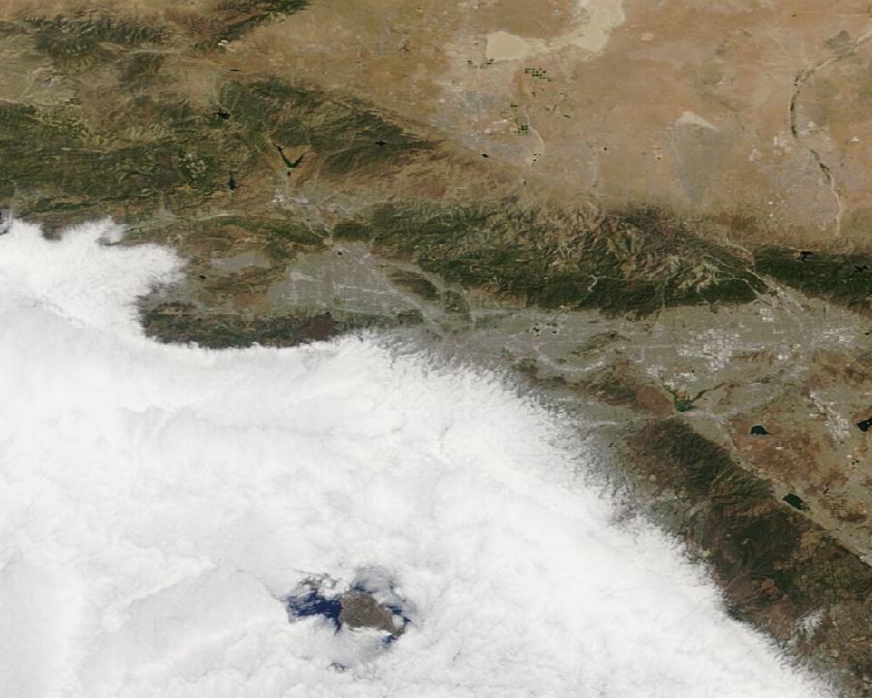
CS 153 · FRONTIER SYSTEMS
Parallax
Agentic satellite query engine
Ask a question about any place. Acquire dated Earth evidence. Inspect exactly what the model saw.
NATURAL LANGUAGE
NASA IMAGERY
VISIBLE AGENT TRACE
One-person frontier lab project
NASA Terra/MODIS scene from a saved Parallax investigation · June 4, 2026
01

Slide 2
PROBLEM & INSIGHT
The bottleneck is assembling trustworthy evidence, not asking the question.
Traditional Earth-observation workflow
Parallax workflow
01
Choose a sensor
“Are there active wildfires near Los Angeles?”
02
Find a catalog
03
Resolve coordinates
↓
04
Select a date
ONE AGENT RUN
05
Join hazard + weather data
06
Interpret uncertainty
Observation plan + dated image + public evidence + confidence + sources + report
Course rubric: meaningful problem, compelling motivation, original and ambitious approach
02

Slide 3
PRODUCT PROOF
One prompt becomes a dated, inspectable investigation.
AI AGENT + VISION
No clear active wildfire signal visible near Los Angeles in this image
41%
evidence confidence
Thick cloud cover limits detection. No obvious plume is visible, but an active fire cannot be ruled out.
TERRA / MODIS · JUNE 4, 2026 · 1 DAY OLD
Real saved query · exact image, sensor, date, model mode, confidence, caveats, and sources persisted
03

Slide 4
AGENT SYSTEM
The system is agentic because the model chooses a bounded observation plan.
The model operates inside typed contracts; tools and deterministic fallbacks constrain every stage.
01
02
03
04
05
06
PLAN
→
LOCATE
→
SELECT
→
GATHER
→
ANALYZE
→
PRESERVE
place · intent · radius
WGS84 coordinates
sensor · date · quality
weather · events · seismic
image + structured evidence
trace · Markdown · PDF
MODEL DECISIONS
planning · visual synthesis · report drafting
DETERMINISTIC CONTROL
geocoding · API bounds · quality thresholds · persistence · fallback
No fine-tuning: model intelligence is composed with query-specific evidence at inference time
04

Slide 5
ARCHITECTURE
The Express orchestrator controls tools, secrets, and failure handling.
Express agent API
React client
plan · orchestrate · normalize · persist
OpenAI
Investigation store
query · map · trace · history
→
→
planner · vision analyst · research writer
←
query JSON · image · Markdown · PDF
PARALLEL EVIDENCE ACQUISITION
NASA GIBS
Open-Meteo
EONET + FIRMS
USGS
imagery
weather
hazards
seismic
Provider calls use timeouts and Promise.allSettled, so one failed feed does not erase the entire observation.
API keys remain server-side · Node/Express orchestrator · React/Vite client
05

Slide 6
IMAGERY SELECTION
“Freshest” is a ranking problem, not a timestamp label.
DATE-FIRST SEARCH
SENSOR CANDIDATES
TODAY
probe all 5 sensors
NOAA-21 / VIIRS
NOAA-20 / VIIRS
SUOMI NPP / VIIRS
AQUA / MODIS
−1 DAY
probe all 5 sensors
TERRA / MODIS
−2 DAYS
only if no usable scene
QUALITY SCORE
−3 DAYS
final lookback window
mean RGB σ + 8 × image entropy
Reject tiny, uniform, very dark, or low-entropy responses before choosing the highest-scoring scene on the newest usable date.
Five NASA VIIRS/MODIS products · current UTC day checked first · maximum 3-day lookback
06

Slide 7
CASE STUDY
A cautious result is a successful result when evidence is weak.
41%
EXACT MODEL INPUT
evidence confidence
IMAGE
Terra / MODIS · June 4 · 1 day old
WEATHER
100% current cloud cover
EVENTS
No nearby corroborating event
ANSWER
No clear signal; active fire not ruled out
UNCERTAINTY IS PART OF THE OUTPUT
Real run on June 5, 2026 · cloud obstruction correctly lowered confidence and constrained the claim
07

Slide 8
EVALUATION & SAFETY
The prototype validates contracts; scientific accuracy is the next benchmark.
What is tested now
What remains to evaluate
9/9
intent + location extraction
unsupported visual-claim rate
geospatial distance + request bounds
location + intent accuracy benchmark
unit tests passing
imagery freshness + FIRMS parsing
provider latency and failure rate
truthful fallback + report metadata
human usefulness + calibration ratings
PRODUCTION BUILD PASSES
PRIMARY SAFETY METRIC: UNSUPPORTED CLAIM RATE
Course rubric: evaluation evidence, limitations, failure analysis, testing, and honest disclosure
08

Slide 9
USE CASES & IMPACT
The same evidence engine supports public-interest decisions across domains.
01
02
03
Disaster screening
Environmental research
Public-interest evidence
RESPONDERS · NGOS
SCIENTISTS · CONSERVATION
JOURNALISTS · POLICY TEAMS
“Are there active wildfires near Los Angeles?”
“What does forest cover near Manaus look like today?”
“What evidence is available for this reported event?”
Rapid regional context before authoritative emergency review.
A sourced snapshot of vegetation, smoke, flood, or coastal conditions.
Dated imagery, public data, provenance, and limitations in one record.
REGIONAL SCREENING + RESEARCH — NOT A REPLACEMENT FOR LOCAL AUTHORITY
Course video Q3: potential use cases, societal value, and how people could use the tool
09

Slide 10
WHAT COMES NEXT
The next leap is temporal change detection.
From a single fresh scene → to before/after evidence → to operational monitoring.
01
02
03
Better sensing
→
Temporal reasoning
→
Operational agent
Sentinel-2 · Landsat · STAC catalogs · radar products
Baseline/latest scenes · NDVI · NBR · NDWI · change masks
Streaming traces · caching · retries · scheduled monitors
One person built a small Earth-observation lab.
AI disclosure: AI assisted development and presentation creation. Runtime models perform bounded planning, vision analysis, and report drafting; no model was trained or fine-tuned.
LIVE DEMO: ARE THERE ACTIVE WILDFIRES NEAR LOS ANGELES?
Sources: NASA GIBS, FIRMS, EONET · USGS · OpenStreetMap Nominatim · Open-Meteo · OpenAI
10

