Slide 1

Django HTML and XML Validator
Thomas Aglassinger
01.11.2022

Slide 2
The Problem
Django provides HTML templates to render into HTML pages
The templates can contain special markup that gets executed while rendering
Because of this markup, in general templates are not valid HTML
Only the rendered HTML can be validated
Middleware solutions exist but typically use external validators
  Slow because of HTTP POST
  Security issue because sensitive data contained in the HTML might get POSTed to external site

Slide 3
The Solution
django_html_xml_validator middleware
Django middleware
Internally uses lxml
  runs locally
  fast (because large parts are native)
  provides specific error locations (line and column)
Can be enabled for local testing only
PyPI: https://pypi.org/project/django-html-xml-validator/
GitHub: https://github.com/itell-solutions/django_html_xml_validator

Slide 4
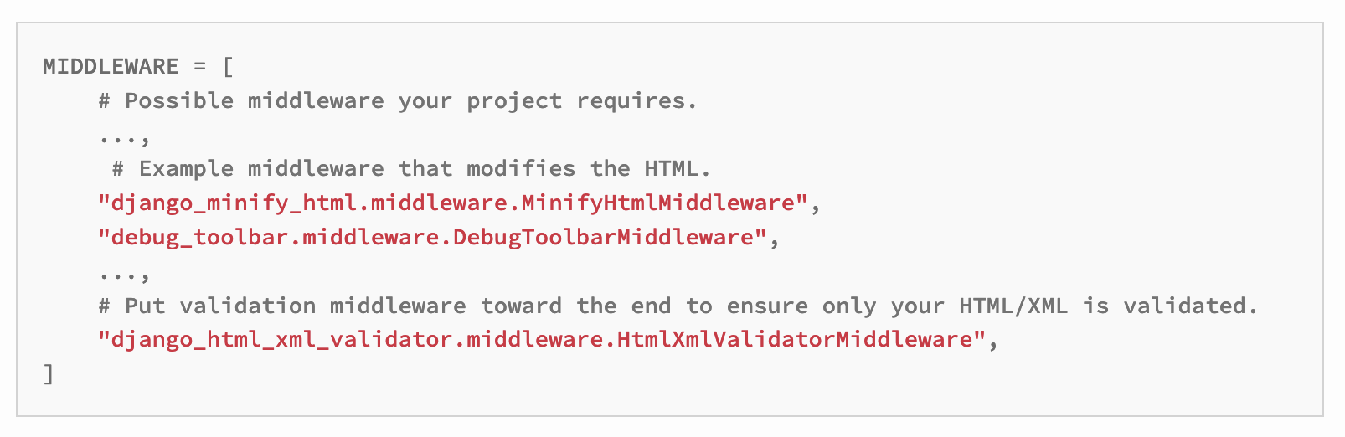
Usage

Slide 5
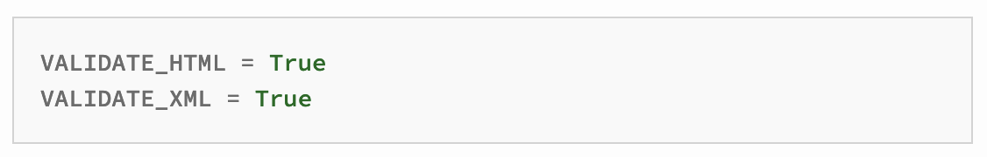
Configuration
In settings.py:

Slide 6
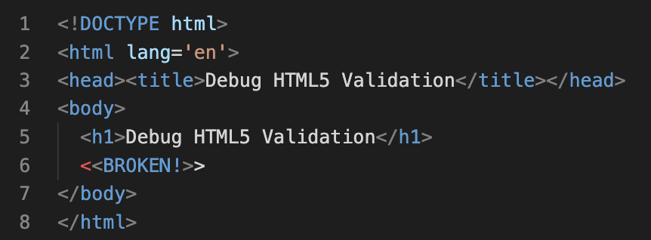
Example broken HTML (rendered)

Slide 7
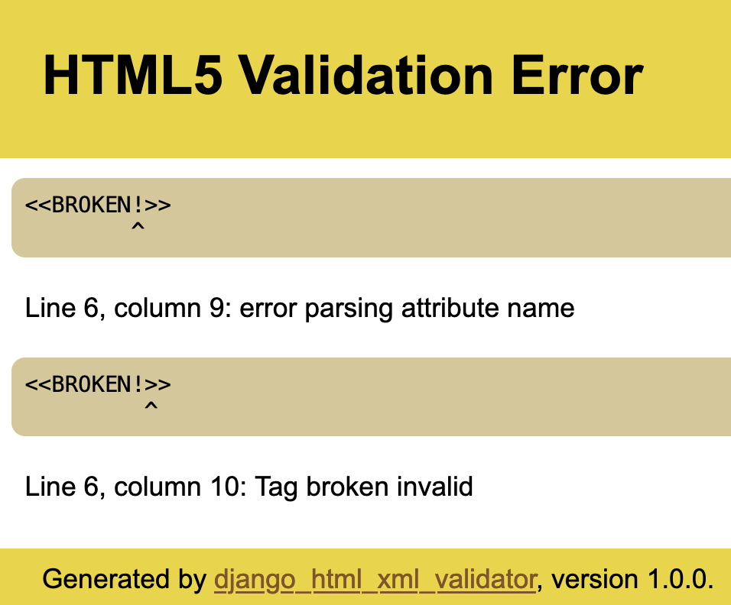
Example validation result

Slide 8
Availability
PyPI: https://pypi.org/project/django-html-xml-validator/
GitHub: https://github.com/itell-solutions/django_html_xml_validator
Open source with MIT License

