Slide 1
Java, Kotlin the JVM, Spring and 42
What is it?
felix@zalando.de

Slide 2

Content
Java / the SDK / the JVM
Kotlin
Spring
Demo
Comments Service

Slide 3
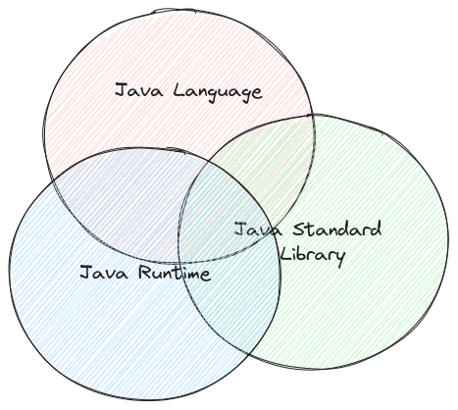
What is Java?
1. The Java Language as defined in the JLS
2. The Java Standard Library (java.lang / java.net / System in/out)
3. The Java Runtime (JRE) aka. The Java Virtual Machine runs Java Bytecode

Slide 4
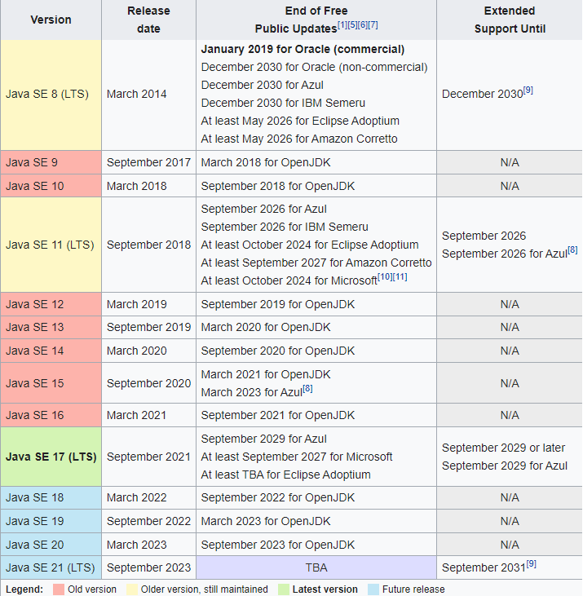
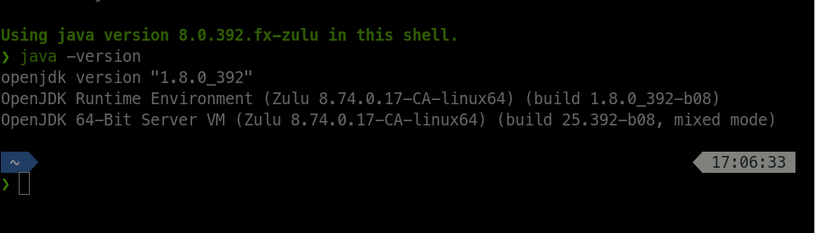
Version Number
Java 1.8 = Java 8
Current Version is 21 LTS
Java SE: Standard Edition
Java EE: Enterprise Edition (now Jakarta)

Slide 5
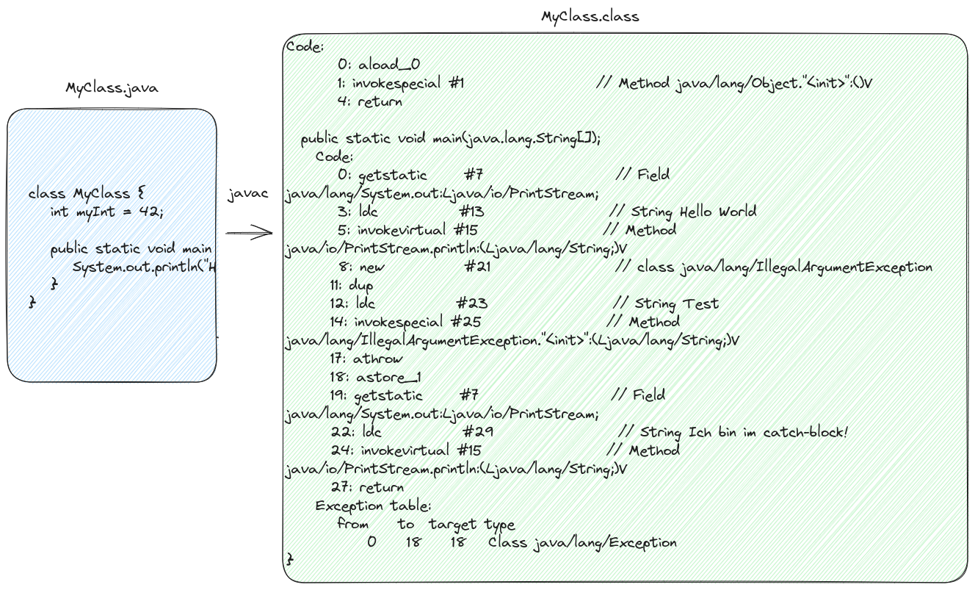
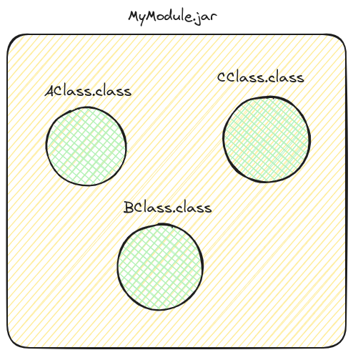

Sourcecode to Bytecode

Slide 6
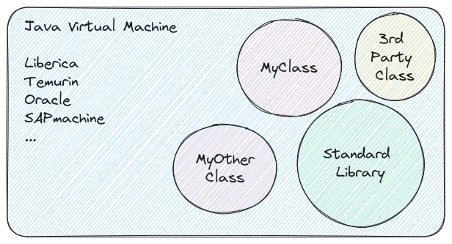
Executing Bytecode

Slide 7
Compatibility
* Language and JVM are backwardscompatible:
JVM with Bytecode 62 (JVM 21) is guaranteed to run (call) Bytecode 50 (JVM 8). Java Language 1.8 compiles with JDK 21.
BUT:
* StdLib not always (!!!)
(Then: ClassNotFoundException, UnsupportedOperationException)

Slide 8
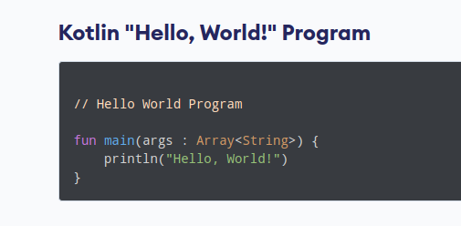
Kotlin
* Close to Java Syntax
* Multi paradigm (oop, functional, scripting)
* “Fixes” some design flaws of Java
* Fully interop with Java classes (and usually vice-versa)
* Doesn’t have to be backwards compatible the way Java does.

Slide 9
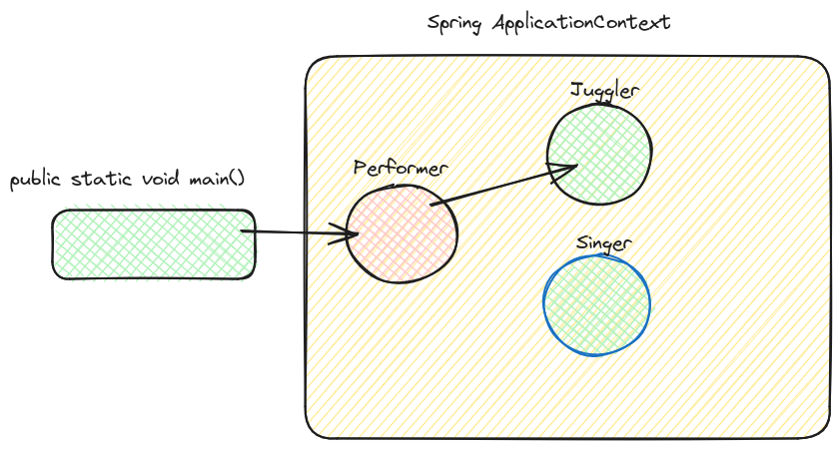
Spring Framework
Spring Framework
IS NOT
Spring Boot
IS NOT
A web / persistence or whatever framework
Spring is a CDI Container!

Slide 10
IoC Container
1. Loosely coupled
2. Modular
3. Testable

Slide 11
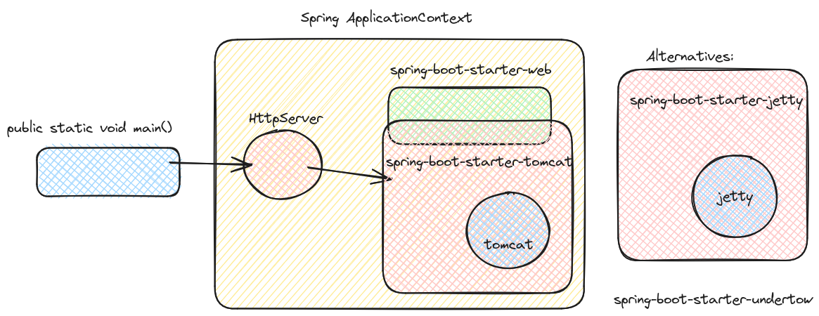
Spring Boot

Slide 12
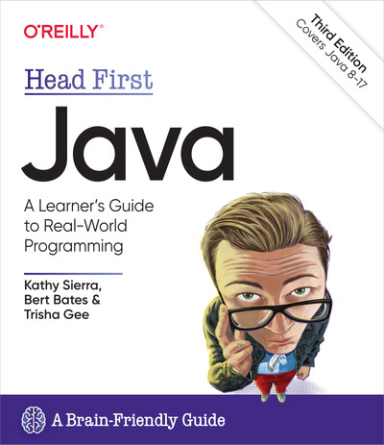
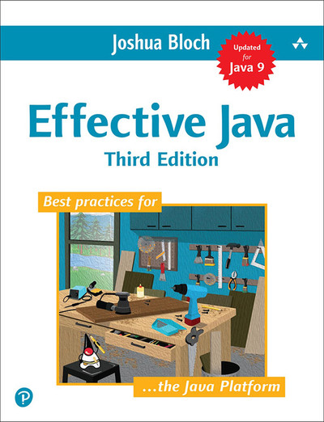
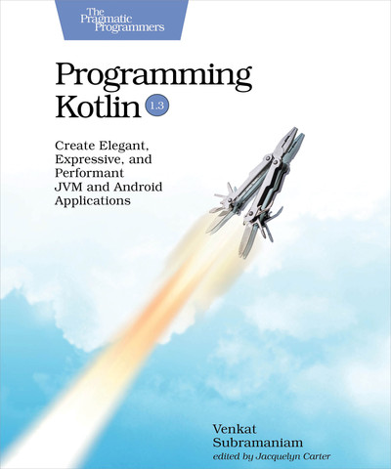

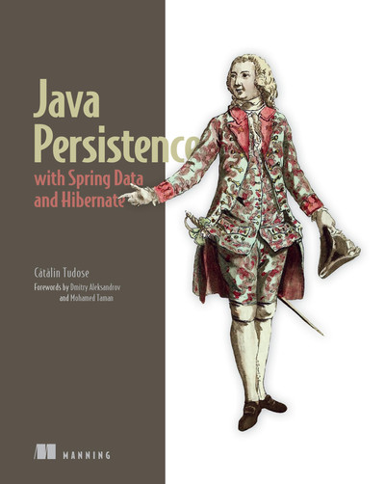
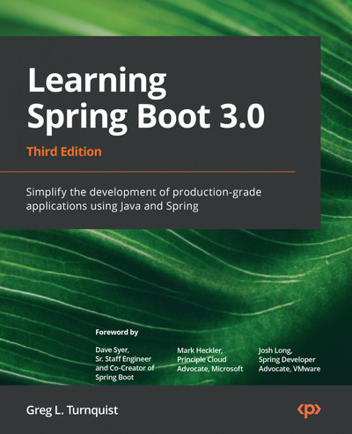
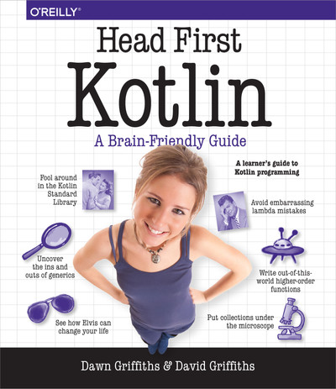
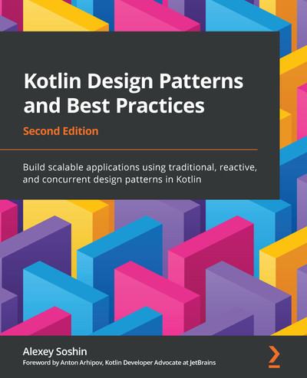
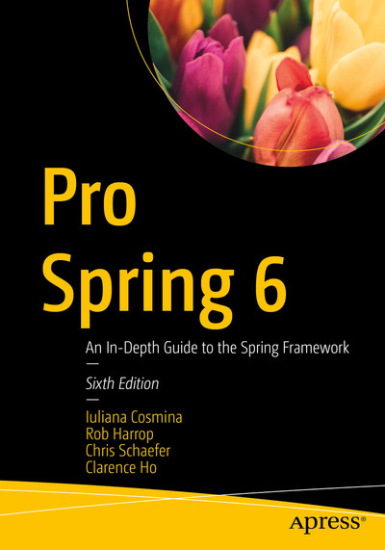
Read Me!

