Slide 1
Feature Of the Day
Small Snackable Snippets
felix@zalando.de

Slide 2

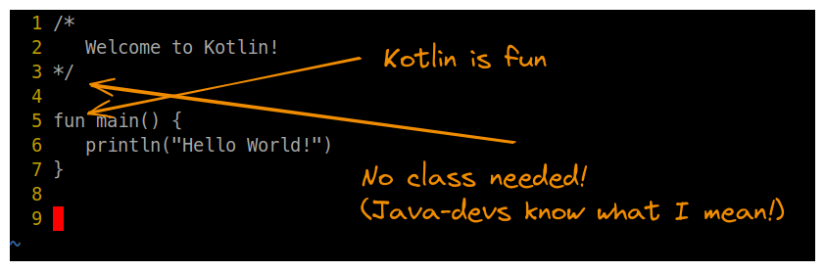
#1 - Hello World
https://github.com/roskenet/feature-of-the-day/tree/main/num_1
1. Run “Hello World!” with kotlin
2. Run “Hello World!” directly on the JVM
3. Run “Hello World!” as native machine code
4. Run “Hello World!” as a script

