Slide 1
Java, Kotlin the JVM, Spring and 42
What is it?
felix@zalando.de

Slide 2
Content
Java / the SDK / the JVM
PI Objective
PI Progress
Demo
Upcoming PI

Slide 3
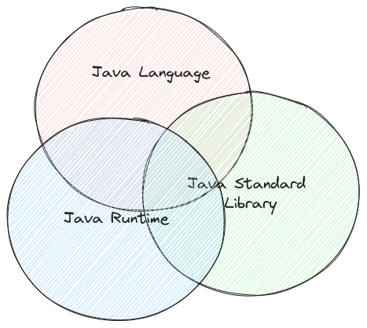
What is Java?
The “Holy Trinity”:
* The Java Language as defined in the JLS
* The Java Standard Library (java.lang)
* The Java Runtime (JRE) aka. The Java Virtual Machine

Slide 4
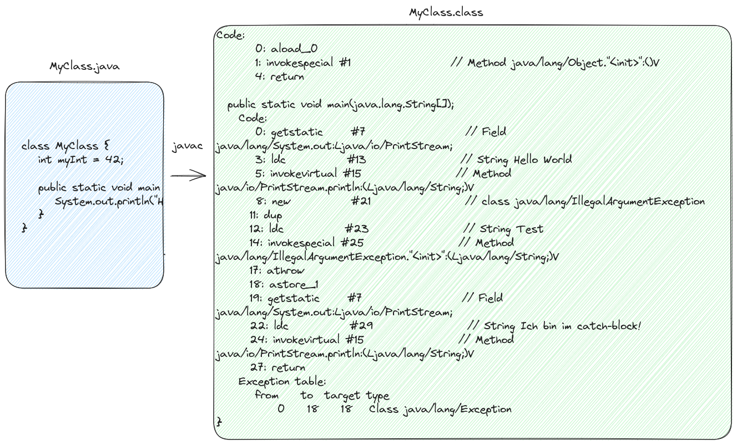

Sourcecode to Bytecode

Slide 5
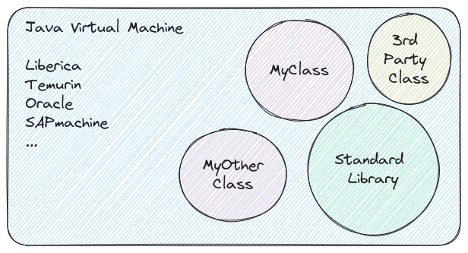
Executing Bytecode

Slide 6
Compatibility
* JVM is backwardscompatible:
JVM with Bytecode 62 (Java 21) is guaranteed to run (call) Bytecode 50 (Java 8).
BUT:
* StdLib not always (!!!)
(Then: ClassNotFoundException, UnsupportedOperationException)

Slide 7
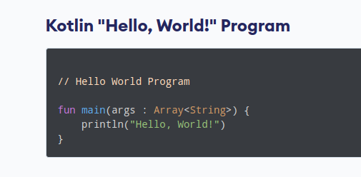
Kotlin
* Close to Java Syntax
* “Fixes” some design flaws of Java
* Fully interop with Java classes (and usually vice-versa)
* Doesn’t have to be backwards compatible the way Java does.

Slide 8
Spring Framework
Spring Framework IS NOT Spring Boot

