Slide 1
Credit scoring for loans with Rattle and R
Created and presented by:
Madhumita Ghosh
Ayan Das

Slide 2
Agenda
What is a credit score?
The Data
Distributions
Correlation of variables
Creation of Models
Evaluation of Models
Facts and Fictions of Credit Scores

Slide 3
What is a credit score?
A number
Connection between the lender and the borrower
Predicts how likely the borrower is, to pay off a loan
Higher the score, more the chances of receiving beneficial terms for loans and credits

Slide 4
The Data
1000 observations
20 independent variables
1 dependent variable ‘credit’
0 – bad credit, 1- good credit

Slide 5
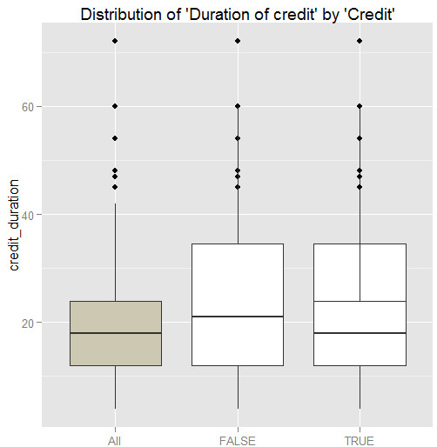
Distributions
Boxplot – credit duration
For all credits – median credit duration is 18 months (approx.)
For bad credits – median duration of credit is about 21 months
For good credits – median duration of credit is less than that for the bad ones

Slide 6
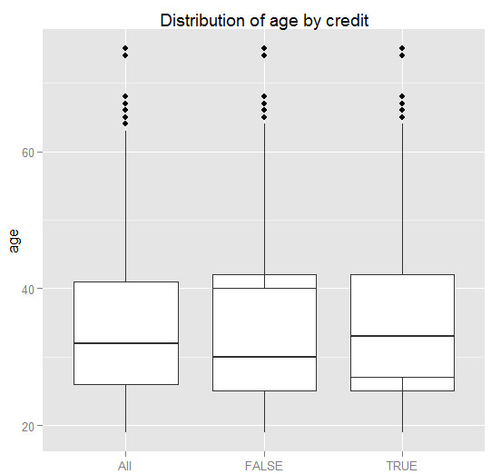
Distributions
Boxplot – Age
Younger applicants are more likely to default
Impulsive nature
Not yet settled in life
Less financial responsibilities towards family

Slide 7
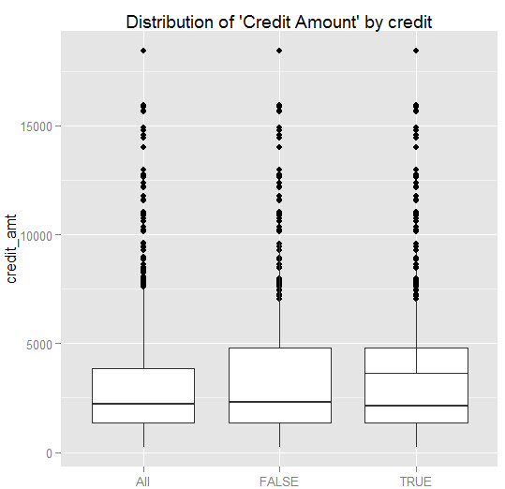
Distributions
Boxplot – Credit amount
High variance in credit amount for bad credit
Might not be significant
Very small margin towards borrowing of the loan amount

Slide 8
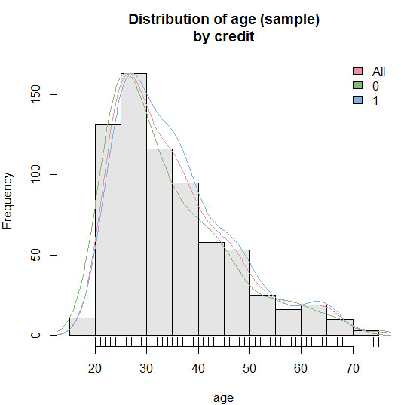
Distributions
Histogram - Age
About 30 years of age is when the default rate tapers off
Ideal age for being settled in life
Higher the age (till an extent), lesser the chances of default
More responsible
Steady job

Slide 9
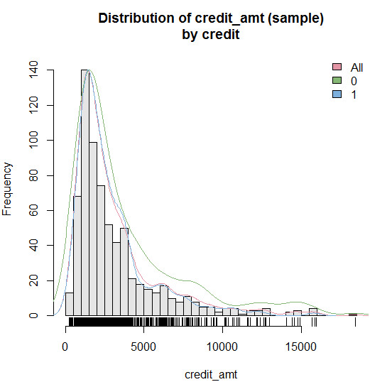
Distributions
Histogram – Credit amount
The likely amount of credit for a low default rate is about 2200 DM
Borrower has a very small margin towards borrowing the loan amount
Too high an amount – may not be able to repay back
Too low an amount – loan may not be necessary

Slide 10
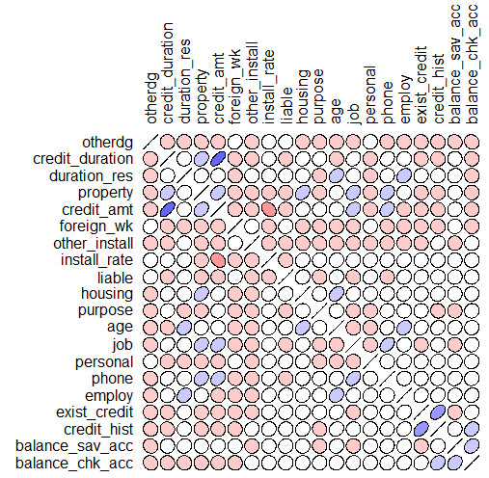
Correlation of variables
Fairly high positive correlation between credit amount and credit duration
More time required to pay off large credit amounts
Negative correlation between installment rate % and credit amount
Offer more discounted rates and easier pay off schemes for larger amounts borrowed

Slide 11
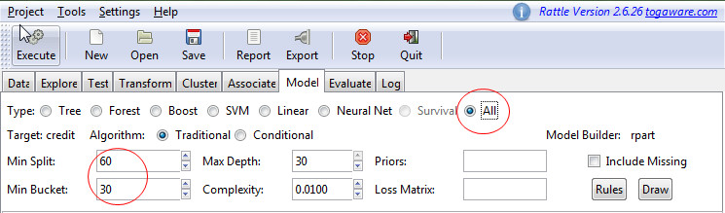
Creation of Models
Check “All” models
Custom “Split” and “Bucket” size
“Draw” models for visualization
Execute

Slide 12
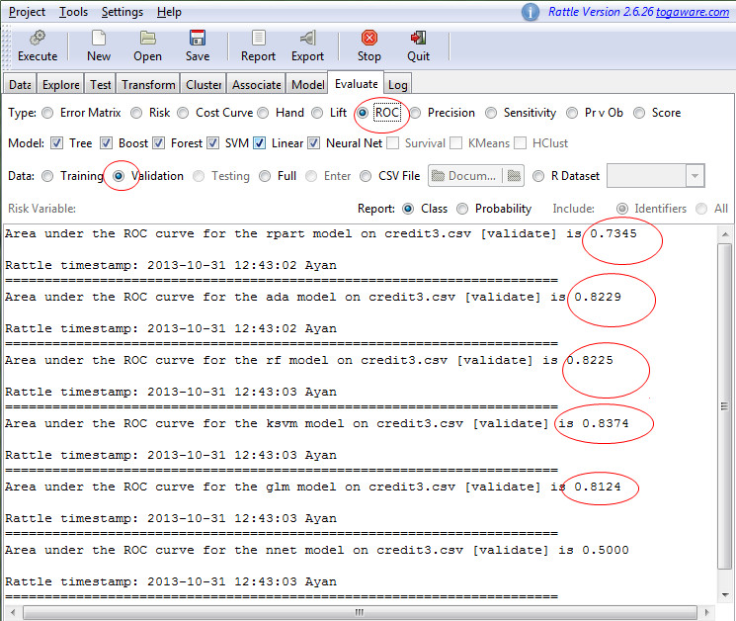
Evaluation of Models

Slide 13
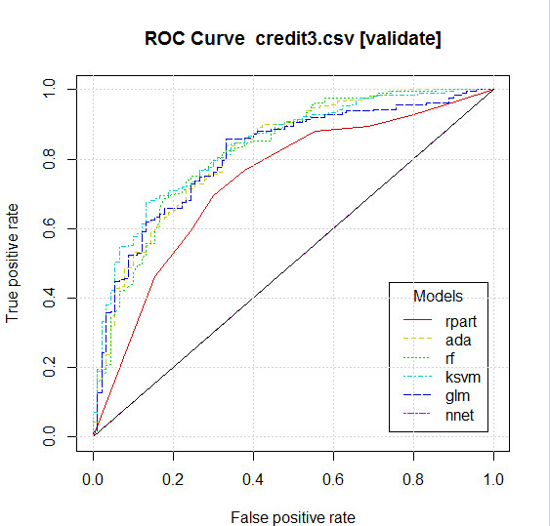
Evaluation of Models
Validation data
Most of the models give identical results
Decision Tree not a good option for Credit Scoring data
Ignore Neural network evaluation

Slide 14
Facts & Fictions of credit scores
Fiction – More money you make, better your credit score will fare
Fact: Income has nothing to do with credit score. It’s not even reported to the credit bureau.
Fiction – Credit bureaus never make mistakes
Fact: Nearly 8 in 10 credit reports contain a serious error or some sort of mistake, according to a survey by the US Public Interest Research Group.
Fiction – Practicing a cash-only policy will help your credit score
Fact: Having good credit is a function of having credit available to you and using it responsibly.

Slide 15


