Slide 1
Applying Static Analysis Techniques to Aid Clafer Modelers
Jordan A. Ross
July 16th, 2015

Slide 2
Overview
Motivation
Static analysis techniques used in Coverity and FindBugs
Using Static Analysis for Clafer
Implementation
Preliminary Results
Preliminary Conclusions

Slide 3
Motivation
Modeling in Clafer is not always intuitive to users.
Users can find themselves unaware that what they modeled is not what they intended.
Large number of instances generated makes it hard to “debug” or verify that the model is correct.
Consequences of incorrect models:
Incorrect optimization => sub optimal implementation
Degraded performance => search space might be larger than expected

Slide 4
How to Help Users Write Correct Models?

Slide 5
Coverity and FindBugs
Coverity
A very successful tool in industry that aids developers in finding bugs in code statically.
Infers specifications (what the developer intended to do) for determining what is a bug.
Specifications can also be given explicitly.
FindBugs
The original goal of FindBugs was to see if simple static analysis could find real bugs in large well developed projects.
Specifications are not inferred but rather stated explicity.
Both tools use statistical analysis to reduce the number of false positives.
Notes:
Example of an easy bug to find with FindBugs:
Infinite recursion
S.toLower() where s is a to string

Slide 6
Static Analysis in Coverity
Searches for related code
Determines specifications using MUST and MAY beliefs
Uses dataflow analysis in order to capture lock and unlock type sequences.
Statistical analysis to filter out false positives

Slide 7
Static Analysis in FindBugs
Uses “Detectors” that find pattern matches to the input specification
Dataflow analysis to find more complicated bugs like lock and unlock
Statistical analysis to filter out false positives
Example A:
public String foundType() {
return this.foundType();
}
Example B:
s.toLowerCase()

Slide 8
How to Help Users Write Correct Models?
Static Analysis

Slide 9
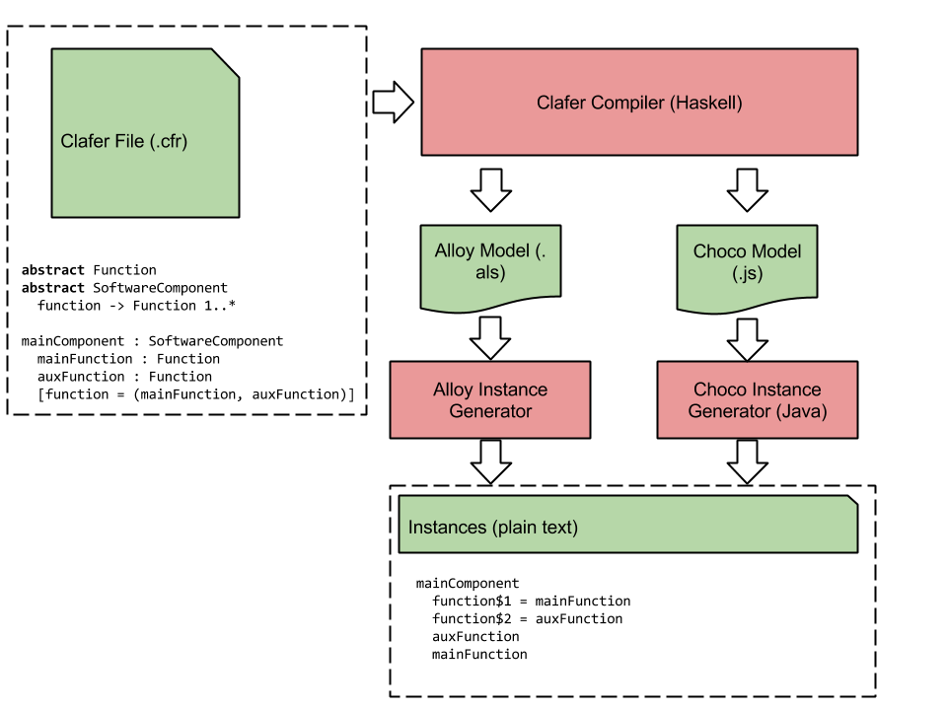
Clafer Tool Chain

Slide 10
How Static Analysis Would Work in Clafer
abstract Wheel
radius -> integer
frontWheel : Wheel
[radius = 10]
Clafer models are made up of two main entities:
Clafers
Abstract – A type for a Clafer
Concrete – A Clafer that will produce a concrete instance
Constraints
These are given in square brackets
Use explicit specifications to detect possible errors in the model.

Slide 11
Pattern 1
abstract Node
abstract Edge
location -> Node 2
length -> integer
abstract SpecialEdge : Edge
area -> integer
node1 : Node
node2 : Node
node3 : Node
se1 : SpecialEdge
[location = (l2, l3)]
[length = 1]
[area = 2]
se2 : SpecialEdge
[location = (l1, l2)]
[length = 1]
[area = 3]
Use statistical analysis to determine when a user may have forgotten a constraint.
Traverse the AST to find the inheritance hierarchy.

Slide 12
Pattern 2
abstract Component
deployedTo -> Device
abstract Device
abstract Connector
abstract Command
sender -> Component
receiver -> Component
medium -> Connector ?
[(sender.deployedTo = receiver.deployedTo) <=> no this.medium]
abstract Component
deployedTo -> Device
abstract Device
abstract Connector
abstract Command
sender -> Component
receiver -> Component
medium -> Connector ?
[(sender.deployedTo.ref = receiver.deployedTo.ref) <=> no this.medium]
No statistical analysis since 99% of the time this is an error.
Traverse each constraint expression to determine if this pattern is ever found.

Slide 13
Pattern 3
Not going to include in presentation for time

Slide 14
Pattern 4
Not going to include in presentation for time

Slide 15
Implementation
The Clafer compiler is written in Haskell but generates an IR for a Java/Javascript backend.
Existing Java library for parsing the AST generated by the backend.
This tool implementation was done in Java.
The AST was only traversed for pattern 1.
The other patterns collected all constraints in the model and traversed the expressions using the visitor design pattern.

Slide 16
Evaluation
Executed tool on 11 different size Clafer models.
Models written by two different intermediate/advanced users.
Classified warnings as false positives or not
False positives were either true or implementation errors.

Slide 17
Preliminary Results
Model | Size |  | # Warning's Generated
 | Clafers | Constraints | Pattern 1 | Pattern 2 | Pattern 3 | Pattern 4
Power Window Thesis | 107 | 154 | 0 | 0 | 0 | 0
Software Architecture - 1st draft | 33 | 25 | 0 | 2 | 0 | 0
Software Architecture - 2nd draft | 33 | 37 | 0 | 0 | 0 | 0
Data Center Resource Allocation - ISAP | 31 | 22 | 3 | 0 | 0 | 0
Data Center Resource Allocation - SSAP | 21 | 13 | 3 | 0 | 0 | 0
Data Center Resource Allocation - TSAP | 27 | 27 | 1 | 0 | 0 | 0
Data Center Resource Allocation - WSAP | 21 | 13 | 3 | 0 | 0 | 0
Power Window | 136 | 152 | 4 | 0 | 0 | 0
Power Window Old | 117 | 88 | 0 | 2 | 0 | 0
Wire Routing | 83 | 77 | 4 | 0 | 0 | 0
Zeller Paper Model | 106 | 186 | 1 | 0 | 0 | 0

Slide 18
Preliminary Results
Model | # Warning's Generated |  |  |  | # False Positives |  |  |  | Classification of False Positives
 | Pattern 1 | Pattern 2 | Pattern 3 | Pattern 4 | Pattern 1 | Pattern 2 | Pattern 3 | Pattern 4 | Incorrect Implementation | True false positive
Power Window Thesis | 0 | 0 | 0 | 0 | 0 | 0 | 0 | 0 | 0 | 0
Software Architecture - 1st draft | 0 | 2 | 0 | 0 | 0 | 0 | 0 | 0 | 0 | 0
Software Architecture - 2nd draft | 0 | 0 | 0 | 0 | 0 | 0 | 0 | 0 | 0 | 0
Data Center Resource Allocation - ISAP | 3 | 0 | 0 | 0 | 1 | 0 | 0 | 0 | 0 | 0
Data Center Resource Allocation - SSAP | 3 | 0 | 0 | 0 | 1 | 0 | 0 | 0 | 0 | 0
Data Center Resource Allocation - TSAP | 1 | 0 | 0 | 0 | 1 | 0 | 0 | 0 | 0 | 0
Data Center Resource Allocation - WSAP | 3 | 0 | 0 | 0 | 1 | 0 | 0 | 0 | 0 | 0
Power Window | 4 | 0 | 0 | 0 | 0 | 0 | 0 | 0 | 0 | 0
Power Window Old | 0 | 2 | 0 | 0 | 0 | 0 | 0 | 0 | 0 | 0
Wire Routing | 4 | 0 | 0 | 0 | 3 | 0 | 0 | 0 | 2 | 1
Zeller Paper Model | 1 | 0 | 0 | 0 | 0 | 0 | 0 | 0 | 0 | 0

Slide 19
Status & Conclusions
All four patterns have been implemented.
The missing constraint pattern generates the most warnings and not an unreasonable number of false positives.
As Clafer models become larger a more sophisticated statistical analysis approach will need to be put in place.
Patterns 3 & 4 don’t have any warnings given the small selection of models that is available.
More helpful in debugging of models and early stages of creating the model
A bigger sample set and controlled study would need to be done to see if this analysis will benefit modelers.

