Slide 1
Computational model of drug delivery through human skin
Ross Miller

Slide 2


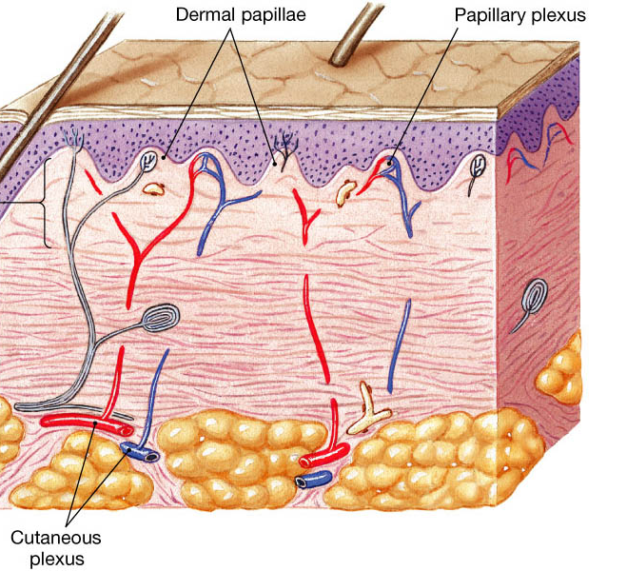
Intro
Our domain is from the surface of the dermis to the blood vein layer below
For our purposes we will assume that the concentration of the drug at the blood vein layer will be zero since the drug will be carried away by the bloodstream
The diffusion equation will model the concentration of a substance at a specific point in space at a specific point in time

Slide 3
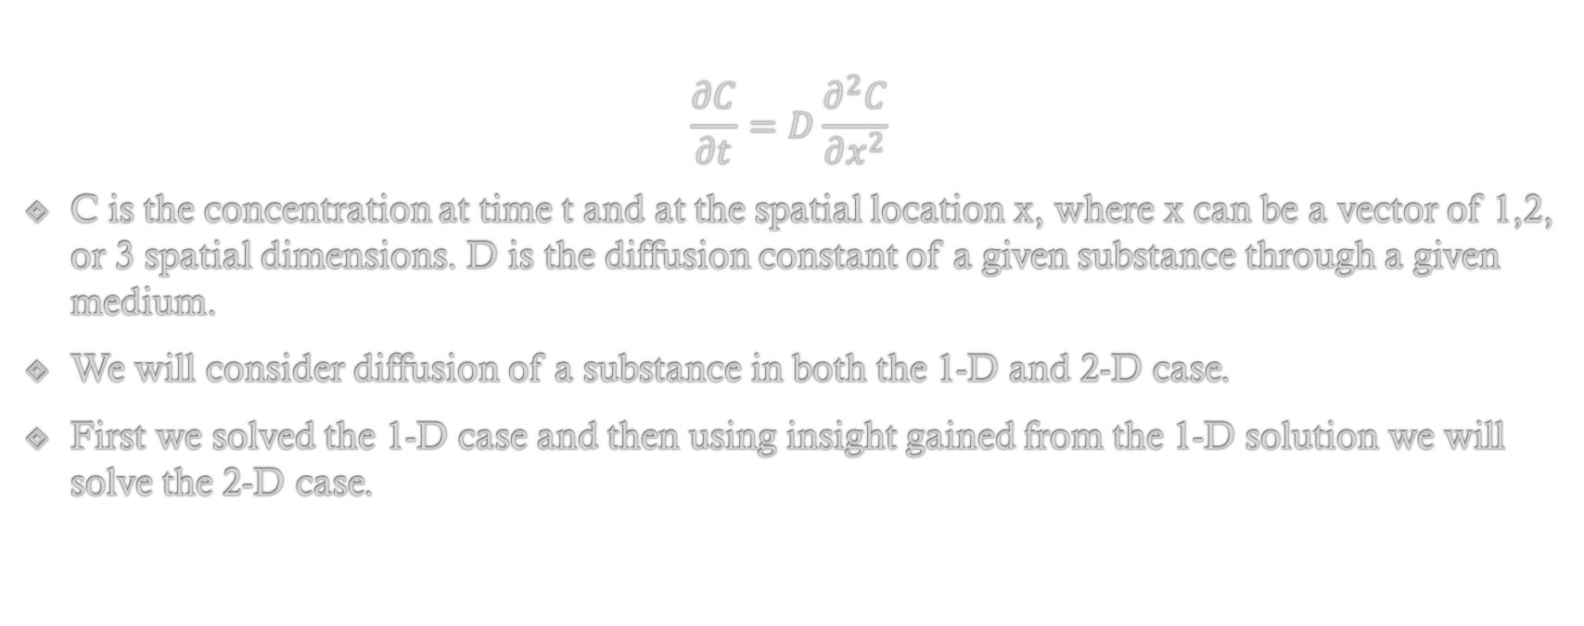
Mathematical Model
$$\frac{∂C}{∂t}=D\frac{∂^{2}C}{∂x^{2}}$$
C is the concentration at time t and at the spatial location x, where x can be a vector of 1,2, or 3 spatial dimensions. D is the diffusion constant of a given substance through a given medium.
We will consider diffusion of a substance in both the 1-D and 2-D case.
First we solved the 1-D case and then using insight gained from the 1-D solution we will solve the 2-D case.
Notes:
In this case the substance is the drug and the medium is the skin.

Slide 4


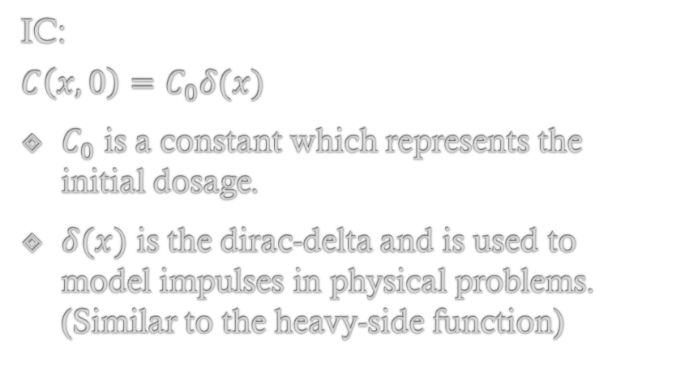
1-D diffusion Model
$$\frac{∂C}{∂t}=D\frac{∂^{2}C}{∂x^{2}}$$
C(x,t) = X(x)T(t)
BC:
$\frac{∂C}{∂x}=0$ at x = 0
$C\left(x,t\right)=0$ at x = L
IC:
$$C\left(x,0\right)=C_{0}δ(x)$$
$C_{0}$ is a constant which represents the initial dosage.
$δ(x)$ is the dirac-delta and is used to model impulses in physical problems. (Similar to the heavy-side function)
Notes:
In this case x is a vector of one dimentsion
We will assume that C(x,t) = X(x)T(t)
Then we can use separation of variables to find a solution which fits our boundary condtions

Slide 5

1-D Diffusion Model Solution
$$C_{n}\left(x,t\right)= \sum_{n=1}^{∞}{B_{n}cos\left(λ_{n}x\right)e^{−Dλ_{n}^{2}t}}$$
$$λ_{n}=\frac{(2n+1)π}{2L}$$
$$B_{n}=\frac{2}{L}C_{0}\int{δ(x)}dx$$
Notes:
By using separation of variables we find a solution of the form above
Nice thing about the dirac delta is that it’s anti derivative is defined to be one.
Solution is a summation because of principle of superposition.

Slide 6
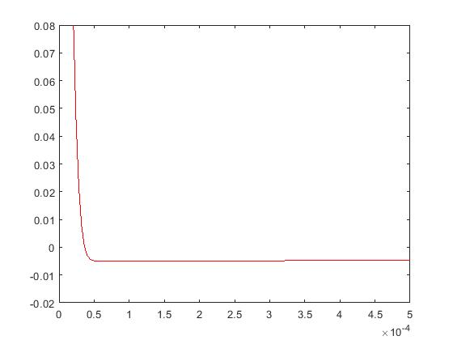
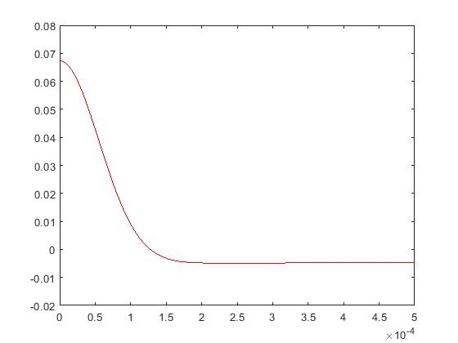
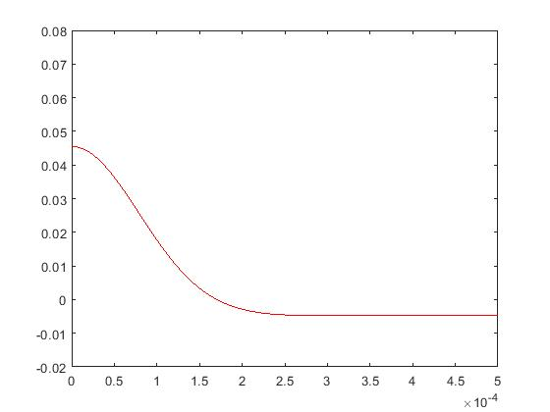
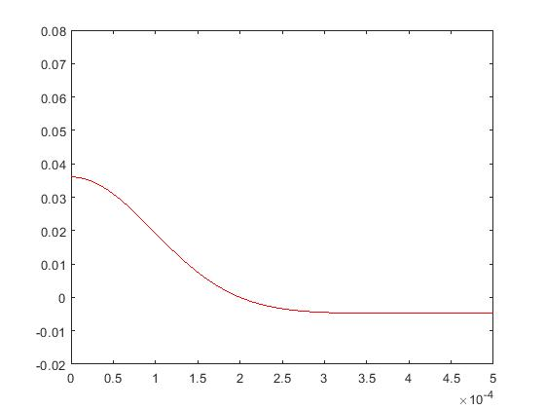
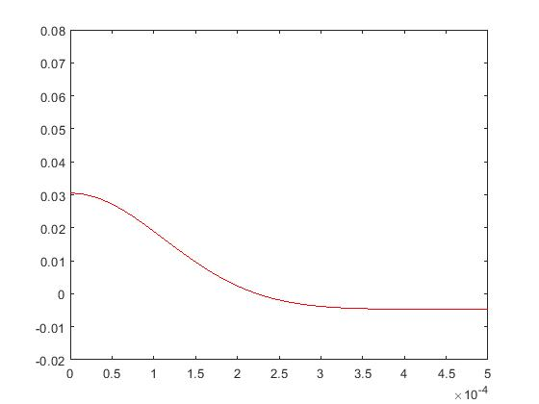
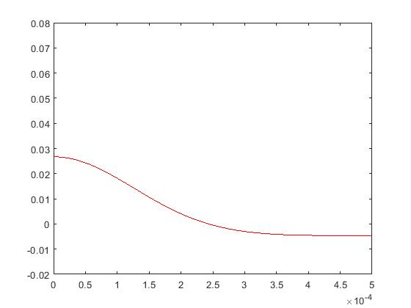
Notes:
Plots of diffusion equation at:
2, 20, 40, 60, 80, and 100 seconds

Slide 7
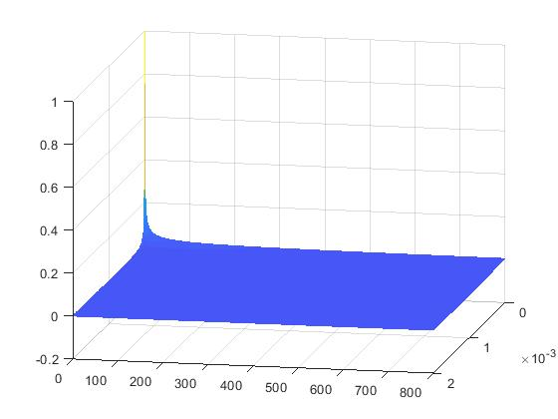
Surface Plot

Slide 8
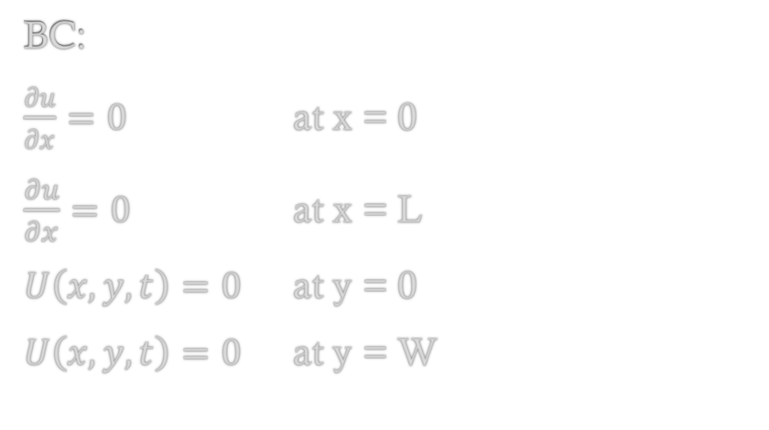

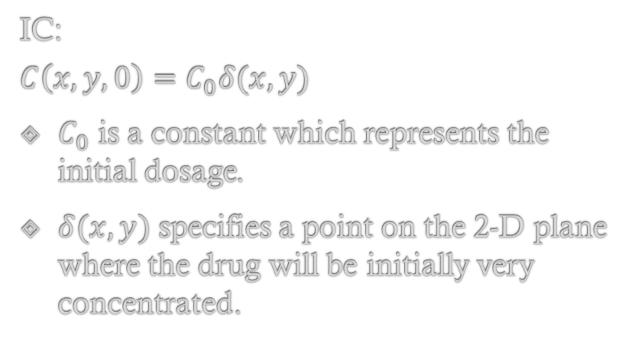
2-D diffusion Model
$$\frac{∂u}{∂t}=D\left[\frac{∂^{2}u}{∂x^{2}}+\frac{∂^{2}u}{∂y^{2}}\right]$$
C(x,y,t) = X(x)Y(y)T(t)
BC:
$\frac{∂u}{∂x}=0$ at x = 0
$\frac{∂u}{∂x}=0$ at x = L
$U\left(x,y,t\right)=0$ at y = 0
$U\left(x,y,t\right)=0$ at y = W
IC:
$$C\left(x, y,0\right)=C_{0}δ(x,y)$$
$C_{0}$ is a constant which represents the initial dosage.
$δ(x,y)$ specifies a point on the 2-D plane where the drug will be initially very concentrated.
Notes:
In this case x is a vector of one dimentsion
We will assume that C(x,t) = X(x)T(t)
Then we can use separation of variables to find a solution which fits our boundary condtions

Slide 9

2-D Diffusion Model Solution
$$U_{nm}\left(x,y,t\right)= \sum_{n=1}^{∞}{\sum_{m=1}^{∞}{C_{nm}cos\left(r_{n}x\right)sin⁡(s_{m}y)e^{−Dλ_{nm}^{2}t}}}$$
$$λ_{nm}^{2}=r_{n}^{2}+s_{m}^{2}$$
$$r_{n}=\left(\frac{nπ}{L}\right)$$
$$s_{m}=\left(\frac{mπ}{L}\right)$$
$$C_{nm}=?$$
Notes:
By using separation of variables we find a solution of the form above
Nice thing about the dirac delta is that it’s anti derivative is defined to be one.
Solution is a summation because of principle of superposition.

Slide 10
Conclusion
Though we sovled these equations via analytical which allowed us to model the it’s behavior exactly there exist other means for an approximation of a solution. (Several numerical approaches including ftcs, and btcs).
As we used the insight gained from the 1-D case to solve the 2-D case we could use the insights gained in solving the 2-D case to potentially solve the 3-D case.
Somewhat paradoxically the difficulty in solving the equations remains much the same except for the constant terms, who’s evaluation becomes significantly more difficult as the number of dimensions increases.
Any Questions?

Slide 11
Sources
https://socratic.org/questions/in-the-skin-what-is-the-function-of-the-papillary-layer (4/26/2018)

