Slide 1
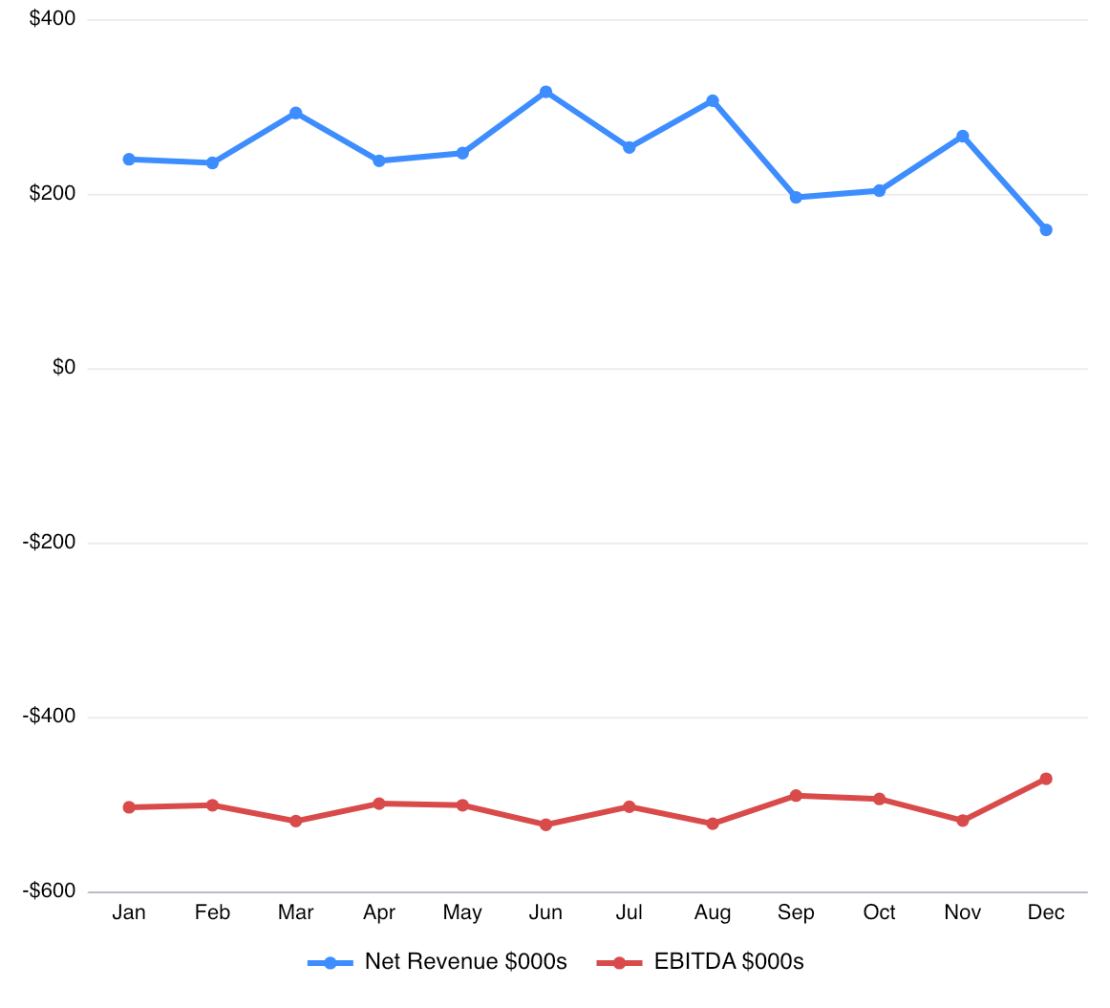
Jan 2026: stable margin, persistent cash watch
Forecast revenue starts at $240.5; gross margin holds at 59.2%. ending cash is ($7,258.5), while inventory closes at 740,522 units. Cash remains the central board issue.
$240.5
($7,258.5)
Net revenue
opens the forecast year
Ending cash
Cash Watch
1
Notes:
Key interpretation: Forecast revenue starts at $240.5; gross margin holds at 59.2%. ending cash is ($7,258.5), while inventory closes at 740,522 units. Cash remains the central board issue.
[Sources]
DreamBig ecommerce financial model workbook: /Users/rossegates/Documents/desktop automation/outputs/dreambig_financial_model/DreamBig_ecommerce_financial_model.xlsx
Source range: Monthly_Board!A4:R28. Values are the forecast month row for Jan 2026; charts use the 2026 forecast rows from the same range.

Slide 2
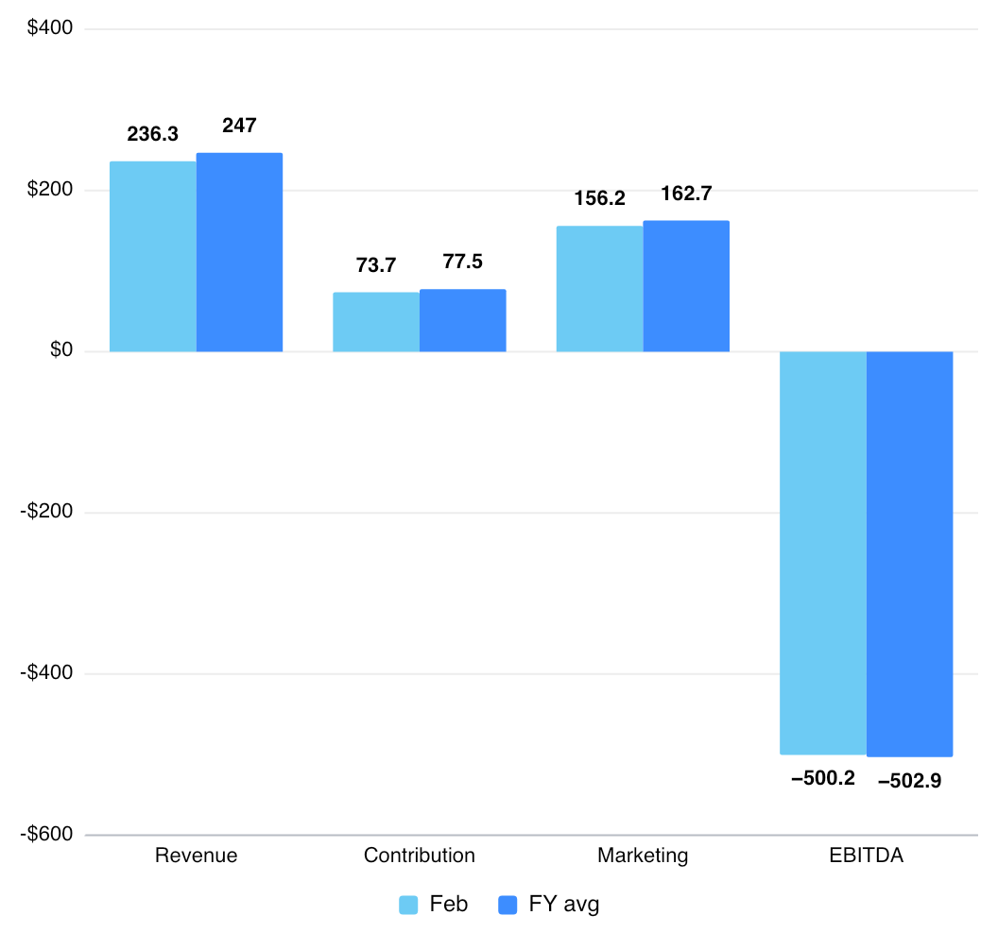
Feb 2026: stable margin, persistent cash watch
Revenue declines by $4.1; gross margin holds at 59.4%. cash declines by $524.1, while inventory draws down by 31,591 units. Cash remains the central board issue.
59.4%
708,931
Gross margin
31.2% contribution margin
Ending inventory
no stockout weeks
2
Notes:
Key interpretation: Revenue declines by $4.1; gross margin holds at 59.4%. cash declines by $524.1, while inventory draws down by 31,591 units. Cash remains the central board issue.
[Sources]
DreamBig ecommerce financial model workbook: /Users/rossegates/Documents/desktop automation/outputs/dreambig_financial_model/DreamBig_ecommerce_financial_model.xlsx
Source range: Monthly_Board!A4:R28. Values are the forecast month row for Feb 2026; charts use the 2026 forecast rows from the same range.

Slide 3
Mar 2026: demand steps up, not enough to offset spend
Revenue improves by $57.3; gross margin holds at 59.5%. cash declines by $542.3, while inventory builds by 133,410 units. Cash remains the central board issue.
$293.6
($8,324.9)
Net revenue
improves by $57.3
Ending cash
Cash Watch
3
Notes:
Key interpretation: Revenue improves by $57.3; gross margin holds at 59.5%. cash declines by $542.3, while inventory builds by 133,410 units. Cash remains the central board issue.
[Sources]
DreamBig ecommerce financial model workbook: /Users/rossegates/Documents/desktop automation/outputs/dreambig_financial_model/DreamBig_ecommerce_financial_model.xlsx
Source range: Monthly_Board!A4:R28. Values are the forecast month row for Mar 2026; charts use the 2026 forecast rows from the same range.

Slide 4

Apr 2026: revenue softens and cash burn persists
Revenue declines by $54.9; gross margin holds at 59.6%. cash declines by $522.2, while inventory draws down by 203,606 units. Cash remains the central board issue.
59.6%
638,735
Gross margin
31.6% contribution margin
Ending inventory
no stockout weeks
4
Notes:
Key interpretation: Revenue declines by $54.9; gross margin holds at 59.6%. cash declines by $522.2, while inventory draws down by 203,606 units. Cash remains the central board issue.
[Sources]
DreamBig ecommerce financial model workbook: /Users/rossegates/Documents/desktop automation/outputs/dreambig_financial_model/DreamBig_ecommerce_financial_model.xlsx
Source range: Monthly_Board!A4:R28. Values are the forecast month row for Apr 2026; charts use the 2026 forecast rows from the same range.

Slide 5
May 2026: stable margin, persistent cash watch
Revenue improves by $8.8; gross margin holds at 59.5%. cash declines by $524.2, while inventory draws down by 31,948 units. Cash remains the central board issue.
$247.6
($9,371.3)
Net revenue
improves by $8.8
Ending cash
Cash Watch
5
Notes:
Key interpretation: Revenue improves by $8.8; gross margin holds at 59.5%. cash declines by $524.2, while inventory draws down by 31,948 units. Cash remains the central board issue.
[Sources]
DreamBig ecommerce financial model workbook: /Users/rossegates/Documents/desktop automation/outputs/dreambig_financial_model/DreamBig_ecommerce_financial_model.xlsx
Source range: Monthly_Board!A4:R28. Values are the forecast month row for May 2026; charts use the 2026 forecast rows from the same range.

Slide 6
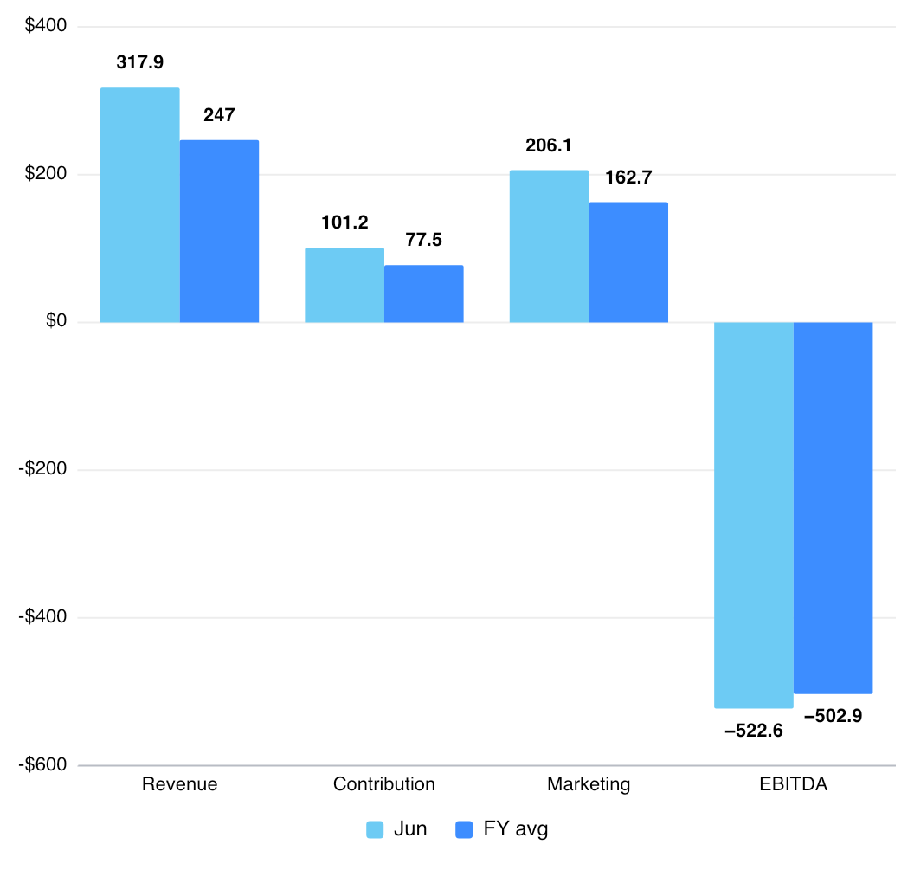
Jun 2026: revenue peaks, but cash still tightens
Revenue improves by $70.3; gross margin holds at 59.5%. cash declines by $546.5, while inventory builds by 105,625 units. Cash remains the central board issue.
59.5%
712,412
Gross margin
31.8% contribution margin
Ending inventory
no stockout weeks
6
Notes:
Key interpretation: Revenue improves by $70.3; gross margin holds at 59.5%. cash declines by $546.5, while inventory builds by 105,625 units. Cash remains the central board issue.
[Sources]
DreamBig ecommerce financial model workbook: /Users/rossegates/Documents/desktop automation/outputs/dreambig_financial_model/DreamBig_ecommerce_financial_model.xlsx
Source range: Monthly_Board!A4:R28. Values are the forecast month row for Jun 2026; charts use the 2026 forecast rows from the same range.

Slide 7
Jul 2026: revenue softens and cash burn persists
Revenue declines by $63.9; gross margin holds at 59.5%. cash declines by $525.8, while inventory draws down by 179,603 units. Cash remains the central board issue.
$254
($10,443.6)
Net revenue
declines by $63.9
Ending cash
Cash Watch
7
Notes:
Key interpretation: Revenue declines by $63.9; gross margin holds at 59.5%. cash declines by $525.8, while inventory draws down by 179,603 units. Cash remains the central board issue.
[Sources]
DreamBig ecommerce financial model workbook: /Users/rossegates/Documents/desktop automation/outputs/dreambig_financial_model/DreamBig_ecommerce_financial_model.xlsx
Source range: Monthly_Board!A4:R28. Values are the forecast month row for Jul 2026; charts use the 2026 forecast rows from the same range.

Slide 8

Aug 2026: demand steps up, not enough to offset spend
Revenue improves by $53.6; gross margin holds at 59.5%. cash declines by $545.3, while inventory builds by 87,534 units. Cash remains the central board issue.
59.5%
620,344
Gross margin
31.6% contribution margin
Ending inventory
no stockout weeks
8
Notes:
Key interpretation: Revenue improves by $53.6; gross margin holds at 59.5%. cash declines by $545.3, while inventory builds by 87,534 units. Cash remains the central board issue.
[Sources]
DreamBig ecommerce financial model workbook: /Users/rossegates/Documents/desktop automation/outputs/dreambig_financial_model/DreamBig_ecommerce_financial_model.xlsx
Source range: Monthly_Board!A4:R28. Values are the forecast month row for Aug 2026; charts use the 2026 forecast rows from the same range.

Slide 9
Sep 2026: revenue softens and cash burn persists
Revenue declines by $110.8; gross margin holds at 59.7%. cash declines by $513, while inventory draws down by 157,043 units. Cash remains the central board issue.
$196.8
($11,501.8)
Net revenue
declines by $110.8
Ending cash
Cash Watch
9
Notes:
Key interpretation: Revenue declines by $110.8; gross margin holds at 59.7%. cash declines by $513, while inventory draws down by 157,043 units. Cash remains the central board issue.
[Sources]
DreamBig ecommerce financial model workbook: /Users/rossegates/Documents/desktop automation/outputs/dreambig_financial_model/DreamBig_ecommerce_financial_model.xlsx
Source range: Monthly_Board!A4:R28. Values are the forecast month row for Sep 2026; charts use the 2026 forecast rows from the same range.

Slide 10
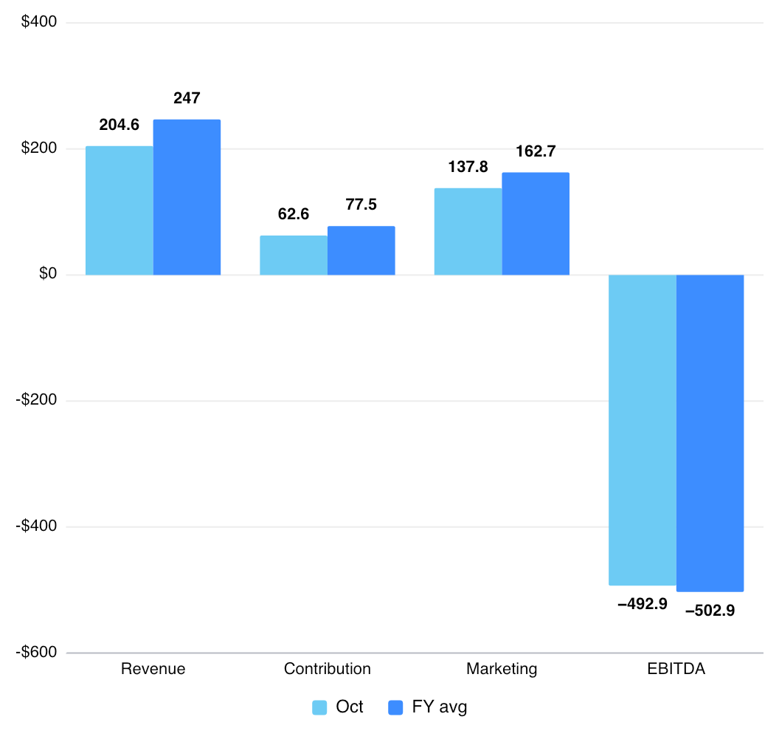
Oct 2026: stable margin, persistent cash watch
Revenue improves by $7.7; gross margin holds at 59.4%. cash declines by $516.9, while inventory draws down by 27,639 units. Cash remains the central board issue.
59.4%
435,662
Gross margin
30.6% contribution margin
Ending inventory
no stockout weeks
10
Notes:
Key interpretation: Revenue improves by $7.7; gross margin holds at 59.4%. cash declines by $516.9, while inventory draws down by 27,639 units. Cash remains the central board issue.
[Sources]
DreamBig ecommerce financial model workbook: /Users/rossegates/Documents/desktop automation/outputs/dreambig_financial_model/DreamBig_ecommerce_financial_model.xlsx
Source range: Monthly_Board!A4:R28. Values are the forecast month row for Oct 2026; charts use the 2026 forecast rows from the same range.

Slide 11
Nov 2026: demand steps up, not enough to offset spend
Revenue improves by $62.5; gross margin holds at 59.2%. cash declines by $590.2, while inventory builds by 86,361 units. Cash remains the central board issue.
$267
($12,608.9)
Net revenue
improves by $62.5
Ending cash
Cash Watch
11
Notes:
Key interpretation: Revenue improves by $62.5; gross margin holds at 59.2%. cash declines by $590.2, while inventory builds by 86,361 units. Cash remains the central board issue.
[Sources]
DreamBig ecommerce financial model workbook: /Users/rossegates/Documents/desktop automation/outputs/dreambig_financial_model/DreamBig_ecommerce_financial_model.xlsx
Source range: Monthly_Board!A4:R28. Values are the forecast month row for Nov 2026; charts use the 2026 forecast rows from the same range.

Slide 12
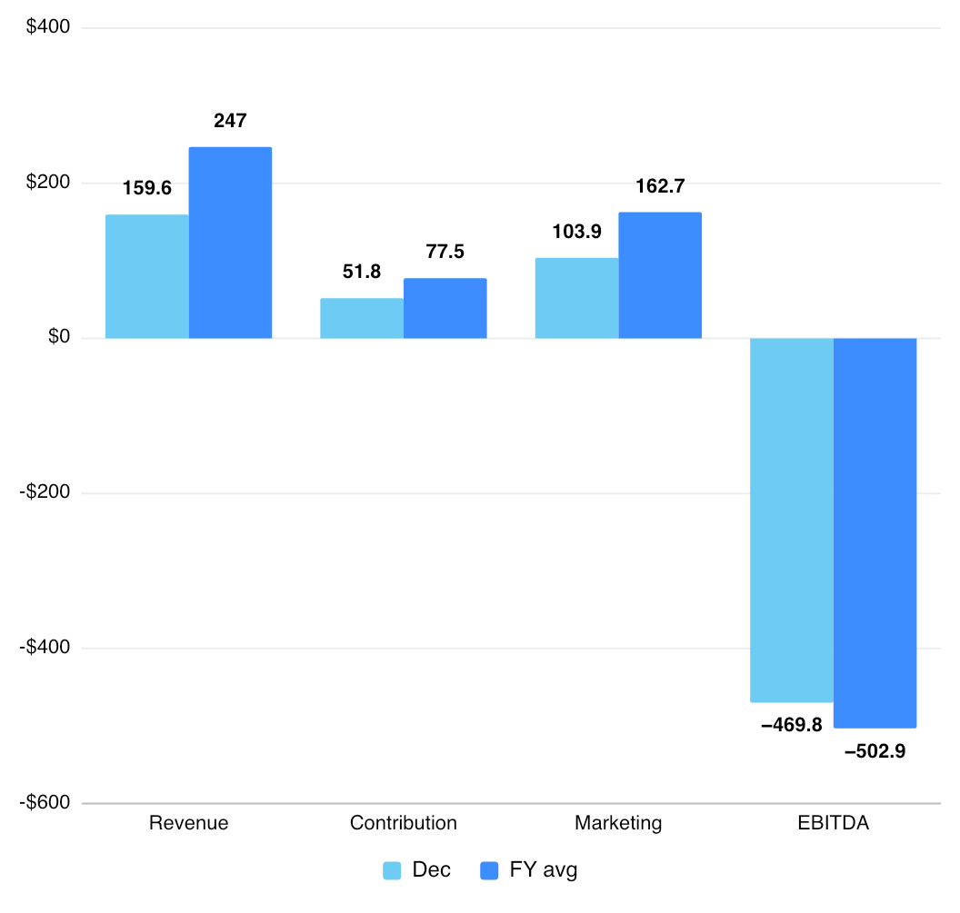
Dec 2026: cash pressure reaches the year low
Revenue declines by $107.4; gross margin holds at 61.3%. cash declines by $493.8, while inventory draws down by 129,171 units. Cash remains the central board issue.
61.3%
392,851
Gross margin
32.4% contribution margin
Ending inventory
no stockout weeks
12
Notes:
Key interpretation: Revenue declines by $107.4; gross margin holds at 61.3%. cash declines by $493.8, while inventory draws down by 129,171 units. Cash remains the central board issue.
[Sources]
DreamBig ecommerce financial model workbook: /Users/rossegates/Documents/desktop automation/outputs/dreambig_financial_model/DreamBig_ecommerce_financial_model.xlsx
Source range: Monthly_Board!A4:R28. Values are the forecast month row for Dec 2026; charts use the 2026 forecast rows from the same range.

