Slide 1





Network Science Disinformation Research for Communication Researchers
Ross Dahlke
@ross_dahlke
github.com/rossdahlke
Stanford University
rdahlke@stanford.edu

Slide 2
Hierarchy of Network Science Research
Network Science

Slide 3
Hierarchy of Network Science Research
Networks of Information
Network Science

Slide 4
Hierarchy of Network Science Research
Networks of Information
Network Science
Networks of People

Slide 5
Hierarchy of Network Science Research
Cascades of Information
Networks of Information
Network Science
Networks of People

Slide 6
Hierarchy of Network Science Research
Cascades of Information
Experiments & Theory Testing
Networks of Information
Applied
Fake News Detection
Network Science
Networks of People

Slide 7
Hierarchy of Network Science Research
Cascades of Information
Experiments & Theory Testing
Networks of Information
Applied
Fake News Detection
Network Science
Networks of People
Theoretical/ Simulation-Based

Slide 8
Hierarchy of Network Science Research
Cascades of Information
Experiments & Theory Testing
Networks of Information
Applied
Fake News Detection
Network Science
Networks of People
Theoretical/ Simulation-Based
Simulated Information Spread

Slide 9
Hierarchy of Network Science Research
Cascades of Information
Experiments & Theory Testing
Networks of Information
Applied
Fake News Detection
Network Science
Networks of People
Theoretical/ Simulation-Based
Simulated Information Spread

Slide 10
How does information spread across a network?

Slide 11
Two Models of Information Spread
Daley-Kendal (DK)

Slide 12
Two Models of Information Spread
Daley-Kendal (DK)
Three groups of people

Slide 13
Two Models of Information Spread
Daley-Kendal (DK)
Three groups of people
Ignorance

Slide 14
Two Models of Information Spread
Daley-Kendal (DK)
Three groups of people
Ignorance
Spreaders

Slide 15
Two Models of Information Spread
Daley-Kendal (DK)
Three groups of people
Ignorance
Spreaders
Stiflers

Slide 16
Two Models of Information Spread
Daley-Kendal (DK)
Three groups of people
Ignorance
Spreaders
Stiflers
SIR Model

Slide 17
Two Models of Information Spread
Daley-Kendal (DK)
Three groups of people
Ignorance
Spreaders
Stiflers
SIR Model
Three groups of people

Slide 18
Two Models of Information Spread
Daley-Kendal (DK)
Three groups of people
Ignorance
Spreaders
Stiflers
SIR Model
Three groups of people
Susceptible (S)

Slide 19
Two Models of Information Spread
Daley-Kendal (DK)
Three groups of people
Ignorance
Spreaders
Stiflers
SIR Model
Three groups of people
Susceptible (S)
Infected (I)

Slide 20
Two Models of Information Spread
Daley-Kendal (DK)
Three groups of people
Ignorance
Spreaders
Stiflers
SIR Model
Three groups of people
Susceptible (S)
Infected (I)
Recovered (R)

Slide 21
SIR Model--parameters (Deters, Aguiar, & Feuerborn)

Slide 22
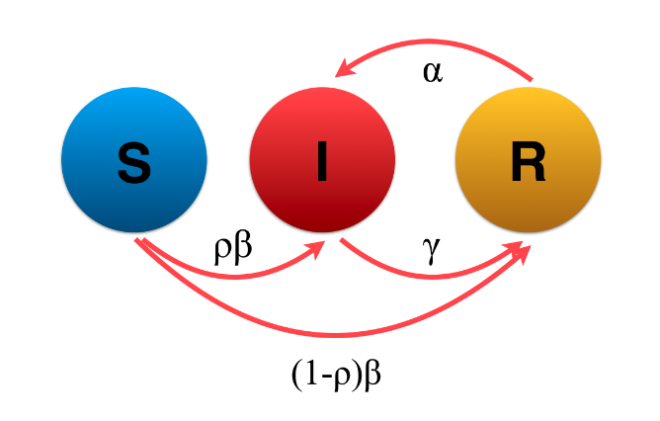
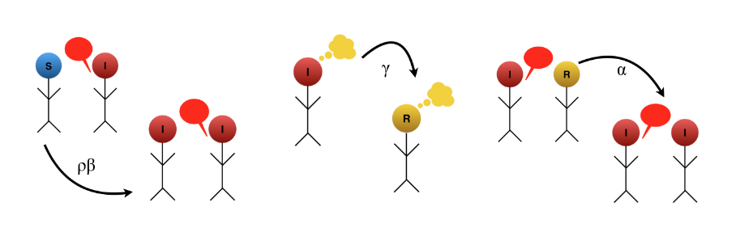
SIR Model--parameters (Deters, Aguiar, & Feuerborn)

Slide 23
SIR Model--parameters (Deters, Aguiar, & Feuerborn)
1. ρ = proportion who don’t know info is false

Slide 24
SIR Model--parameters (Deters, Aguiar, & Feuerborn)
1. ρ = proportion who don’t know info is false
2. β = rate of transmission, how “contagious”

Slide 25
SIR Model--parameters (Deters, Aguiar, & Feuerborn)
1. ρ = proportion who don’t know info is false
2. β = rate of transmission, how “contagious”
3. γ = rate of recovery, how easy to counteract

Slide 26
SIR Model--parameters (Deters, Aguiar, & Feuerborn)
1. ρ = proportion who don’t know info is false
2. β = rate of transmission, how “contagious”
3. γ = rate of recovery, how easy to counteract
4. α = how convincing, reinfection

Slide 27
SIR Model--parameters (Deters, Aguiar, & Feuerborn)
ρ = .9
2. β = .5
3. γ = .2
4. α = .1
.1
.9 * .5
.2
(1 - .9) * .5

Slide 28
Simulation: Step = 0
.1
100
0
0
.9 * .5
.2
(1 - .9) * .5

Slide 29
Simulation: Step = 1
.1
50
45
5
.9 * .5
.2
(1 - .9) * .5

Slide 30
Simulation: Step = 2
.1
25
55
15
.9 * .5
.2
(1 - .9) * .5

Slide 31
Simulation: Step = n
.1
0
0
100
.9 * .5
.2
(1 - .9) * .5

Slide 32
Parameters matter

Slide 33
Parameters = Assumptions on System

Slide 34
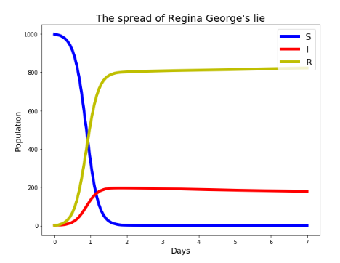
Parameters = Assumptions on System

Slide 35
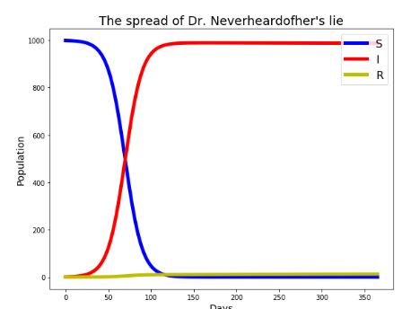
Parameters = Assumptions on System

Slide 36
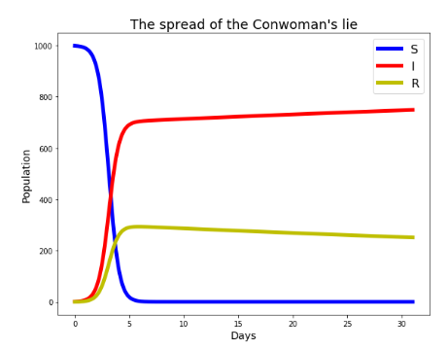
Parameters = Assumptions on System

Slide 37
Network Structure Matters

Slide 38
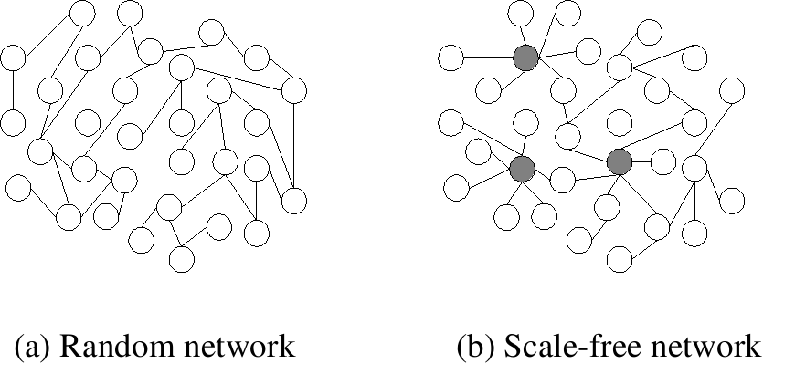
Different Networks = Different Flows

Slide 39
Bridging the Theoretical and Practical

Slide 40
Parameters & Network Structures

Slide 41
Parameters & Network Structures
 | Network 1: Facebook | Network 2: Twitter | Network 3: Tik Tok
Parameter Config. 1 (Regina George)
Parameter Config. 2 (Dr. N.)
Parameter Config. 3 (Conwoman)

Slide 42
As disinformation happens, estimate parameters to know how to stop the spread

Slide 43
Multiple Choice
The SIR Model of Disinformation Spread consists of:
Ignorance; Spreaders; Stiflers
Stiflers; Infected; Recovered
Susceptible; Infected; Recovered
Susceptible; Infected; Stiflers

