Slide 1





SCC Ch. 3: Construct Validity and External Validity
Ross Dahlke
@ross_dahlke
github.com/rossdahlke
Stanford University
rdahlke@stanford.edu

Slide 2


Construct Validity
External Validity

Slide 3

Construct Validity
External Validity

Slide 4
What are we actually measuring?

Slide 5

Example

Slide 6
Example
Race sentiment predicts Trump & Biden support

Slide 7
Example
Race sentiment predicts Trump & Biden support
Theory: Becoming less racist causes Biden support

Slide 8
Design
Racism survey

Slide 9
Design
Racism survey
Anti-racism treatment

Slide 10
Design
Racism survey
Anti-racism treatment
Biden support survey

Slide 11
Design
What are we measuring?
Racism survey
Anti-racism treatment
Biden support survey

Slide 12
Design
What are we measuring?
Racism survey
Anti-racism treatment
Biden support survey
If we make racist people not racist, will they support Biden more?

Slide 13
Design
What are some problems with this study?
Racism survey
Anti-racism treatment
Biden support survey

Slide 14
Threats to Construct Validity
Racism survey
Anti-racism treatment
Biden support survey

Slide 15
Threats to Construct Validity
Inadequate explication of construct
Racism survey
Anti-racism treatment
Biden support survey

Slide 16
Threats to Construct Validity
Inadequate explication of construct
Racism survey
Anti-racism treatment
Biden support survey
Construct Confounding

Slide 17
Threats to Construct Validity
Inadequate explication of construct
Mono-Operation Bias
Racism survey
Anti-racism treatment
Biden support survey
Construct Confounding

Slide 18
Threats to Construct Validity
Inadequate explication of construct
Mono-Operation Bias
Racism survey
Anti-racism treatment
Biden support survey
Construct Confounding
Mono-Method Bias

Slide 19
Threats to Construct Validity
Inadequate explication of construct
Mono-Operation Bias
Confounding Constructs
Racism survey
Anti-racism treatment
Biden support survey
Construct Confounding
Mono-Method Bias

Slide 20
Threats to Construct Validity
Inadequate explication of construct
Mono-Operation Bias
Confounding Constructs
Reactivity to the Exp. Setting
Racism survey
Anti-racism treatment
Biden support survey
Construct Confounding
Mono-Method Bias

Slide 21
Threats to Construct Validity
Inadequate explication of construct
Mono-Operation Bias
Confounding Constructs
Reactivity to the Exp. Setting
Racism survey
Anti-racism treatment
Biden support survey
Construct Confounding
Mono-Method Bias
Experimenter Expectancies

Slide 22
Threats to Construct Validity
Inadequate explication of construct
Mono-Operation Bias
Confounding Constructs
Reactivity to the Exp. Setting
Resentful Demoralization
Racism survey
Anti-racism treatment
Biden support survey
Construct Confounding
Mono-Method Bias
Experimenter Expectancies

Slide 23
Threats to Construct Validity
Inadequate explication of construct
Mono-Operation Bias
Confounding Constructs
Reactivity to the Exp. Setting
Resentful Demoralization
Racism survey
Anti-racism treatment
Biden support survey
Construct Confounding
Mono-Method Bias
Experimenter Expectancies
Treatment Diffusion

Slide 24
Construct Validity
What do we think we’re measuring?

Slide 25
Construct Validity
What do we think we’re measuring?
If we make racist people not racist, will they support Biden more?

Slide 26
Construct Validity
What do we think we’re measuring?
If we make racist people not racist, will they support Biden more?
What are we actually measuring?

Slide 27
Construct Validity
What do we think we’re measuring?
If we make racist people not racist, will they support Biden more?
What are we actually measuring?
If we make people who self-report to be racist, whatever it means to them, and put them through an anti-racism course in a university setting, that may make them demoralized for receiving the treatment, will they support Biden more?

Slide 28
Why should we care?

Slide 29
Why should we care?
Connect experiments to theory

Slide 30
Why should we care?
Connect experiments to theory
Social, political, and economic implications

Slide 31
Why should we care?
Connect experiments to theory
Social, political, and economic implications
Fundamental task of science

Slide 32
Construct Validity
External Validity

Slide 33

Construct Validity
External Validity

Slide 34
How generalizable is our study?

Slide 35

Minimum Wage

Slide 36

Minimum Wage

Slide 37

Targets of Generalization

Slide 38

Targets of Generalization
Narrow to Broad

Slide 39

Narrow to Broad

Slide 40

Narrow to Broad

Slide 41
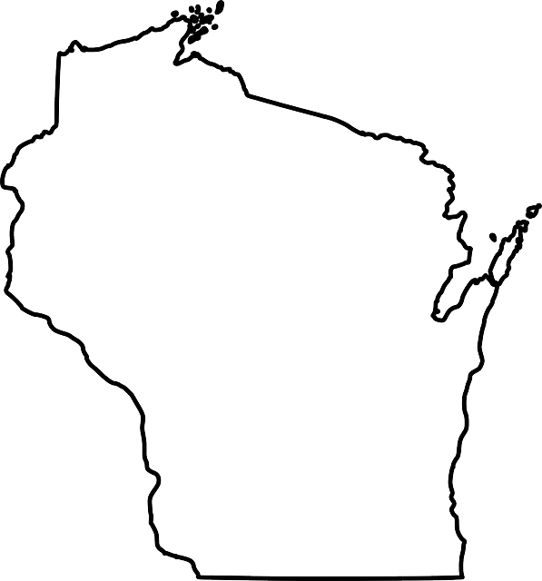
Narrow to Broad

Slide 42

Targets of Generalization
Narrow to Broad
Broad to Narrow

Slide 43

Broad to Narrow

Slide 44

Broad to Narrow

Slide 45

Targets of Generalization
Narrow to Broad
Broad to Narrow
At a Similar Level

Slide 46

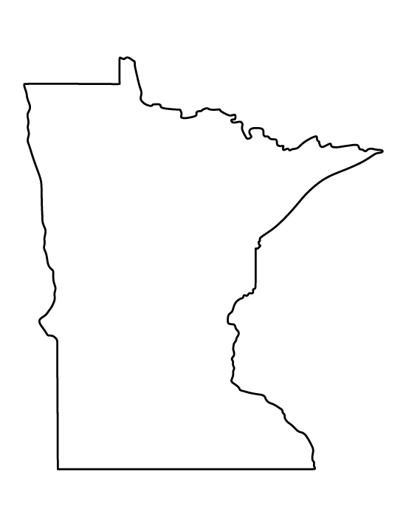
Similar Level

Slide 47
Similar Level

Slide 48

Targets of Generalization
Narrow to Broad
Broad to Narrow
At a Similar Level
To a Similar or Different Kind

Slide 49



Similar or Different Kind

Slide 50
Similar or Different Kind

Slide 51
Similar or Different Kind

Slide 52

Targets of Generalization
Narrow to Broad
Broad to Narrow
At a Similar Level
To a Similar or Different Kind
Random Sample to Population Members

Slide 53

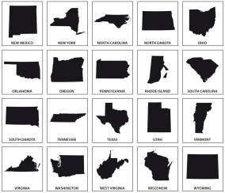
Random Sample

Slide 54
Threats to External Validity

Slide 55
Threats to External Validity
Units

Slide 56
Threats to External Validity
Units
Treatment Variation

Slide 57
Threats to External Validity
Units
Treatment Variation
Outcomes

Slide 58
Threats to External Validity
Units
Treatment Variation
Outcomes
Settings

Slide 59
Threats to External Validity
Units
Treatment Variation
Outcomes
Settings
Context-Dependent Mediation

Slide 61

Trade-Offs

