Slide 1





A Mathematical Approach to Deception
Ross Dahlke
@ross_dahlke
github.com/rossdahlke
Stanford University
rdahlke@stanford.edu

Slide 2
Many ways to study deception

Slide 3
We’ve learned a psychological approach

Slide 4
Mathematical Model of Information Spread

Slide 5
Mathematical Model of Information Spread
SIR Model

Slide 6
Mathematical Model of Information Spread
SIR Model
Three types of people

Slide 7
Mathematical Model of Information Spread
SIR Model
Three types of people
Susceptible (S)

Slide 8
Mathematical Model of Information Spread
SIR Model
Three types of people
Susceptible (S)
Infected (I)

Slide 9
Mathematical Model of Information Spread
SIR Model
Three types of people
Susceptible (S)
Infected (I)
Recovered (R)

Slide 10
SIR Model--parameters (Deters, Aguiar, & Feuerborn)

Slide 11
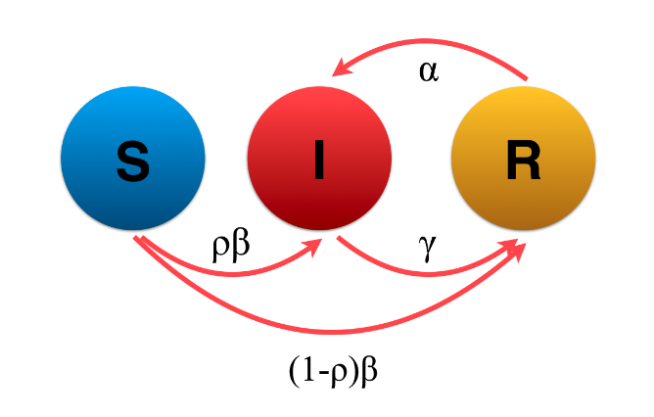
SIR Model--parameters (Deters, Aguiar, & Feuerborn)

Slide 12
SIR Model--parameters (Deters, Aguiar, & Feuerborn)
1. ρ = proportion immune

Slide 13
SIR Model--parameters (Deters, Aguiar, & Feuerborn)
1. ρ = proportion immune
2. β = rate of transmission, how “contagious”

Slide 14
SIR Model--parameters (Deters, Aguiar, & Feuerborn)
1. ρ = proportion immune
2. β = rate of transmission, how “contagious”
3. γ = rate of recovery, how easy to counteract

Slide 15
SIR Model--parameters (Deters, Aguiar, & Feuerborn)
1. ρ = proportion immune
2. β = rate of transmission, how “contagious”
3. γ = rate of recovery, how easy to counteract
4. α = how convincing, reinfection

Slide 16
Parameters matter

Slide 17
Parameters = Assumptions on System

Slide 18
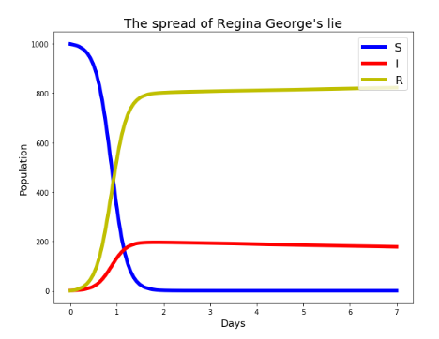
Parameters = Assumptions on System

Slide 19
Parameters = Assumptions on System

Slide 20
Parameters = Assumptions on System
Popular

Slide 21
Parameters = Assumptions on System
Popular
High β

Slide 22
Parameters = Assumptions on System
Popular
High β
Easy to disprove

Slide 23
Parameters = Assumptions on System
Popular
High β
Easy to disprove
High γ

Slide 24
Parameters = Assumptions on System
Popular
High β
Easy to disprove
High γ
Deceptive reputation

Slide 25
Parameters = Assumptions on System
Popular
High β
Easy to disprove
High γ
Deceptive reputation
Low ρ
High (1-p)

Slide 26
Parameters = Assumptions on System
Popular
High β
Easy to disprove
High γ
Deceptive reputation
Low ρ
High (1-p)

Slide 27
Parameters = Assumptions on System
Popular
High β
Easy to disprove
High γ
Deceptive reputation
Low ρ
High (1-p)

Slide 28
Parameters = Assumptions on System
Popular
High β
Easy to disprove
High γ
Deceptive reputation
Low ρ
High (1-p)

Slide 29
Parameters = Assumptions on System
Popular
High β
Easy to disprove
High γ
Deceptive reputation
Low ρ
High (1-p)

Slide 30
Parameters = Assumptions on System
Popular
High β
Easy to disprove
High γ
Deceptive reputation
Low ρ
High (1-p)

Slide 31
Parameters = Assumptions on System
Popular
High β
Easy to disprove
High γ
Deceptive reputation
Low ρ
High (1-p)

Slide 32
Parameters = Assumptions on System
Popular
High β
Easy to disprove
High γ
Deceptive reputation
Low ρ
High (1-p)

Slide 33
Parameters = Assumptions on System
Popular
High β
Easy to disprove
High γ
Deceptive reputation
Low ρ
High (1-p)

Slide 34
Parameters = Assumptions on System

Slide 35
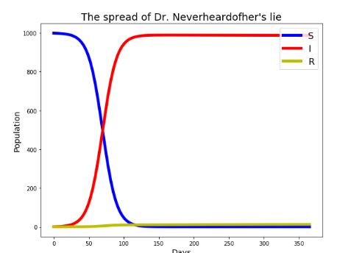
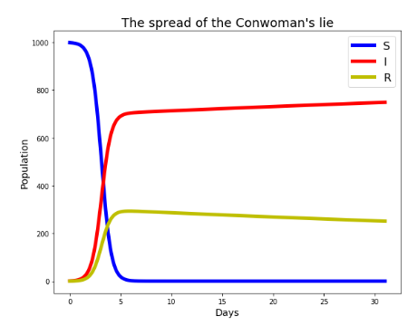
Parameters = Assumptions on System
Deters, Jessica; Aguiar, Izabel P.; and Feuerborn, Jacquie (2019) "The Mathematics of Gossip," CODEE Journal: Vol. 12, Article 7. Available at: https://scholarship.claremont.edu/codee/vol12/iss1/7

Slide 36
Many ways to study deception

Slide 37
Multiple Choice
The SIR Model of Disinformation Spread consists of:
Ignorance; Spreaders; Stiflers
Stiflers; Infected; Recovered
Susceptible; Infected; Recovered
Susceptible; Infected; Stiflers

