Slide 1





Baron & Kenny: Mediators and Moderators
Ross Dahlke
@ross_dahlke
github.com/rossdahlke
Stanford University
rdahlke@stanford.edu

Slide 2
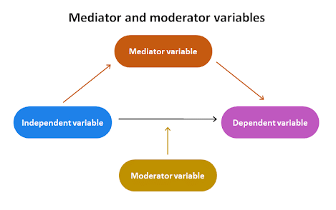
Source: scribbr.com/methodology/mediator-vs-moderator/

Slide 3
Dressbarn Email Promo

Slide 4
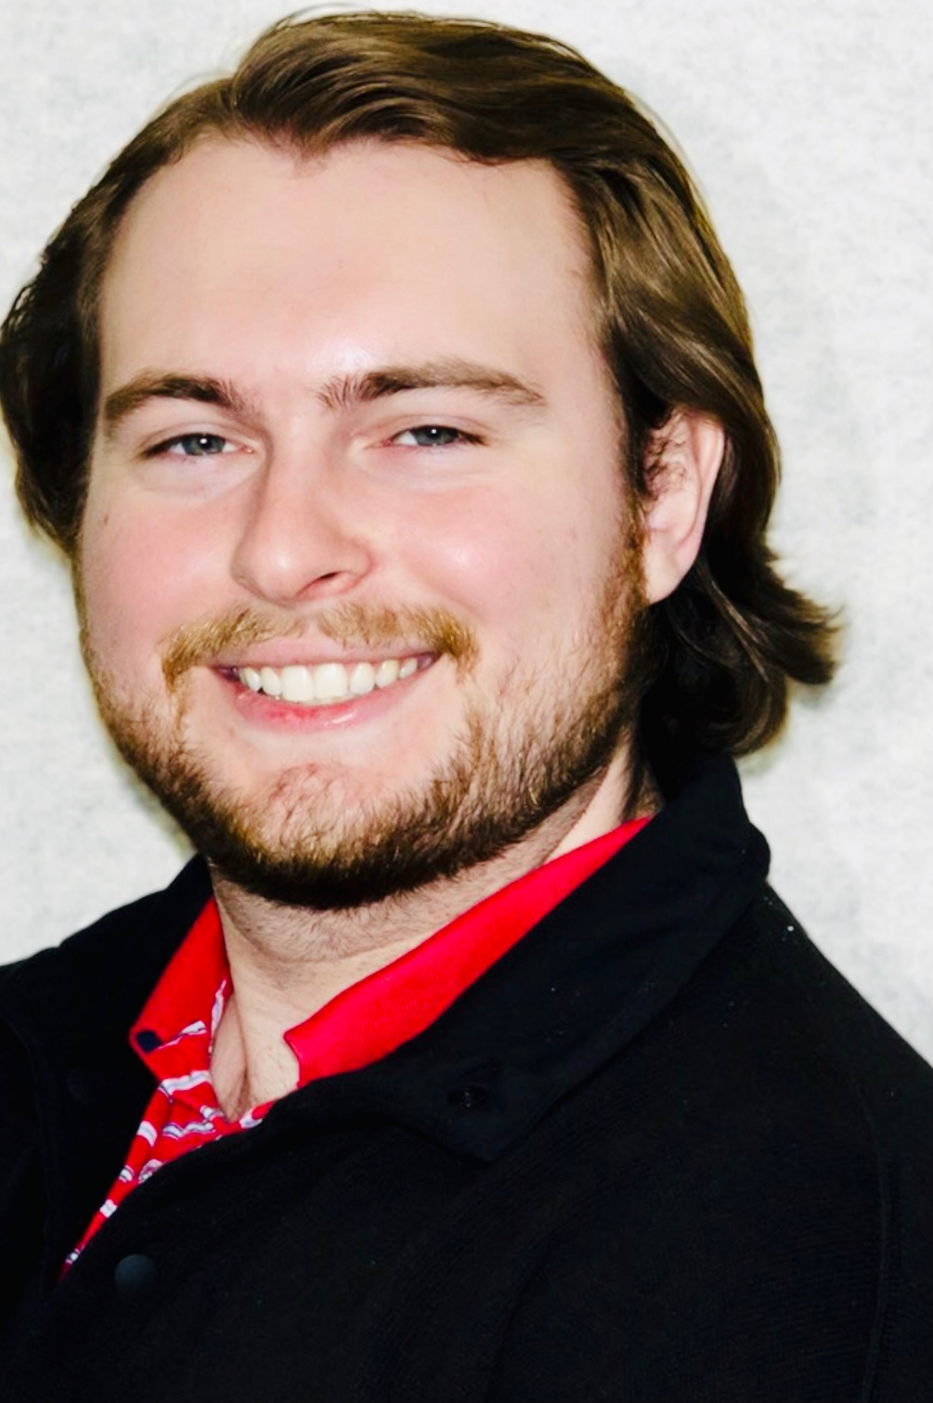

Slide 6
Email Promo
Sales Amount

Slide 7
$50 per person
Email Promo
Sales Amount

Slide 8


Slide 9
$__ per person
Email Promo
Sales Amount

Slide 10
$15 per person
Email Promo
Sales Amount

Slide 11

Mr. Dressbarn

Slide 12
$50 per person
Email Promo
Sales Amount
Original Experiment

Slide 13
$50 per person
Email Promo
Sales Amount
Original Experiment

Slide 14
$50 per person
Email Promo
Sales Amount
Gender
Original Experiment

Slide 15
$50 per person
Email Promo
Sales Amount
Gender
Original Experiment

Slide 16
$50 per person
Email Promo
Men: $25
Women: $75
Sales Amount
Gender
Original Experiment

Slide 17


Slide 18
Email Promo
Sales Amount

Slide 19
$20 per person
Email Promo
Sales Amount

Slide 20
$50 per person
Email Promo
Sales Amount
Original Experiment

Slide 21
Quality
$50 per person
Email Promo
Sales Amount
Original Experiment

Slide 22
Quality
1 unit
$50 per person
Email Promo
Sales Amount
Original Experiment

Slide 23
Quality
$30 per person
1 unit
$20 per person
$50 per person
Email Promo
Sales Amount
Original Experiment

Slide 24
Quality
$30 per person
1 unit
$20 per person
$50 per person
Email Promo
Sales Amount
Sobel Test: √b²s_{a}² + a²s_{b}²
Original Experiment

Slide 27
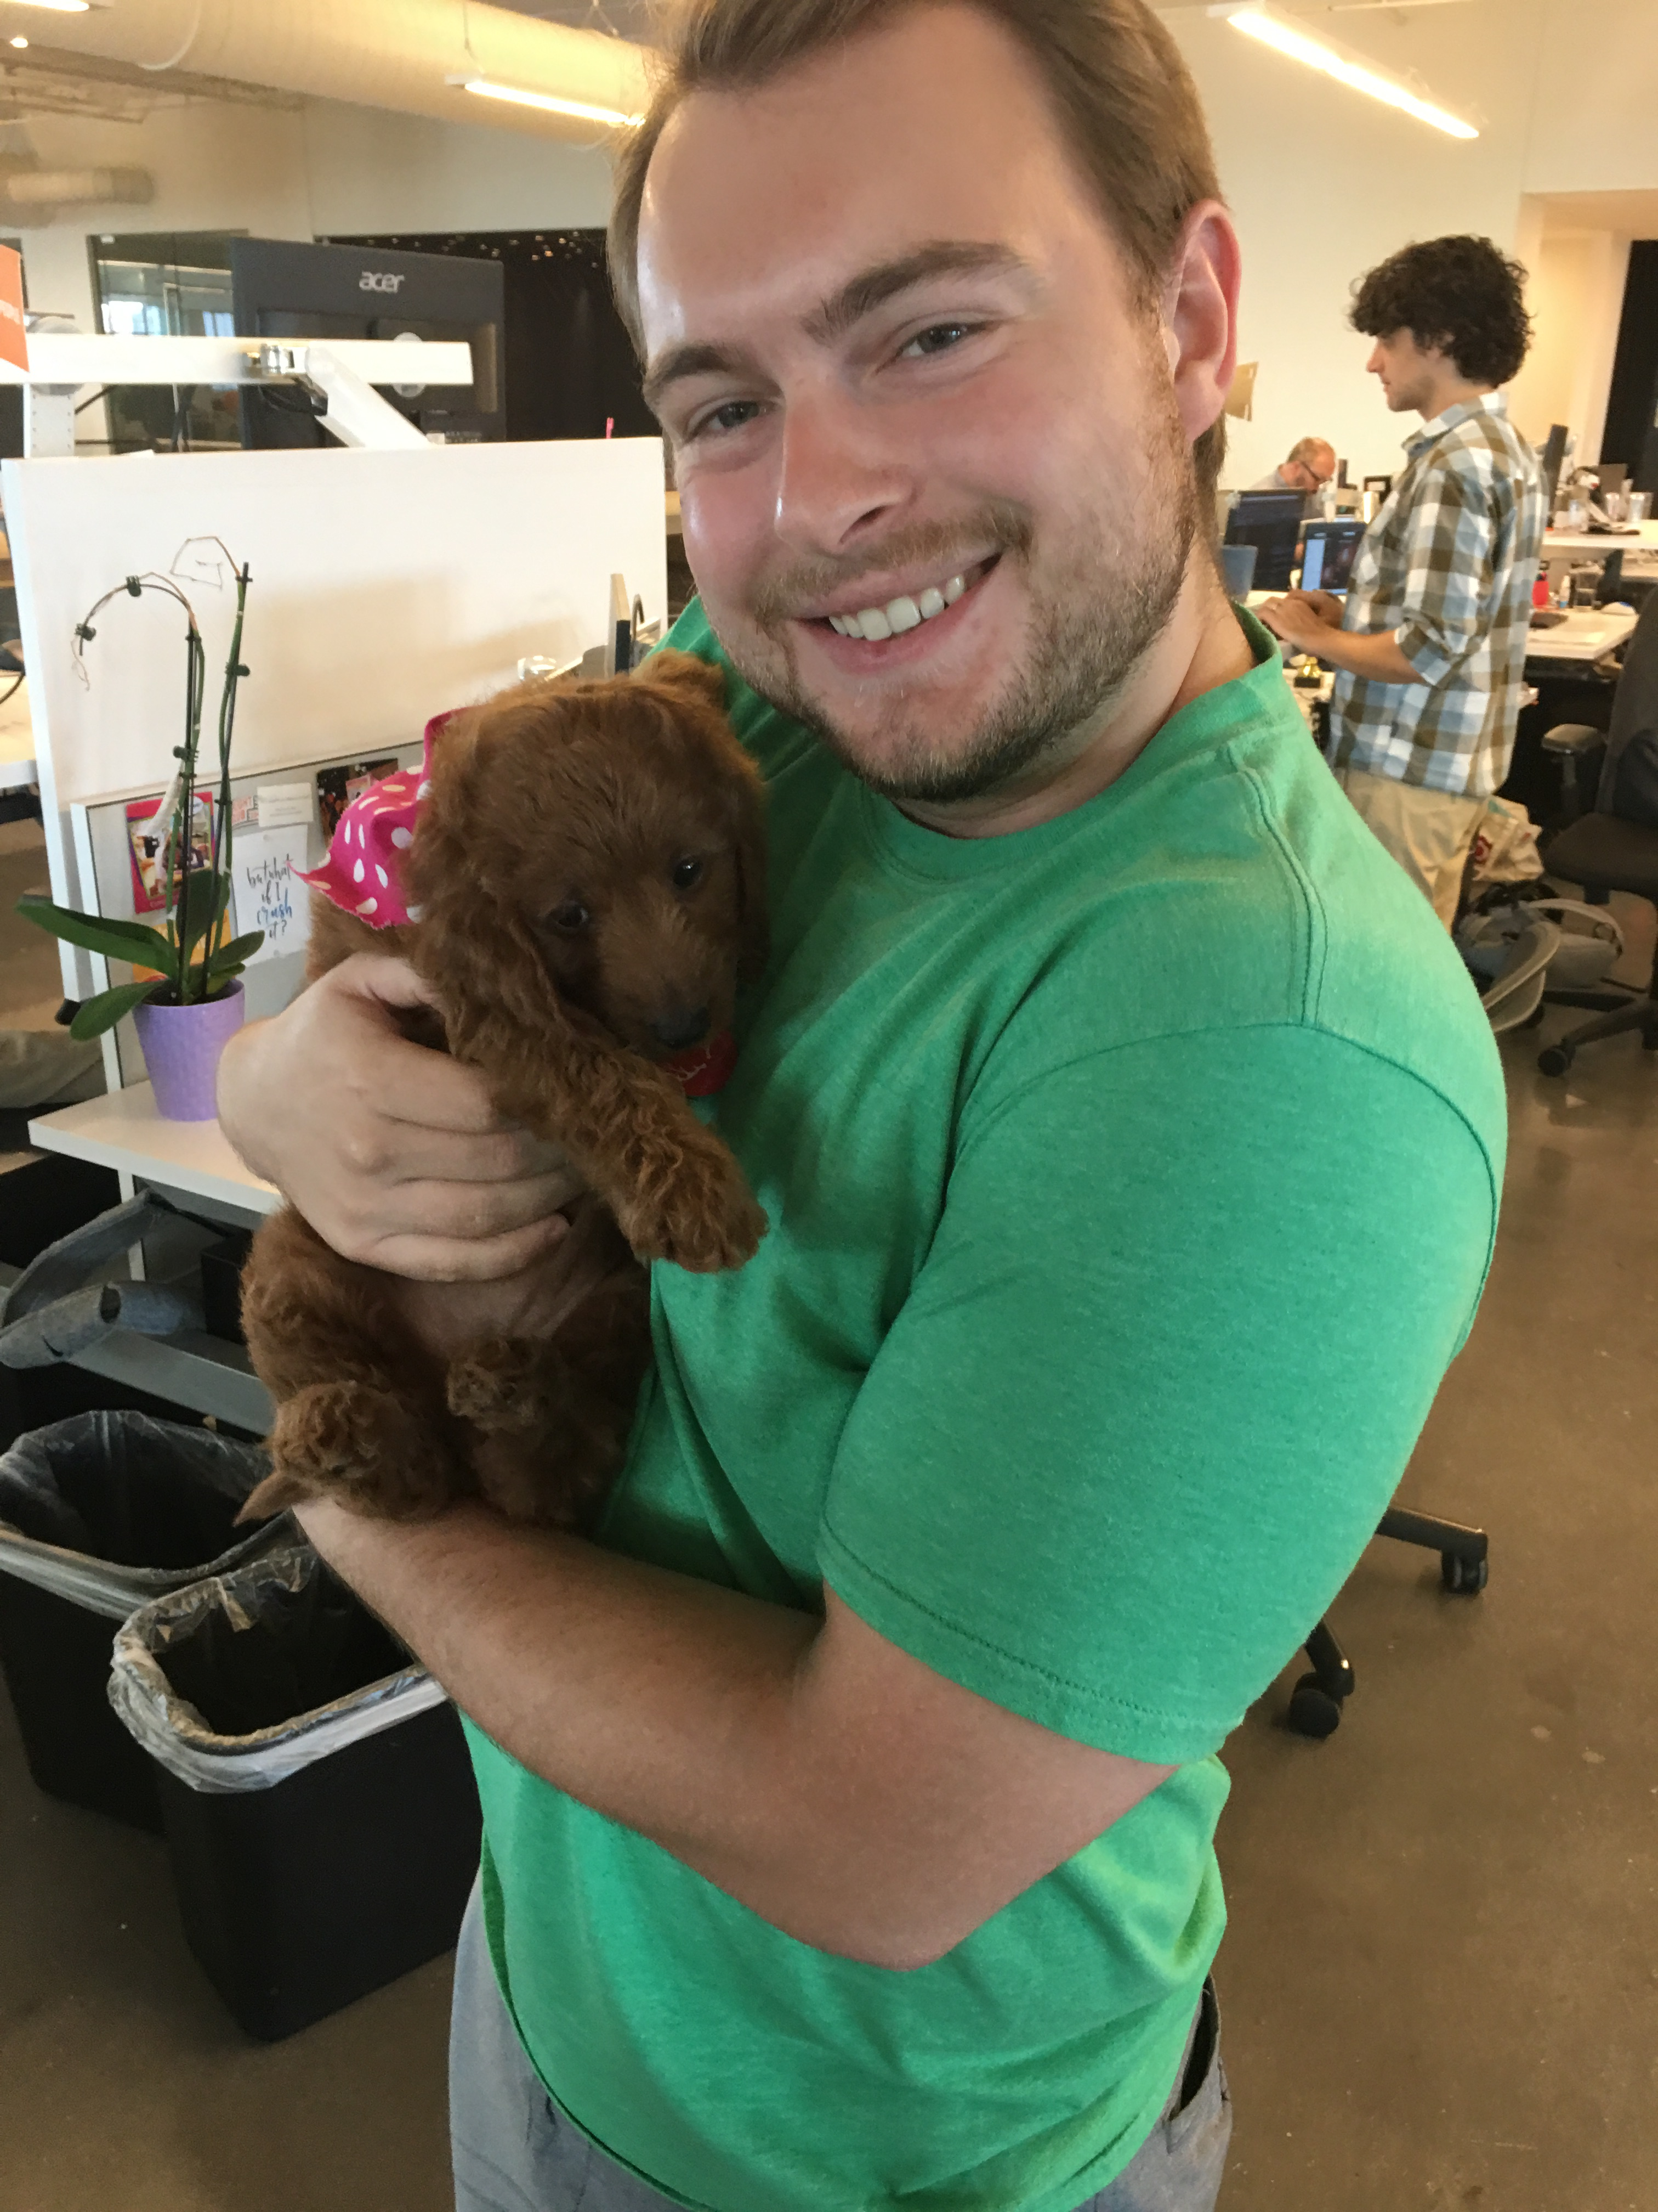

Slide 28
Source: scribbr.com/methodology/mediator-vs-moderator/

