Slide 1

Cleaning Messy Data
Workflow, tips and tricks

Slide 2
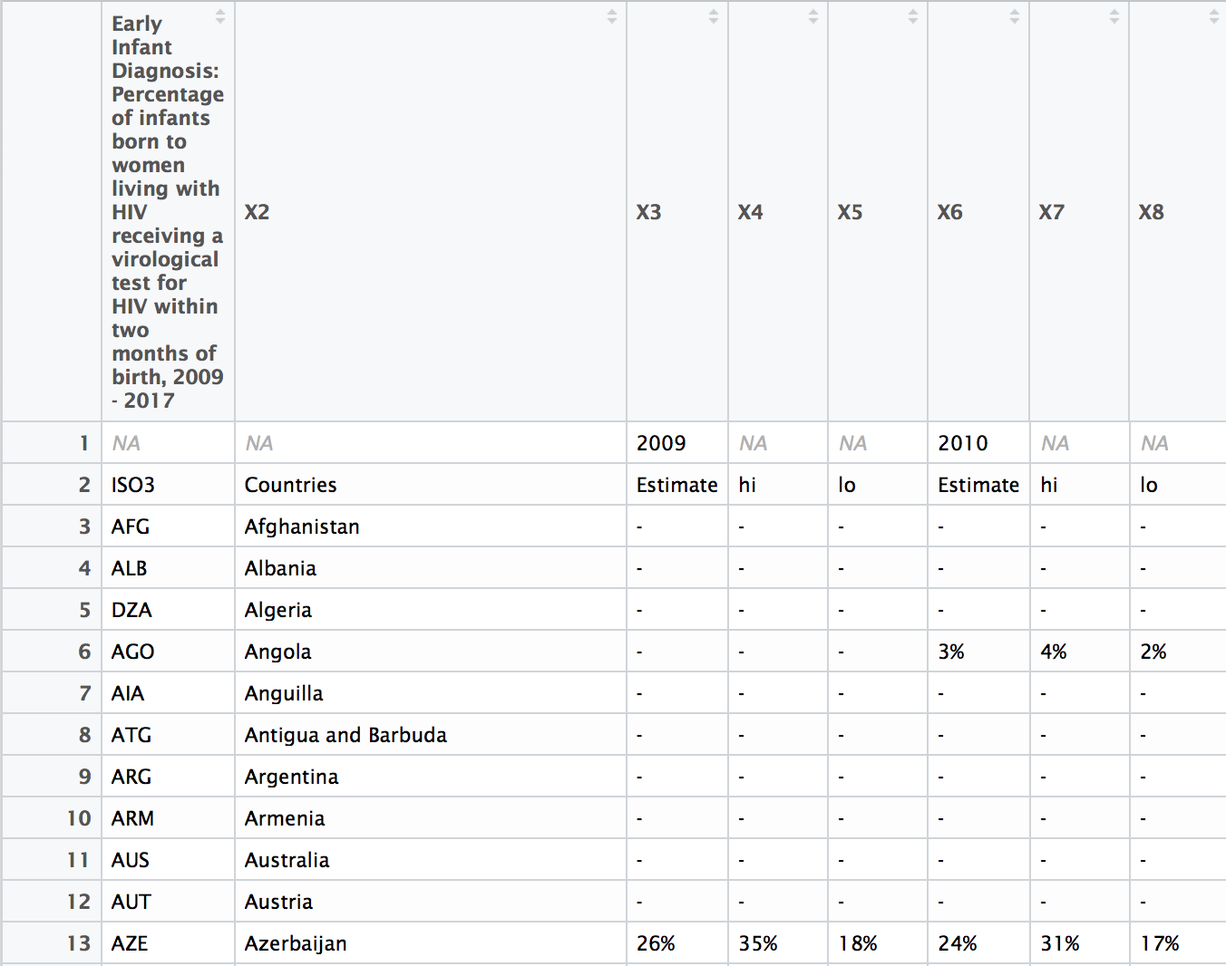
Import the dataset
Here R isn’t able to infer the column names.
1st row is a very long comment string.
2nd row has years spaced at intervals.
After first two rows, column 1 is ISO country codes.
Other columns are full country name, then hi, lo and Estimate repeated.

Slide 3
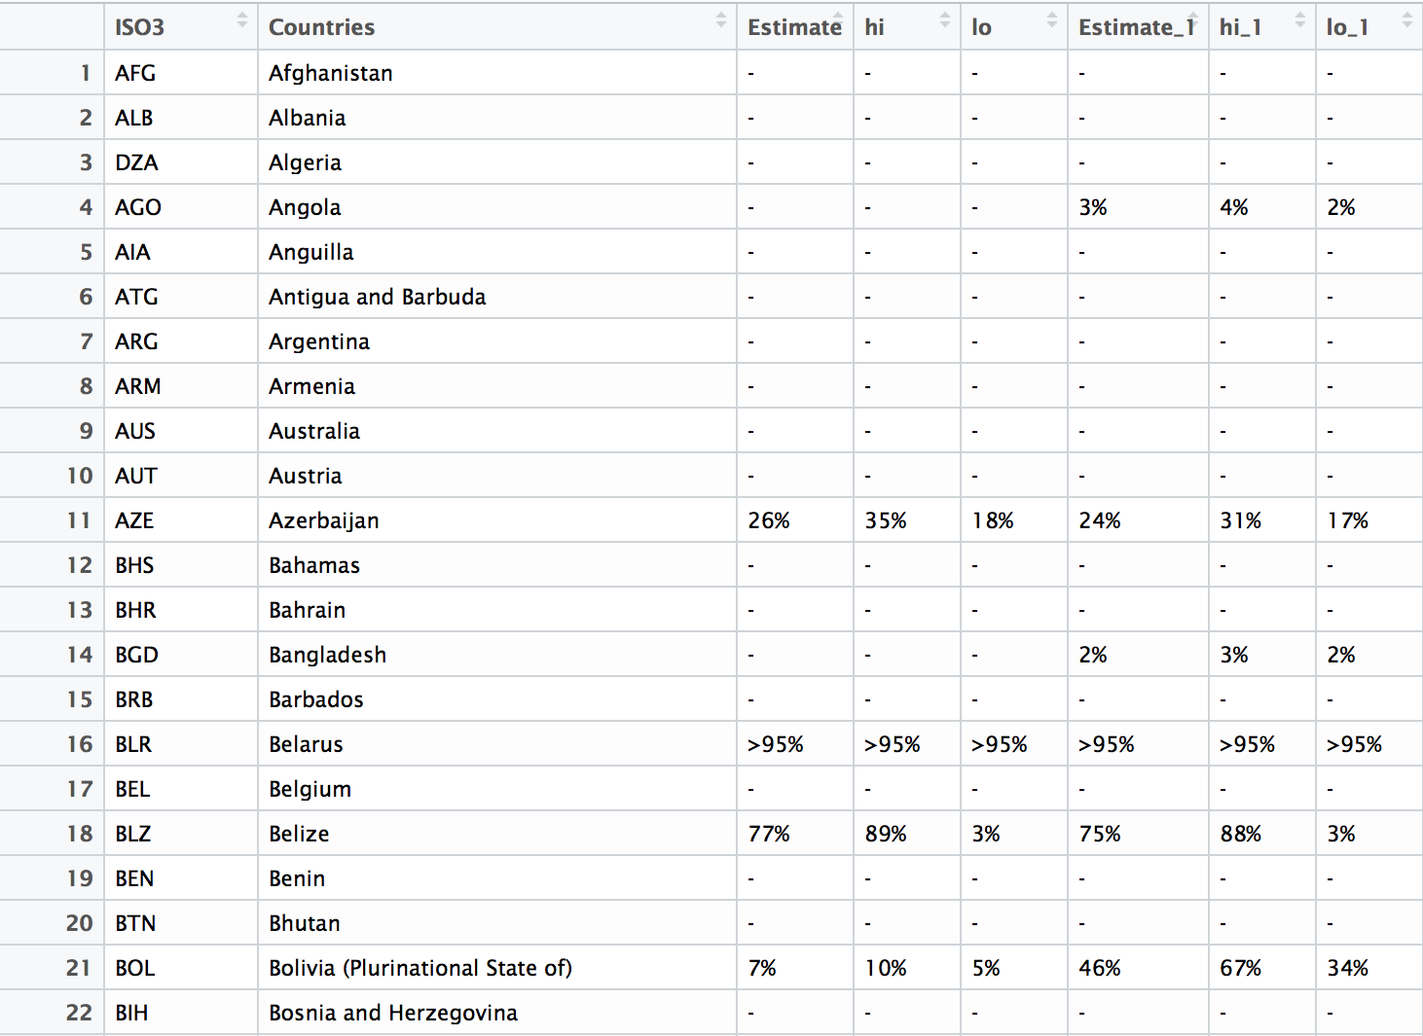
Import the dataset and skip the first two rows
Better but numeric data is characters. Why?
CSV uses a single dash for NA
Numbers end with ‘%’

Slide 4
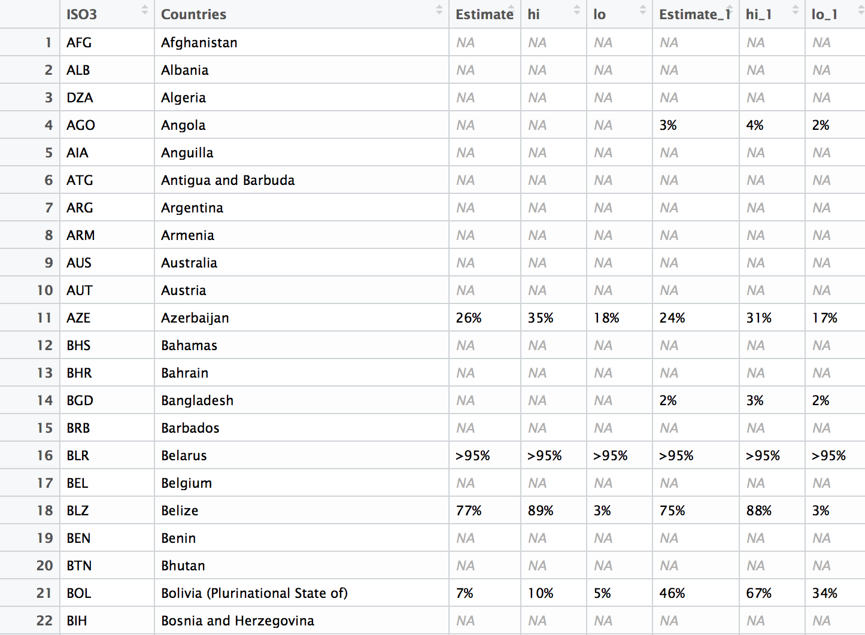
Import the dataset and skip the first two rows and identify NA character
Notice how R deduplicates column names.
Progress, but what do the bottom rows of the data look like?

Slide 5
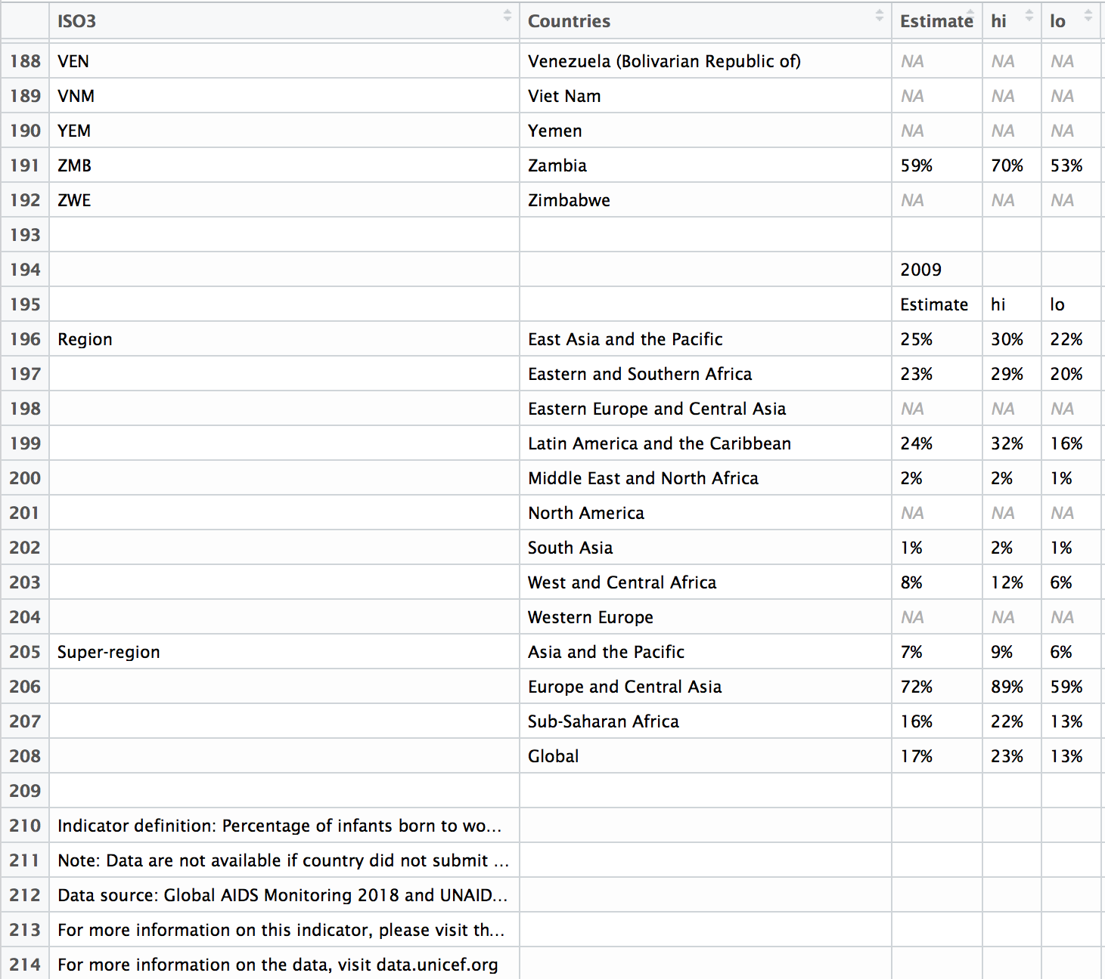
Determine number of bottom rows that are not part of data set
Grrrr, lots of text at end of data.
For now let’s just determine where the data stops.
Open and count in text editor (or Excel)
nrow(raw)-22
Ideally, should be generalized.
Row # of first non-all caps entry in countries -1

Slide 6
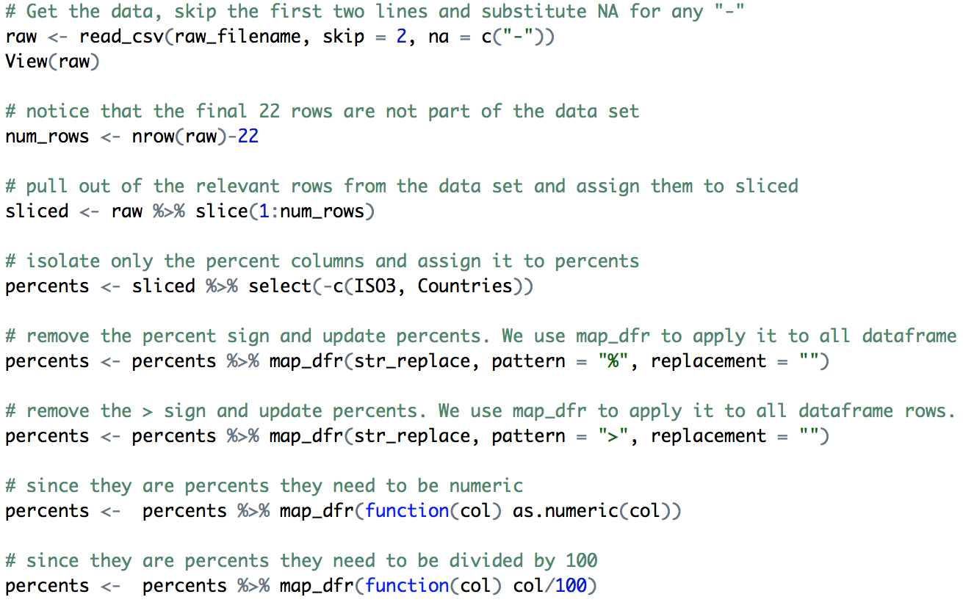
Import the dataset. Skip the 1st two rows, skip last 22 rows. Identify NA character. Then remove ISO Country so we can strip % and < signs out and make it numeric
We are getting there.
What do we need to do next?
Give it better column names

Slide 7

Give the tbl more descriptive column names
names(percent) <- (“2009-Estimate”, “2009-UpperBound”, “2009-LowerBound”, “2010-Estimate”, “2010-UpperBound”, “2010-LowerBound”)
What do we think of this strategy?
Anyone feel uncomfortable?

Slide 8
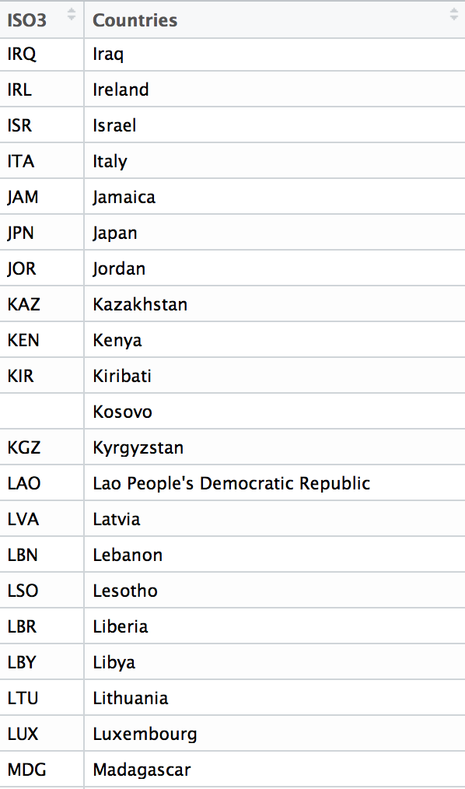
Looking at the labels
Lets slice out the labels and look at them
Scrolling down the list … hmmm – Kosov is empty
Partially recognized, disputed territory
According to: https://en.wikipedia.org/wiki/ISO_3166-1_alpha-3
It uses ISO-3 Country Code “UNK”

Slide 9
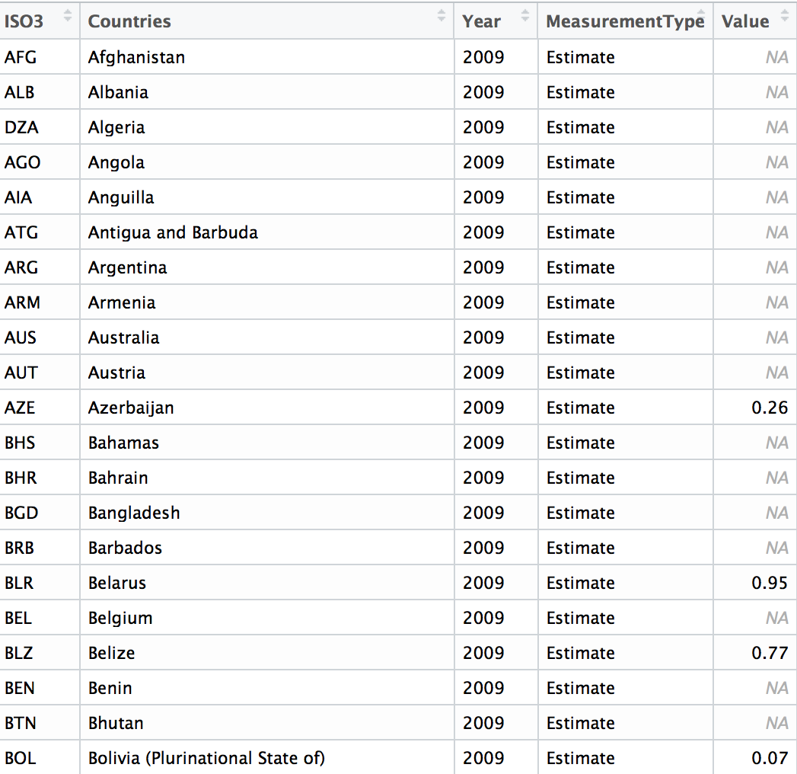
After this we have everything we need. We just need to reshape it.
Use cbind() to combine percents and labels
Use gather() to take the Year and Measurement Type column headers and make them all entries into a column called YearAndMeasurementType. Make their values into a column called Value.
Use separate() to split up YearAndMeasurementType into two columns called Year and MeasurementType

