Slide 1

Verification & Validation Calculator
Ross Gore
Saikou Diallo
Old Dominion University
Virginia Modeling and Simulation Center (VMASC)
rgore@odu.edu
sdiallo@odu.edu

Slide 2
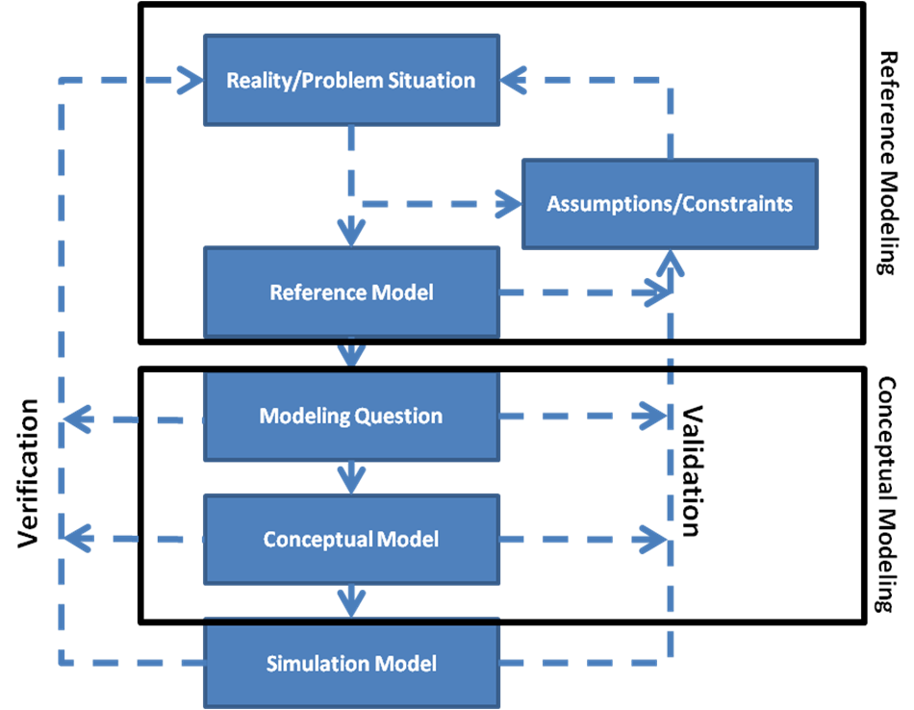
V & V is necessary but hard
Notes:
The process of developing, verifying and validating models and simulations should be straightforward. Unfortunately, following conventional development approaches can render a model design that appeared complete and robust into an incomplete, incoherent and invalid simulation during implementation. An alternative approach is for subject matter experts (SMEs) to employ formal methods to describe their models. However, formal methods are rarely used in practice due to their intimidating syntax and semantics rooted in mathematics.

Slide 3
Goal
Ensure SME conceptual model matches
implementation of simulation.
Do certain properties always hold in my simulation?
Are certain constraints never violated?
Under what conditions are the unexpected behavior(s) manifested?

Slide 4
How
Move model checking & automated debugging techniques developed by computer scientists up to the SME level.

Slide 5
Required Input
SME creates log file:
Possibly relevant variables and their values
Final column captures simulation output
Currently tool expects .csv file with column headers

Slide 6
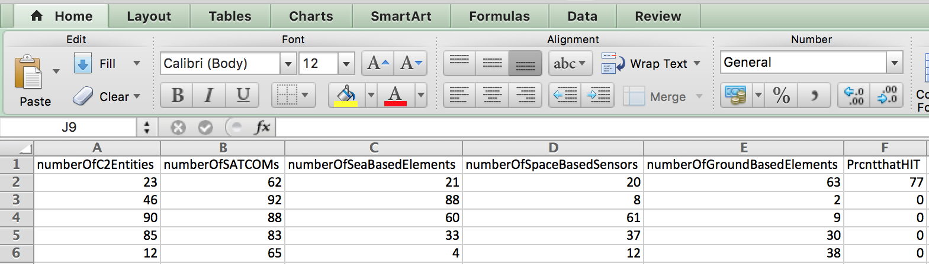
Required Input

Slide 7
Required Hardware/Software
Any machine running Java 1.5 or later
Tool can be downloaded at:
http://github.com/rossgore/IVandVLevelChecker

Slide 8
Unit of Analysis
All analysis is done on predicates
Predicate – Boolean expression that includes at least one non-output variable in the log file.
Examples:
x > 5
y > x
x > 5 AND y > x

Slide 9
Describing a predicate
Structure – is the variable compared to a value (x < 0) or another variable (x > y)?
Elasticity – is the value the variable is compared to decided before or after looking at values in the log file?
Compoundness – does the predicate reflect multiple predicates joined together using logical operators (i.e. x < 0 AND y > z)?

Slide 10
Two Structures for Predicates
First Structure – Single Variable Predicate
Single Variable Predicate – compares the value of a variable x to a numeric value
Examples:
x > 5
y = 0
z < -4

Slide 11
Two Structures for Predicates
Second Structure – Scalar Pairs Predicate
Scalar Pairs Predicate – compares the value of a variable x to another variable y
Examples:
x > y
x = y
x < y
Notes:
.

Slide 12
Model Checking Analysis
Operates on static single variable and scalar pairs predicates.
User describes properties and constraints using these types of predicates.
Specifies if predicate should:
Always be true
Never occur
These predicates reflect simulation requirements

Slide 13
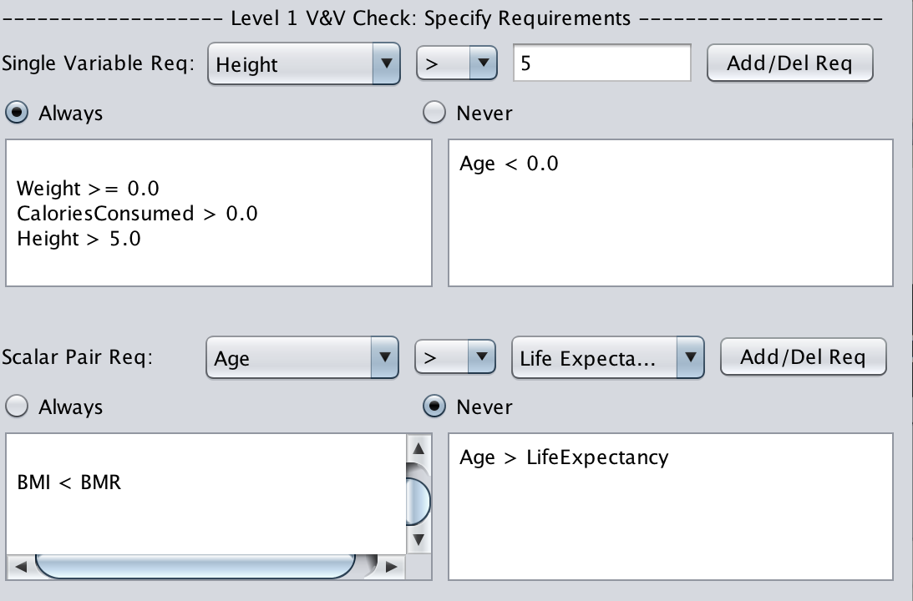
Model Checking Analysis

Slide 14
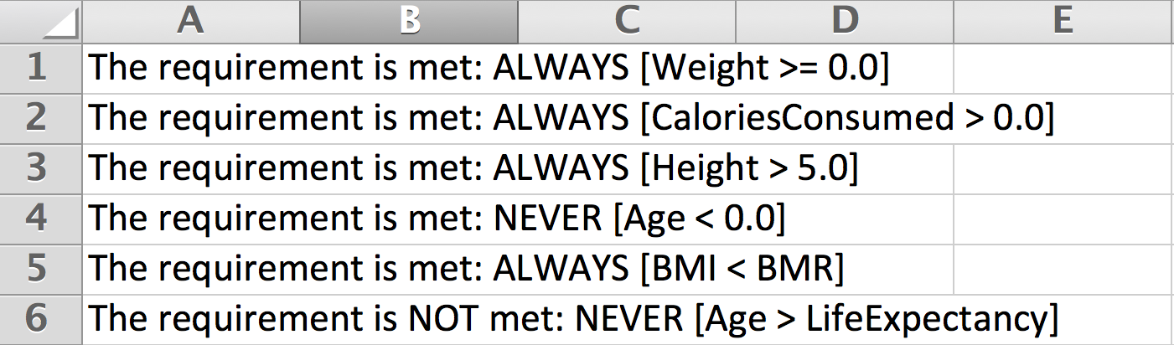
Model Checking Analysis

Slide 15
Model Checking Analysis
Based on the rows in the log file reports if the requirement is met.
Analysis is exhaustive for the log file.
Analysis is NOT exhaustive for the simulation.
NOT as powerful as model checking which can identify if the model is capable of producing any condition that violates a requirement.

Slide 16


Reset - Goals
Ensure SME conceptual model matches
implementation of simulation.
Do certain properties always hold in my simulation?
Are certain constraints never violated?
Under what conditions are the unexpected behavior(s) manifested?

Slide 17
Defining the Unexpected Output
Recall the final column of the log file contains the simulation output.
SME specifies the range of the output that is considered expected.
Anything falling outside that range is considered unexpected.
Tool conveys % of test cases with output falling in expected range to SME.

Slide 18
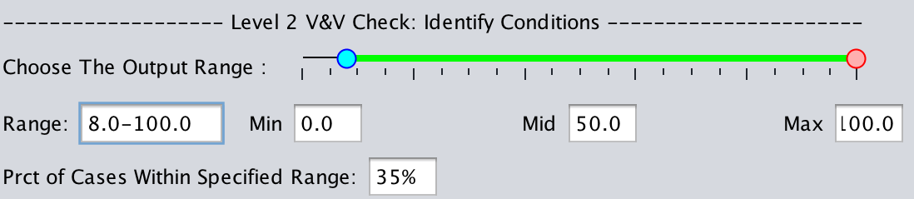
Defining the Unexpected Output
Recall the final column of the log file contains the simulation output.

Slide 19
Isolating conditions that occur with an unexpected output
Idea is to measure the extent to which a given predicate is:
correlated with the presence of the unexpected output (similar to precision)
covers those cases where the unexpected output is produced (similar to recall)

Slide 20
Isolating conditions that occur with an unexpected output
Correlation of a given predicate p with an unexpected output u:
u_{p} = # rows where unexpected output occurs and p is true.
e_{p} = # rows where expected output occurs and p is true.

Slide 21
Isolating conditions that occur with an unexpected output
Extent to which a given predicate p covers an unexpected output u:
u_{p} = # rows where unexpected output occurs and p is true.

Slide 22
Isolating conditions that occur with an unexpected output
Predicates with high correlation and coverage:
Almost only occur when the unexpected output occurs.
Occur almost every time the unexpected output occurs.
To balance correlation and coverage the harmonic or geometric mean is used.
Tool produces a csv file with correlation, coverage and mean of generated predicates.

Slide 23
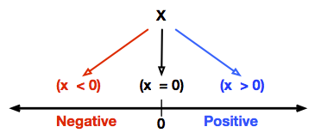
Reset: Static Predicates
Single variable predicates created by partitioning the values of a variable in the log file around 0.
In scalar pairs we partition the difference of two variables at 0 [i.e. x < y or (x – y) = 0]

Slide 24
What’s wrong with this?
The predicates are static!
In other words the comparison to a value (i.e. 0) is made before we can analyze the values.

Slide 25
Static Predicates – Lack Elasticity
Static Scalar Pairs Predicate – compares the value of the difference between a variable x and a variable y to 0
Examples:
x > y | x – y > 0
x = y | x – y = 0
x < y | x – y < 0

Slide 26
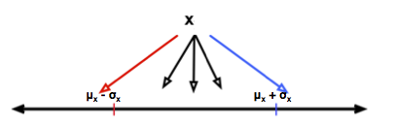
Elastic Predicates
Sample the distribution of values a variable takes on to partition the values of a variable.

Slide 27
Single Variable Elastic Predicates
Sample the distribution of values a variable takes on to partition the values of a variable.
Predicate | Description
x > μ_{x} + σ_{x} | Unusually Large Value
μ_{x} - σ_{x} < x_{y} < μ_{x} + σ_{x} | Usual Value
x < μ_{x} - σ_{x} | Unusually Small Value

Slide 28
Scalar Pair Elastic Predicates
Sample the distribution of the difference of values between two variables x and to partition predicates comparing the two.
Predicate | Description
x – y > μ_{x-y} + σ_{x-y} | Unusually Large Value
μ_{x-y} - σ_{x-y} < x-y < μ_{x-y} + σ_{x-y} | Usual Value
X-y < μ_{x-y} - σ_{x-y} | Unusually Small Value

Slide 29
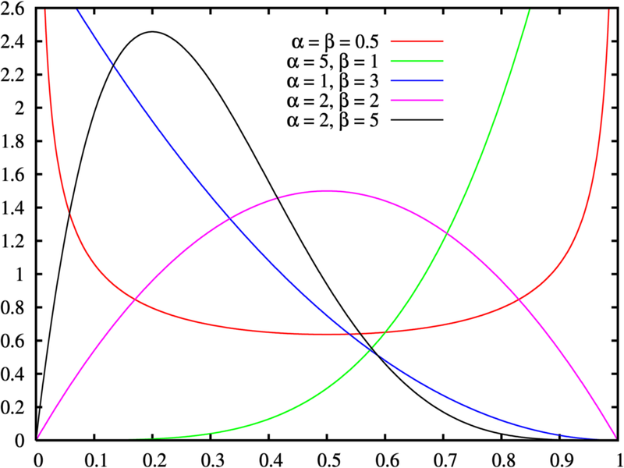
Assuming All Data Is Normal, Eh?

Slide 30
Elastic Predicates
We are assuming a normal distribution as a heuristic to get useful predicates.
We have thoughts on inferring the distribution of the data to get even better predicates but have no implementation.

Slide 31
Other predicates for analysis?
Compound Predicates - Tool will generate all predicates that combine elastic and static predicates formed with single variable and scalar pair structures with AND/OR.
Custom Predicate – SME can specify any predicate s/he’d like and use any operator supported by JAVA. Calculator will determine the coverage and correlation of the predicate.

Slide 32
Using the tool in practice
Step A: Setup
Start
Specify Hypotheses
Specify Outputs that should ALWAYS/NEVER Occur
Specify Type of Experiment
Specify Expected Conditions
Trace Experiment
Optimization Experiment
Uncertainty Experiment
Specify Expected Output
Determine Number of Unique Experimental Setups
Determine Number of Replications

Slide 33
Using the tool in practice
Step B: Data Collection and Testing
Run Experiments
Check Results against Level 2 Specifications
Record TRUE/FALSE output for each run
Provide list of Conditions Contributing to the Expected Output
Load Results into the V&V Calculator
Yes
Check Results against Level 1 Specifications
Fail Experimental Requirements?
Fail Validation
No
Yes
Check Results of Hypotheses
Violate Specifications?
No
Fail Verification
Step A

Slide 34
Further Reading
Gore et al. "Statistical debugging for simulations." ACM Transactions on Modeling and Computer Simulation (TOMACS).
Diallo et al. "Emergent behavior identification within an agent-based model of the Ballistic Missile Defense System using statistical debugging." The Journal of Defense Modeling and Simulation (JDMS).
Gore et al. "Applying statistical debugging for enhanced trace validation of agent-based models." SIMULATION.
Diallo et al. "Formal methods, statistical debugging and exploratory analysis in support of system development: Towards a verification and validation calculator tool." International Journal of Modeling, Simulation, and Scientific Computing.

