Slide 1

Detecting and Exploiting Emergent Security Behaviors in Cyber-Physical System Architectures
A Weird Machines Approach
Jada Cumberland, Brianne Dunn, Samuel Jackson

Slide 2
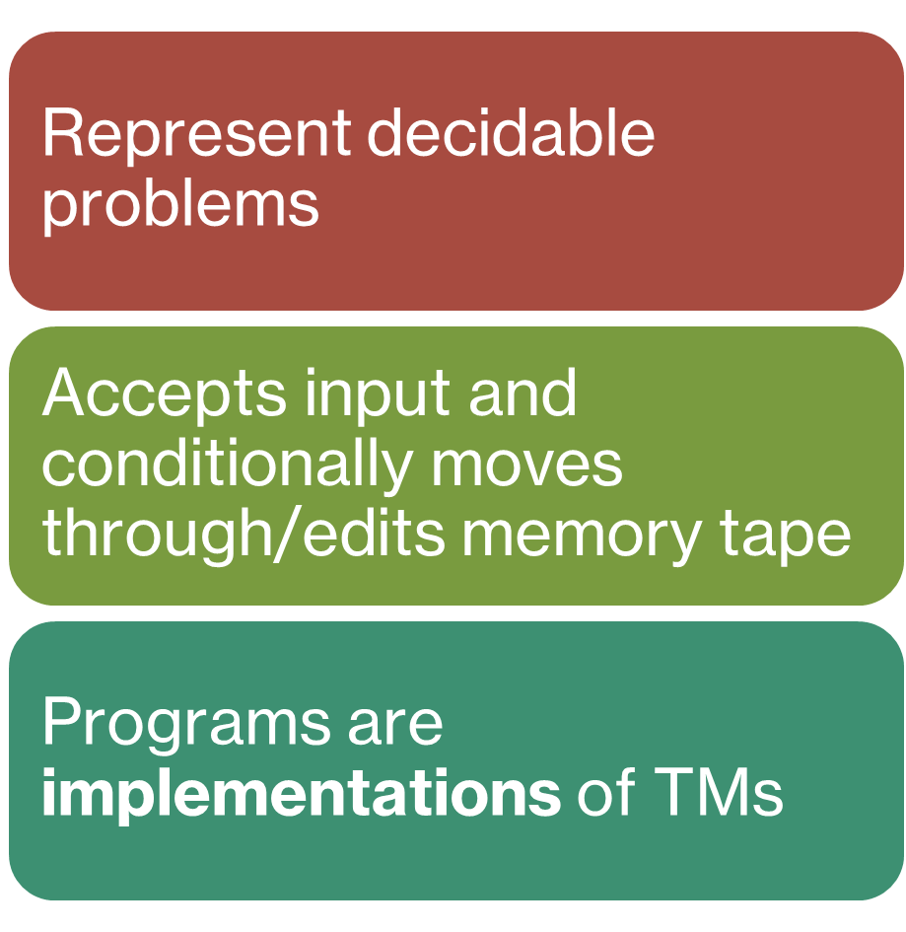
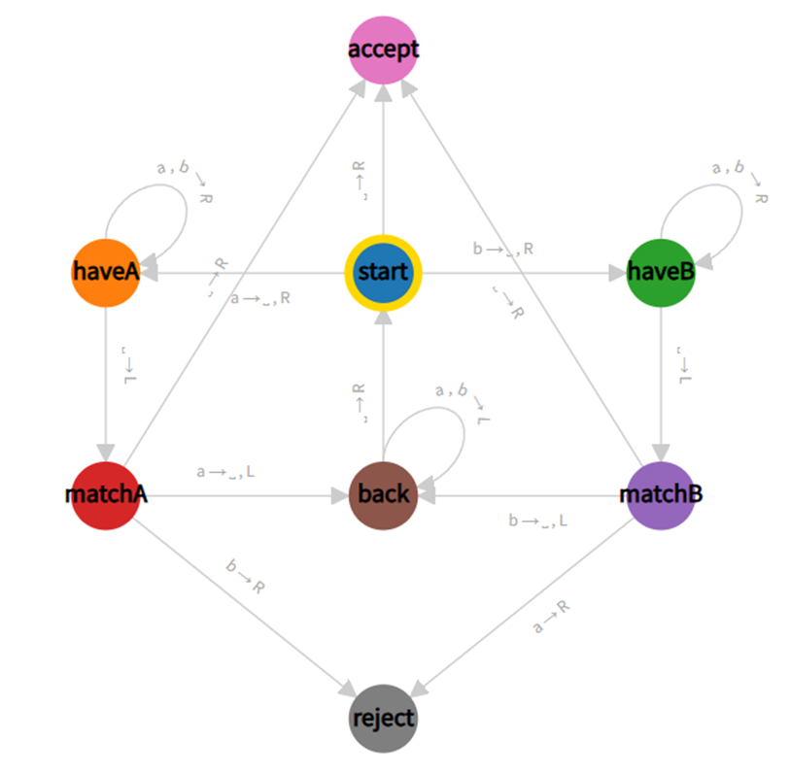
Turing Machines
Notes:
Turing machines were initially ideated by Alan Turing, an English mathematician. They consist of a “tape,” which represents an arbitrary amount of memory, and a “tape head,” which points to the current position in the memory. The head reads the value at that position in memory and conditionally moves to the left or right. The underlying Turing Machine consists of various states and transitions, which provide instructions to write a value and move left or right based the input value. In computer science, they are used to represent decidable problems, which are problems that are “computationally feasible” to compute. Computer programs are implementations of Turing Machines, although exact implementations may depend on the language and programmer.

Slide 3
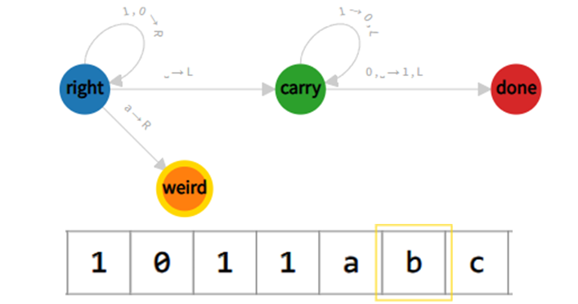
What is a weird machine?
A computational artifact where code execution can happen outside the original specification of the program due to unexpected input
Notes:
So, what happens when the implementation of a Turing Machine does not match the theoretical design? The Turing Machine in the image (from https://turingmachine.io) simulates adding “1” to a given binary number. The machine moves right to the end of the binary number, then moves left and changes 1s to 0s until a 0 or blank is reached and changed to a “1” in the transition to the “done” state. A programmer could implement this fairly easy in almost any modern language, but while the TM itself may not be affected by unintended inputs, the implementation could be. This is the central concept of the “Weird Machine;” unintended (“weird”) states and behaviors can emerge from inputs that the programmer did not account for or consider. A very well-known example of this is a Buffer Overflow attack, where an attacker uses a specially-crafted input to overwrite values on memory and arbitrarily execute code.
Weird machines can add both benign and malicious functionalities to a machine.

Slide 4
Weird Machine Reading List
Dullien, T. Weird Machines, Exploitability, and Provable Unexploitability
Bratus, et al. Exploit Programming: From Buffer Overflows to “Weird Machines” and Theory of Computation
Bratus, et al. Hacking & Computer Science
Pavlovic, Seidel. Security Science (SecSci), Basic Concepts and Mathematical Foundations
Dullien, T. Programming the Weird Machine
Riley, Karen, et al. Crema
Benjamin, Thomas S., et al. Computing with Time: Microarchitectural Weird Machines
Notes:
Sam - From Buffer Overflows to “Weird Machines” and Theory of Computation paper was the most helpful because it reframed exploits not as ad-hoc hacking, but as programs for emergent “weird machines,” which really helped connect practical exploitation techniques to computability theory and providing a clearer way to reason about unexpected system behavior.
Jada - Both Bratus papers were especially useful in understanding what a Weird Machine was and how it could result from existing structures in a program or system. Hacking & Computer Science introduced the concept of data-ruled machine rather than machine-controlled data. Machines operate based on the data they are given and are thus controlled by them. From Buffer Overflows… provided exploits as proofs for the presence of Weird Machines, connecting the security mindset to the theoretical.
Bri - Hacking & Computer Science by Bratus introduced that security complexity can be a detriment in many systems even when organized within layers. It suggested that every system operated on some layer of trust, inviting exploitation a complex environment a weird machine would thrive in. Additionally, Weird Machines, Exploitability, and Provable Unexploitability by Dullien helped in defining a weird machine as a unintended, but functional state existing between a system’s normal operations.

Slide 5
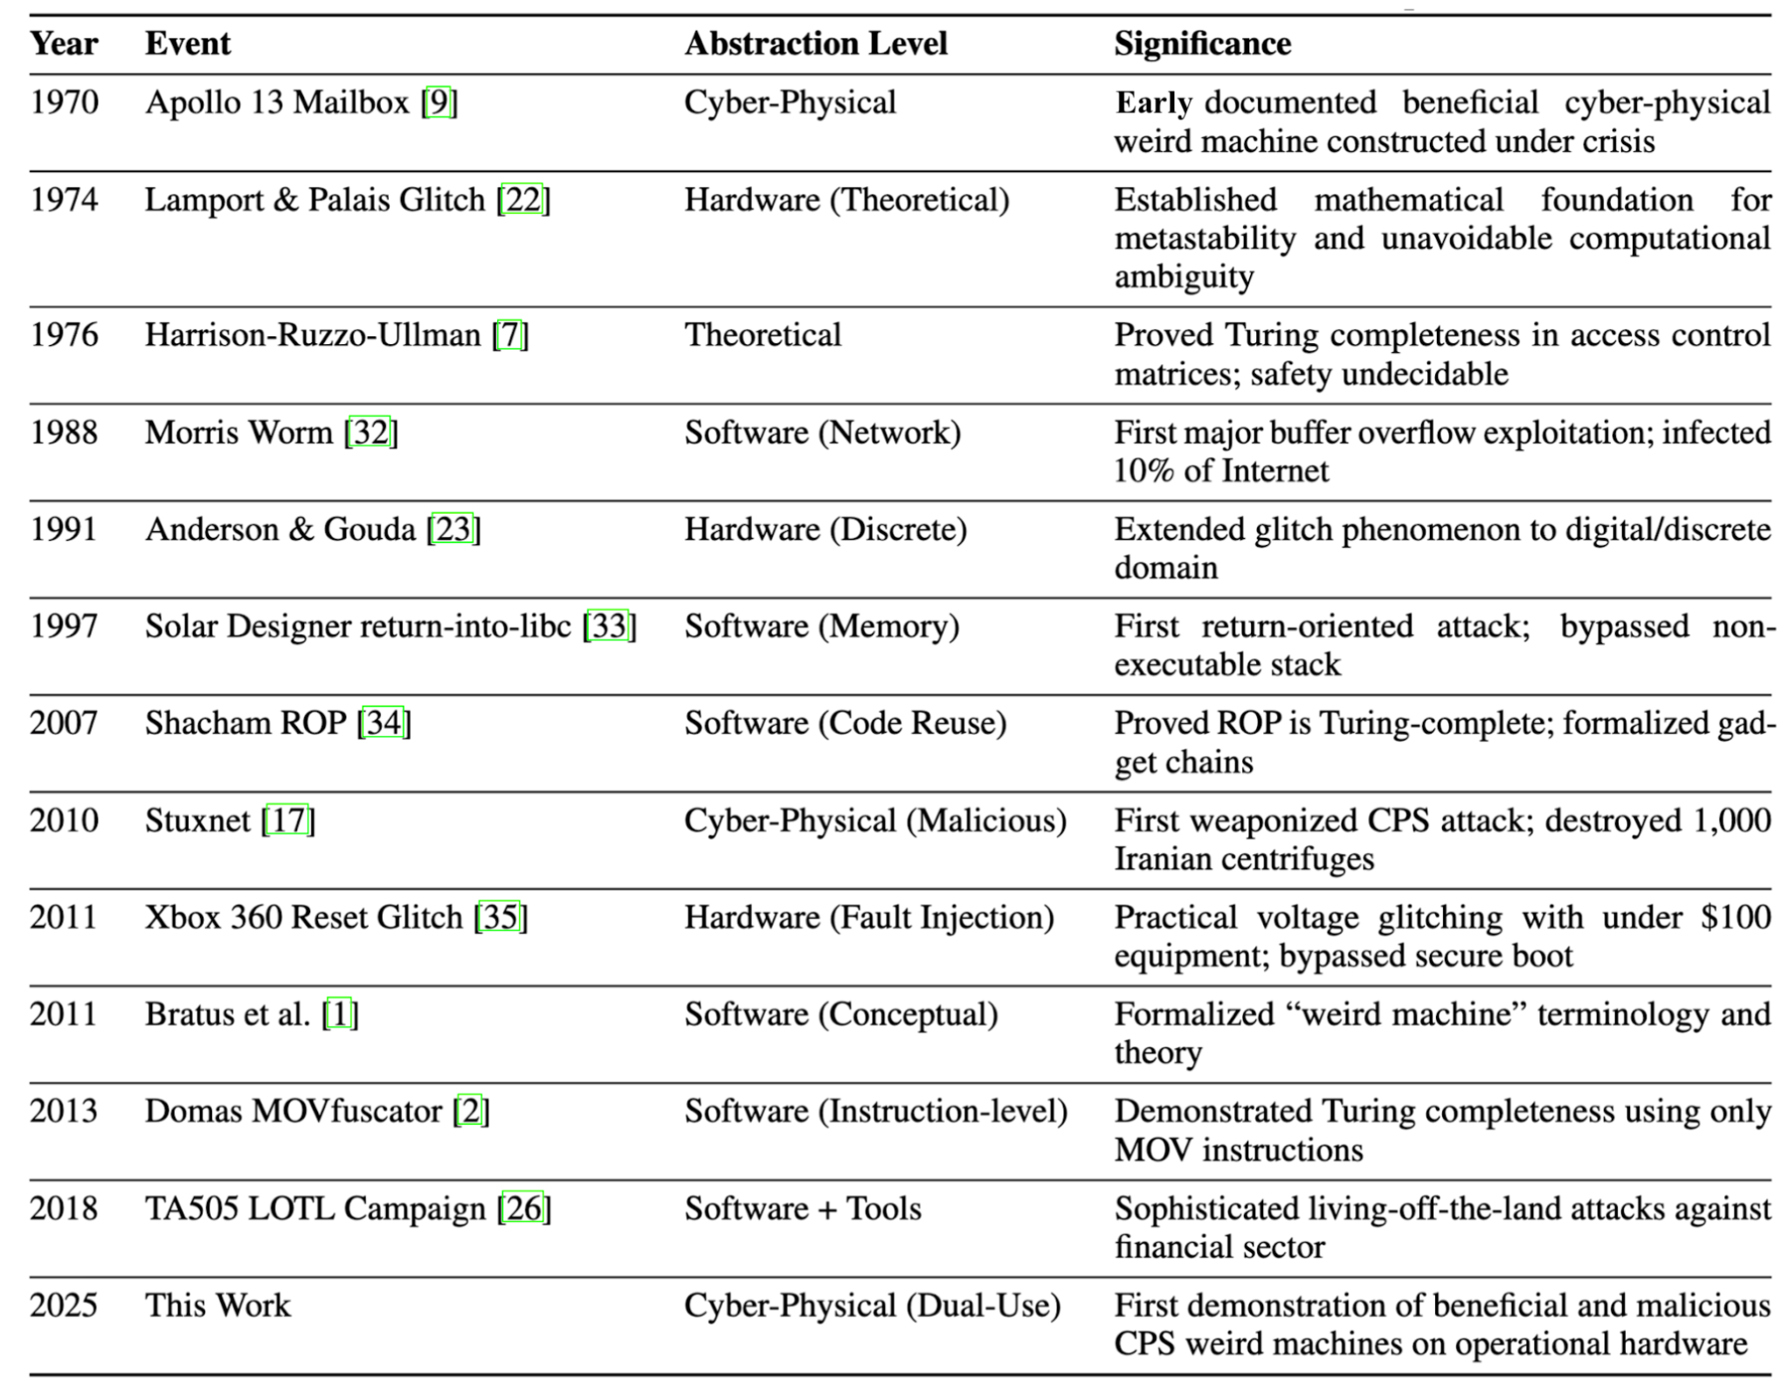
Weird Machine Timeline
Notes:
This timeline shows that weird machines aren’t new they have appeared repeatedly across hardware, software, and cyber-physical systems.
An early weird machine example is the Apollo 13 Mailbox, arguably one of the first recorded beneficial cyber-physical weird machine, astronauts repurposed constrained hardware and procedures to compute a life-saving solution under failure conditions.
By the 1980s and 1990s, weird machines became visible in software, with the Morris Worm and early memory-reuse attacks demonstrating unintended computation at scale.
In the 2000s, this behavior was formalized by ROP (Return-Oriented Programming) proving that even restricted gadgets can be Turing-complete, and Bratus et al. paper formally named and unified these behaviors under the concept of weird machines, giving us a vocabulary to reason about them.
This work builds on that history by demonstrating intentional, dual-use weird machines in cyber-physical systems, showing they can be both beneficial and malicious depending on how they’re composed.

Slide 6
Thinking about previous experiences and weird machines
Arista EOS (Extensible Operating System) Logging as a Weird Machine
  Intended Machine:
    Local logging and remote logging are independent
    Local logs persist even if remote forwarding fails
  Weird Machine:
    An emergent control path where the TCP reachability of a remote syslog server controls whether local device logging executes.
Robolink Zumi Programmable Cars
  Intended Machine:
    Car executes code as entered, then stops
  Weird Machine:
    Car catches on specific parts of code and loops
    Sensor data as input to unintended state

Slide 7
Thinking about previous experiences and weird machines (cont.)
Swapping Movesets in Tekken 8
    Users were able to find a bug which allowed male characters to use an unintended slap move on female characters
    Found through conditionals that incorporated stance changes, specific timing, and a reaction from the opposing character.
    This allowed for even deeper exploitation, allowing for discoverable data.
  Intended Machine
    A fighting game with rigid movesets, some moves being gender locked to certain characters.
Weird machine
  Everyone was able to respond to slap prompt, movesets became variables that allowed users to find new data.
Notes:
My personal experience of a weird machine came from a fighting game, Tekken 8, where through using unexpected inputs, players were able to give male characters access to a slapping move only intended for female characters. Users then exploited this further by building a syntax upon it when introducing other factors like specific stance changes and timing. As a result, movesets that had hardly changed for decades, became variables as characters began swapping movelists entirely, even allowing players to discover data tables for characters not yet in the game.

Slide 8

Weird Machine Gadgets
What is a gadget?
Set of architectural artifacts that can be composed to construct a program
Architectural artifacts can be:
Software
Protocols
Physical components
Example: Video Game Save File Corruption
Gadgets: Save file format, game state parser, memory layout
Composition: Carefully corrupt specific bytes in the Final Fantasy VII save file to gain extra items
The Final Fantasy VII save file is just data, but when the parser crashes on malformed input, it becomes a lever for control.
Notes:
A weird machine gadget is just a set of pieces in a system that were never meant to be a programming language, but that you can still “wire together” to make the system follow your instructions. Think of it as finding Lego bricks hidden inside something that was supposed to be finished and fixed.
In the video game world, a famous example showed up in Final Fantasy VII. Players discovered that by performing a particular sequence of actions around saving, loading, or exiting, the game would write inconsistent state to disk and then reload it as if the same item existed in two places. Players ended up with duplicate high-value gear or endgame items much earlier than intended, effectively “programming” the game into giving them extra items without touching the code directly
So the save file, the game’s loader, and the console’s memory layout together form a gadget: controllable pieces that, when combined carefully, behave like a little unintended program. The designers never meant for save files to be code, but attackers turned them into exactly that.

Slide 9
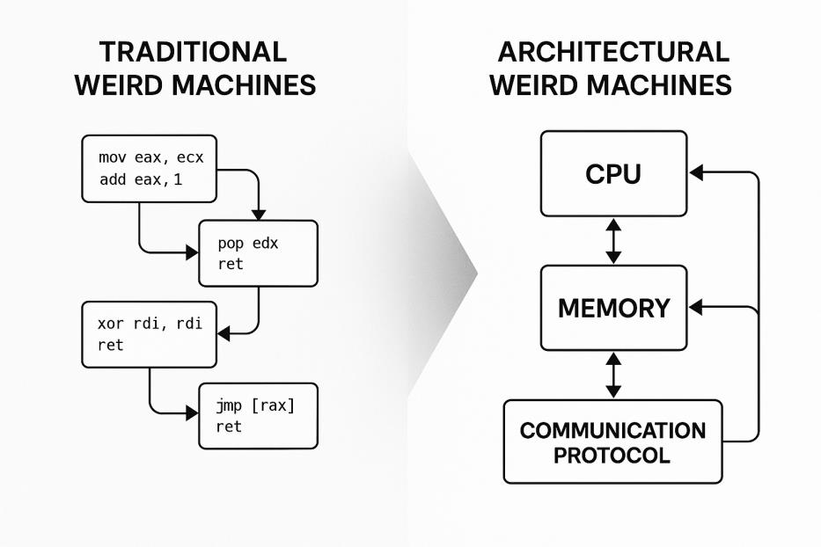
Architectural Weird Machines
Unlike traditional weird machines which use code-level gadgets, architectural gadgets exploit the interactions across system boundaries, communication channels, and operational constraints.

Slide 10
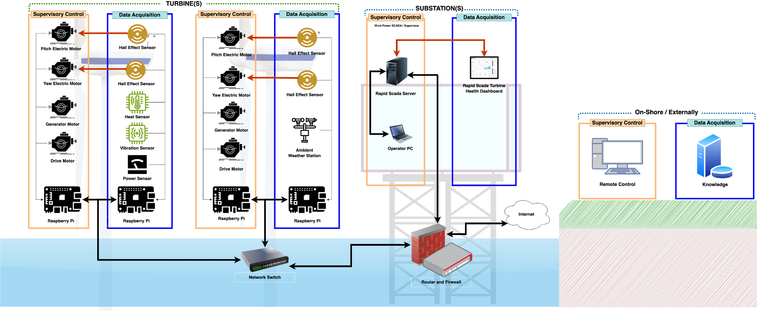
Our Wind Energy Testbed
Modbus Connection
Notes:
The wind energy test bed operates as a scaled-down cyber‑physical wind farm, integrating turbines, industrial controllers, and a SCADA system into a unified environment.
The architecture centers on Modbus TCP interconnections. Edge controllers (PLCs and Raspberry Pis) expose turbine data and command interfaces via Modbus, which are routed through a custom Python‑based proxy. This proxy inspects Modbus traffic to authenticate devices, effectively acting as a secure gateway before forwarding data. The Rapid SCADA server is configured to poll and control these networked devices simultaneously using Modbus commands, mapping specific registers to system logs. This design replicates the Modbus‑driven supervisory control and cybersecurity stack of a production wind farm.

Slide 11
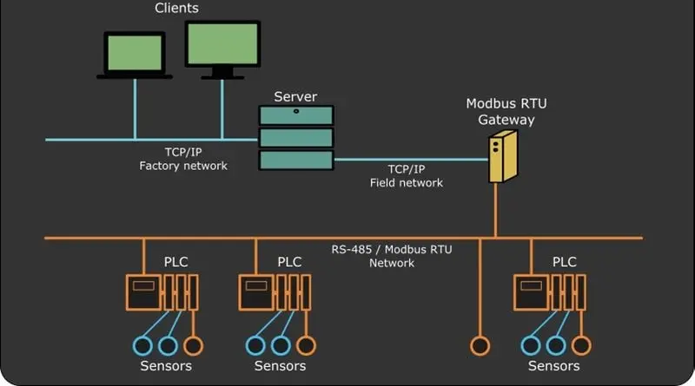
Modbus is the connective tissue
Building blocks:
Coils (on-off) &
Registers (numeric values)
Shared access enables real-time coordination
Simplicity creates "opportunity"
Notes:
Modbus defines how everything communicates in the test bed. It uses two simple building blocks: coils, which are like on-off switches, and registers, which store numbers. Every sensor and every control device gets assigned an address. When a turbine's wind sensor measures the wind speed, that number shows up in a specific register. When the SCADA server wants to shut down a turbine, it flips a specific coil. A key feature is that same register can be read by multiple systems at the same time. This shared address space is really the connective tissue of the whole system. Every device in the wind farm—sensors, controllers, the SCADA server—they're all reading from and writing to the same set of addresses. It's elegant, but it also means that any device connected to the network could potentially access any register.

Slide 12
Building weird machines using components like modbus can be hard when you have a software mindset
Software mindset assumes:
  Clear APIs
  Deterministic behavior
  Separation between control and execution
Cyber-physical reality breaks those assumptions:
  Software decisions directly affect physical state
  Hardware timing, sensors, and actuators introduce tangible side effects
Weird machines Emerge:
From composition, side effects, and misused assumptions
Python gadget libraries helped bridge this gap by:
  Abstracting low-level hardware and protocol details
  Exposing simpler, composable primitives
  Enabling rapid experimentation with unintended behaviors
Result: easier exploration of emergent control and computation
GitHub Repository: https://github.com/rossgore/weird_machine_gadgets
Notes:
Coming from a traditional software mindset, we expect systems to behave according to their APIs, inputs go in, outputs come out, and anything unexpected is treated as a bug.
That assumption breaks down in cyber-physical systems, where software doesn’t just compute, it directly controls hardware.
In our wind-energy testbed, PLC logic and control software affect physical turbines, sensors, and actuators. Timing delays, protocol retries, and feedback loops introduce behaviors that simply don’t exist in software-only systems.
This is where weird machines emerge – not purely in code or hardware, but in their interaction.
Because we’re not energy engineers or PLC experts, we built a Python API that abstracts Modbus registers, PLC state, and timing behavior into composable software primitives. This let us explore the architecture as software engineers and ask: what unintended machines already exist here?
Using these gadgets, we could intentionally compose and discover cyber-physical weird machines in software. In future work, these models will be deployed onto the actual hardware to evaluate how much of this behavior can run in the background of a live system.

Slide 13
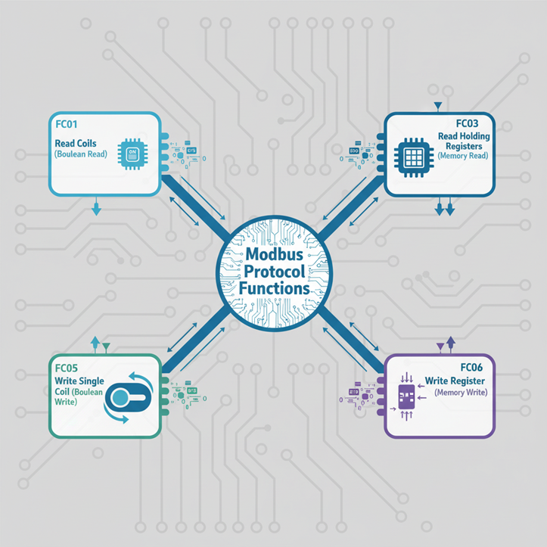
Wind Energy Testbed Weird Gadgets: Modbus
The testbed uses 16 function code (FC01-FC16) that operate like opcodes in a computer’s instruction set. The most significant ones include:
FC01 (Read Coils): Boolean read operations
FC03 (Read Holding Registers): Memory read operations
FC05 (Write Single Coil): Boolean write operations
FC06 (Write Single Register): Memory write operations

Slide 14
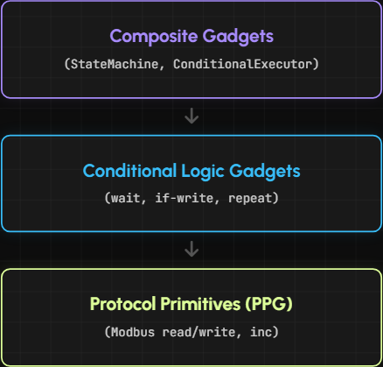
Wind Energy Testbed Weird Gadgets
Core Idea: Using the Modbus Protocol “opcodes” we can create computational behavior through composition.
Gadget Stack (3 layers):
  PPG (Protocol Processing Gadgets)
    Provide register/coil read+write and increment/decrement primitives
  CLG (Conditional Logic Gadget)
    CLGs provide emergent control-flow-like behavior using only protocol interactions such as while-loops, if-statements, and do-while loop
  Composite Gadgets
    Higher-level logic like a State Machine or a Conditional Executor
Notes:
In the wind-energy testbed, we treat Modbus-like operations as primitives. By sequencing register/coil reads and writes,
then adding control gadgets like wait/conditional/loop, we can build composite behaviors like counters, timers,
and even state machines computation emerging from the protocol itself. Allowing unintended computational structure to emerge within a non-computational control protocol.

Slide 15
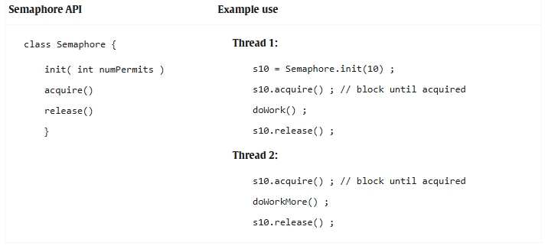
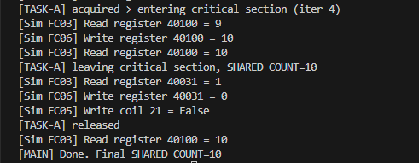
Wind Energy Testbed Weird Machines
Here are the Weird Machines we composed using our manufactured Weird Gadgets:
Binary Semaphore Weird Machine
  Emergent synchronization primitive built from protocol & control gadgets
  Enforces mutual exclusion over a shared resource

Slide 16
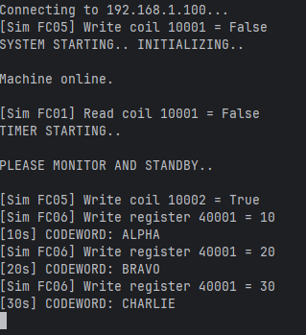

Wind Energy Testbed Weird Machines (cont.)
Weird Machines composed using our manufactured Weird Gadgets
Code Signaling Weird Machine
  Utilized modbus coils and registries
  Machine stored conditional flags to coils to signal whether machine was vulnerable
  Sent code words from registry,
  After countdown value would modify coil to display vulnerability
Notes:
Using the modbus features I created a counter that relayed codewords only if a coil was flipped as true. These codewords would be signaled in intervals, writing strings to register addresses, and then finally modifying the initial coil to return back to false after completing. As mentioned previously, modbus coils naturally flip in changes to the machines operation. A simple program like this would allow for an outsider to not only monitor but also exploit vulnerable states, as this would only execute from naturally occurring conditions in the machines intended state.

Slide 17
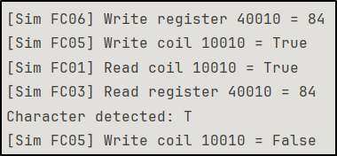
Wind Energy Testbed Weird Machines (cont.)
Remote Mailbox
  Segmented: Send a message one character at a time in server registries
  Unsegmented: Save and retrieve messages in server registries
  Utilizes: Conditionals, loops, read/write to registers/foils
Notes:
This implementation of the Weird Gadgets creates a remote mailbox system where messages can be read and written. There is a segmented implementation, where messages of arbitrary size can be sent one character at a time, and an unsegmented implementation, where messages less than some memory size are converted to raw bytes and stored for retrieval. Both pseudo programs make use of conditionals and read/write functions with both integer registers and binary foils. The segmented program also uses loops to iterate through each character of the message.
The included screenshot shows one iteration of the segmented messaging system. One system starts by writing a character ASCII value to the specified integer register and changing the “unread message” coil to “On” (logically, “True”). The host checks to see if there is a message by reading the “unread message” coil and goes to read the associated message register if it is on. The character is output to the screen and the “unread message” coil is turned off to mark the message as read. This occurs for each letter in the message, terminating when there are no more characters left to send.
These two programs demonstrate the flexibility of Weird Machines and Architectural Gadgets to create functionality outside of the intended set.

Slide 18




What is Turing Completeness?
Programming Language with full capabilities of a Turing Machine:
  Sequence: Read/write to arbitrary memory
  Selection: Make conditional decisions
  Iteration: Move/jump through memory, loops
Notes:
As they are Turing Complete, these languages can be used to solve any decidable programming problem.
* Something interesting found during the literature review was the Crema programming framework, which proposed non-Turing Complete programming languages. It was created with the argument that Turing Completeness is not always necessary or needed for specific programs.

Slide 19
Are the Wind Energy Testbed Gadgets Turing Complete?
Yes, they satisfy the necessary qualities of Turing Completeness
  Sequence: Capability of reading/writing to registers and foils with “get” and “set”
  Selection: Conditional writes simulate if-then-else
  Iteration: Wait or repeat until condition is satisfied with ControlGadget
Weird Machines => Turing Complete => Solve any “decidable problem”
This work argues Turing completeness by construction and analogy; a formal proof is out of scope

Slide 20
What is coming next?
White Paper & Research Artifacts
  Document our findings, methodology, and lessons learned in a formal white paper. Publication and public release will occur only after sponsor review and approval.
Research Workflow & Tooling Experience
  This research project provides hands-on practice in technical writing, version control, and reproducible research workflows utilizing tools such as Overleaf, Git, and LaTeX.
Scaling Weird-Machine Discovery with LLMs
  Explore a large-language-model consortium approach to assist in identifying potential weird gadgets within complex system architectures such as our Wind Energy Testbed.
Actualizing Our Research
  In the future we will implement these weird machine models on the actual hardware and determine the extent to which they can run "in the background" of the existing system
Notes:
This work doesn’t end with the prototype gadgets we built. The next step is formalizing the research, reflecting on the tooling that enabled it,
and exploring how LLMs could help scale weird-machine discovery across cyber physical systems such as our Wind Energy Testbed.

Slide 21
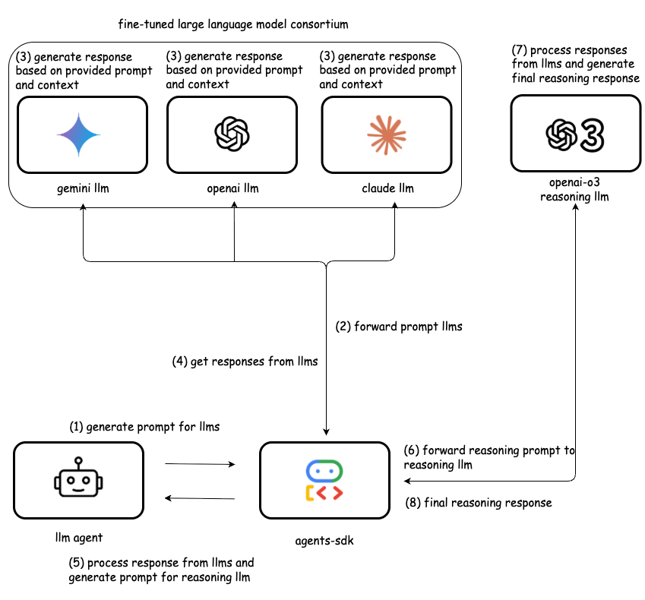
LLM Consortium For Identifying Weird Gadgets from Technical Manuals
Multiple fine-tuned llms independently generate responses, creating redundancy and reducing bias / hallucination
Dedicated reasoning model compares, validates, and synthesizes these outputs into a single trusted result
Notes:
A consortium LLM is a team of specialized models plus a reasoning “conductor” that turns many opinions into one justified decision. It lets us replace a single general model with a coordinated group that can explain what it decided and why.
Instead of relying on one large language model, we use several smaller, specialized models that all read the same technical manual from different perspectives. This setup mimics a case conference: each “expert” notices different clues, and together they give a more reliable answer than any one model alone.
Each member starts as a general‑purpose model, then is fine‑tuned on domain‑specific data and task‑specific outputs. In our case, that means fine‑tuning on the weird‑machine gadget work we already did by hand on the wind energy test bed, using its technical manuals and our labeled gadget examples. That training teaches each model to “speak the local language” of registers, coils, state machines, protocol bridges, and security checks in exactly the way we analyzed them manually.
On top of these specialists sits a reasoning LLM that acts as the orchestrator. It takes their proposed gadgets, compares where they agree or disagree, and then walks through an explicit step‑by‑step argument to choose a final answer and rationale. This turns raw diversity into structured consensus, makes the process transparent, and lets the system know when to hand a hard case back to a human because disagreement remains high.
What the output looks like
For example, the consortium might produce an output like:
“Type: Read/Write gadget. Location: Modbus holding register 40001, accessed via FC03/FC06 in the turbine technical manual. Explanation: By issuing a sequence of legitimate writes and reads to 40001 each control cycle, one can implement a counter variable for use in a weird machine.

Slide 22
Q&A
Points of Contact:
  Jada Cumberland - jcumb002@odu.edu
  Brianne Dunn - bdunn003@odu.edu
  Samuel Jackson - sjack047@odu.edu
  Dr. Ross Gore - rgore@odu.edu
  Dr. Sachin Shetty - sshetty@odu.edu
GitHub Repository: https://github.com/rossgore/weird_machine_gadgets
Notes:
This work doesn’t end with the prototype gadgets we built. The next step is formalizing the research, reflecting on the tooling that enabled it,
and exploring how LLMs could help scale weird-machine discovery across cyber physical systems such as our Wind Energy Testbed.

