Slide 1
A WebSocket-based Approach to Transporting Web Application Data
Ross Andrew Hadden
March 26, 2015
Dr. Paul Talaga, committee chair
Dr. Fred Annexstein, committee member
Dr. John Franco, committee member

Slide 2
Background
Transporting data to clients
Server rendering

Slide 3
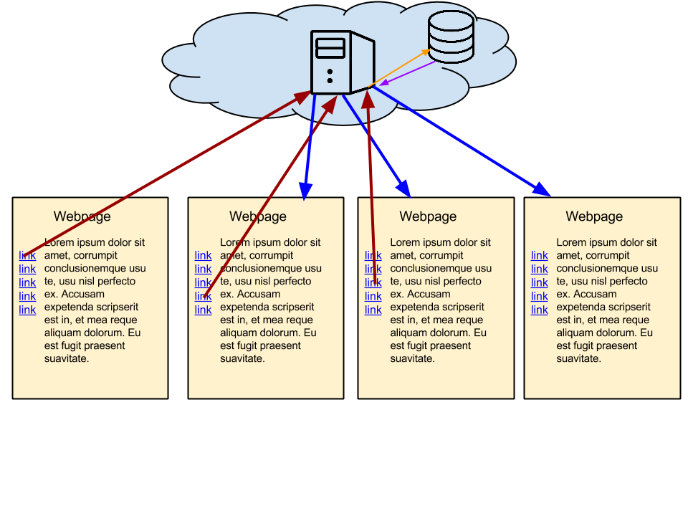
Typical Server Interaction, 1990’s

Slide 4
Background
Transporting data to clients
Server rendering
AJAX

Slide 5
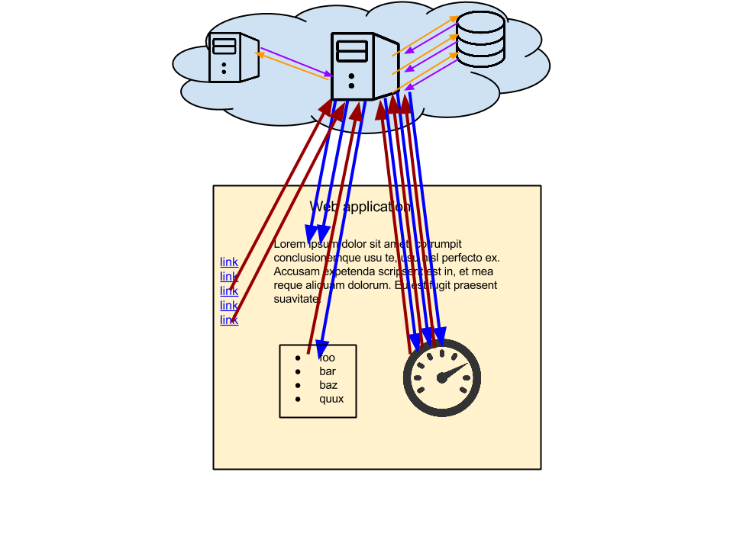
Typical Server Interaction, 2010

Slide 6
Background
Transporting data to clients
Server rendering
AJAX
WebSockets

Slide 7
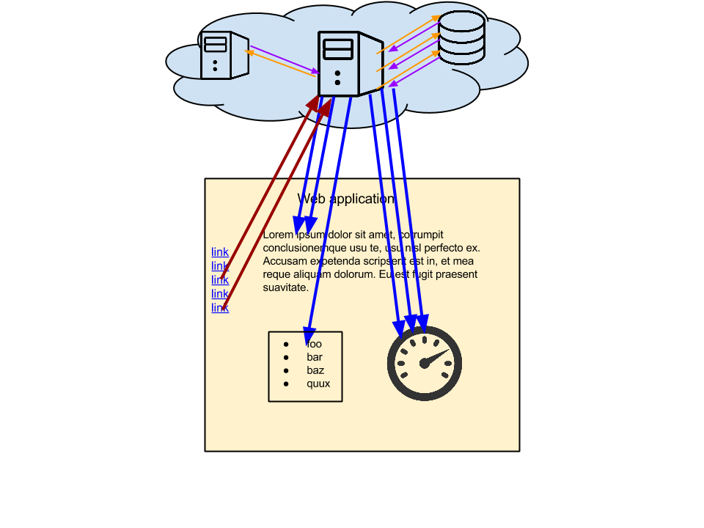
Typical Server Interaction, 2015

Slide 8
Motivation
Maybe we can improve on AJAX!
Reduce request gap
Reduce request latency
Utilize Cornerstone for convenient experimentation

Slide 9
Overview
AJAX method
Client makes endpoint request
Server responds immediately
Client loads
Client fetches data
Client receives data when ready
Thesis method
Client makes endpoint request
Server responds immediately
Server fetches data
Client loads
Client receives data when ready

Slide 10
Theoretical Advantages
No request gap
Fewer requests; same responses

Slide 11
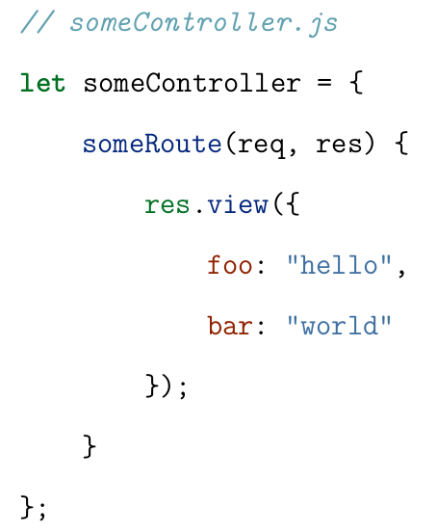
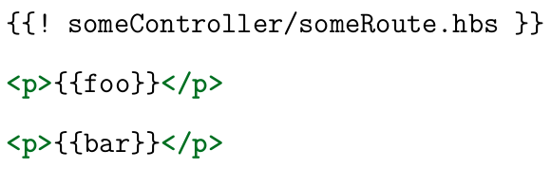
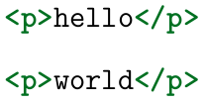
Implementation

Slide 12
Implementation, continued
Promise
WebSocket connection listener
{{{stream}}} helper

Slide 13
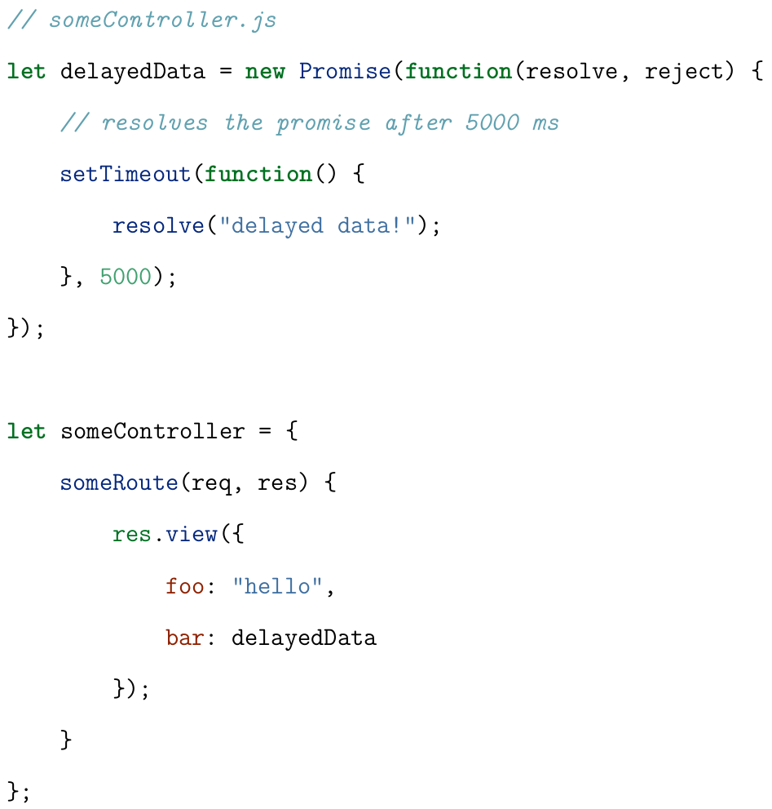

Slide 14
Testing Methods
Server
relatable benchmark
AJAX
modern practice
Stream
thesis

Slide 15
Testing Scenarios
Local file
Local database
Timeout
Series
Parallel

Slide 16
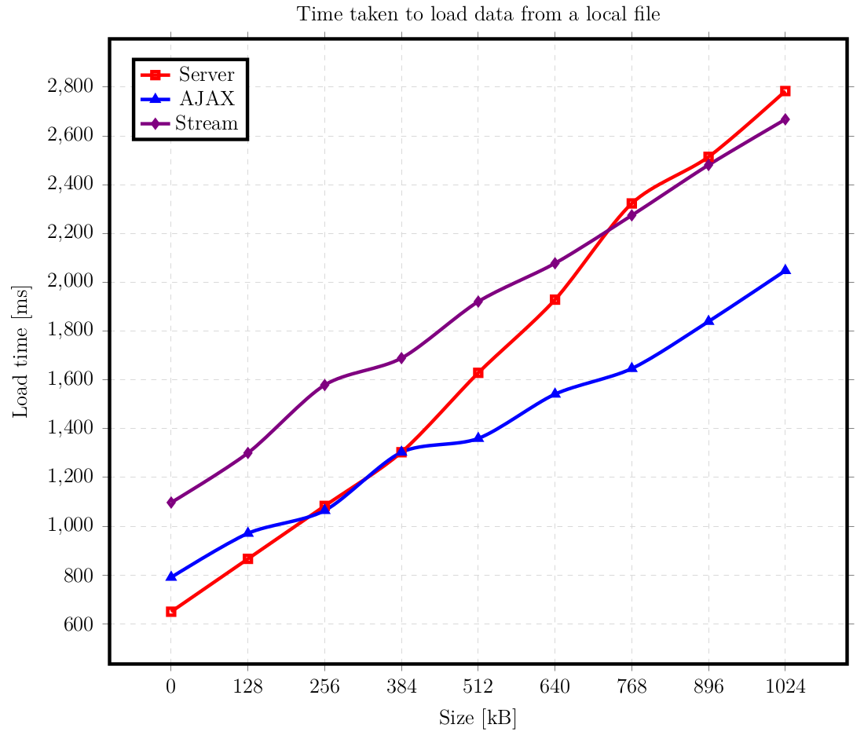
Data - Local File

Slide 17
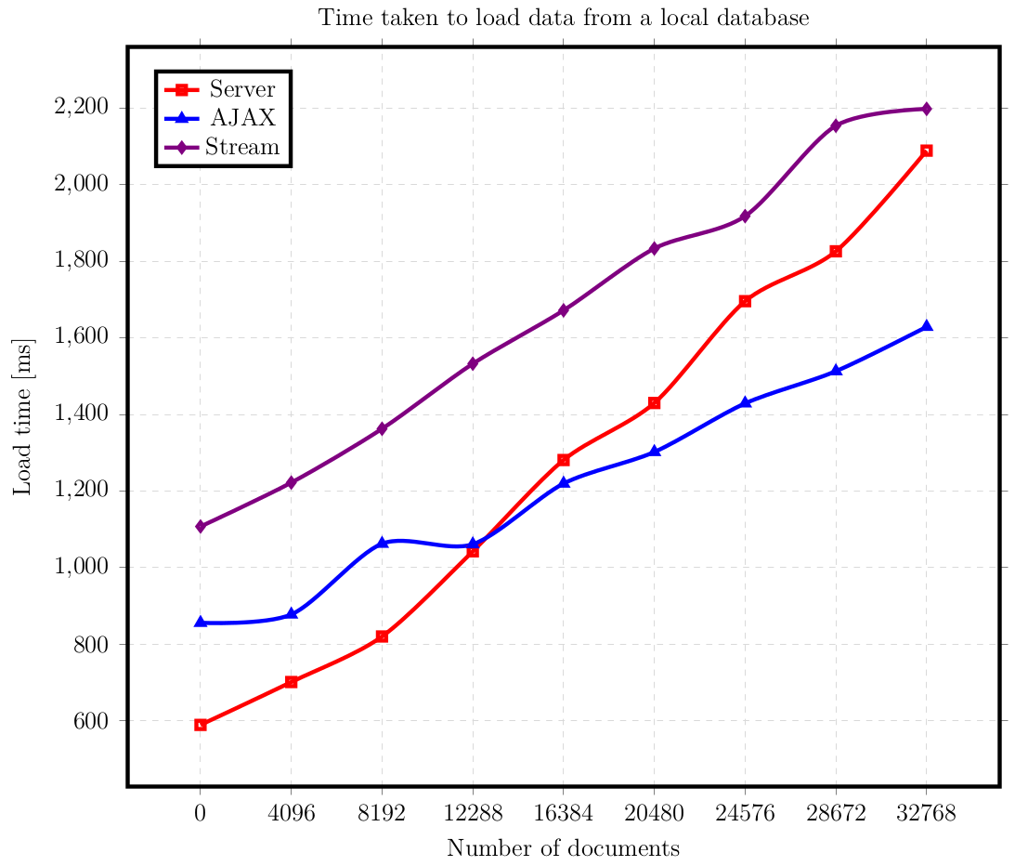
Data - Local Database

Slide 18
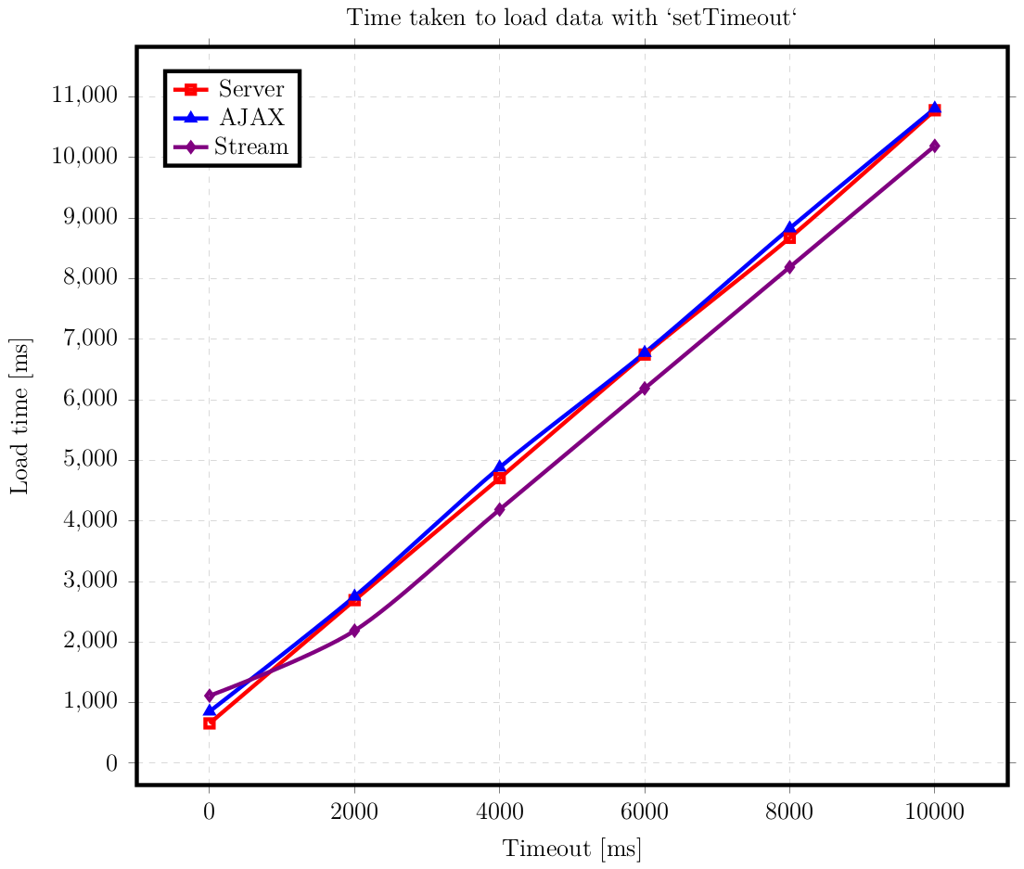
Data - Timeout

Slide 19
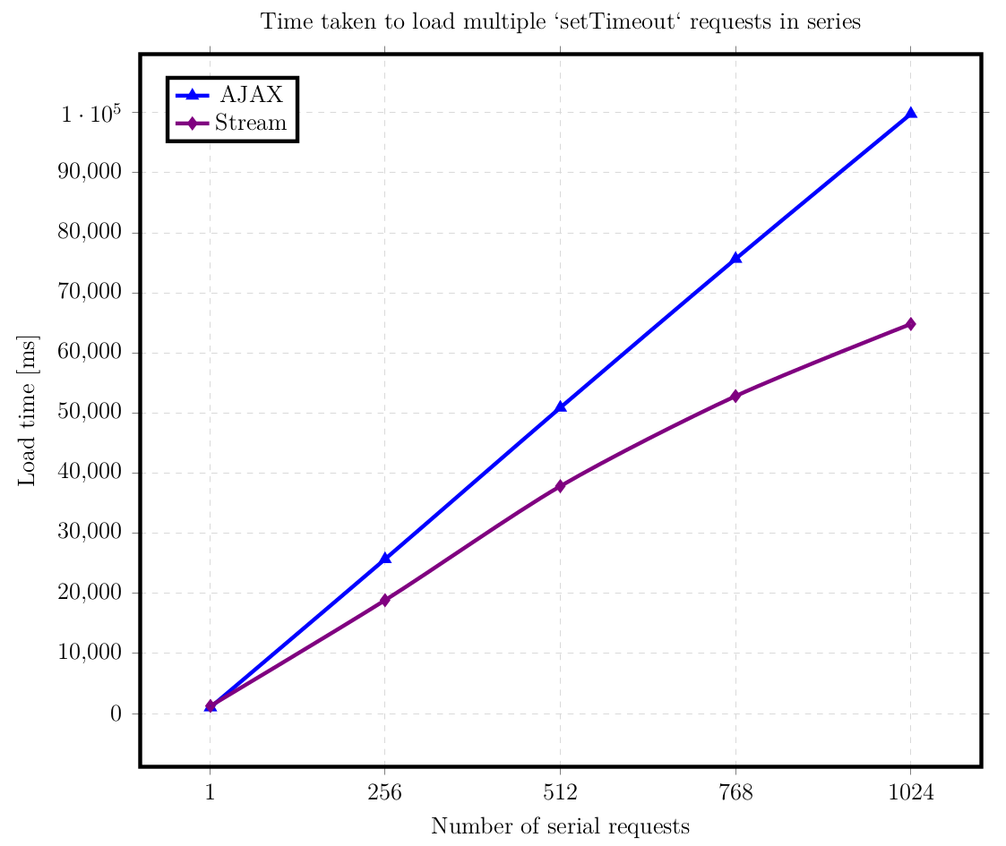
Data - Series

Slide 20
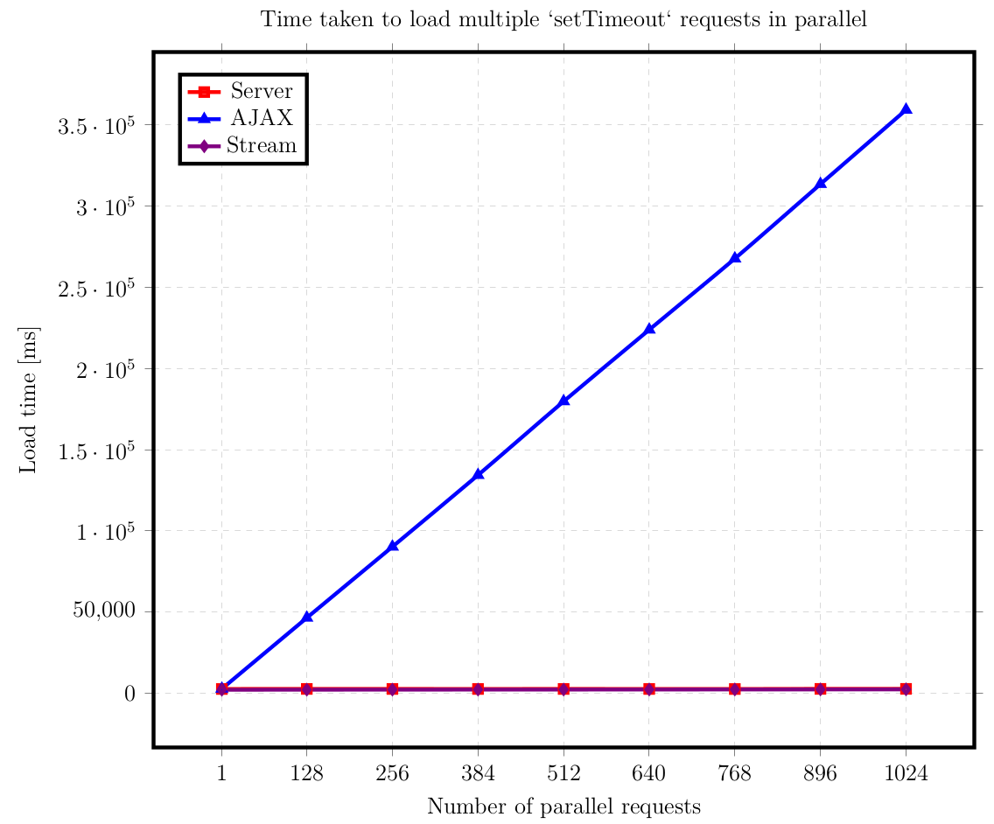
Scenarios - Parallel

Slide 21
Analysis
Number of HTTP requests, responses
Server: 1, 1
AJAX: n+1, n+1
WebSockets: 2, n+2

Slide 22
Analysis, continued
File and database tests
Timeout test
Series test
Parallel test

Slide 23
Conclusions
Parallel requests → WebSockets
Sequential requests → WebSockets
Large data → AJAX
Both?

Slide 24
Related Work
MeteorJS
HTTP pipelining (in HTTP/1.1)
bizarre vendor support
HTTP/2 (formerly Google SPDY)
bizarre vendor support

Slide 25
Future Work
stream data in chunks
stream data updates

Slide 26
Questions?
Feel free to ask me anything

Slide 27
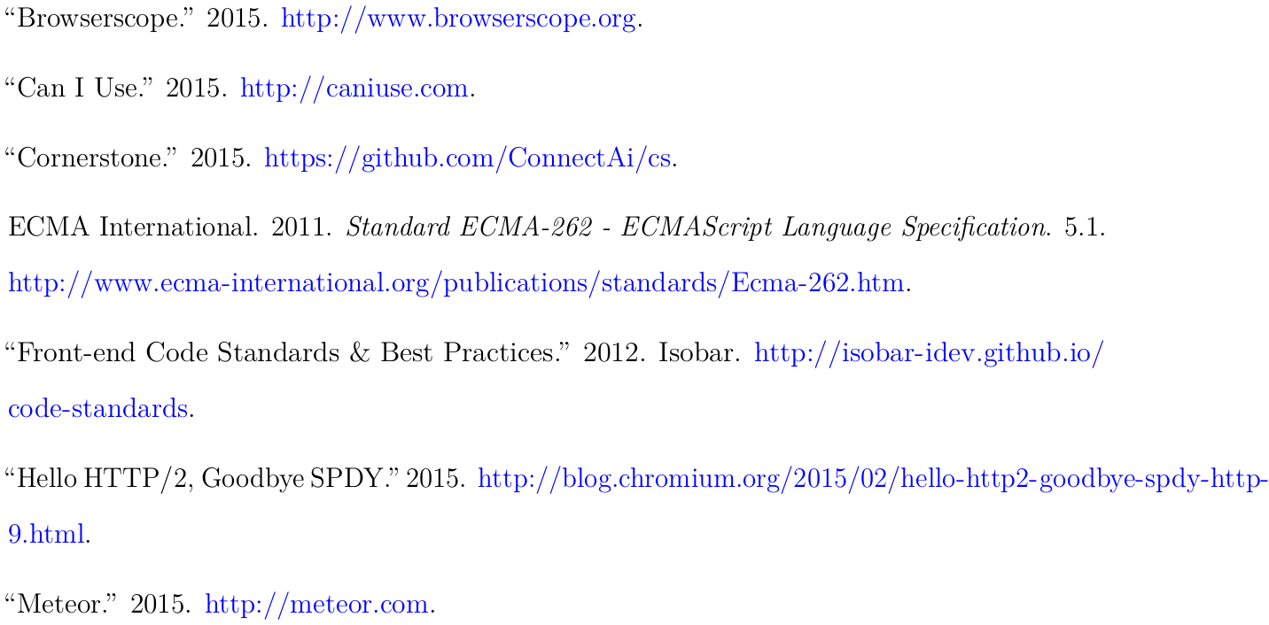
References

Slide 28
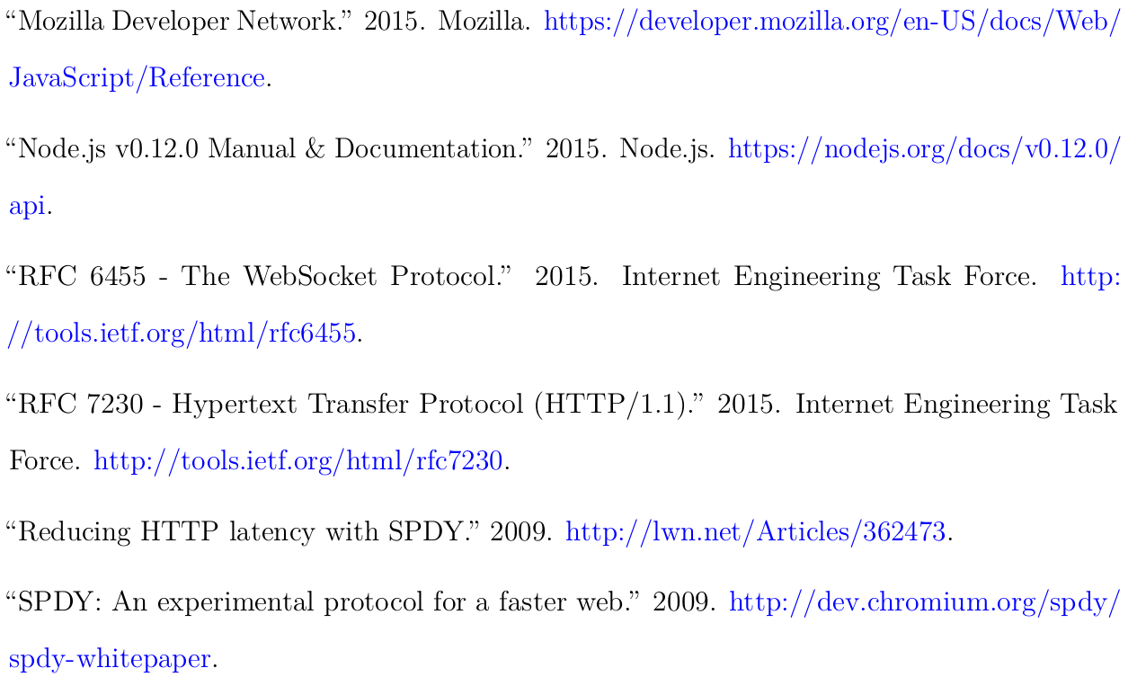
References, continued

Slide 29
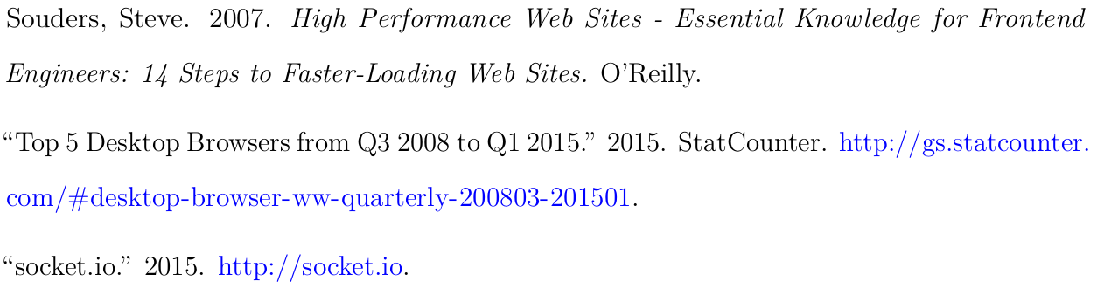
References, continued

