Slide 1

Implementing Security

Slide 2
Authentication and Authorization
Authentication is the process of ensuring that a user is who they say they are
Authorization is the process of ensuring that a user has the right to perform some action

Slide 3
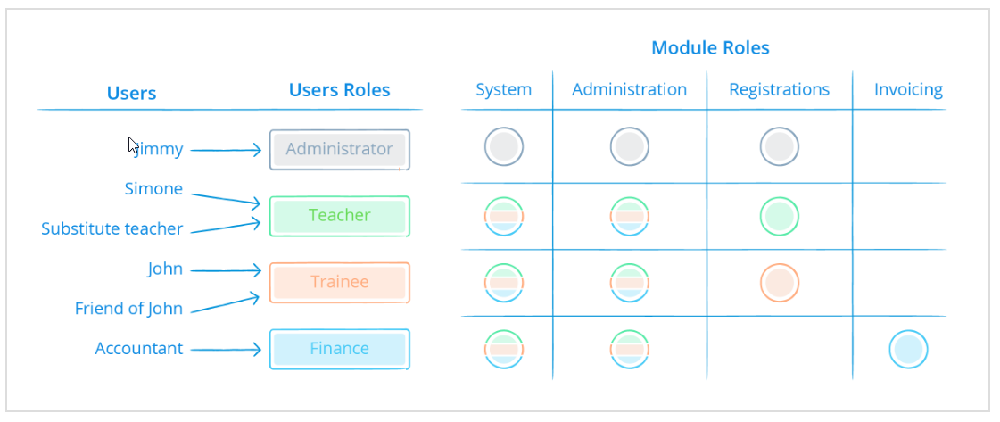
Users are assigned user roles
Modules roles are assigned to objects in the project
Modules roles are assigned to user roles

Slide 4
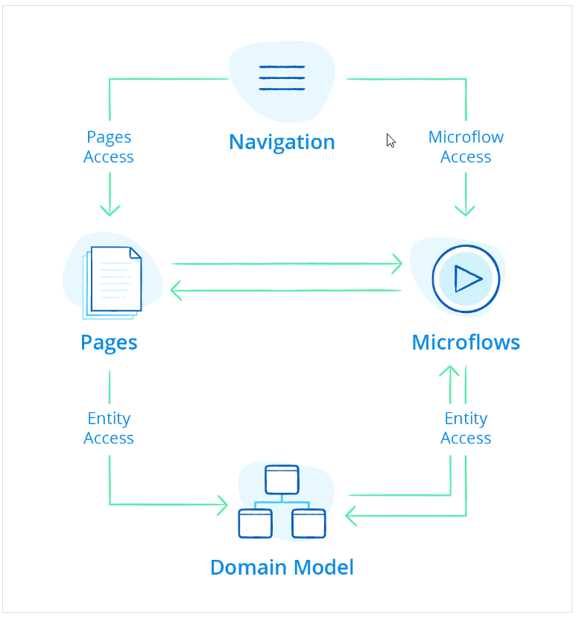
Module security is where you determine who gets to do what. You do this by configuring the Page, Microflow, and Entityaccess.

Slide 5
Page Access
Page access defines which pages can be accessed. The navigation items (menu bars/buttons) will show items only if access is granted.
Page access takes the shape of a matrix showing pages and modules roles. For each combination, you can indicate if the module role has access to the page. You can also edit this information in a page using the Visible for property.

Slide 6
Microflow Access
Microflow access defines which microflows can be used. The navigation items (menu bars/buttons) will show items only if access is granted.
Microflow access also uses a matrix to show microflows and modules roles. For each combination you can indicate if the module role has access to the microflow. You can also edit this information in a microflow using the Allowed roles property.

Slide 7
Entity Access
Entity access defines for each module role whether users are authorized to Create, Read, Update, and Delete (CRUD) objects of the entity. Read means whether you can see the information, Update whether you can change it.
Entity access is configured with access rules that are applied to entities. Each access rule in turn is applied to one or more module roles.
The access rules of an entity define what a user is allowed to do with objects of that entity. Users can be allowed to create and delete objects, and to view and edit member values. A member is an attribute or association. Furthermore, the set of objects available for viewing, editing and removing can be limited by means of an XPath constraint.

Slide 8
Configure Page and Microflow Access

Slide 9
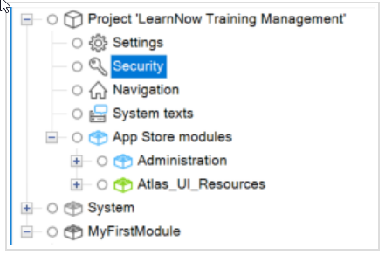
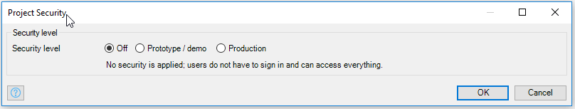
The first thing you have to do is turn security on
Off – no security
Prototype/demo – used while you are developing the app. Not suitable for production apps
Production – Required before deploying the app in the Mendix cloud

Slide 10

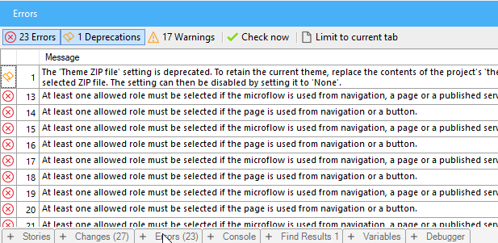
Once you turn security on you will see a new item in each module in the Project explorer. This is used to configure module security.
You'll also see a lot of errors telling you that the security configuration is no complete. Every page and microflow must have security applied to it.

Slide 11
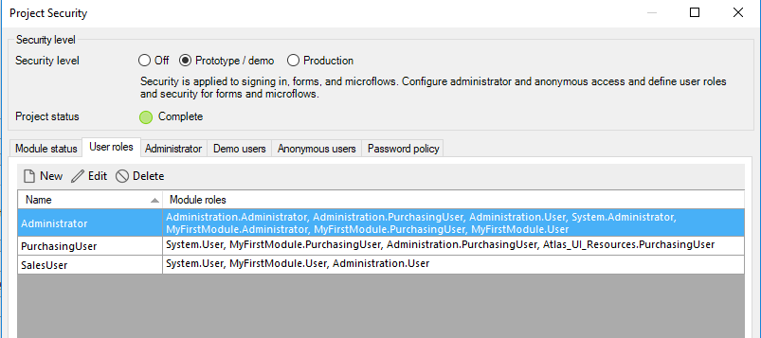
On the User roles tab, change the User role to PurchasingUser and create a new role called SalesUser

Slide 12

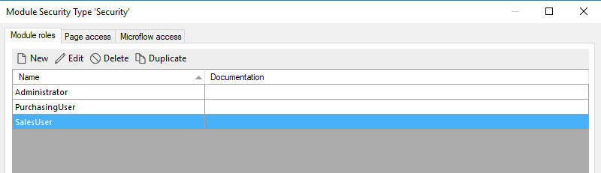
Open the module Security
Modify the Module roles as shown below

Slide 13
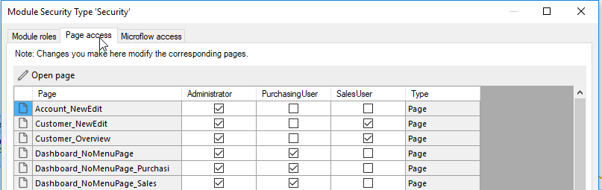
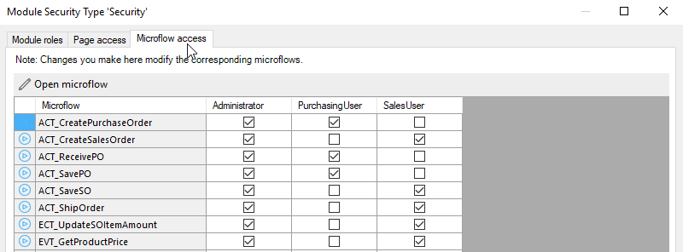
Configure the Page access and Microflow access tabs so that the Administrator has access to everything, the SalesUser role has access to sales pages and microflows and PurchasingUser has access to purchasing pages and microflows

Slide 14
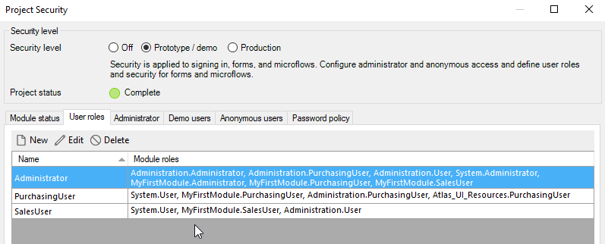
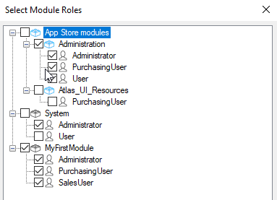
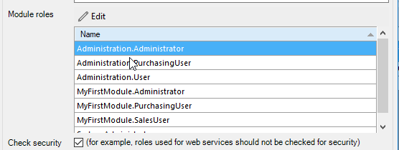
Back in the project security, make sure each User roles is assigned the appropriate Module roles

Slide 15
Configure User Accounts

Slide 16
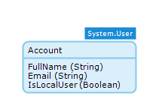
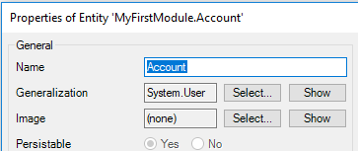
Add Account entity to the domain model
Set the Generalization property of the Account entity to System.User

Slide 17
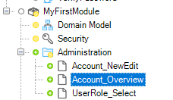
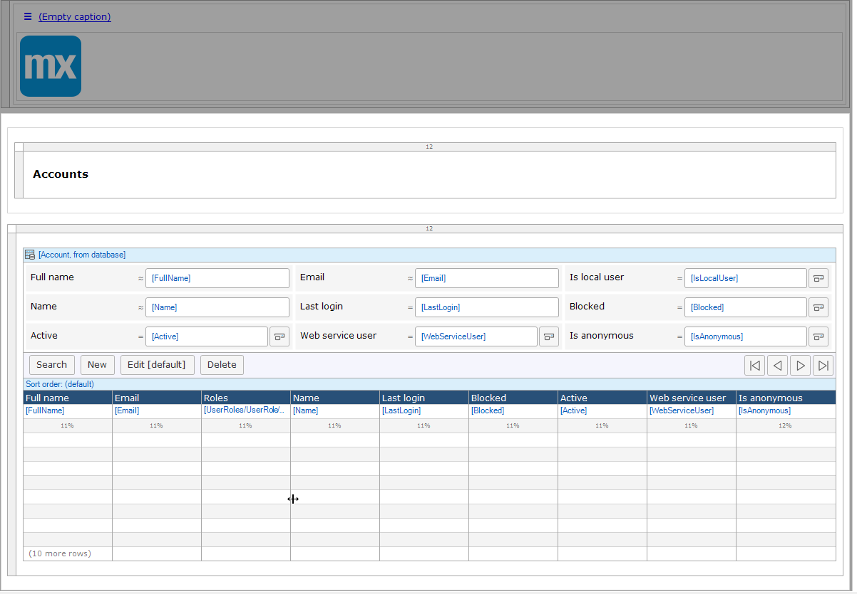
Create a folder called Administration
Create a page called Account_Overview which uses a Grid layout. The data source should be Accounts from the database

Slide 18
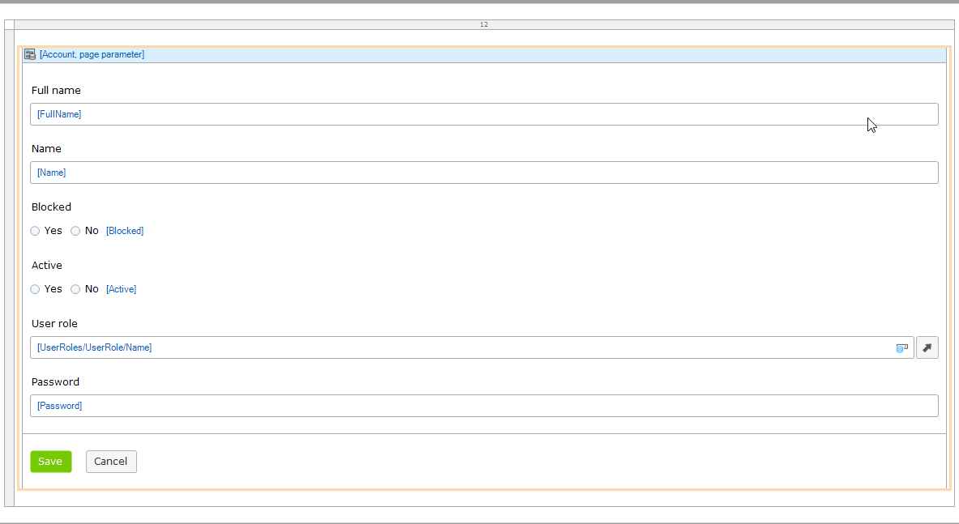
The Account_NewEdit page looks like the one below. Watch the video for the details on how to create this.

Slide 19
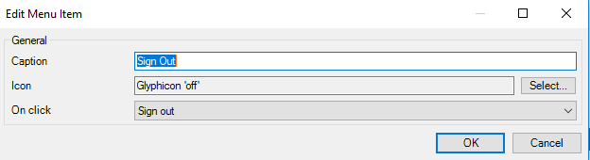
Create a logout option on the menu

