Slide 1


SAPUI5: Routing
Version 1.0, July 2015
Author Ross Hightower
Product SAPUI5
Level Beginner
July 13, 2017
Focus
Routing in SAPUI5.
Public

Slide 2
Routing in SAPUI5
Routing is a method for implementing navigation among the views in an application.
Routing is not the only method to implement navigation and is more complex than other methods but it has some advantages over other methods:
It imposes a structure that becomes is easier to manage as an application becomes more complex
Each view has a unique URL:
When the user refreshes the browser the view they are on is refreshed. In other methods of navigation, a browser refresh will return to the initial view of the application.
You can enter the URL into a browser and navigate directly to the indicated view so you could, for example, provide a URL to another person share a particular view.
Routing is used in many popular web development frameworks such as Angular and Ember.

Slide 3
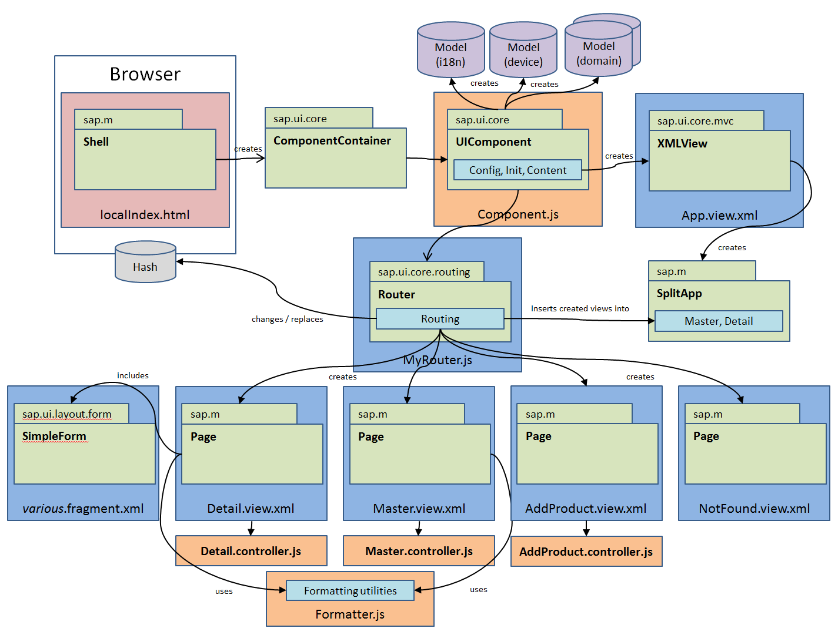
Application Architecture
Component defines metadata for the application, defines models, creates the router object which handles navigation and loads App view.
Index.html file bootstraps UI5 libraries and loads the component
App view creates the application object which defines the interface structure: full screen or master/data
Router object handles navigation between views
Views make up the visual interface
Controllers assigned to views, handle logic

Slide 4
Router Configuration in manifest.js
"routing": { "config": { "routerClass": "sap.m.routing.Router", "viewType": "XML", "viewPath": "ui5.view", "controlId": "app", "controlAggregation": "pages“ },
"routes": [ { "pattern": "", "name": "Master", "target": "Master“ } ],
"targets": { "Master": { "viewName": "Master“ } }
}
Config section defines default values various parameters
The routes define the URL, name of the route and the target in which to load the view
Targets define where the view loads and the name of the view file.

Slide 5
Config Section
"config": { "routerClass": "sap.m.routing.Router", "viewType": "XML", "viewPath": "ui5.view", "controlId": "app", "controlAggregation": "pages“ },
The config object configures default values for route properties:
viewType: type of view files
viewPath: location of view files. The ui5 in
this case is the resourceroot defined in the bootstrap in the index.html file and view is a folder in the project.
controlId: the app control created in the App view.
controlAggregation: The aggregation on the controlId app in which to load views by default.

Slide 6
controlId
The controlId defines the control which is used to display the views in the interface. This control is defined in the App view. The possibilities are:
The App control creates a fullscreen application
The SplitApp control creates a master/detail application
<mvc:View xmlns:mvc="sap.ui.core.mvc“ displayBlock="true“ xmlns="sap.m" > <SplitApp id="idAppControl" /> </mvc:View>
This creates a SplitApp targetControl with id splitApp. The id is used in the router configuration.

Slide 7
controlAggregation
The views are displayed in the controlId by assigning them to the control’s view aggregations:
The App control has one aggregation called pages because it is fullscreen and only one view can be shown at a time
The SplitApp control has two aggregations:
masterPages are views shown on the master (or left) side of the interface
detailPages are views shown on the detail (or right) side of the interface

Slide 8

Routes Section
pattern: the string that attached to the browser URL that appears after the #. The empty string in this case "“ indicates this is the route invoked when the application loads initially
name: The name of the route used in code.
target: The target to use for the route.
"routes": [ { "pattern": "", "name": "Master", "target": "Master“ } ],

Slide 9
Target Section
"targets": { "Master": { "viewName": "Master“ } }
viewName: The name of the view file
Targets can also override the default value for the targetAggregation

Slide 10
Defining Multiple Routes
"routes": [
{
"pattern": "",
"name": "Master",
"target": "Master"
},
{
"pattern": "Detail1/{item}",
"name": "Detail1",
"target": "Detail1"
}
],
"targets": {
"Master": {
"viewName": "Master",
"controlAggregation": "masterPages"
},
"Detail1": {
"viewName": "Detail1",
"controlAggregation": "detailPages"
}
}
Multiple routes can be defined separated by commas. Only one default route can be defined.
The {entity} in the second route defines a parameter passed to the route. This is described on a later slide.
The route’s pattern appears in the browser after the #. The # tells the browser not to interpret the rest of the URL because it is handled by the application.

Slide 11
Initiating Routing
The router object is referenced when needed in a controller file
sap.ui.define([
"sap/ui/core/mvc/Controller"
], function (Controller) {
"use strict";
return Controller.extend("ui5.controller.Master", {
go: function (oEvent) {
var oRouter = sap.ui.core.UIComponent.getRouterFor(this);
oRouter.navTo("Detail1);
}
});
});
The navTo method of the router object is used to trigger a navigation. Detail1 is the name of the route.

Slide 12
Initiating Routing with a Parameter
Often when a user clicks an item on a list (for example) we want to pass the some information about the clicked item to the target of a navigation.
oItem.getBindingContext(“routing").getPath() retrieves the path to the data that is bound to the list item. For example,
/collection/0
Substr(12) retrieves the 12th character in the path
The value retrieved will be passed as the parameter item in the route
Object with information about the item that was clicked
showDetail : function(oEvent) {
var oItem = oEvent.getSource();
var oRouter = sap.ui.core.UIComponent.getRouterFor(this);
oRouter.navTo("Detail1", {
item: oItem.getBindingContext("routing").getPath().substr(12)
});
}

Slide 13
Initiating Routing with a Parameter (continued)
The entity parameter is indicated in the route definition by curly brackets { } in the route’s pattern.
{
"pattern": "Detail1/{item}",
"name": "Detail1",
"target": "Detail1"
}
The value passed in entity appears in the browser’s URL

Slide 14
Processing the Parameter in the Target View
In order to process the route parameter in the target control we have to setup an event handler that will be fired when the route targets the view.
Retrieve the application’s router
Assign the function ._onObjectMatched to handle the route matched event. The function will execute when a route pattern is matched.
onInit: function () {
var oRouter = sap.ui.core.UIComponent.getRouterFor(this);
oRouter.getRoute("Detail1").attachPatternMatched(this._onObjectMatched, this);
},

Slide 15
Processing the Parameter in the Target View
Object with information about route event
Bind the view to the model
_onObjectMatched: function (oEvent) {
this.getView().bindElement({
path: "/collection/" + oEvent.getParameter("arguments").item,
model: "routing"
});
}
Construct the path in the model using the parameter passed
Identify the model by name

Slide 16
{
"collection" : [
{
"prop1" : "A",
"subcol" : [
{
"subProp1" : "One"
},
{
"subProp1" : "Two"
}
]
},
{
"prop1" : "B",
"subcol" : [
{
"subProp1" : "Three"
},
{
"subProp1" : "Four"
}
]
}
]
}
Data model from Routing Exercise

Slide 17
Binding in Detail View
The view is bound to /collection/0 and the list is bound to subcol within /collection/0 so the list is bound to /collection/0/subcol
Detail View Binding: /collection/0
List Binding: subcol
<List
headerText="Detail 1 List"
items="{routing>subcol}" >
<StandardListItem
type="Active"
title="{routing>subProp1}" />
</List>

Slide 18
Thank you
Contact information:
Ross Hightower
hightowe@uwm.edu

