Slide 1


Core Data Services
Version 1.0, July 2015
Author Ross Hightower
Product SAP HANA
Level Beginner
March 27, 2018
Focus
An introduction to HANA Core Data Services.
Public

Slide 2
With the availability of the SAP HANA platform there has been a paradigm shift in the way business applications are developed at SAP. The rule-of-thumb is: Do as much as you can in the database to get the best performance.

Slide 3
Core Data Services on HANA
CDS is a semantically rich layer above SQL.
CDS artifacts are design time objects that HANA uses to create the persistence objects in the HANA repository.
The way that CDS works is by interpreting the descriptions of database objects that you create and then creating the SQL DDL statements to create the objects in the HANA database.

Slide 4
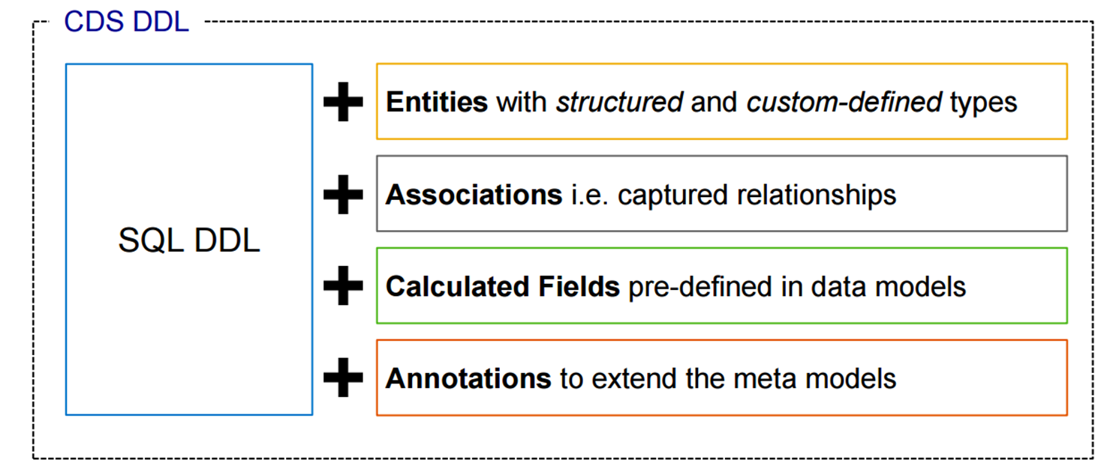
Core Data Services

Slide 5
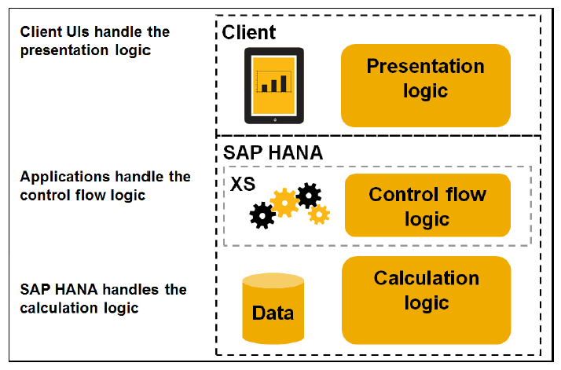
Native HANA Application Tiers

Slide 6
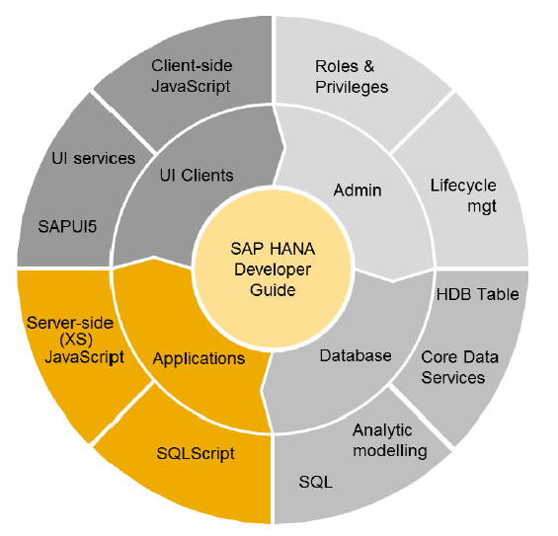
Elements of HANA Native Development
Client: HTML5, SAPUI5, JavaScript
Server: SQLScript, JavaScript
Database: SQL, Views, Core Data Services
Admin: Roles and Privileges

Slide 7
Client container (Web Browser)
SAPUI5 Application Frontend
SAPUI5 Application Frontend
oData model
oData model
Extended Application Services (XS)
oData Service
Application Backend
createCustomer SQLScript procedure
CDS Created Objects
HANA Database
HANA System

Slide 8
Core Data Service Design Artifacts
Data definition file (.hdbdd) contain the descriptions of types, tables, indexes, views and associations.
Sequence files (.hdbsequence) contain definitions of sequences used for auto incrementing columns.
Data import files (.hdbti) contain information that links csv files to database tables for importing data into tables.

Slide 9
.hdbdd File
The namespace is the path to your design time files
namespace GBI_106.data;
@Schema: ' GBI_106'
context CPCC {
}
The target Schema
Initial context must be the same as the name of the .hdbdd file

Slide 10
Hierarchical Contexts
namespace GBI_106.data;
@Schema: ' GBI_106'
context CPCC {
context MASTERDATA {
}
}
Can create nested contexts if you want to organize artifacts
Anything defined in an outer context is accessible from an inner context

Slide 11
Custom Data Types
type AddressType
{
Address : String(35);
City : String(20);
Region : String(2);
Country : String(2);
Postal_code : String(5);
};
type BusinessIDType : String(10);
type OrgUnitIDType : String(4);
Custom types can ensure consistent use of data types across entities.

Slide 12
Creating Tables
namespace GBI_002.gbi.data;
@Schema: 'GBI_002'
context GBI_002 {
context MASTERDATA {
@Catalog.tableType: #COLUMN
entity SALES_ORGS {
key ID : OrgUnitIDType;
Description : String(16);
Address : AddressType;
Phone : String(14);
Fax: String(14);
};
};
Annotations provide direction to the SQL engine and allow you to add metadata to the database
Creates a column oriented table in the MASTERDATA context.
Table name in repository:
GBI_002.gbi.data::GBI_002.MASTERDATA.SALES_ORGS
Namespace
Context path

Slide 13
Indexes
context MASTERDATA {
@Catalog:
{ tableType: #COLUMN,
index : [ { name: 'CustomerIDIdx', order:#DESC, unique: false, elementNames:['CustomerID’,’requiredDate’] } ]
}
entity SALES_ORDERS {
CreatedAt : LocalDate;
CreatedBy : String(20);
CustomerID : String(10) not null;
key ID : BusinessIDType;
GrossAmount : CurrencyType;
Discount : ValueType;
Status : String(15) default 'New';
requiredDate : LocalDate;
shipDate : LocalDate;
};
}

Slide 14
Associations
entity Customer {
key id : Integer;
orders : Association[*] to SalesOrder on orders.cust_id = id;
name : String(80);
};
entity SalesOrder {
key id : Integer;
cust_id : Integer;
customer: Association[1] to Customer on customer.id = cust_id;
items : Association[*] to Item on items.order_id = id;
status: String(20);
date : LocalDate;
};
entity Item {
key id : Integer;
order_id : Integer;
salesOrder : Association[1] to SalesOrder on salesOrder.id = order_id;
descr : String(100);
price : Decimal(8,2);
};
Creates a one-to-many relationship between SalesOrder and Customer

Slide 15
view C1 as select from Customer {
name,
orders[status='open'].id as orderId
};

Slide 16
Indexes and Associations
@Catalog:
{ tableType: #COLUMN,
index : [ { name: 'CustomerIDIdx', order:#DESC, unique: false, elementNames:['CustomerID’,’requiredDate’] } ]
}
entity SALES_ORDERS {
CreatedAt : LocalDate;
CreatedBy : String(20);
CustomerID : String(10) not null;
key ID : Association[1..*] TO SALES_ORDER_DETAILS { OrderID };
GrossAmount : CurrencyType;
Discount : ValueType;
Status : String(15) default 'New';
requiredDate : LocalDate;
shipDate : LocalDate;
};
Can create multiple indexes for tables
Can create associations between tables

Slide 17
Views
VIEW CustomerSales AS SELECT FROM CUSTOMERS
{
ID.Status,
CompanyName,
sum(ID.GrossAmount.Amount) AS GrossAmount
} GROUP BY ID.Status, CompanyName HAVING ID.Status = 'New';
Views can take advantage of associations

Slide 18
oData Services
oData services can be created with a single line of code as with the Customers service but you can also create associations as with the SalesOrg service.
service {
"GBI_002.gbi.data::GBI_002.MASTERDATA.CUSTOMERS" as "Customers";
"GBI_002.gbi.data::GBI_002.MASTERDATA.SALES_ORGS" as "SalesOrg"
navigates ("SOrg_Customers" as "SOrgCustomers");
association "SOrg_Customers" principal "SalesOrg"("ID") multiplicity "1"
dependent "Customers"("SalesOrgID") multiplicity "*";
}

Slide 19
Thank you
Contact information:
Ross Hightower
hightowe@uwm.edu

