Slide 1
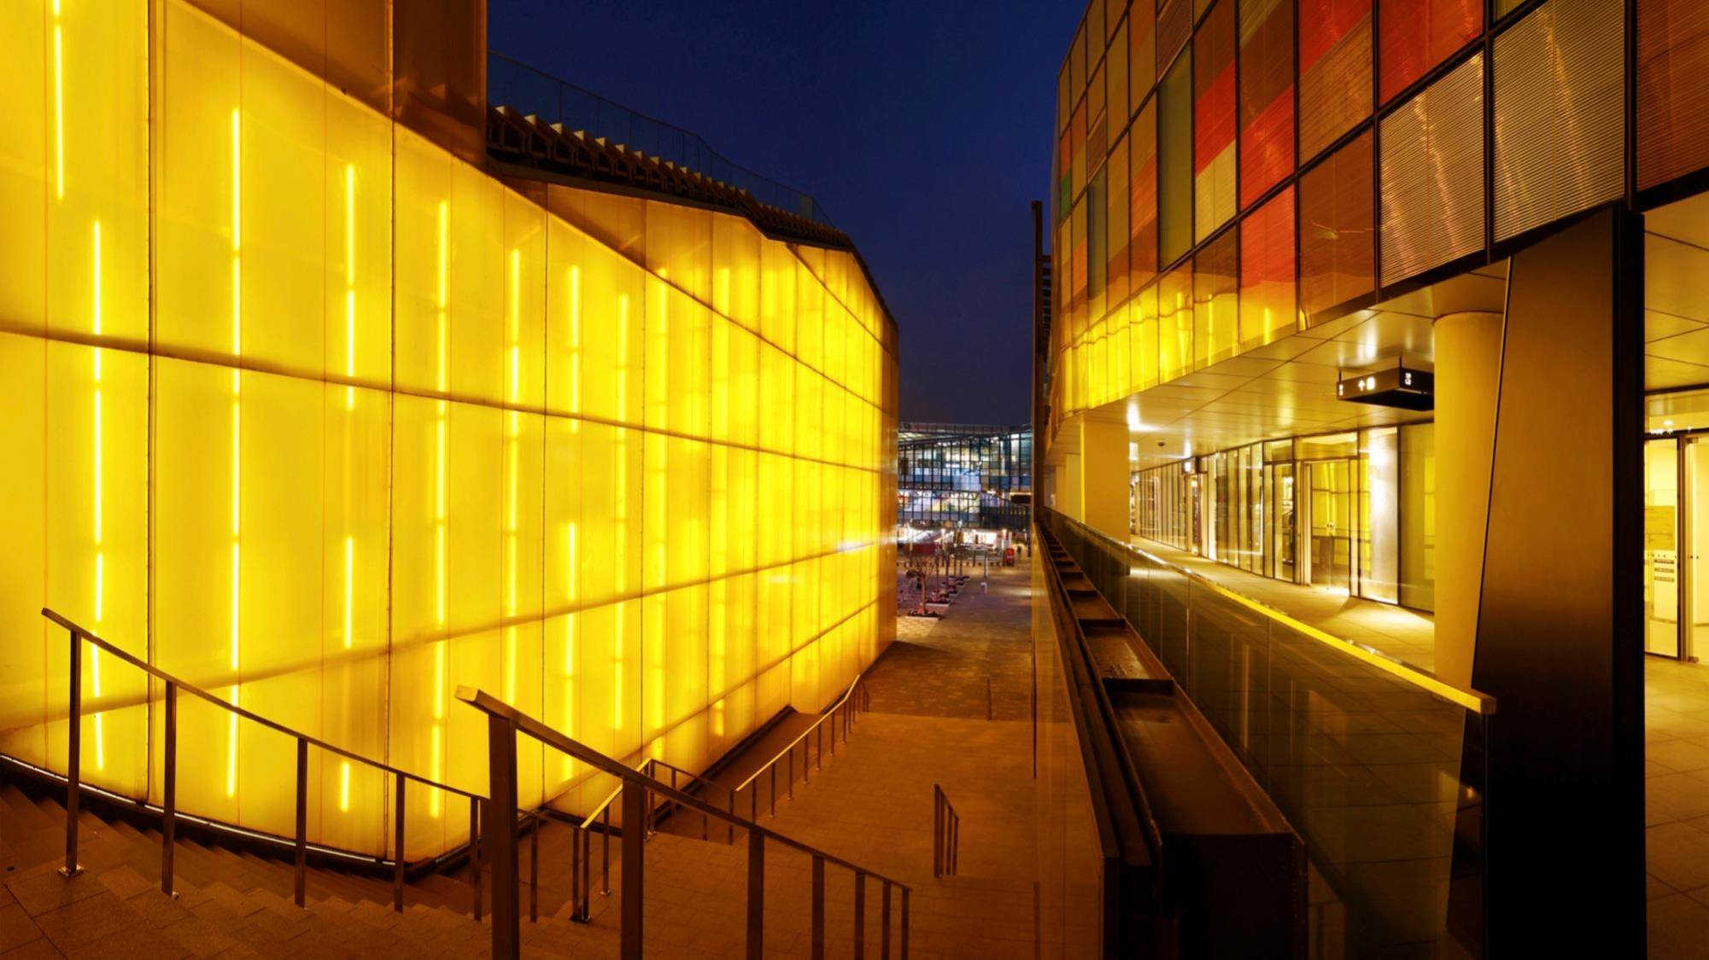

SAPUI5: Lists
Version 1.0, July 2015
Author Ross Hightower
Product SAPUI5
Level Beginner
October 6, 2015
Focus
Lists.
Public

Slide 2
Lists and Tables
Lists and Tables are staples of business applications
UI5 provides the controls and options to create complex Lists and Tables very easily
https://experience.sap.com/fiori-design/ui-components/list-overview/
https://experience.sap.com/fiori-design/ui-components/analytical-table-alv/

Slide 3
Lists

Slide 4
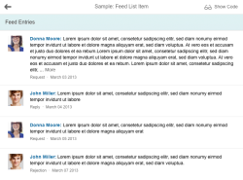
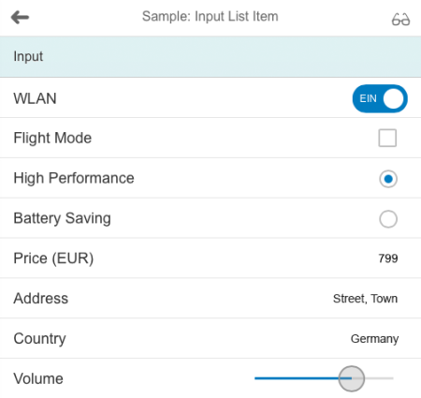
List Control
The List control, while not as versatile as the Table control, can be used to display lists of items in a variety of ways.

Slide 5
Standard List
<List
id="ShortProductList"
headerText="Products"
items="{gbi>/ProductsCollection}" >
<StandardListItem
type="Active"
press="handleListItemPress"
title="{gbi>PRODUCT}"
description="{gbi>PRODUCT_NAME}" />
</List>
The List control is a container with an aggregation called items. The items aggregation should be bound to a collection in the model.
A list item will be created using the provided template, in this case a StandardListItem.
The attributes of the template are bound to the properties in the objects in the contained in the aggregation collection.
Other templates

Slide 6
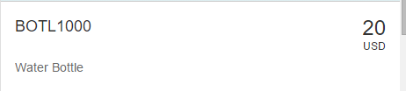
ObjectListItem
<ObjectListItem
type="Active"
press="handleListItemPress"
title="{gbi>PRODUCT}"
number="{gbi>PRICE}"
numberUnit = "{gbi>CURRENCY}">
</ObjectListItem>
An ObjectListItem can be used instead of the StandardListItem if more detail is required for each list item.

Slide 7
ObjectListItem
You can add one or more attributes and statuses using the ObjectAttribute and ObjectStatus Controls.
<ObjectListItem
type="Active"
press="handleListItemPress"
title="{gbi>PRODUCT}"
number="{gbi>PRICE}"
numberUnit = "{gbi>CURRENCY}">
<attributes>
<ObjectAttribute text ="{gbi>PRODUCT_NAME}" />
</attributes>
<firstStatus>
<ObjectStatus text = "{gbi>PRODUCT_GROUP}" />
</firstStatus>
</ObjectListItem>

Slide 8
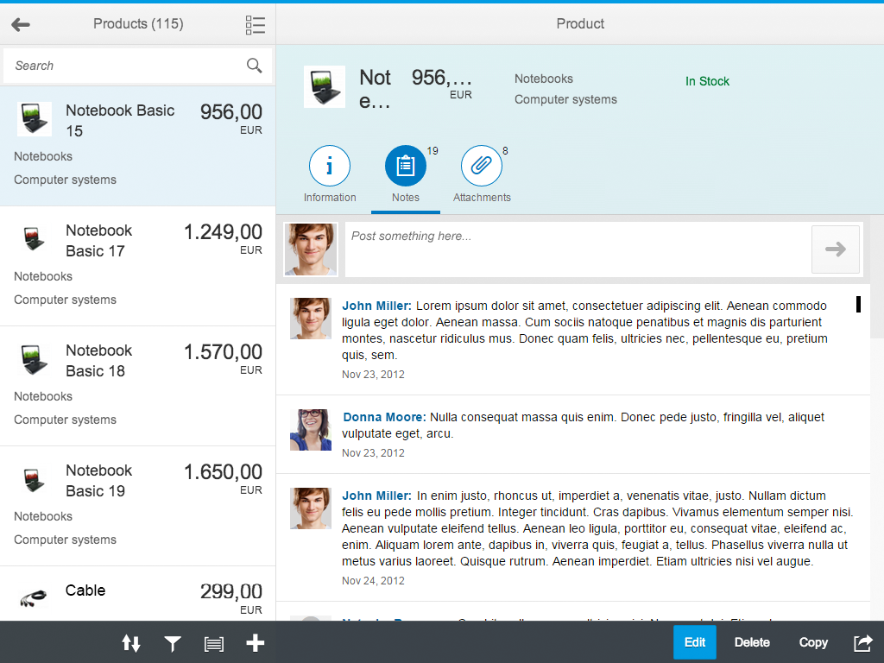
List Item Templates
Other list item templates include the FeedListItem for displaying unformatted text and a user image
The InputListItem for displaying input controls.

Slide 9
Add a Search Field
The SearchField control is used to add a search field to Lists. It is inserted into a Bar control (a general toolbar) and left justified.
<subHeader>
<Bar>
<contentLeft>
<SearchField search="handleSearch" width="100%">
</SearchField>
</contentLeft>
</Bar>
</subHeader>
SubHeader control adds a subheader below the Page control’s header

Slide 10
Search Handler Function
A data binding can have one or more filters so we add them to an array
handleSearch : function (evt) {
var filters = [];
var query = evt.getParameter("query");
if (query && query.length > 0){
var filter = new sap.ui.model.Filter("PRODUCT", sap.ui.model.FilterOperator.Contains, query);
filters.push(filter);
}
var list = this.getView().byId('ShortProductList');
var binding = list.getBinding("items");
binding.filter(filters);
}
The SearchField control has a parameter called query which contains the text entered by the
user
This filter will keep every record for which the PRODUCT field Contains the query string. Can filter using EQ, GT, LT, etc.
Get the List control and then get it’s binding context and add the filters to the binding.

Slide 11
Tables

Slide 12
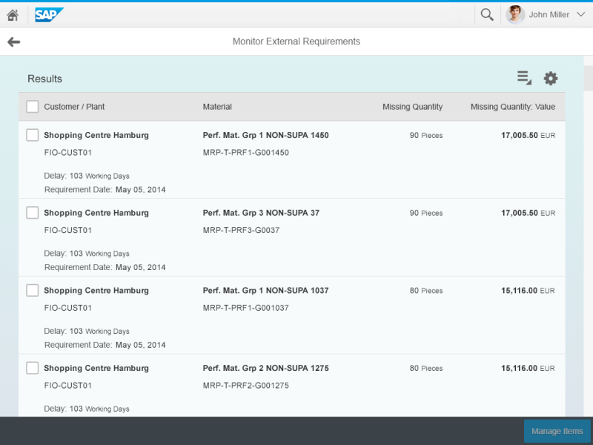
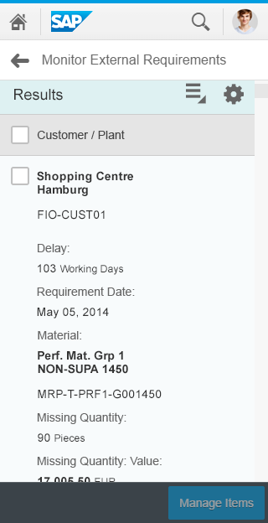
Table Control
The Table control is very flexible and allows you easily create complex, responsive tables.
Table on a Tablet
Table on a Phone

Slide 13
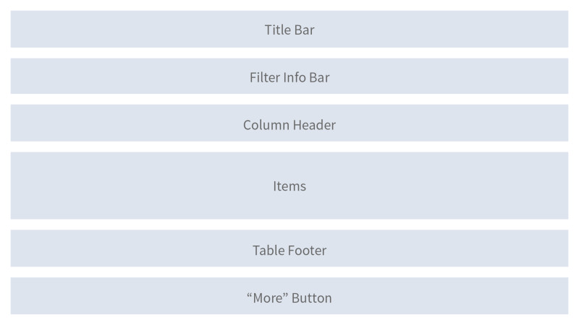
Table Structure

Slide 14
Tables
<Table id="idProductsTable"
inset="false" items="{gbi>/ProductsCollection}">
<headerToolbar>
<Toolbar> <Label text="Products“/>
</Toolbar>
</headerToolbar>
<columns>
</columns>
<items> </items>
</Table>
The Table control has an items aggregation that is bound to a collection in the model.
Basic table structure contains a columns section that is used to define the columns and column headers.
The items section is used to define the contents of the table cells.
This table also contains a toolbar in the header. You can insert multiple controls in the toolbar.

Slide 15
Columns
<Column
width=“12em”>
<header>
<Text text="Product" />
</header>
</Column>
<Column
minScreenWidth="Tablet">
<header>
<Text text="Division" />
</header>
</Column>
The column section can contain one or more Column controls which can contain a header control with a Text control to provide the header.
The Column control also contains attributes used to
configure the column. In this case, the minScreenWidth control will cause the control to be hidden on small screens.
A number of attributes are also available.

Slide 16
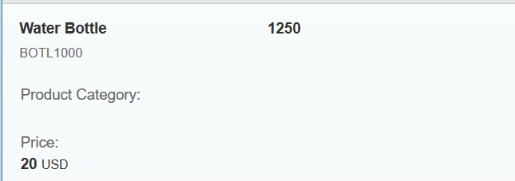
Items
The items section can contain an ObjectListItem as a template for the Table rows. The definition of the structure of the rows is contains with the cell control.
There is a great deal of flexibility in the controls that can be used to define table cells.
The Table is responsive. The image below shows the row on a small screen. Notice how the Price column has shifted to the left.
<ColumnListItem>
<cells>
<ObjectIdentifier
title="{gbi>PRODUCT_NAME}"
text="{gbi>PRODUCT}" />
<Text
text="{gbi>DIVISION}" />
<Text
text="{gbi>PRODUCT_CATEGORY}" />
<ObjectNumber
number="{gbi>PRICE}"
unit="{gbi>CURRENCY}" />
<ObjectNumber
number="{gbi>INVENTORY}" />
</cells>
</ColumnListItem>

Slide 17
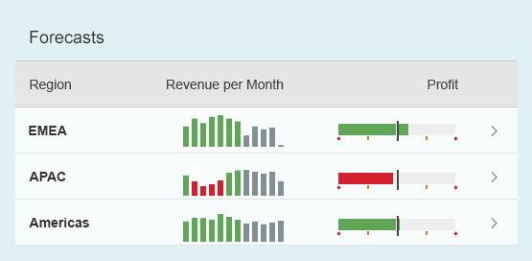
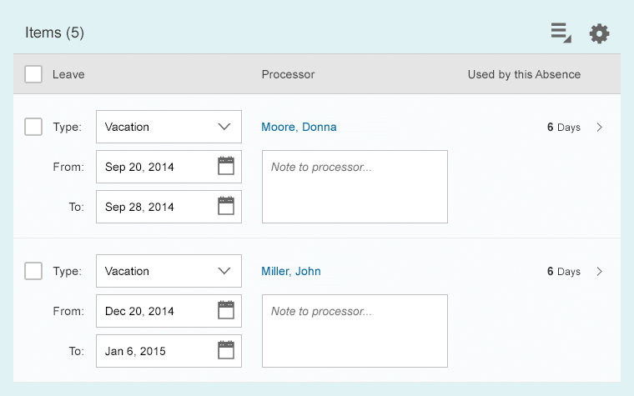
Table Examples
Table with Input controls
Table with micro charts

Slide 18
Thank you
Contact information:
Ross Hightower
hightowe@uwm.edu

