Slide 1


SAPUI5: Routing
Version 1.0, July 2015
Author Ross Hightower
Product SAPUI5
Level Beginner
January 5, 2016
Focus
Routing in SAPUI5.
Public

Slide 2
Routing in SAPUI5
Routing is a method for implementing navigation among the views in an application.
Routing is not the only method to implement navigation and is more complex than other methods but it has some advantages over other methods:
It imposes a structure that becomes is easier to manage as an application becomes more complex
Each view has a unique URL:
When the user refreshes the browser the view they are on is refreshed. In other methods of navigation, a browser refresh will return to the initial view of the application.
You can enter the URL into a browser and navigate directly to the indicated view so you could, for example, provide a URL to another person share a particular view.
Routing is used in many popular web development frameworks such as Angular and Ember.

Slide 3
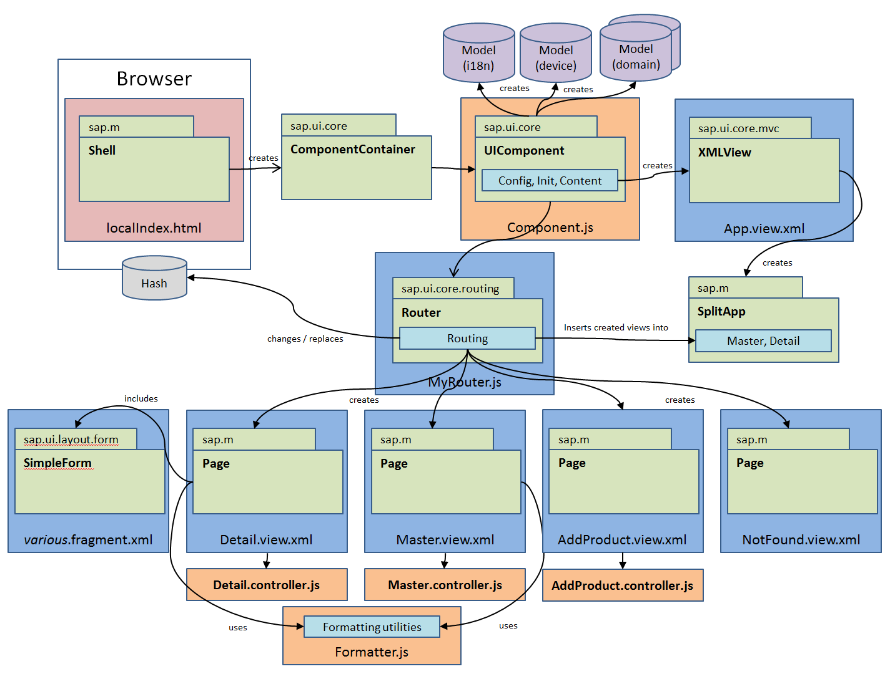
Application Architecture
Component defines metadata for the application, defines models, creates the router object which handles navigation and loads App view.
Index.html file bootstraps UI5 libraries and loads the component
App view creates the application object which defines the interface structure: full screen or master/data
Router object handles navigation between views
Views make up the visual interface
Controllers assigned to views, handle logic

Slide 4
Router Configuration in Component.js
sap.ui.core.UIComponent.extend("routing.Component",{
metadata: {
},
init: function() {
jQuery.sap.require("sap.m.routing.RouteMatchedHandler");
jQuery.sap.require("sap.ui.core.routing.HashChanger");
…
this._router = this.getRouter();
this._routeHandler = new sap.m.routing.RouteMatchedHandler(this._router);
this._router.initialize();
Routes will be configured here
Router library is loaded in init function.
Creates router object. The this refers to the component
Initiates the routeHandler which does the heavy lifting for routing
Initialize the router
sap.m.routing.RouteMatchedHandler – handles the navigation events in the application

Slide 5
Configuring a Default Route
metadata: {
routing: {
config: {
viewType: "XML",
viewPath: “ui5.view",
targetControl: "splitApp",
clearTarget: false,
transition: "slide"
},
routes: [
{
pattern : "",
name : "ProductCategories",
view : "Master1",
targetAggregation : "masterPages"
}
]
}
}
The config object configures default values for route properties:
viewType: type of view files
viewPath: location of view files. The gbi in
this case is the resourceroot defined in the bootstrap in the index.html file and view is a folder in the project.
targetControl: the app control created in the App view.
clearTarget: should the aggregation be cleared before navigation. More on this
later.
transition: the type of visual transition.

Slide 6

Configuring a Default Route
The routes array includes the routes. The properties of a route are:
pattern: The pattern used to display the URL in the browser. An empty pattern means the route is the default route and will load when the application first loads.
name: The name of the route used to invoke the route.
view: The name of the view file.
targetAggregation: See next slide.
metadata: {
routing: {
config: {
viewType: "XML",
viewPath: "gbi.view",
targetControl: "splitApp",
clearTarget: false,
transition: "slide"
},
routes: [
{
pattern : "",
name : "ProductCategories",
view : "Master1",
targetAggregation : "masterPages"
}
]
}
}
Default route URL is the base URL of the application

Slide 7
targetControl
The targetControl defines the control which is used to display the views in the interface. This control is defined in the App view. The possibilities are:
The App control creates a fullscreen application
The SplitApp control creates a master/detail application
sap.ui.jsview("gbi.view.App", {
createContent : function() {
return new sap.m.SplitApp("splitApp",{});
}
});
This creates a SplitApp targetControl with id splitApp. The id is used in the router configuration.

Slide 8
targetAggregation
The views are displayed in the targetControl by assigning them to the control’s view aggregations:
The App control has one aggregation called pages because it is fullscreen and only one view can be shown at a time
The SplitApp control has two aggregations:
masterPages are views shown on the master (or left) side of the interface
detailPages are views shown on the detail (or right) side of the interface

Slide 9
Defining Multiple Routes
routes: [
{
pattern : "",
name : "ProductCategories",
view : "Master1",
targetAggregation : "masterPages"
},
{
pattern : "ProductCategory/{entity}",
name : "Products",
view : "Products",
targetAggregation : "masterPages"
}
]
Multiple routes can be defined separated by commas. Only one default route can be defined.
The {entity} in the second route defines a parameter passed to the route. This is described on a later slide.
The route’s pattern appears in the browser after the #. The # tells the browser not to interpret the rest of the URL because it is handled by the application.

Slide 10
Subroutes
Routes that load views into the detail side of a master/detail application are defined as subroutes of the master view.
The properties used to define the route are the same except the targetAggregation is detailPages.
{
pattern : "ProductCategory/{entity}",
name : "Products",
view : "Products",
targetAggregation : "masterPages",
subroutes : [
{
pattern : "Products/{entity}",
name : "Detail1",
view : "Detail1",
targetAggregation : "detailPages"
}
]
}

Slide 11
Initiating Routing
onInit: function() {
this.router = sap.ui.core.UIComponent.getRouterFor(this);
},
handleListItemPress: function(){
this.router.navTo("Detail1", {
from: "Master1"
});
}
onInit function in a view’s controller retrieves a reference to the router object created in the Component.js file. The this refers to the controller. Prefacing the router variable with this means it can be accessed from any function in the controller.
The navTo method of this.router object is used to trigger a navigation. Detail1 is the name of the route. The from property is not required but could be accessed by the target view. This could be written as:
this.router.navTo(“Detail1”);

Slide 12
Initiating Routing with a Parameter
Often when a user clicks an item on a list (for example) we want to pass the some information about the clicked item to the target of a navigation.
oItem.getBindingContext("gbi").getPath() retrieves the path to the data that is bound to the list item. For example,
/Products(‘DXTR1100’)
split() is a JavaScript function that splits a string on the provided character and places the parts into an array.
The result is that the value in single quotes is passed as a parameter called entity to the router.
Object with information about the item that was clicked
showDetail : function(oItem) {
var entity = oItem.getBindingContext("gbi").getPath().split("'");
this.router.navTo("Detail1", {
entity: entity[1]
});
}

Slide 13
Initiating Routing with a Parameter (continued)
The entity parameter is indicated in the route definition by curly brackets { } in the route’s pattern.
subroutes : [
{
pattern : "Products/{entity}",
name : "Detail1",
view : "Detail1",
targetAggregation : "detailPages"
}
]
The value passed in entity appears in the browser’s URL

Slide 14
Processing the Parameter in the Target View
In order to process the route parameter in the target control we have to setup an event handler that will be fired when the route targets the view.
Retrieve the application’s router
Assign the function onRouteMatched to handle the route matched event. The function will execute when a route pattern is matched.
onInit: function() {
this.router = sap.ui.core.UIComponent.getRouterFor(this);
this.router.attachRoutePatternMatched(this.onRouteMatched, this);
}

Slide 15
Processing the Parameter in the Target View
Object with information about route event
Retrieve route parameters
onRouteMatched : function(oEvent) {
var oParameters = oEvent.getParameters();
if (oParameters.name !== "Detail1") {
return;
}
var oView = this.getView();
var sEntityPath = "/Products('" + oParameters.arguments.entity + "')";
var oModel = oView.getModel('gbi');
var context = new sap.ui.model.Context(oModel , sEntityPath);
oView.setBindingContext(context,'gbi');
},
Make sure this view is the target and not a parent
Retrieve the entity argument and construct a binding path
Create a binding context and bind it to the view

Slide 16
{
"collection" : [
{
"prop1" : "A",
"subcol" : [
{
"subProp1" : "One"
},
{
"subProp1" : "Two"
}
]
},
{
"prop1" : "B",
"subcol" : [
{
"subProp1" : "Three"
},
{
"subProp1" : "Four"
}
]
}
]
}
Data model from Routing Exercise

Slide 17
Binding in Detail View
The view is bound to /collection/0 and the list is bound to subcol within /collection/0 so the list is bound to /collection/0/subcol
Detail View Binding: /collection/0
List Binding: subcol

Slide 18
Thank you
Contact information:
Ross Hightower
hightowe@uwm.edu

