Slide 1


BPM-Related Experiential Learning with SAP S/4HANA and BPMN Process Mapping
Dr. Lorraine R. Gardiner
#SAPACC

Slide 2


BPM-Related Experiential Learning with SAP S/4HANA and BPMN Process Mapping
Lorraine R. Gardiner Dalton State College lgardiner@daltonstate.edu

Slide 3

Context
Undergraduate enterprise systems class
Covers SCM concepts and enterprise systems
Uses a variety of SAP UA curriculum resources and clients
Enhances SAP exercises with BPMN swimlane process maps
Begins with procurement concepts and exercises
Includes coverage of various possible process/task automations

Slide 4

Catalysts
Dissatisfaction with concept-only coverage of automation
Large industry partner implementing purchase order (PO) automation

Slide 5

Automations Added
Automated PO creation for one vendor and several materials
Evaluated receipt settlement (ERS) for same vendor and materials
Both types of automation require coordination with vendors

Slide 6

Student Activities
Typical S/4HANA procure-to-pay (P2P) exercise
Run exercise
Create BPMN swimlane process map
Enable automated PO creation
Change vendor and material master data
Redo P2P exercise with automated PO creation
Document process change in BPMN swimlane process map
Enable ERS
Change vendor and material master data
Redo P2P exercise with automated PO creation and ERS
Document process change in BPMN swimlane process map

Slide 7
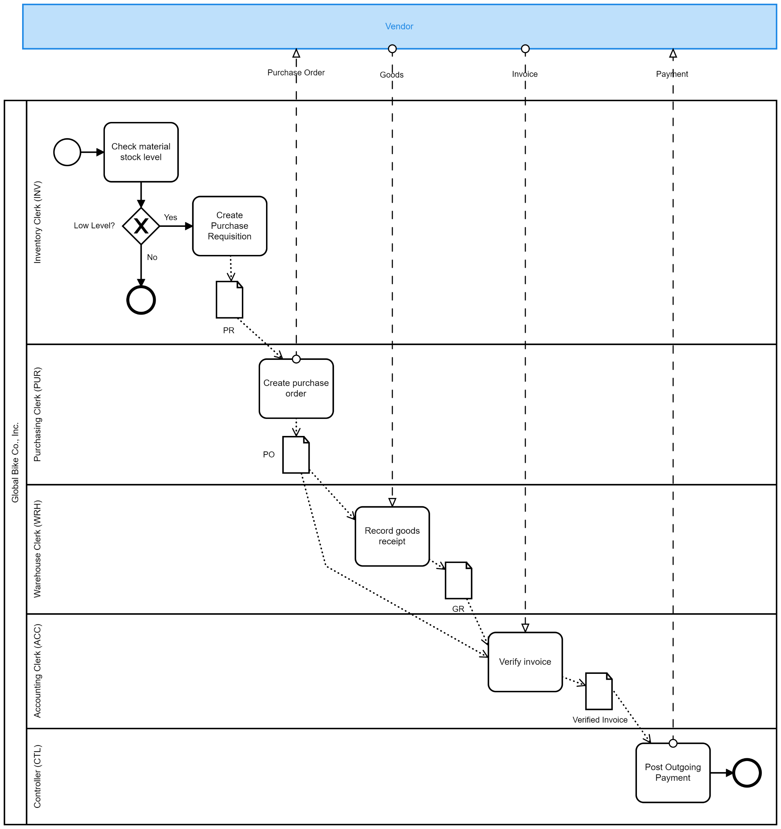
Typical P2P Exercise Process Map

Slide 8
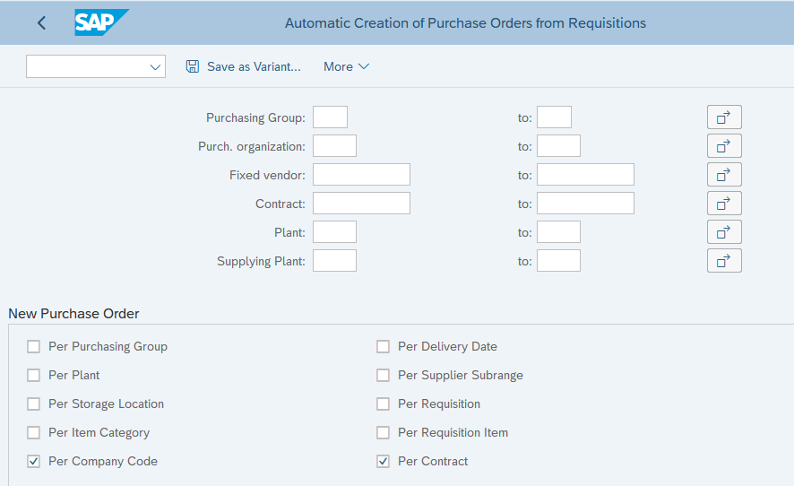
Automated PO Creation (T-Code: ME59N)

Slide 9
Enabling Automated PO Creation
Add
Option to material master data
Option to vendor master data
Vendor as fixed for the material in source list
Check InfoRecord for each vendor and material combination
When purchase requisition is created, confirm fixed vendor

Slide 10
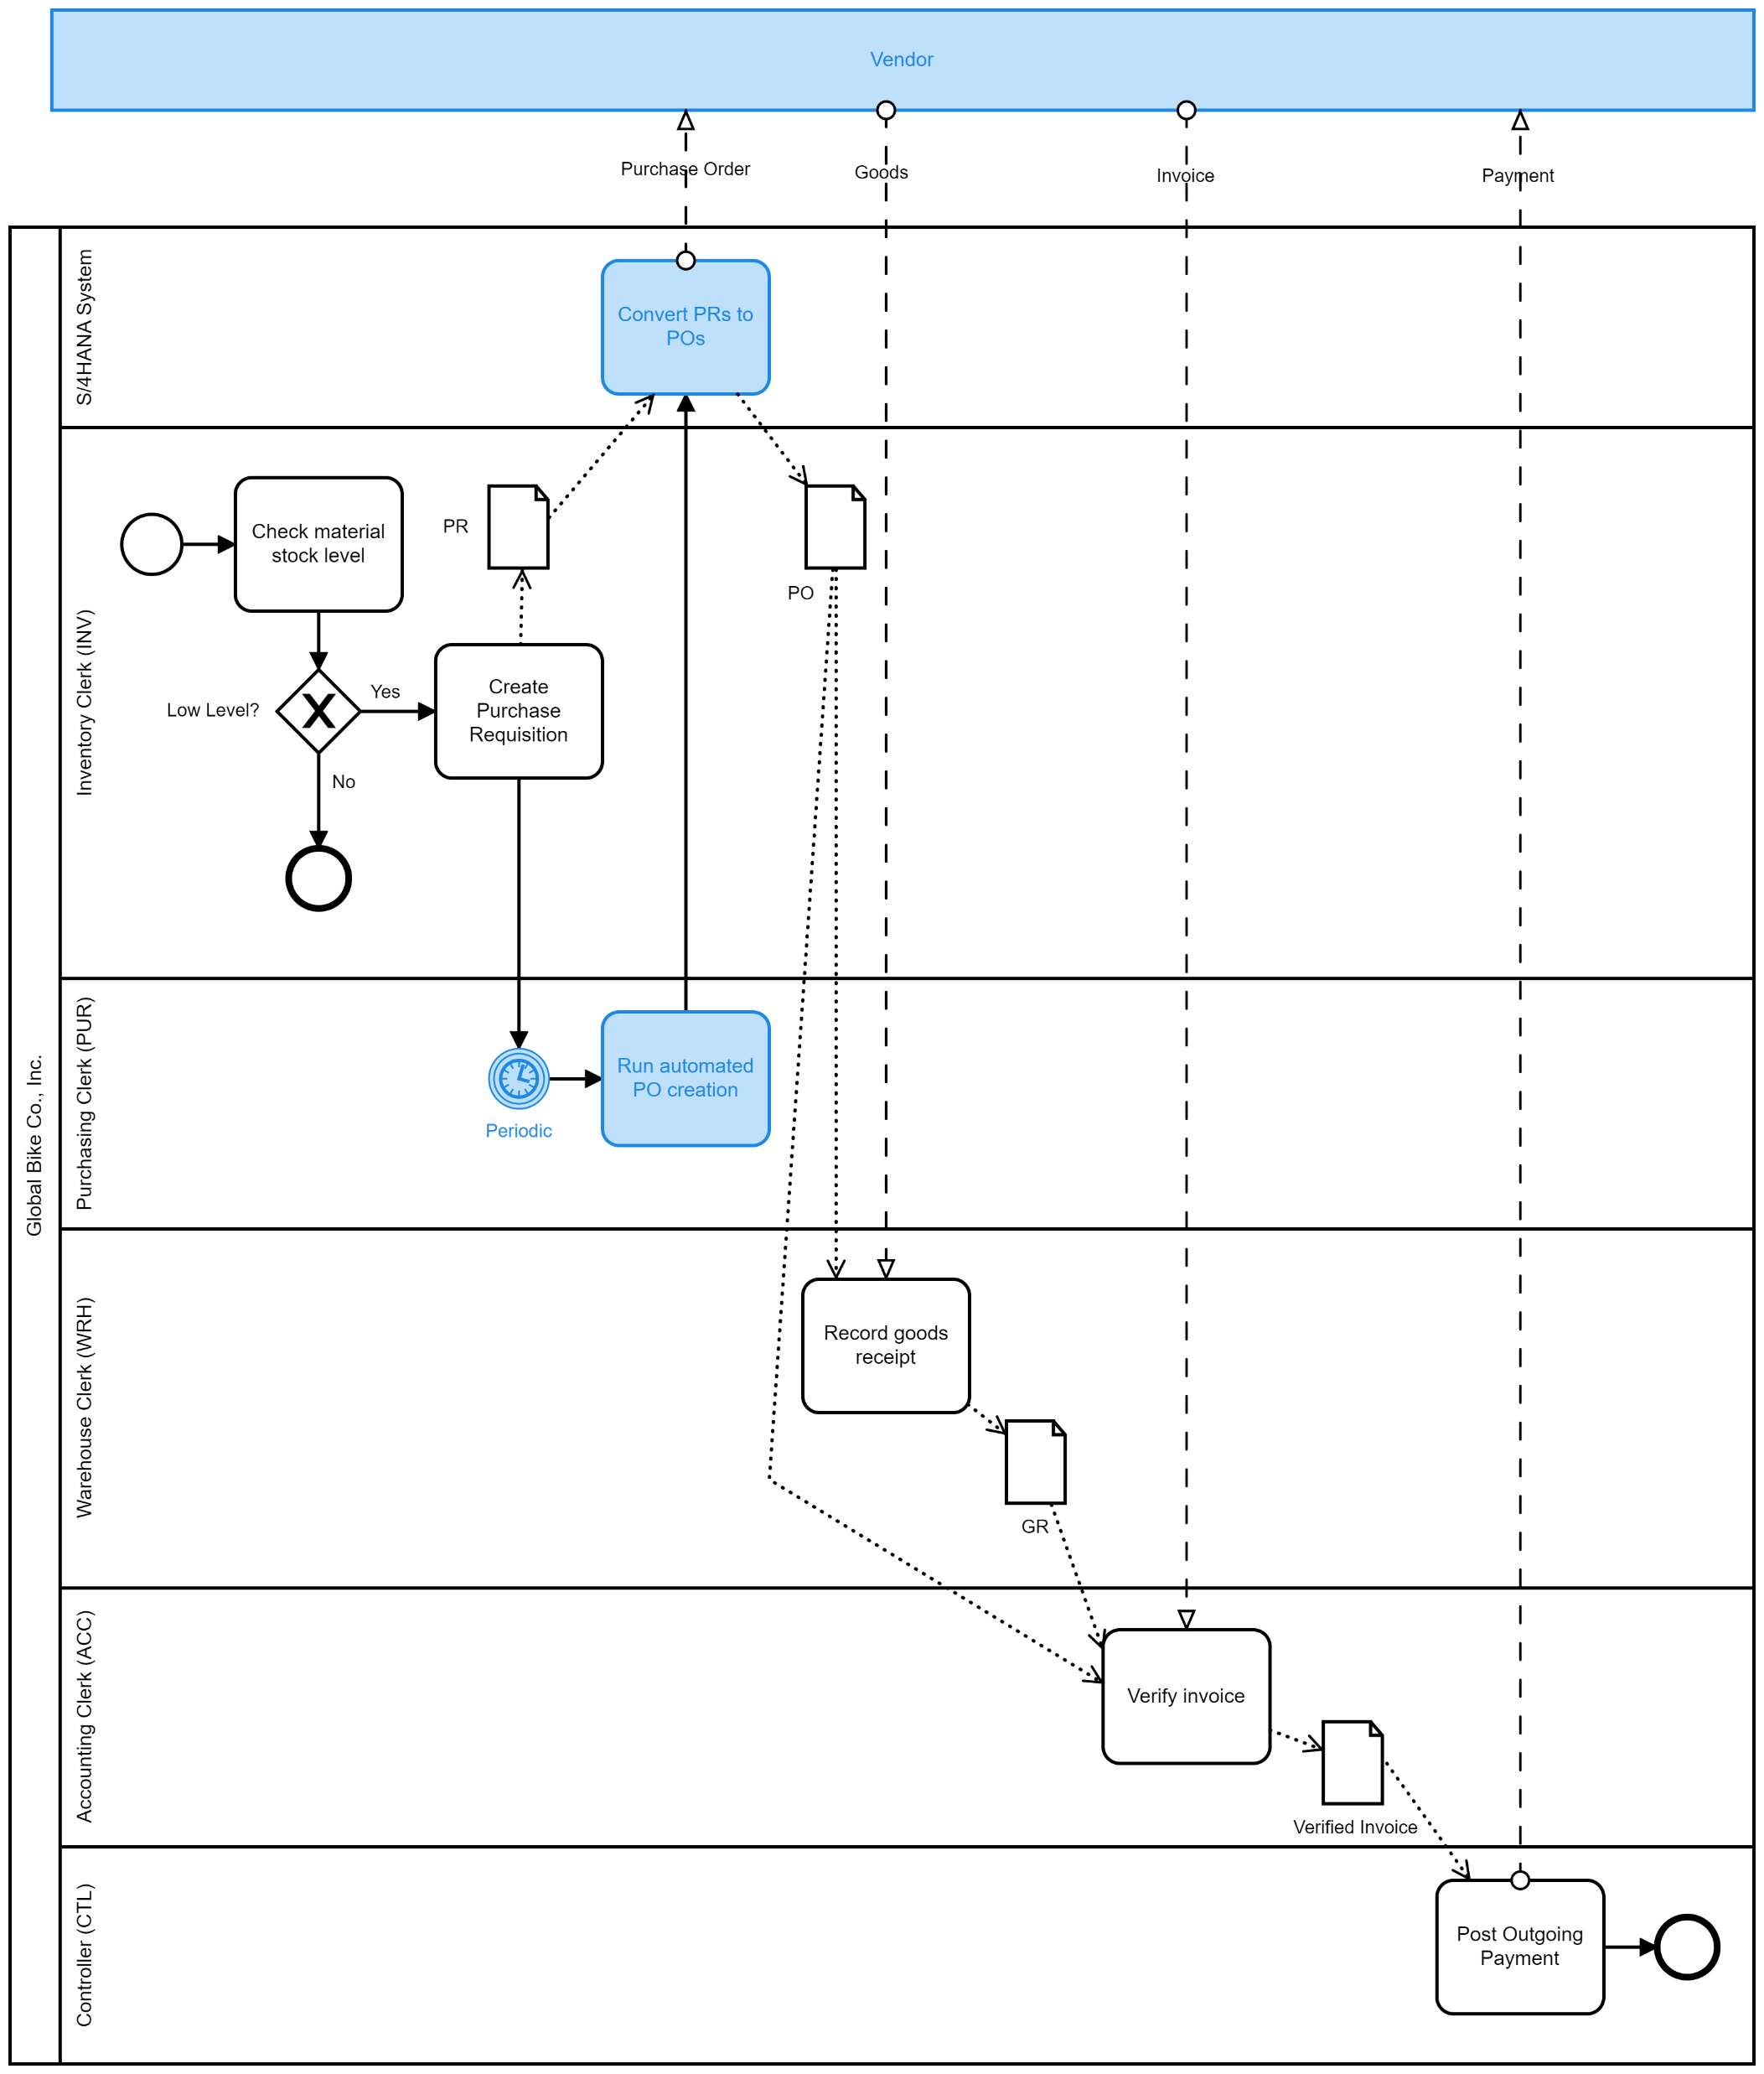
P2P with Automated PO Process Map

Slide 11
Accounts Payable Automation
Large amount of industry interest
One accounts payable bottleneck is three-way match for invoice verification
Possible improvements:
Automated three-way match
ERS
ERS
Pioneered by General Motors in 1994
Payments made based on quantities received and PO unit prices
No vendor invoices
Popular with large companies

Slide 12
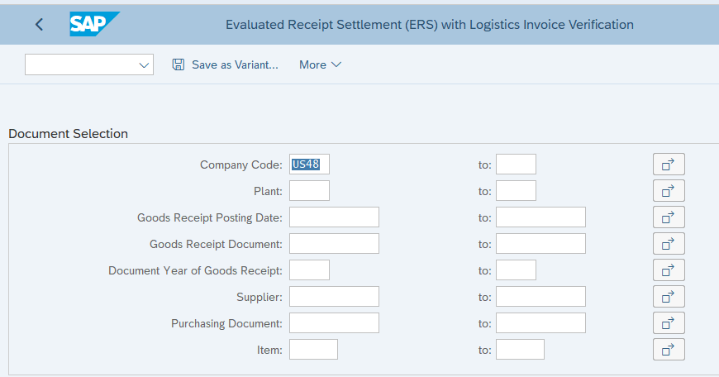
ERS (T-Code: MRRL)

Slide 13
Enabling ERS
Add
Option to vendor master data
Option to InfoRecord for each vendor and material combination
Tax code to InfoRecords for each vendor and material combination

Slide 14
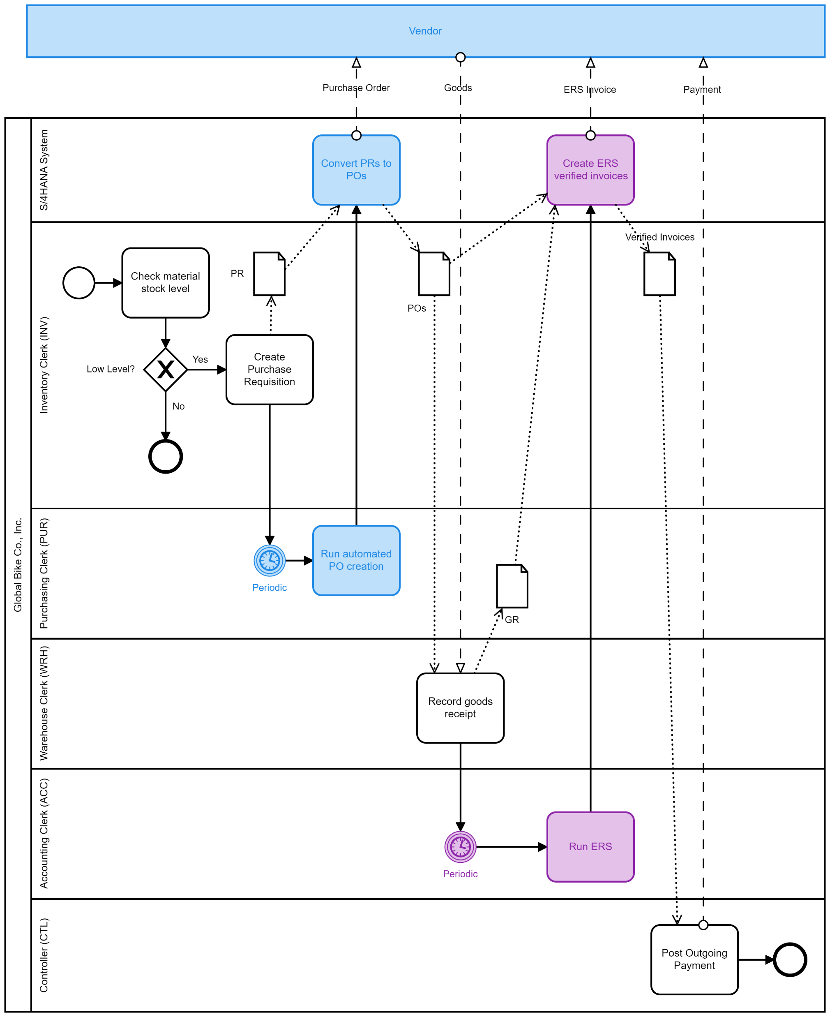
P2P with Automated PO and ERS Process Map

Slide 15

Wrap Up
Activities followed by
Robotic Process Automation (RPA) with UiPath to create purchase requisitions
Other conceptual coverage of EDI, scanners, IOT, MRP, etc.
Tested on AIS curriculum client
Will test on other curriculum clients (e.g., Epistemy Press BPI)
Will share materials after some cleanup

