Slide 1


Enhancing SAP/GBI Learning with Game Design Elements
Esi Adeborna
Luvai Motiwalla
University of Massachusetts
#SAPACC

Slide 2

Enhancing SAP/GBI Learning with Game Design Elements
How can we engage students in the use of SAP in the classroom? One potential mechanism to improve student engagement and motivation in the use of SAP GBI exercises and case study is game-based environment.
Esi Adeborna - University of Massachusetts, Lowell esi_adeborna@uml.edu
Luvai Motiwalla - University of Massachusetts, Lowell luvai_motiwalla@uml.edu

Slide 3





What if?
We can incorporate gamification design principles and elements into ERPs at the transactional level (L4s) to improve student engagement and motivation?
Points
Levels
Leaderboard
Badges
Onboarding

Slide 4
GBI Example
During the creation of a purchase order in the procurement process in the SAP Materials Management (MM) module, here are some gamification design elements that can be incorporated to promote a “fun” and engaging environment for the students using the GBI MM case study
Student is able see on-screen guide for steps to take to complete the order transaction
1
Student receives points for successfully completing the purchase order steps
2
A leaderboard to show students’ performance compared to his/her colleagues performing the same or similar tasks
3
Student sees an on-screen interactive feedback/progress bar to visualize their progress in the entire procurement process
4
Receive achievement badge(s) as a recognition of effort and/or accomplishment after completing several tasks in his/her assigned work description
5

Slide 5
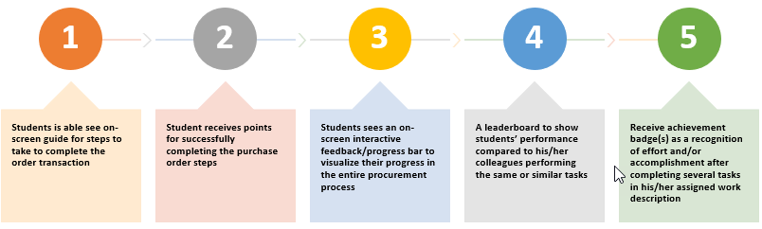
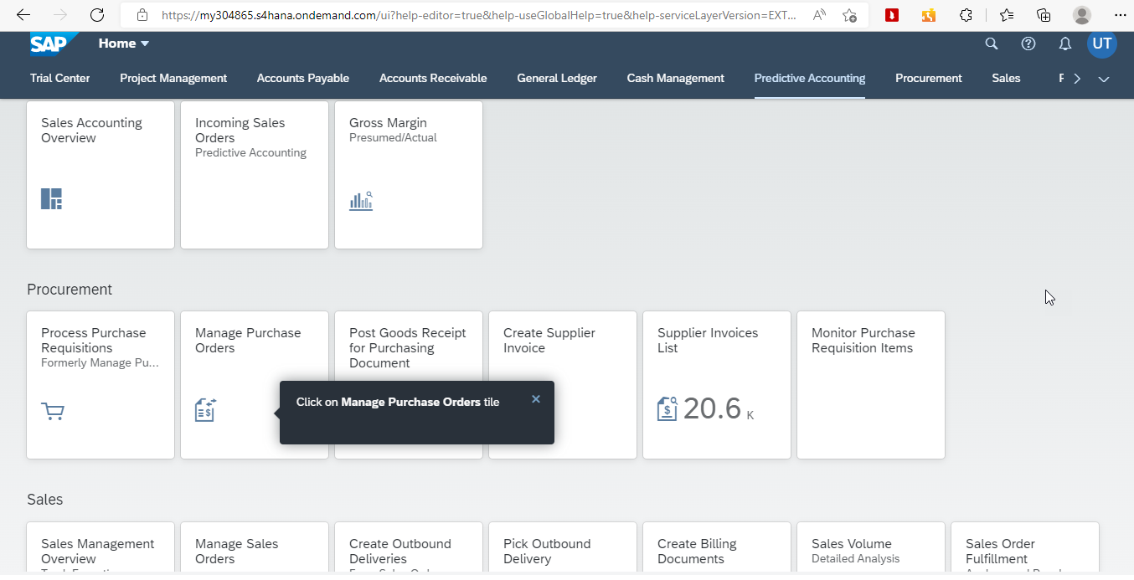

On-screen Guide…
Points:
5.0
|
Leader Board
|

Slide 6
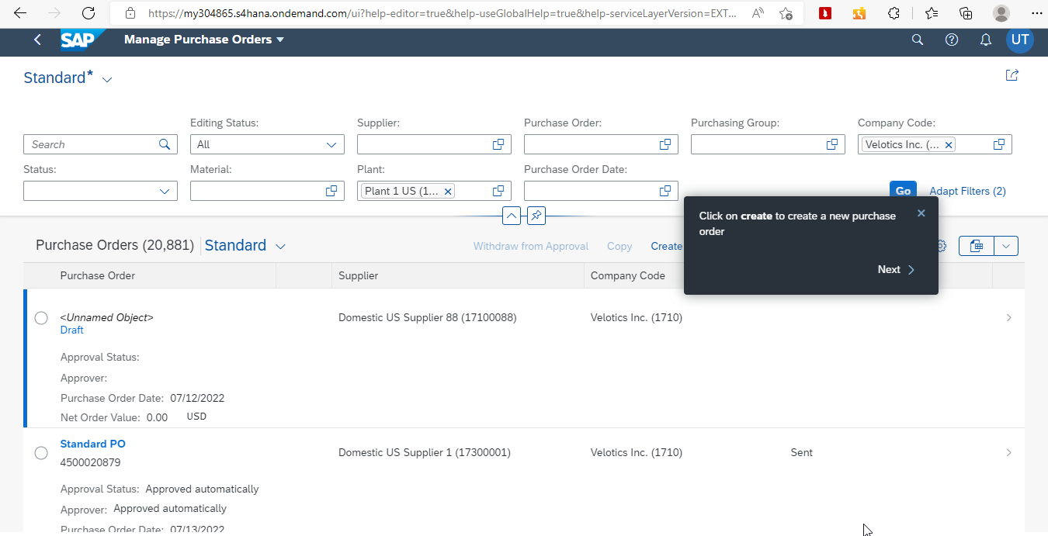
On-screen Guide…
Points:
20
|
Leader Board
|

Slide 7
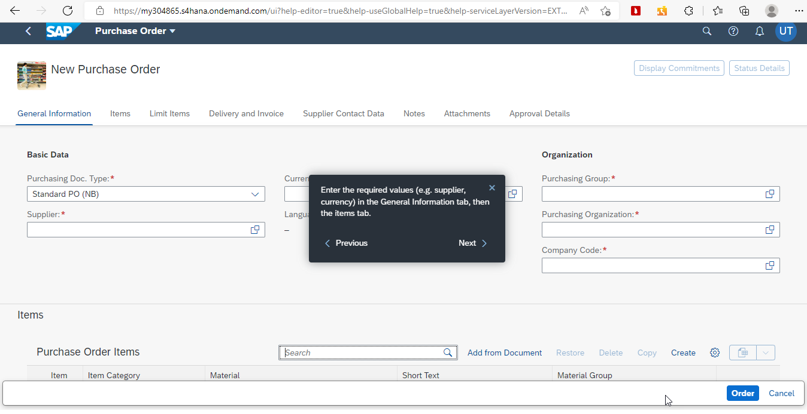
Points…
Points:
45
|
Leader Board
|

Slide 8
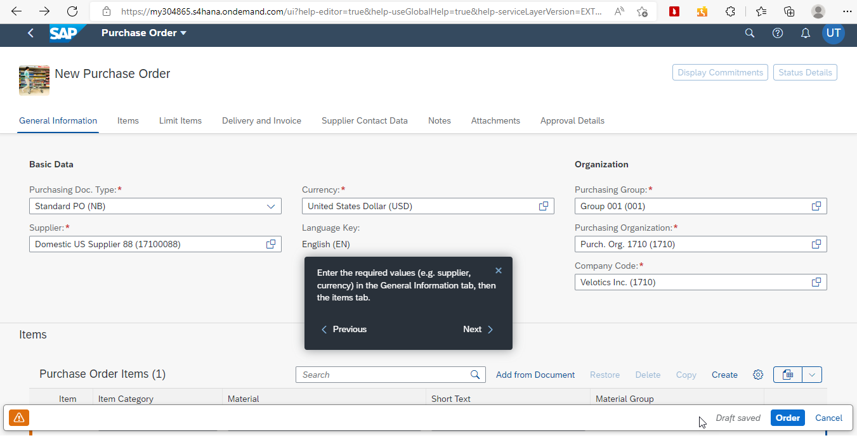
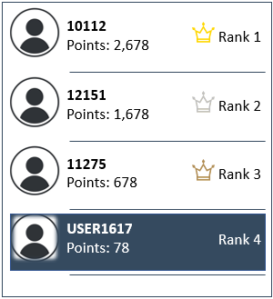
Leaderboard…
Points:
45
|
Leader Board
|

Slide 9
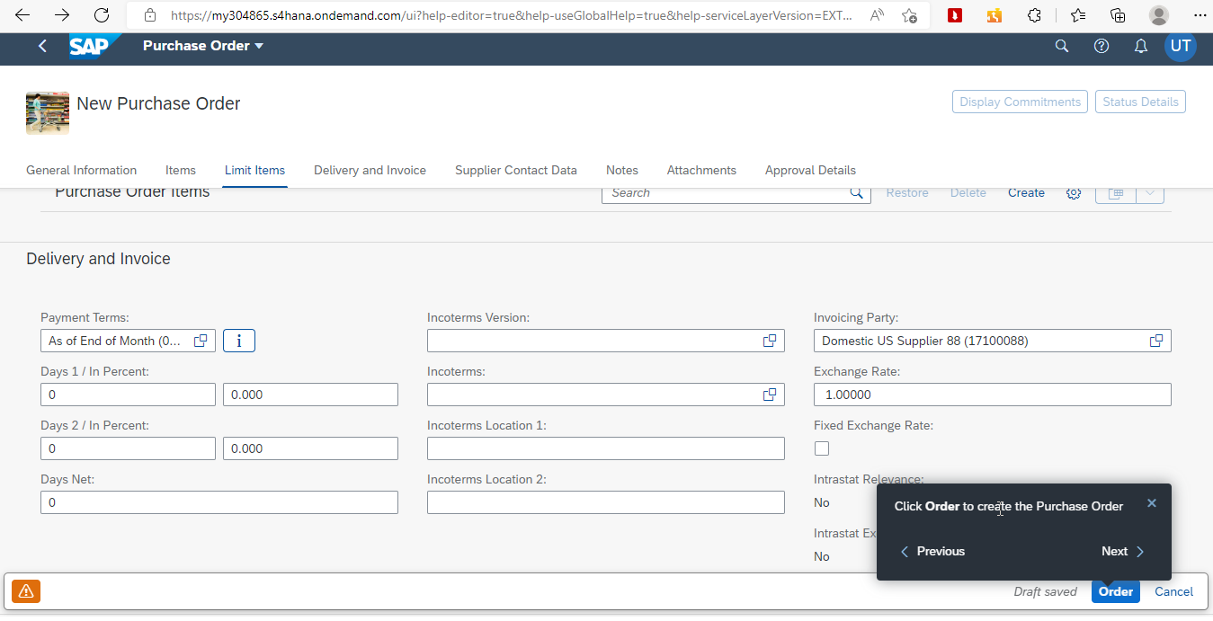
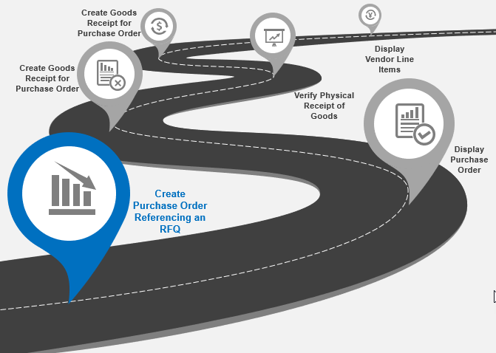
Onboarding…
Points:
60
|
Leader Board
|

Slide 10
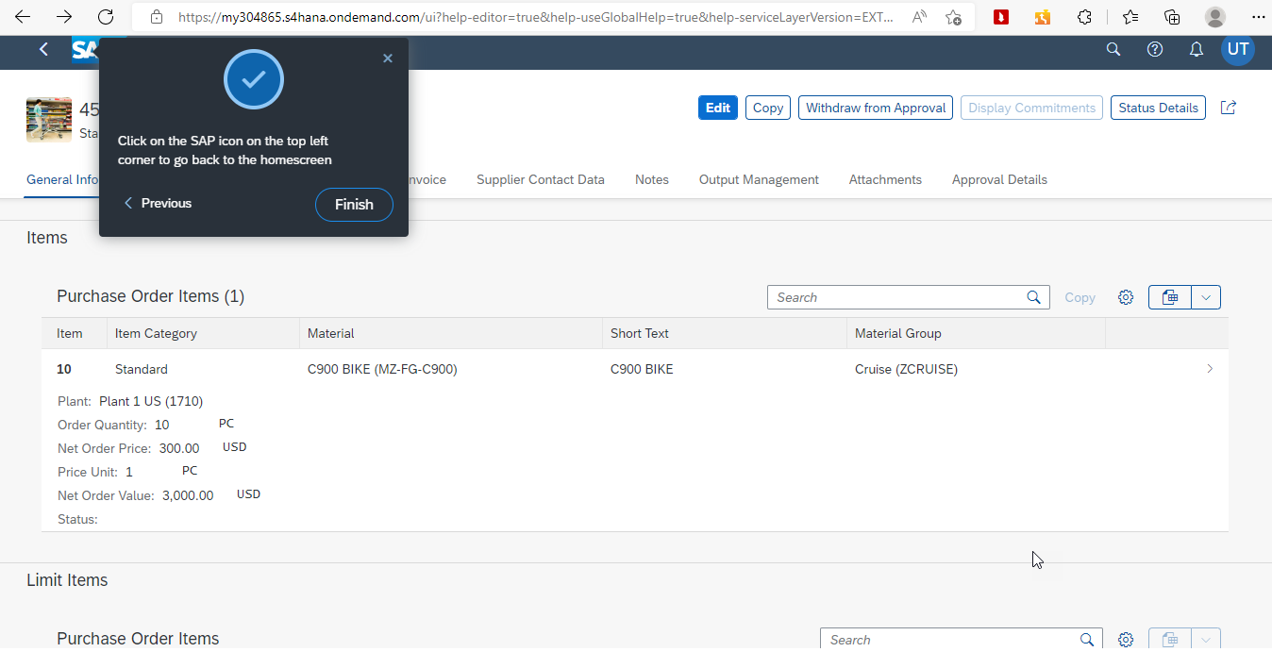
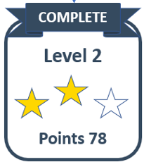
Levels…
Points:
78
|
Leader Board
|

Slide 11
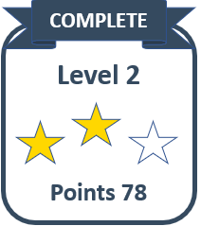
Gamification Design Elements Examples
Points:
78
|
Leader Board
|
PRIZES OR AWARD CERTIFICATES FOR TOP ACHIEVERS

Slide 12
Conclusion and Next Steps
Benefits
Increase student motivation and engagement around SAP GBI case studies and assignments
Active student interaction
Sparks friendly competition
Next Steps
Starting localized pilot testing in the fall then in Spring 2023
Contact me if interested to participate in the pilot testing phase

Slide 13
THANK YOU
Esi Adeborna - University of Massachusetts, Lowell esi_adeborna@uml.edu
Luvai Motiwalla - University of Massachusetts, Lowell luvai_motiwalla@uml.edu

