Slide 1


Next Generation ERP: Managerial Accounting with Fiori Apps
Birsen Karpak, Ph.D.
Kerri Henderson, CPA, MBA
#SAPACC

Slide 2



Next Generation ERP: Managerial Accounting with Fiori Apps
YSU has an ERP certificate consisting of BPI, SCM, IS (MIS or AIS), and POM classes. Authors have already introduced SAP into Managerial Accounting classes to enhance this certificate program. They will talk about their innovation in Managerial Accounting class during 2021-2022 academic year.
Birsen Karpak, Ph.D. Distinguished Professor Emeritus, Management and Marketing Department Youngstown State University bkarpak@ysu.edu
Kerri Henderson, CPA, MBA Lecturer – Accounting and Finance Department Youngstown State University kahenderson@ysu.edu

Slide 3
Recent Enhancements in our SAP integration into curriculum
We are at the new Frontiers!
Created an honors version of our Financial Accounting
Financial accounting with SAP S/4 HANA with Global Bike Data base
SAP S/4 HANA in Managerial accounting with GUI first later with Fiori.
Realized that students like better Fiori Apps
Accounting students love SAP they find jobs in fortune 500, big accounting firms, get better jobs with their Next Generation Enterprise Systems Management Knowledge.

Slide 4
Recent Enhancements in our SAP integration into curriculum
We are at the new Frontiers!
Prefer introducing SAP with FIORI.
Students are App generation
FIORI is computer agnostic
Intuitive
Well Organized

Slide 5
Next Generation ERP: Managerial Accounting with Fiori Apps
We enjoy applying the pedagogy of experiential learning in our classes.
We like to prepare business ready students
That is why we use SAP, leading Information System used by most fortune 1000 companies as well as small medium sized enterprises.
With SAP, Students learn business concepts with an information system used in real life
We know industry is looking for technology savvy business students

Slide 6
Next Generation ERP: Managerial Accounting with Fiori Apps
ERP system, Next Generation ERP system
Managerial accounting related certain concepts
Cost Centers, Primary Cost Elements, Secondary Cost Elements, Material Master Data, Bill of Material, GR/IR Account, Reconciliation Account, Controlling
Perform certain transactions of procurement process
Purchase Order, Good receipt, Goods issue
Comprehend and be able to articulate the impact of them on financial and cost accounting and on inventory and on master data of material.

Slide 7
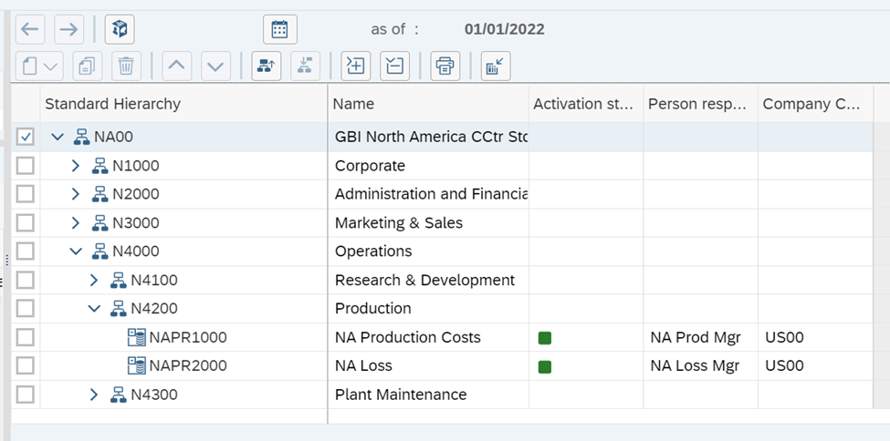
Managerial Accounting Concepts with Fiori Apps
Introduce the Five Cost Center Groups of GBI
Corporate, Administration Financials, Marketing &Sales, Operations, Information Technology

Slide 8
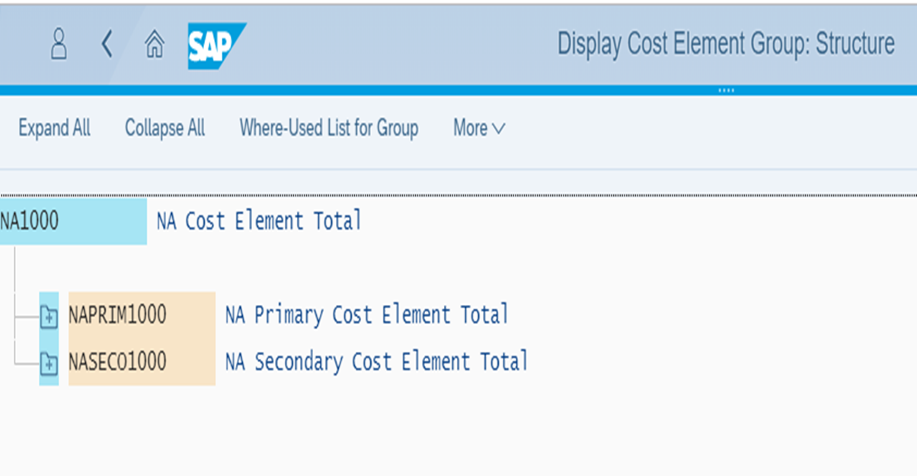
Managerial Accounting Concepts with Fiori Apps
Introduce the Primary and Secondary Cost Elements

Slide 9
Exploring Cost Elements
Since there are corresponding Expenses and Revenue accounts in Financial Accounting for every Primary Cost and Revenue Elements, and a general ledger account for every secondary cost elements we will explore them via “manage General Ledger (G/L) Account master data,” App.

Slide 10
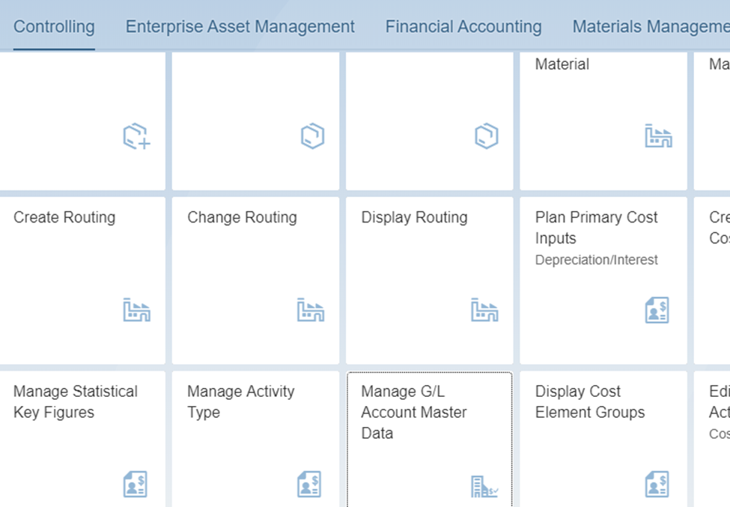
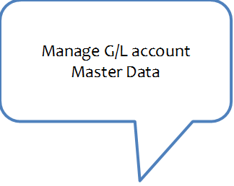
Exploring Cost Elements

Slide 11
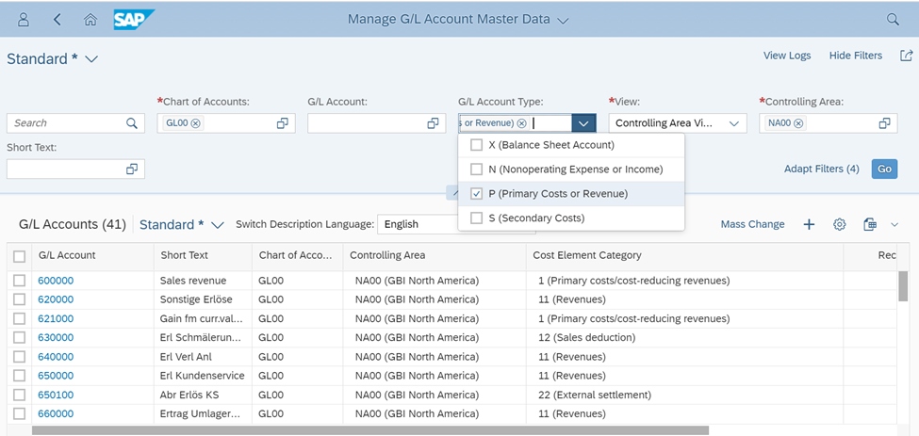

Slide 12
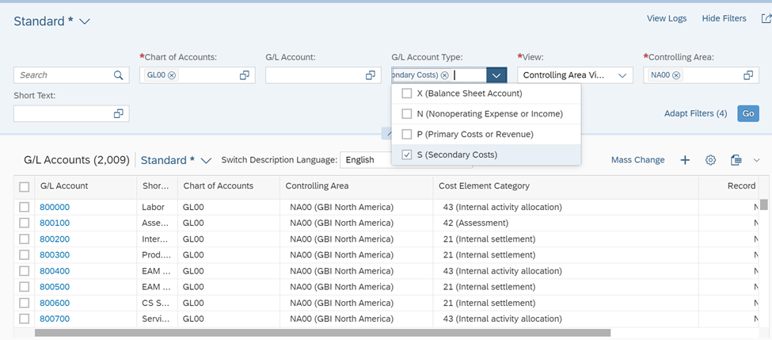

Slide 13
Managerial Accounting Concepts with Fiori Apps
We will procure the material, and issue it to a production center and see the impact on inventory, financial and cost accounting and material master data

Slide 14
What is next?
We do not have enough students for the companies who seek our graduates.
We have more demand than our supply.
We plan to increase the student pool by creating an “Intelligent Enterprise Management” certificate by modifying our current ERP certificate Program

Slide 15
Next Generation ERP: Managerial Accounting with Fiori Apps
Thank you
Birsen Karpak, Ph.D., Distinguished Professor Emeritus, Department of Management and Marketing, bkarpak@ysu.edu
Kerri Henderson, CPA, MBA, Lecturer, Lariccia School of Accounting & Finance, kahenderson@ysu.edu
Youngstown State University
Lecture notes “Next Generation ERP, Managerial Accounting with Fiori Apps,” have developed and will be shared with the interested audience.

