Slide 1


Next Generation Material Requirements Planning (MRP) with Fiori Apps in Operations Management
Birsen Karpak, Ph.D.
Dr. Alina Marculetiu
#SAPACC

Slide 2



Next Generation Material Requirements Planning (MRP) with Fiori Apps in Operations Management
YSU has an ERP certificate consisting of BPI, SCM, IS (MIS or AIS), and POM classes. Authors will talk about their innovation in POM during the 2021-2022 academic year.
Birsen Karpak, Ph.D. Distinguished Professor Emeritus, Management and Marketing Department Youngstown State University bkarpak@ysu.edu
Dr. Alina Marculetiu Assistant Professor of Operations & Supply Chain Management, Department of Management and Marketing, Youngstown State University amarculetiu@ysu.edu

Slide 3
Next Generation Material Requirements Planning (MRP) with Fiori Apps
Prefer introducing SAP with FIORI
Students are App generation
FIORI is computer agnostic
Intuitive
Well organized

Slide 4
Next Generation Material Requirements Planning (MRP) with Fiori Apps
Understand some basic features of next-generation ERP systems
Differentiate independent demand management from dependent demand management
Understand Bill of Materials, lead time, gross requirements, projected on hand, planned order release, planned order receipt, and scheduled receipt concepts.
Develop material requirements planning for dependent materials considering stocks, lead time, and lot sizing rules.

Slide 5
Next Generation Material Requirements Planning (MRP) with Fiori Apps
What do you need for MRP?
Master Production Schedule
BOM (Usually for Finished Goods, sometimes for semi finished goods)
Material (both finished product, and raw materials)

Slide 6
Next Generation Material Requirements Planning (MRP) with Fiori Apps
When we do MRP manually, we need to know bill of material (BOM) of this master production schedule item.
When we are doing MRP with an ERP system, we need BOM to understand the outputs of the MRP system.

Slide 7
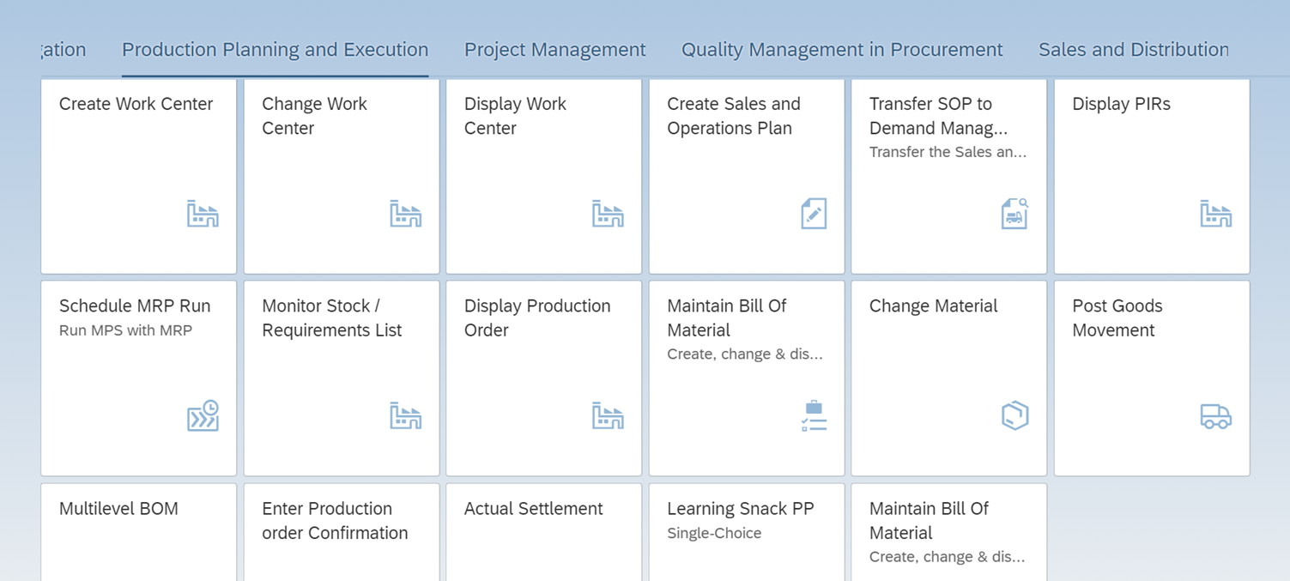
Next Generation MRP with Fiori Apps

Slide 8
MRP
PIRs for our master production items.
MRP
Explanation how various materials are planned for in different time periods considering stocks, lead time, and lot sizing rules.
Students understand at each step why GR at that level,
What are net requirements, why, etc.

Slide 9
What is next?
We do not have enough students for the companies who seek our graduates.
We have more demand than our supply.
We plan to increase the student pool by creating an “Intelligent Enterprise Management” certificate by modifying our current ERP certificate Program

Slide 10
Next Generation MRP with Fiori Apps
Thank you
Birsen Karpak, Ph.D., bkarpak@ysu.edu
Dr. Alina Marculetiu. amarculetiu@ysu.edu
Youngstown State University
Lecture notes “Next Generation ERP, Material Requirements Planning with Fiori Apps” have been developed and will be shared with the interested audience.

