Slide 1


ERPsim Logistics Sustainability: A Simulation Game to Introduce Sustainable Decision-Making in Business Education
Burak Oz
Jacques Robert
Karl-David Boutin
Felix Gaudet-Lafontaine
Constantinos K. Coursaris
Pierre-Majorique Leger
#SAPACC

Slide 2

ERPsim Logistics Sustainability: A Simulation Game to Introduce Sustainable Decision-Making in Business Education
This presentation explains the development process of an SAP-based teaching innovation intended to make management students think about sustainability issues; and discusses possible teaching objectives that can be achieved using this tool.
Burak Oz, Jacques Robert, Karl-David Boutin, Felix Gaudet-Lafontaine, Constantinos K. Coursaris, Pierre-Majorique Leger

Slide 3

The Need for Managers with a Sustainability Mindset
Recent surveys show an increased recognition of the need for managers with a sustainability mindset (PwC 2017).
Notes:
Human impacts on the climate have become more apparent in recent years and it has been acknowledged that the current energy consumption levels are not sustainable. And recent surveys also show that CEO’s have realized that they need their future managers to have a sustainability mindset.

Slide 4
The Need for Managers with a Sustainability Mindset
Teaching
business ethics,
sustainability,
green knowledge
at business schools is a necessity (Podolny 2009; Figueiró and Raufflet 2015).
Notes:
Human impacts on the climate have become more apparent in recent years and it has been acknowledged that the current energy consumption levels are not sustainable. And recent surveys also show that CEO’s have realized that they need their future managers to have a sustainability mindset.

Slide 5
The Challenges Of Integrating Sustainability Into Business Education
Barriers to change
Personal and professional
Technical and administrative
Inter-personal and group dynamics
Organizational
Institutional
Lack of teaching materials
Lack of resources
(Ramboarisata and Gendron 2019)
Notes:
Human impacts on the climate have become more apparent in recent years and it has been acknowledged that the current energy consumption levels are not sustainable. And recent surveys also show that CEO’s have realized that they need their future managers to have a sustainability mindset.

Slide 6

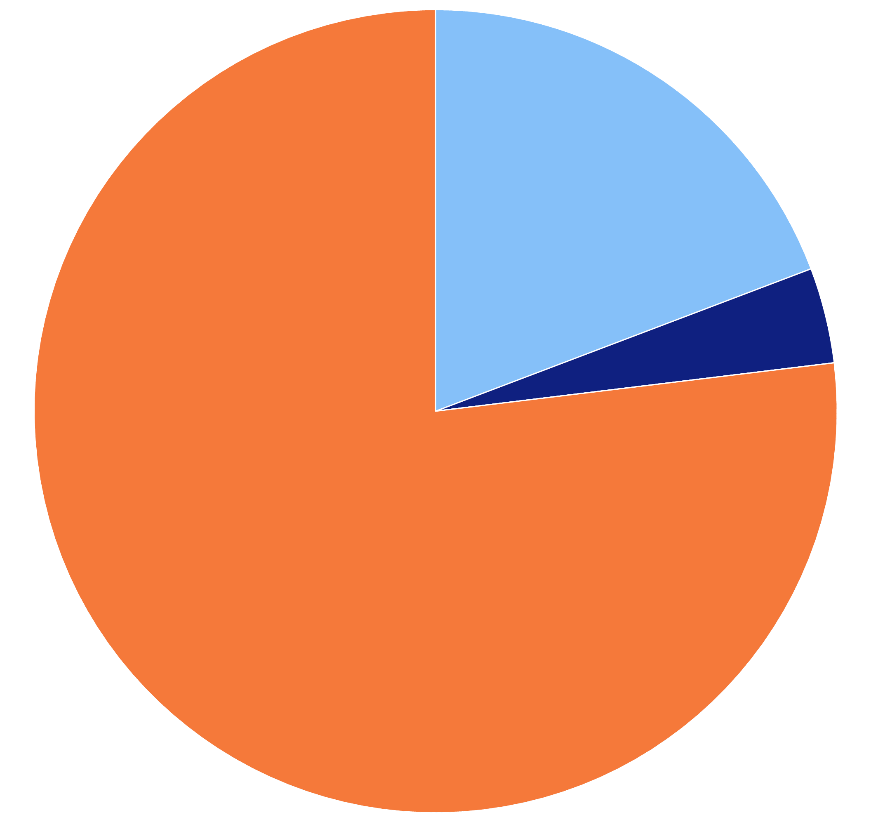
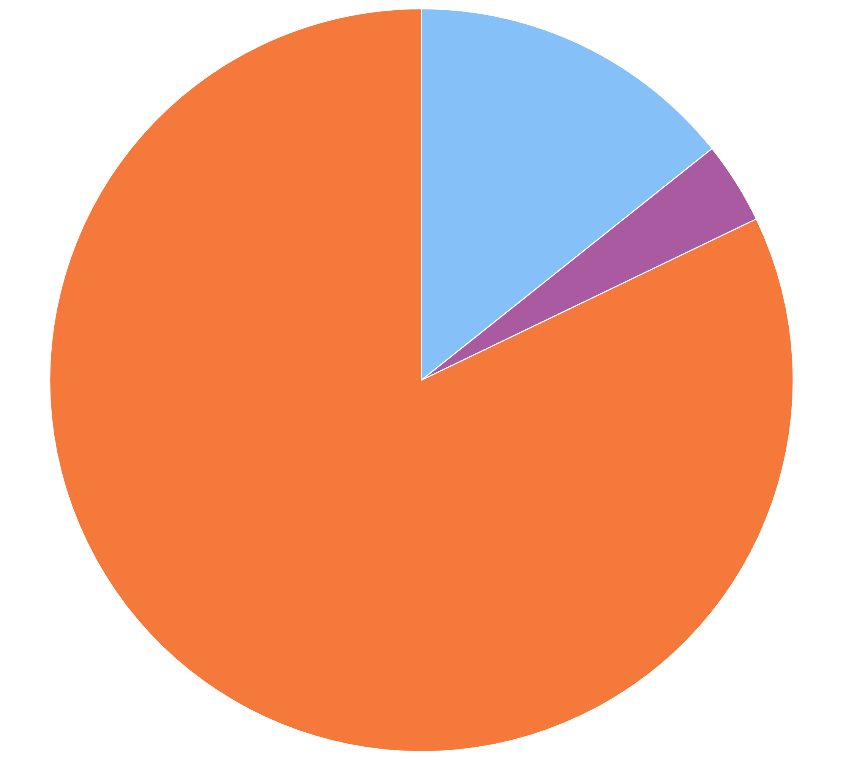
The Role of IT in Education for Sustainability
Realism of Context
Low
High
Creation of Knowledge by Student
Constructivism (n=26)
Socioculturalism
Learner
Cognitive Information Processing
(n=4)
Sharing of Knowledge
Peer Group
Learning
Control of the Learning Environment
Collaborativism (n=28)
Dissemination of Knowledge by Instructor
Automate
Inform up
Instructor
Objectivism
Inform down
Transform
Abstractions
Personally Experienced
Knowledge
(Oz et al. 2021)
Notes:
Human impacts on the climate have become more apparent in recent years and it has been acknowledged that the current energy consumption levels are not sustainable. And recent surveys also show that CEO’s have realized that they need their future managers to have a sustainability mindset.

Slide 7
The Role of IT in Education for Sustainability
Teaching soft skills is one of the identified learning objectives
Critical thinking,
Managing people,
Dealing with complexity.
An active learning environment is beneficial in attaining these learning objectives,
A collaborativist learning model is commonly used in the identified IT-based teaching innovations
(Oz et al. 2021)
Notes:
Human impacts on the climate have become more apparent in recent years and it has been acknowledged that the current energy consumption levels are not sustainable. And recent surveys also show that CEO’s have realized that they need their future managers to have a sustainability mindset.

Slide 8
Objectives in Developing ERPsim Sustainability
A game that will help students to,
Think critically,
Interact with other people within their company and market,
Deal with complex decisions in a realistic multi-objective environment.
Provide information on carbon emissions of;
Raw materials,
Activity types,
Outbound logistics
Notes:
Human impacts on the climate have become more apparent in recent years and it has been acknowledged that the current energy consumption levels are not sustainable. And recent surveys also show that CEO’s have realized that they need their future managers to have a sustainability mindset.

Slide 9
Game Design
First step: exploration
Literature survey on the carbon emission values of;
Dairy production operations,
Logistics operations,
Other business operations
Survey on the carbon emission management policies;
Carbon tax,
Carbon credit
Notes:
Human impacts on the climate have become more apparent in recent years and it has been acknowledged that the current energy consumption levels are not sustainable. And recent surveys also show that CEO’s have realized that they need their future managers to have a sustainability mindset.

Slide 10
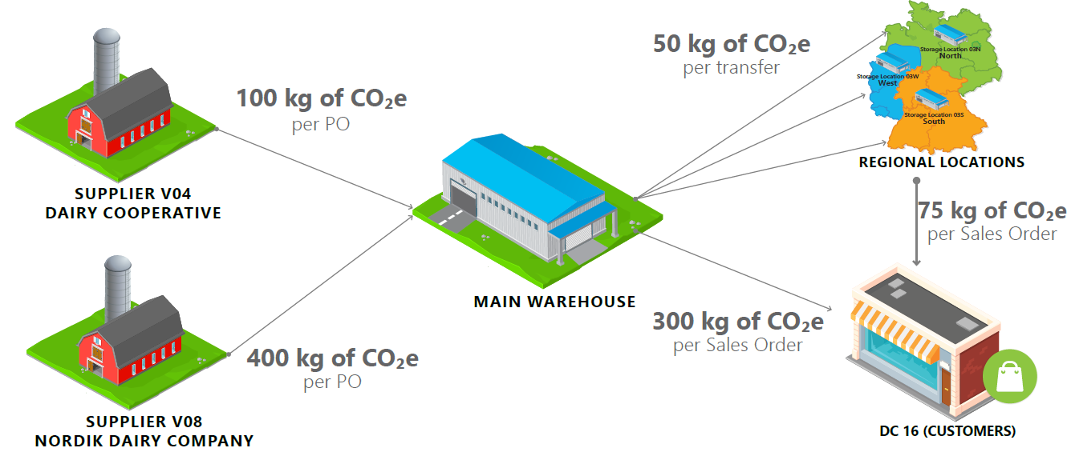
Game Design
In addition to the functions in ERPsim Logistics Extended;
The companies may choose between two delivery options;
From a central warehouse,
From regional warehouses.
A new, more sustainable supplier that can be selected on the procurement sourcing transaction
Sustainable supplier is more expensive and uses full truck loads. Thus, delivery dates are not certain.
A carbon emission reporting system for each product, logistics, and procurement options with a view on scope 1, 2, and 3 emissions.
Notes:
Human impacts on the climate have become more apparent in recent years and it has been acknowledged that the current energy consumption levels are not sustainable. And recent surveys also show that CEO’s have realized that they need their future managers to have a sustainability mindset.

Slide 11
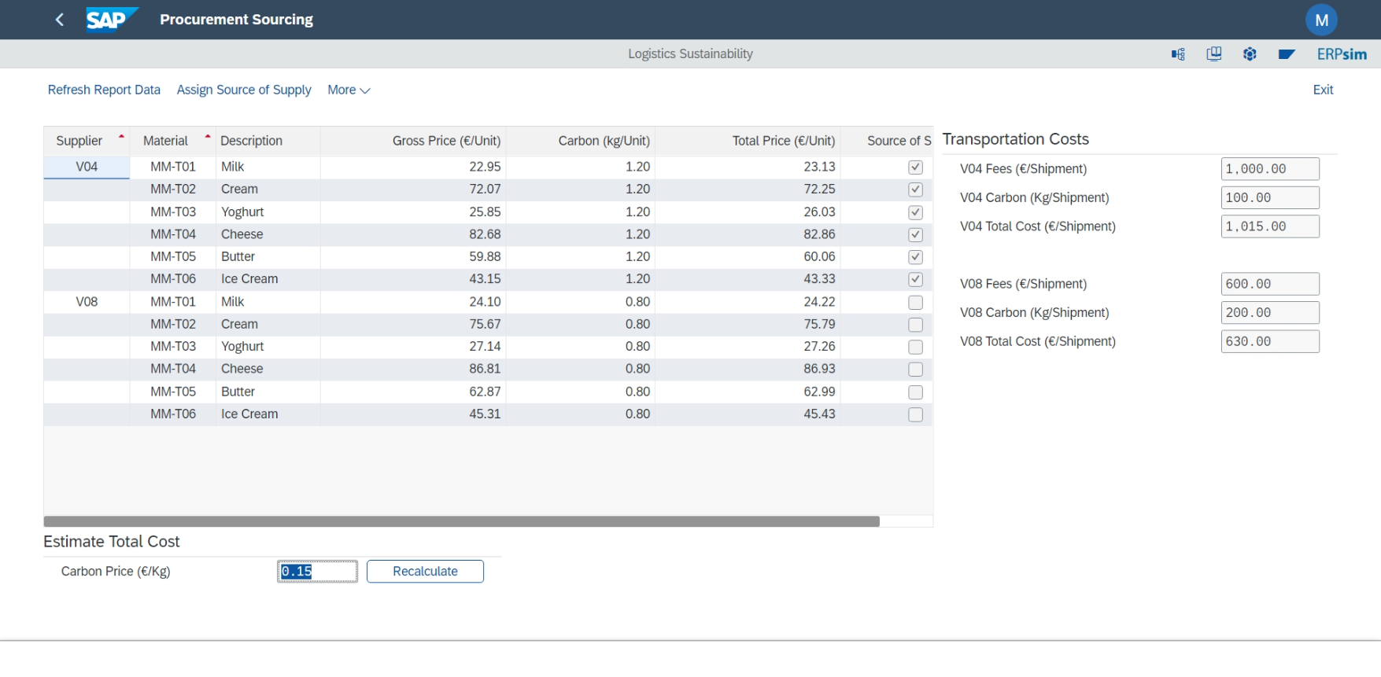
Game Design
Procurement sourcing transaction

Slide 12
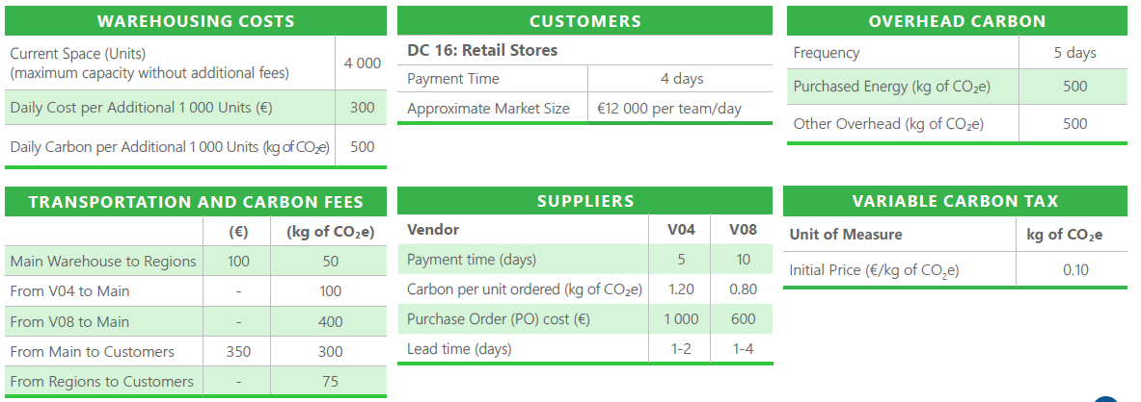
Game Design
Making Trade-Offs
Two performance measures for instructors to use
Teaching objectives include;
Just introducing concepts such as carbon emissions, carbon tax, emissions management, corporate social responsibility;
Showing that being sustainable can still be profitable if a company can manage to leverage the power of data through IT investments.
Other options might be available through;
Parameter adjustment screens,
Selection of performance measures (any combination of carbon emissions and profit, or a threshold value for each)
Notes:
Human impacts on the climate have become more apparent in recent years and it has been acknowledged that the current energy consumption levels are not sustainable. And recent surveys also show that CEO’s have realized that they need their future managers to have a sustainability mindset.

