Slide 1


Penn State SIMBA and SAP University Alliance Collaboration
Julie M. Bressler - SIMBA - The Pennsylvania State University
jmb62@psu.edu
William Cantor –The Pennsylvania State University
wpc2@psu.edu
#SAPACC

Slide 2


Penn State SIMBA and SAP University Alliance Collaboration
A discussion about a collaboration between the SAP project team at Penn State (SIMBA) and academic classes
Julie M. Bressler - SIMBA - The Pennsylvania State University
jmb62@psu.edu
William Cantor –The Pennsylvania State University
wpc2@psu.edu

Slide 3
The Pennsylvania State University
Public state-related land-grant research university (1855)
Not part of the Pennsylvania's State System of Higher Education
24 centrally administered campuses
$7B budget
34,000 employees
90,000 students

Slide 4

Julie M. Bressler
SAP Business Intelligence Group Manager
Penn State IT Enterprise Systems & Services
SIMBA - The Pennsylvania State University
Email: jmb62@psu.edu

Slide 5
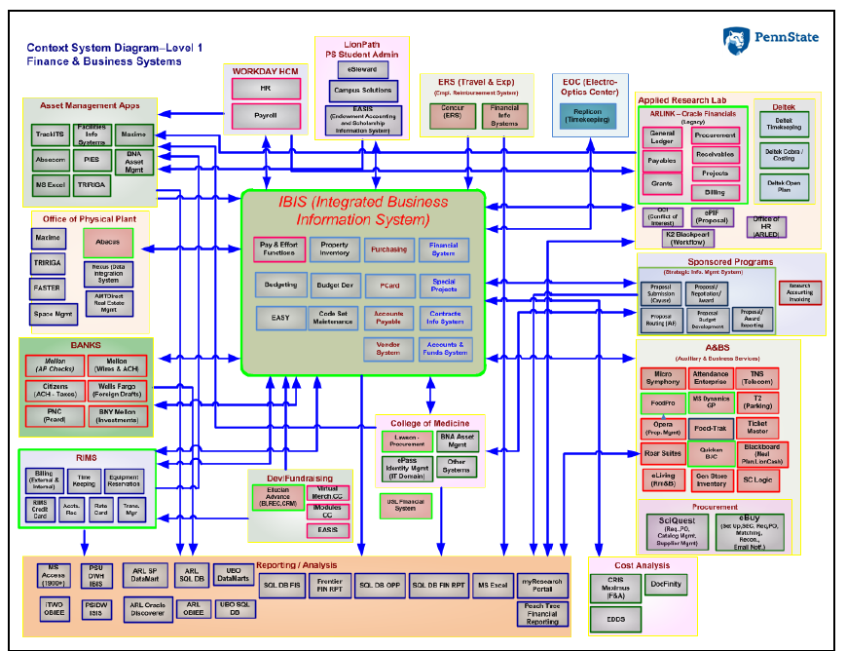
Where did we start? (Pre–July 2020)
30-year-old Mainframe
Data Quality
Data Redundancy
Shadow Systems
Many External Integrations

Slide 6
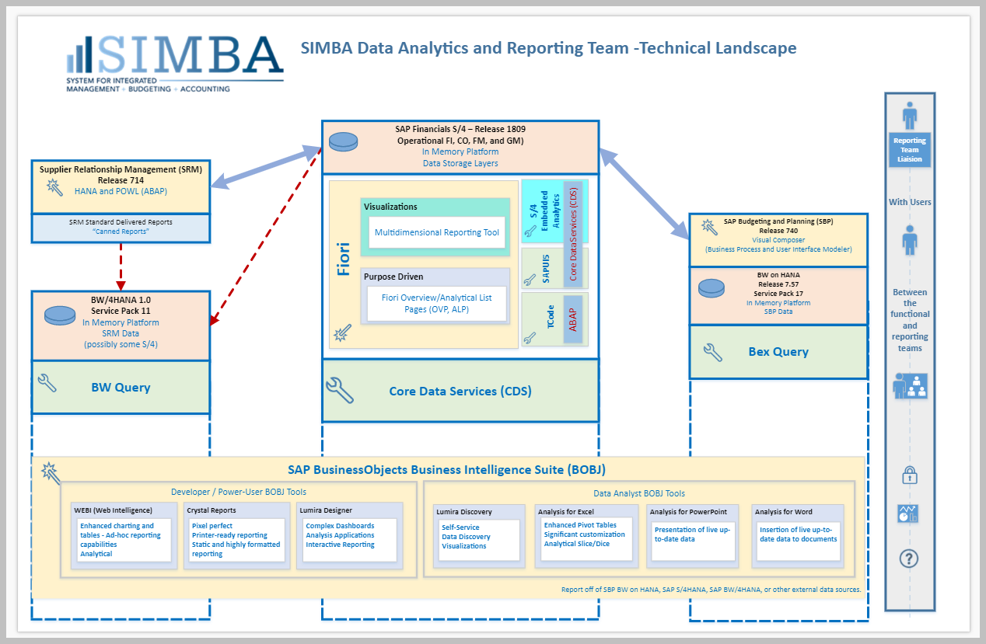

Slide 7
Penn State – University Alliance
Member ~20 years
Not an SAP customer until 2018
Through UA contacts, I was able to connect with the Enterprise Project team and SAP project manager and ultimately Julie

Slide 8
Initial Collaboration
Complete unfiltered access to the project and enterprise team
University strategy
Best of breed decision process
Software selection process (RFP)
Consultant selection process
Infrastructure decision process
Project team formation
Change management plan and team

Slide 9

The Partnership
Information Sciences & Technology Classes
SAP Software
SIMBA
Established 2018
3 IST Class Modules
IST 420
IST 421
IST 440W
75 Total Student Participants
3 Paid Internships
Approximately 1500 hours

Slide 10
Knowledge transfer to SIMBA
Early access to SAP technology (before system access)
Penn State York hosted analytics workshop
SIMBA team – introduction to S/4 Hana Fiori interface
ERPSIM
“Lesson’s Learned” and valuable guidance shared from:
Penn State SAP Faculty
Penn State York Administration and Financial Officer Staff
SIMBA access to the latest SAP Technology through the SAP University Alliance program

Slide 11
Examples of collaboration projects
Mendix
UA hosted workshops
SIMBA team utilized Mendix for customer SAP interface
SIMBA Mendix consultants assisted student project team to connect Mendix to SAP in support of a project with Penn State Applied Research Lab
UiPath
UA hosted workshops
Introduction into classes
Students worked with SIMBA build SAP automations based on PSU use cases
SIMBA hired student intern this summer to create a full POC

Slide 12
SIMBA perspective
Student access to SIMBA key players (Insight into large SAP implementation)
Fulfillment of a Penn State student internship requirements
Analysis of cutting-edge technology that applies to production system
Fresh perspectives and in-depth examination of potential software
Future potential job opportunities
Long-Term relationships and collaboration
Benefits for SIMBA production team and Penn State Financial End-users

