Slide 1


HANA
Version 1.0, July 2015
Author Ross Hightower
Product SAP HANA
Level Beginner
July 5, 2015
Focus
A (very) brief introduction to HANA
Public

Slide 2
Introduction to HANA Table of Content
What is HANA?
Why is HANA a big deal?

Slide 3
What is SAP HANA?

Slide 4
What is HANA?
SAP HANA is an in-memory, column-oriented, relational database management system
developed and marketed by SAP SE.^{[1][2]} HANA's architecture is designed to handle both
high transaction rates and complex query processing on the same platform.^{[3]} SAP HANA
was previously called SAP High-Performance Analytic Appliance.^{[4]}
In addition to the database engine, HANA includes an embedded web server and version
control repository that can be used for application development. HANA applications can be
created using server-side JavaScript and HTML.
https://en.wikipedia.org/wiki/SAP_HANA

Slide 5
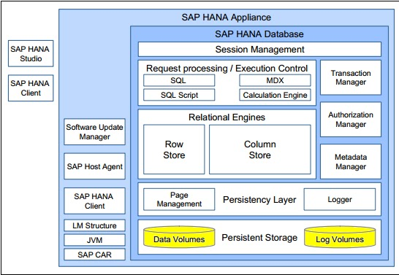
In-Memory Architecture

Slide 6
What is SAP HANA a Big Deal?

Slide 7
SAP HANA is Fast?
In-memory
Data is stored in the main memory of the HANA appliance rather than on a disk
Data centers built on in-memory technologies can store up to 40x the data in the same space and use 80% less energy
Backups of the data are stored on disk
“RAM is the new disk, disk is the new tape”
Column-oriented
Data is mostly stored in column oriented tables rather than row oriented tables
Massive parallel processing
Low cost Intel x86 processors (e.g. 8 processors with 15 cores each)

Slide 8
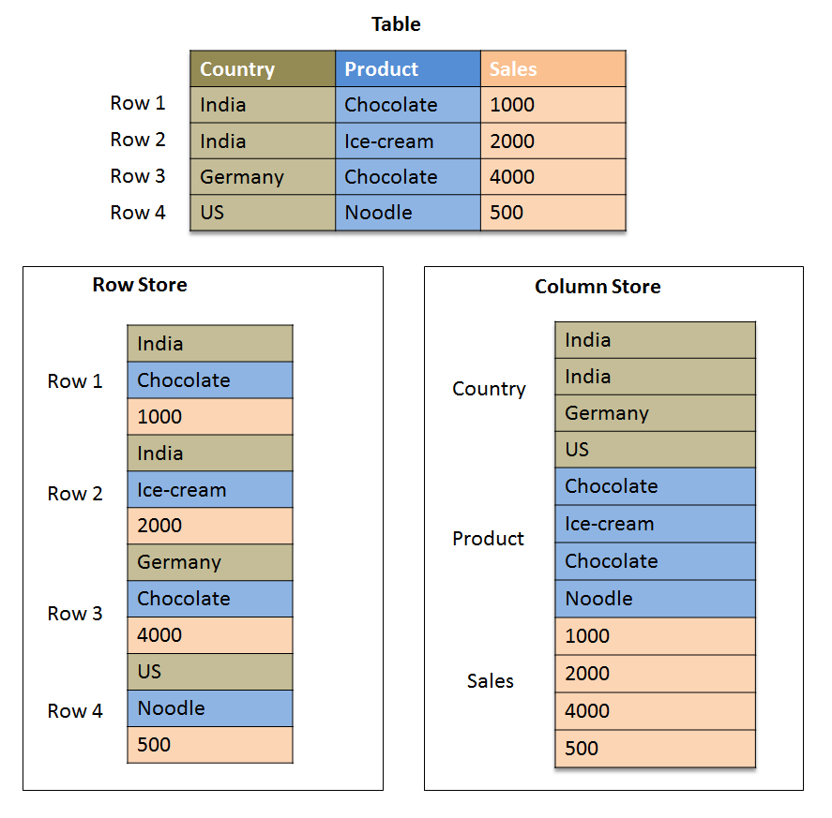
Column vs. Row Storage
In column oriented storage, the contents of a column are stored in contiguous memory locations.
In row oriented storage, the contents of a row are stored in contiguous memory locations.

Slide 9
Advantages/Disadvantages of column oriented tables
Advantages
Much faster when reading or aggregating columns
Well adapted to parallel processing
Each column is an index
Allows up to 10x to 20x compression ratios
Disadvantage
Slow when doing updates
Slower when reading entire rows

Slide 10
How Fast?
100TB database with 100 billion records, query with 5 inner joins: 300 to 500 milliseconds (Oracle boasts 1 sec on 100 million records)
15TB BW database, multiple queries across all functional areas: an average of 16x and up to 291x faster than Oracle
Wall street firm uses an application to push 2.1 million updates/sec into a HANA database

Slide 11
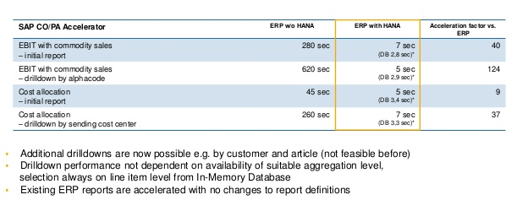

Slide 12
But HANA isn’t just a fast database
Application development platform
Application server built in
Native development tools included
Advanced analytical tools
Simplifies the data center
Data centers built on in-memory technologies can store up to 40x the data in the same space and use 80% less energy

Slide 13
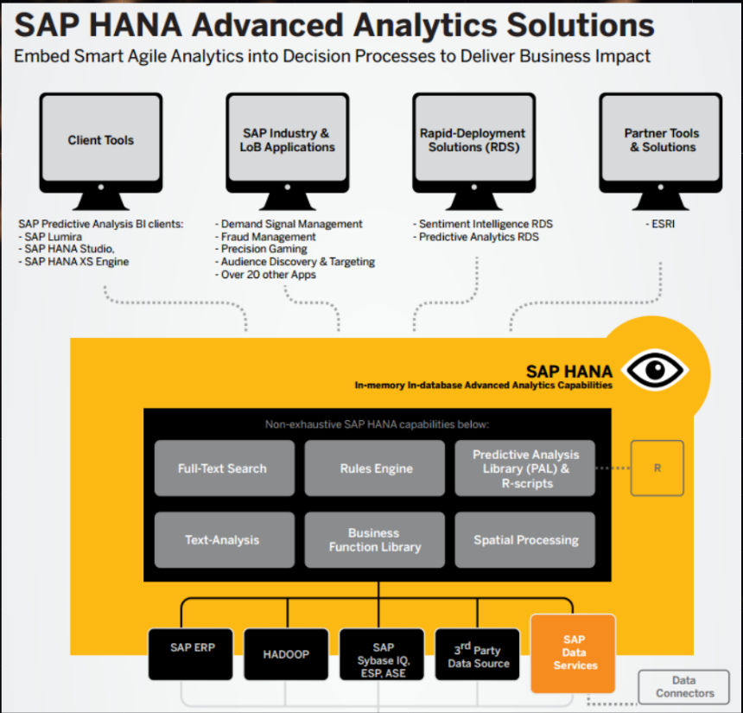

Slide 14
Thank you
Contact information:
Ross Hightower
Director, SAP UCC at UWM
hightowe@uwm.edu

