Slide 1
RNA-seq: Experimental Design and Differential Expression Analysis
Jinliang Yang
PostDoc Scholar
Jeffrey R-I lab
Feb. 23, 2015

Slide 2
RNA-seq Outline
Overview of RNA-seq Experiment
Experimental Design
Sequencing
Data Analysis (Differential Expression)

Slide 3
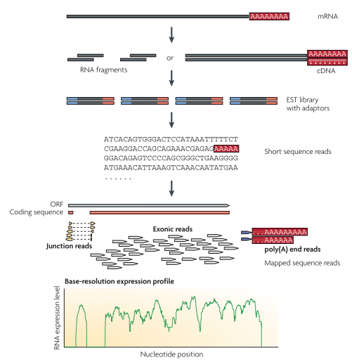
Overview of RNA-seq Experiment
Wang et al., 2009,
Nature Review Genetics
Notes:
A typical RNA-seq experiment: Briefly, long RNAs are first converted into a library of cDNA fragments through either RNA fragmentation or DNA fragmentation. adaptors (blue) are subsequently added to each cDNA fragment and a short sequence is obtained from each cDNA using high-throughput sequencing technology. The resulting sequence reads are aligned with the reference genome or transcriptome, and classified as three types: exonic reads, junction reads and poly(A) end-reads.

Slide 4
RNA-seq: A Toy Example
Notes:
RNA-seq produces millions of reads.
Measure gene expression
Discover and annotate complete transcripts
Characterize alternative splicing

Slide 5
RNA-seq: Source of Variance
Biological variance
Treatment effect (WT vs. Mut)
Difference between two plants
Technical variance
RNA isolation difference
Sequencing library preparation difference
Sequencing difference
Sampling variance
Sampling issue
Notes:
Inappropriate design can result in spending a great deal of time and money only to obtain nearly useless data.

Slide 6
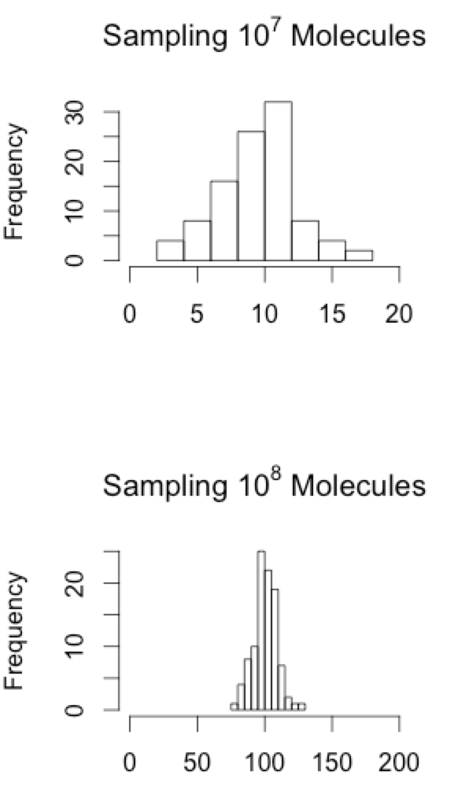
Experimental Design: Control Source of Variance
Sampling variance is the inherent nature of a counting experiment
1000 molecules / 10⁹ in total
Sequencing depth is critical

Slide 7
Technical Replication
Technical replication refers to sequencing multiple libraries derived from the same biological sample
Technical differences are not limited to above factors.
WHO, WHEN and HOW can all be considered as the source of tech variance.
Notes:
Barcode, people, preparing samples at the same time
Do not introduce systematic error
Random assign with unbiased treatment:
RNA isolation difference
Sequencing library preparation difference
Sequencing difference

Slide 8
Biological Replication
Biological replication refers to sequencing libraries derived from the different biological individuals or tissues.

Slide 9
Take Home Message
It is better to have more depth of sequencing (sampling variance)
About 10 million reads per sample is a benchmark to start. (Wang et al. 2011)
Replication and randomization helps to control confounding variance
Limited resources are probably better to allocate to biological rep than technical rep
Notes:
Wang et al. 2011 A chicken RNA-seq study revealed that expression estimates among tech reps for genes stabilized at about 10 million reads per sample.
10 million reads per sample is a benchmark to start.

Slide 10
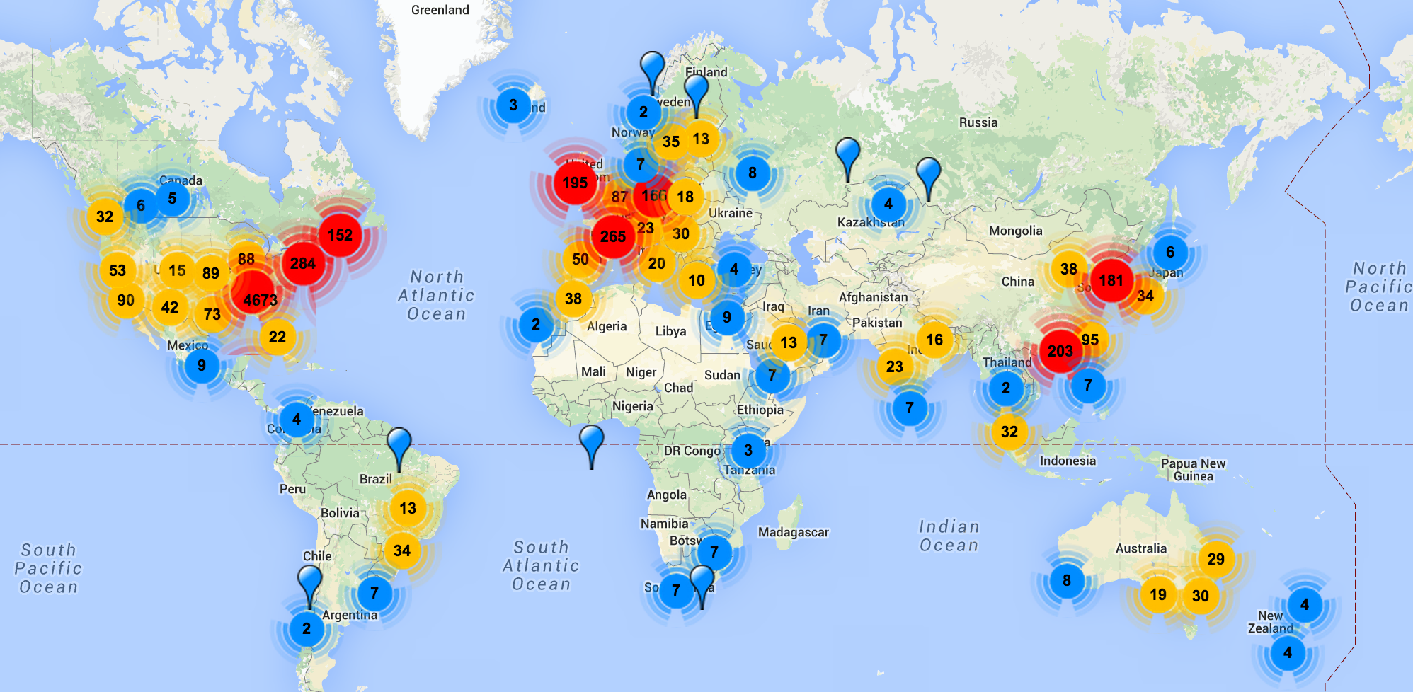
RNA-seq Platforms
Illumina, Ion Torrent, PacBio and Oxford Nanopore
http://omicsmaps.com/

Slide 11
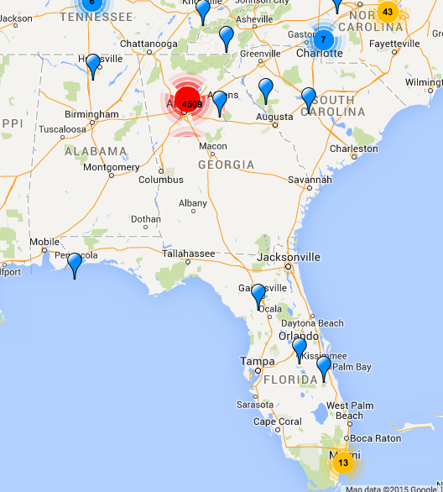
Ion PGM Sequencer?

Slide 12
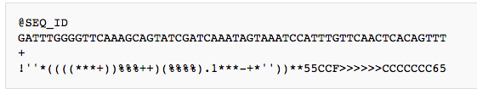
RNA-seq Data
line 1: sequence id
line 2: nucleotide sequence
line 3: a "+" sign separator, optionally with the read identifier repeated
line 4: a corresponding ASCII string of quality characters
p represents the probability that a given base is incorrectly called.

Slide 13
RNA-seq: Data Analysis Outline
Quality checking and data cleaning
Aligning RNA-seq reads to reference
Count reads in gene models
Differential Gene Expression Study
Pipeline: https://github.com/yangjl/Demo
Or /group/jrigrp5/ECL298/Demo

Slide 14
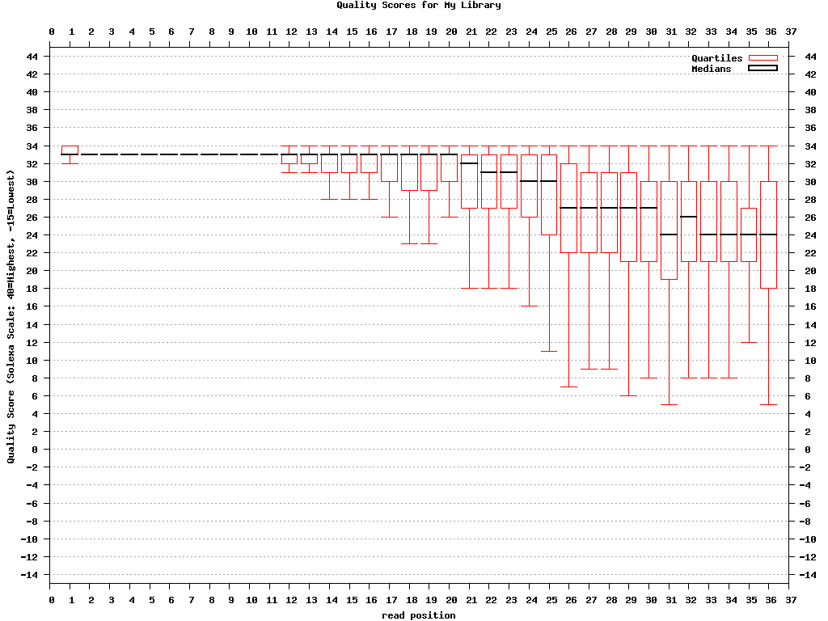
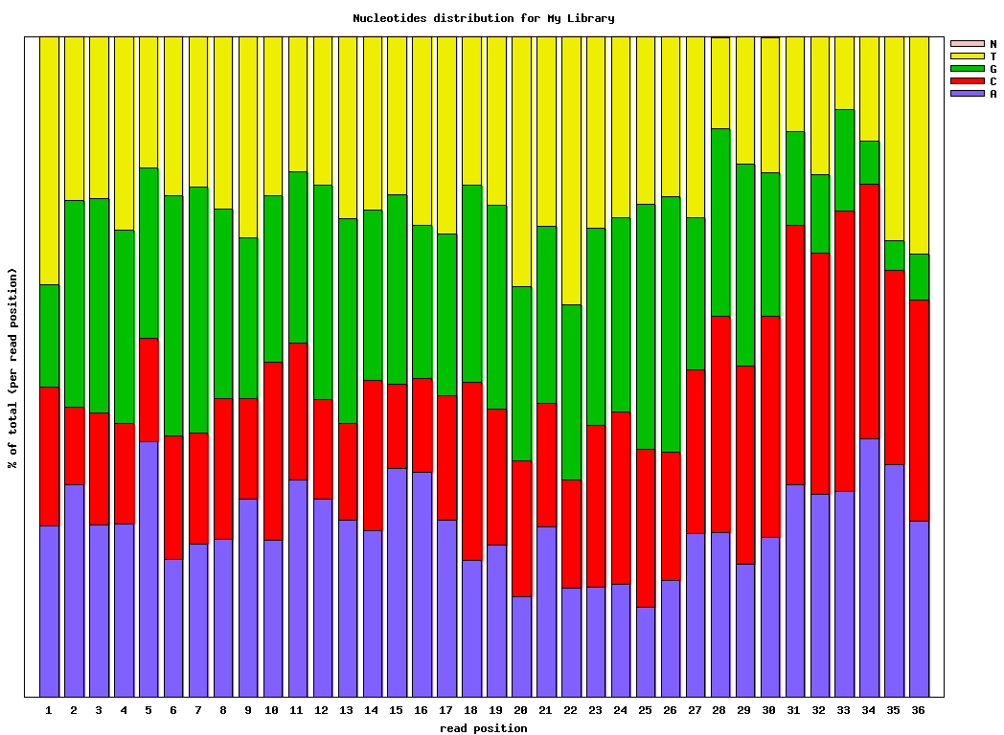
RNA-seq: Quality Checking
Quality Score
Nucleotide Distribution
FASTX-Toolkit

Slide 15
Data Cleaning
1. Demultiplex by barcode
HiSeq 2000 normally yields ~150 million reads
6nt barcode or index
2. Remove adapter sequences
3. Trim basepairs by quality
4. Discard reads by quality/ambiguity
Notes:
Debatable: whether to trim low quality bps. Whether need to discard low quality reads.

Slide 16


Aligning Reads to a Reference Genome
RNA-seq aligner:
Efficiency and splicing awareness
Widely used: GSNAP, BWA-mem, Bowtie2
For differential expression study:
Reference genome
Gene annotation (typically the intron/exon annotations are available in GFF3 or GTF file)
Notes:
From pre-mRNA transcript (spliceosome) => mature mRNA by splicing. Splicing junctions.

Slide 17
Summary Statistics of Alignment
File | # of total reads | # of uniquely aligned reads | Mapping Rate (100%)
1.fq | 4,413,034 | 4,147,652 | 94
2.fq | 4,879,212 | 4,619,978 | 94.7
3.fq | 6,924,929 | 6,618,966 | 95.6
4.fq | 6,848,552 | 6,469,461 | 94.5
5.fq | 5,438,538 | 4,962,816 | 91.3
6.fq | 3,772,703 | 3,507,526 | 93
Uniquely aligned reads will be used for differential expression analysis

Slide 18
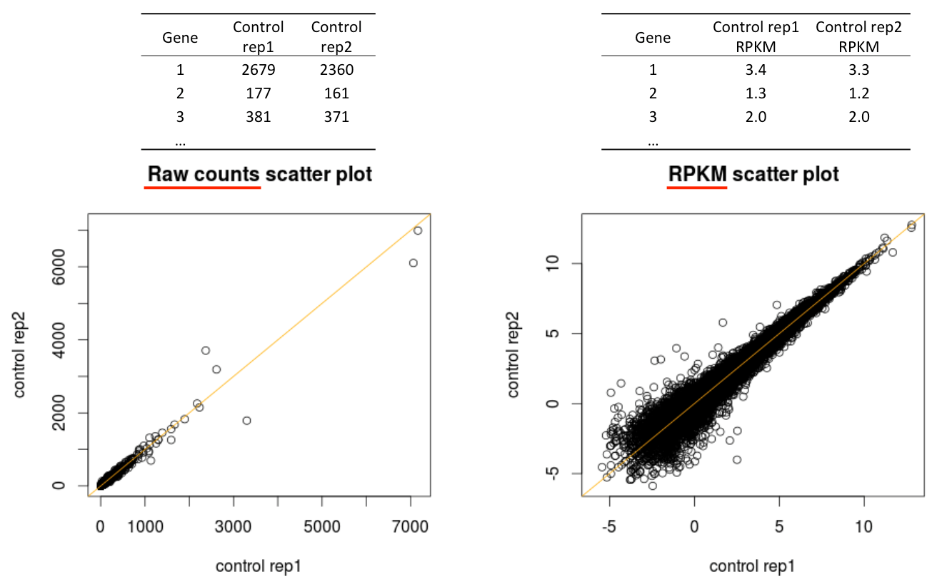
Read Counts and Normalization
RPKM: reads per kilobase per one million mapped reads.
Adjust gene length and library size.
Notes:
Gene length, for example, influences read counts because more reads per single transcript will be observed for longer genes.

Slide 19
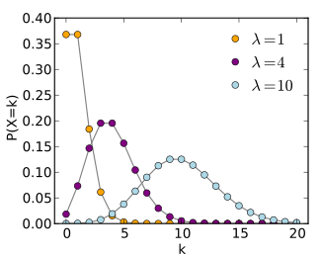
Statistical Model for Differential Gene Expression Study
Poisson distribution
Approximate the random draw reads from a population with given, fixed fraction of genes
Overdispersion issue
A poisson distribution assumes mean = variance
But, RNA-seq data variance > mean
Negative binomial (NB) distribution
Characterized by an additional dispersion parameter
R packages: edgeR, DESeq2

Slide 20
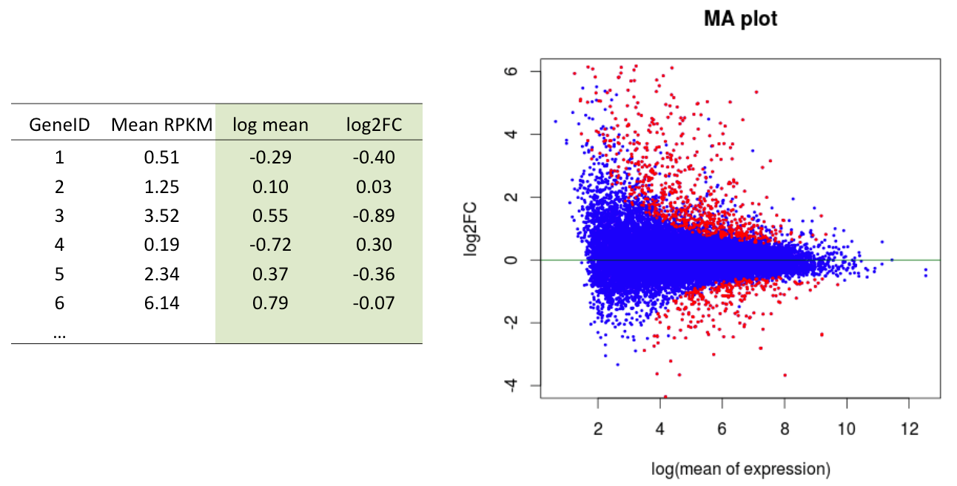
MA plot
M (Log ratios) and A (mean value)
Fold change: measure how much the expression change from one treatment to the other, for example WT to Mutant.

Slide 21
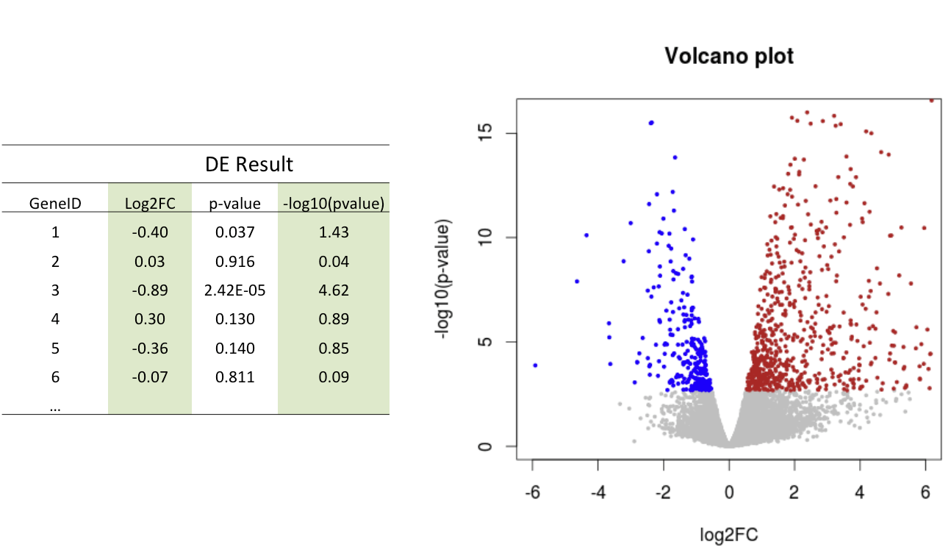
Volcano Plot
False Discovery Rate: is a statistical method to correct multiple hypothesis testing problem.
FDR control

Slide 22
Take Home Message
Experimental Design is critical
Conduct quality checking and then determine how to clean the data
NB distribution is a widely accepted distribution for modeling read counts data
Use FDR and FC to clarify differentially expressed genes

