Slide 1

Applied Data Science Capstone - Coursera
The Battle of the neighborhoods – Adoré du Plessis
29-11-2020

Slide 2
Introduction
New York City:
has a large amount of Japanese inhabitants
welcomes many Japanese tourists each year
interest in the Japanese culture among New Yorkers are increasing.
more people are turning to a healthier alternative in Japanese food.
"Where do I find the best Japanese food in New York City?"

Slide 3
Data
New York City data obtained from https://cocl.us/new_york_dataset
Foursquare API used for locations and quality of Japanese restaurants

Slide 4
Methodology
Data will be collected from https://cocl.us/new_york_dataset, cleaned and processed into a dataframe.
FourSquare be used to locate all venues and then filtered by Japanese restaurants. Ratings, tips, and likes by users will be counted and added to the dataframe.
Data will be sorted based on rankings.
Finally, the data will be visually assessed using graphing from Python libraries.

Slide 5
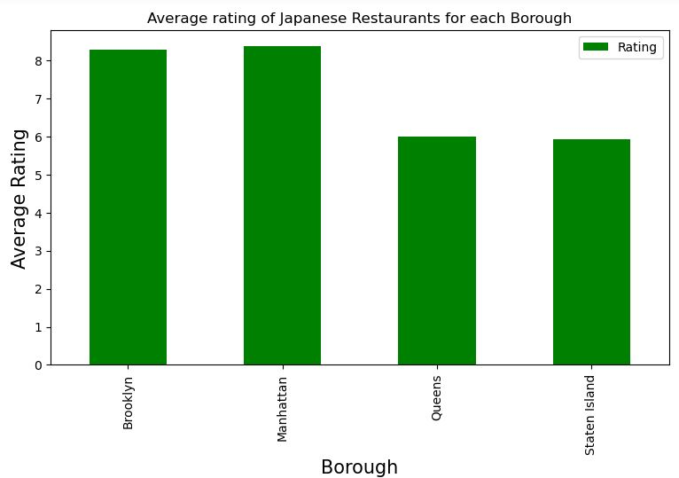
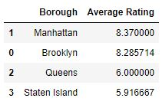
Results – average rating of Japanese restaurants per borough

Slide 6
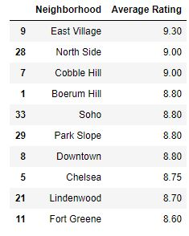
Results – ratings per neighborhood

Slide 7
Conclusion
Best borough: Manhattan
Best neighborhood: East Village
Best restaurant: Kura

