Slide 1
Rossignoli & Partners
Independent Market Intelligence
The Arithmetic of Complacency
S&P 500 hits new highs while breadth deteriorates — is this 1999 redux?
www.rossignolipartners.com
3-7 February 2025

Slide 2
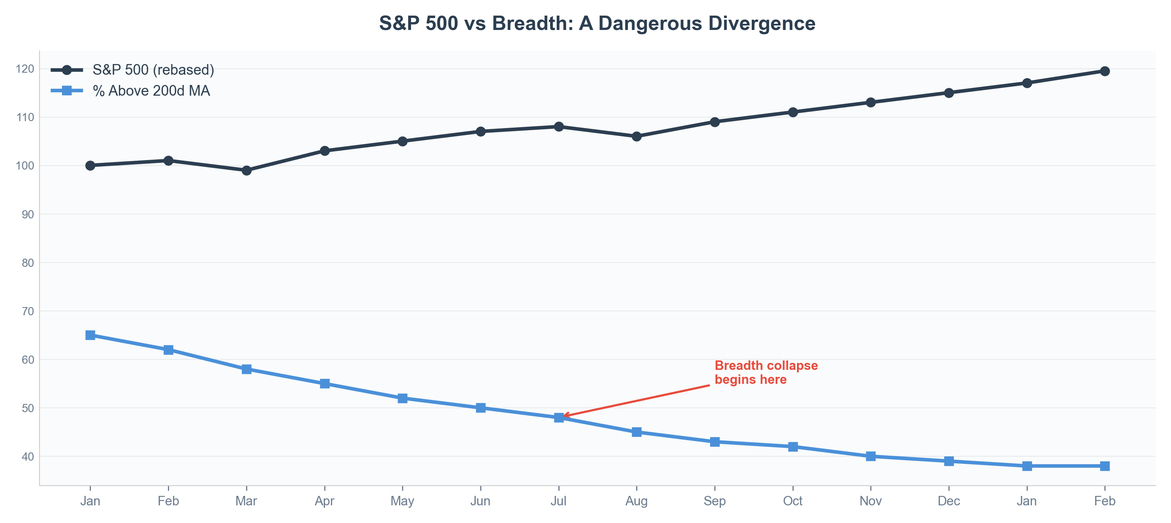
#GLOBALMARKETS WEEKLY WRAP-UP
3-7 February 2025
#equities
CHART OF THE WEEK
#chartoftheweek #sp500 #breadth #technicals
The S&P 500 rose 2.1% this week to a new all-time high — but beneath the surface, only 38% of constituents trade above their 200-day moving average. The last time we saw this divergence was January 2000, three months before the dot-com peak. The Magnificent Seven now account for 34% of index weight, the highest concentration since the Nifty Fifty era of 1972.
Source: Bloomberg, Rossignoli & Partners calculations
Rossignoli & Partners
Page 1

Slide 3
#GLOBALMARKETS WEEKLY WRAP-UP
3-7 February 2025
The Week in One Breath
EXECUTIVE SUMMARY
Strong NFP (+353k) crushed rate-cut hopes → 10Y yield surged to 4.17% → Dollar rallied 0.8% → EM currencies sold off → Gold dropped 1.2% as real yields rose → Credit spreads tightened anyway as equity euphoria overrode duration risk → S&P 500 rose 2.1% to new ATH, but breadth collapsed to 38%.
The 2s10s curve steepened 12bp this week. Last time the curve steepened this fast after an inversion was Q3 2006 — 14 months before recession. Credit markets smell what equity markets refuse to acknowledge.
Consensus: soft landing confirmed, buy the dip. Our view: employment is a lagging indicator. Card delinquencies at 12-year highs. The 'strong consumer' is borrowing to spend — exactly 2006-2007. We are not bearish; we are historically aware.
Rossignoli & Partners
Page 2

Slide 4
01
#equities
Is the Rally Running Out of Fuel?
US, European & Asian equity markets

Slide 5
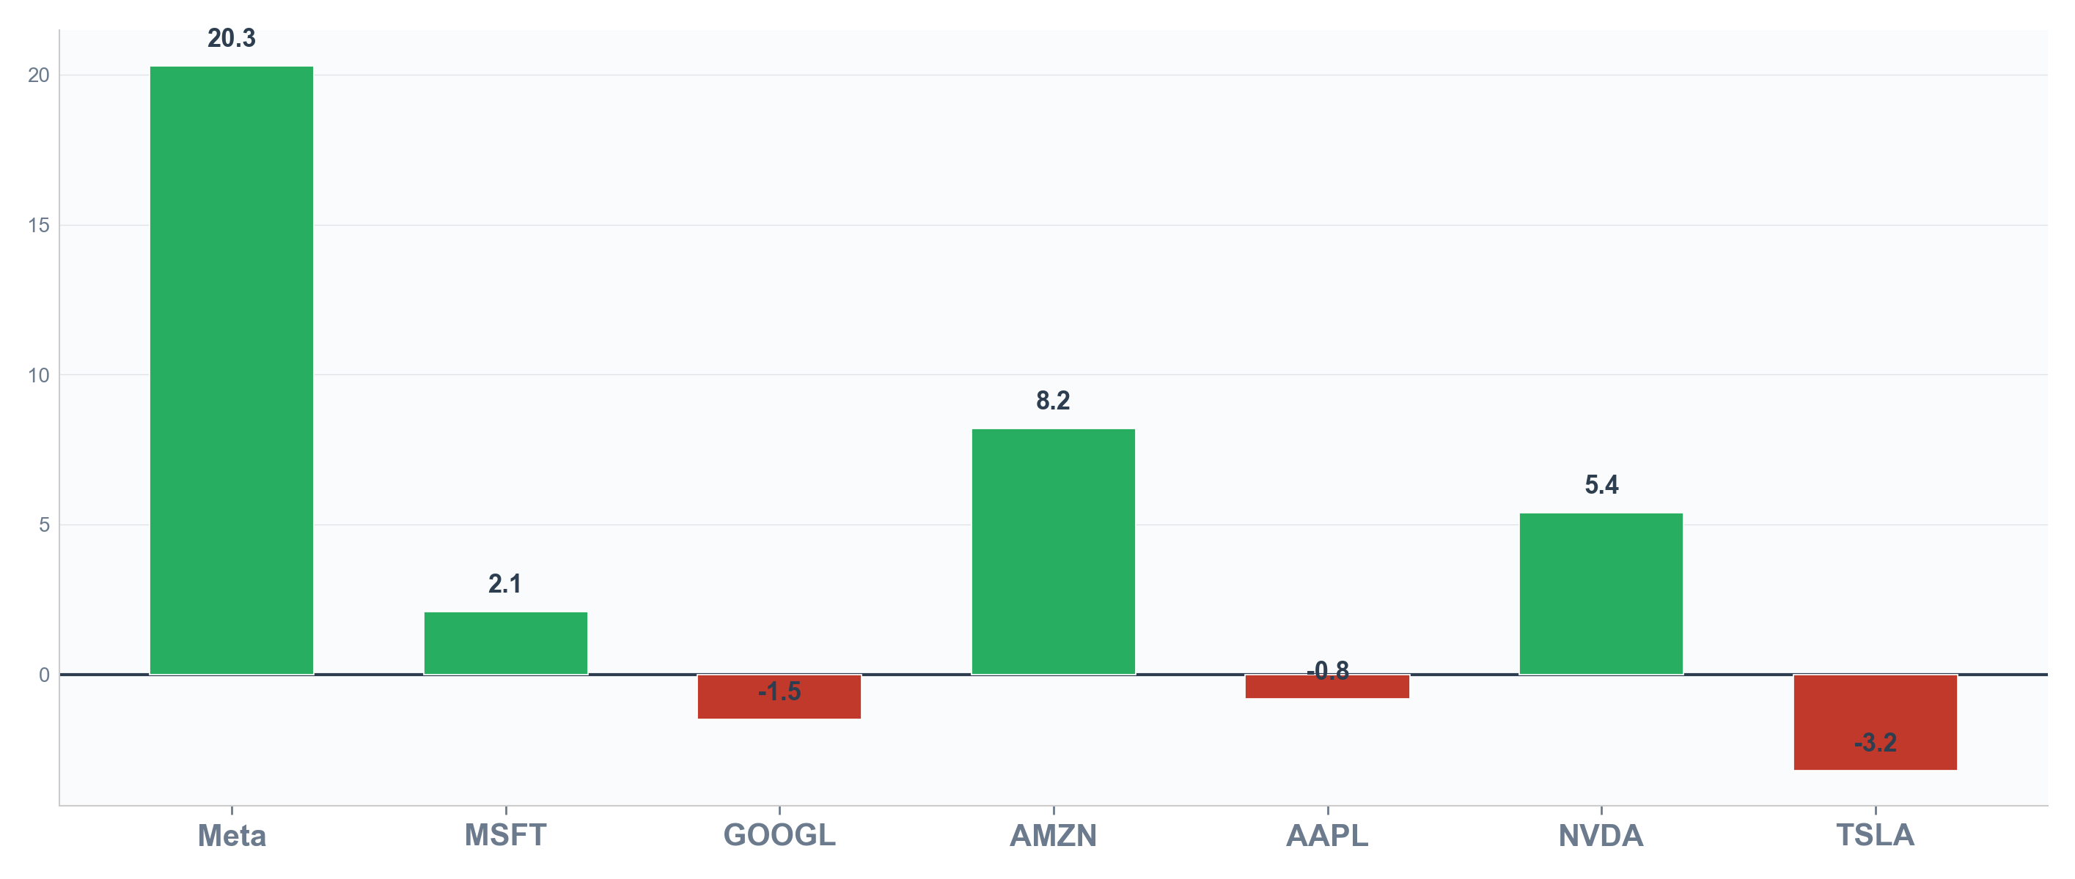
#GLOBALMARKETS WEEKLY WRAP-UP
3-7 February 2025
#equities
#us #equities #sp500 #earnings #ai
The S&P 500 rose 2.1% to a new all-time high at 4,958. Meta surged 20% after reporting AI-driven ad revenue, adding $200Bn in market cap in a single session. But here's the second-level question: if AI works for everyone, where is the competitive moat? The last time a technology 'worked for everyone' was the internet in 1999. We're not saying AI is a bubble — we're saying the market is pricing monopoly returns for a commodity technology.
Source: Bloomberg, company filings
Rossignoli & Partners
Page 3

Slide 6
02
#fixed income
What Is the Bond Market Trying to Tell Us?
Rates, credit & sovereign spreads

Slide 7
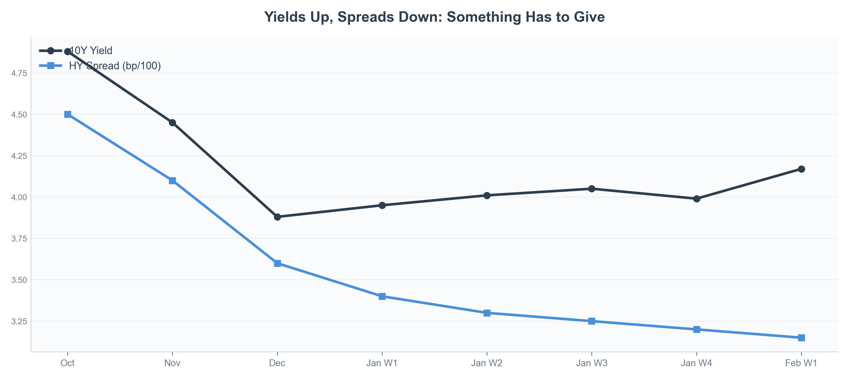
#GLOBALMARKETS WEEKLY WRAP-UP
3-7 February 2025
#fixed income
#bonds #yields #curve #credit #fed
The 10-year Treasury yield surged 18bp to 4.17%, its largest weekly move since October. Credit spreads ignore the signal: HY at 315bp, tightest since January 2022. Either credit markets are wrong about risk, or equity markets are wrong about growth. Both cannot be right. The last time HY spreads were this tight heading into a hiking pause was July 2006.
Source: Bloomberg, Fed funds futures
Rossignoli & Partners
Page 4

Slide 8
#GLOBALMARKETS WEEKLY WRAP-UP
3-7 February 2025
#equities
“
There are two types of investors: those who want to get rich and those who want to stay rich. In 2024, the distinction matters more than it has since 1999.”
— Michael Hartnett, BofA Global Research
BofA Flow Show, February 2 2024
Hartnett's Bull & Bear indicator hit 6.8 this week — above 8 triggers a contrarian sell signal. The velocity of ascent from 3.2 in October is historically unprecedented outside of 1999 and 2021.
Rossignoli & Partners
Page 5

Slide 9
03
#fx
Is the Dollar's Rally a Feature or a Bug?
Foreign exchange & commodity markets

Slide 10
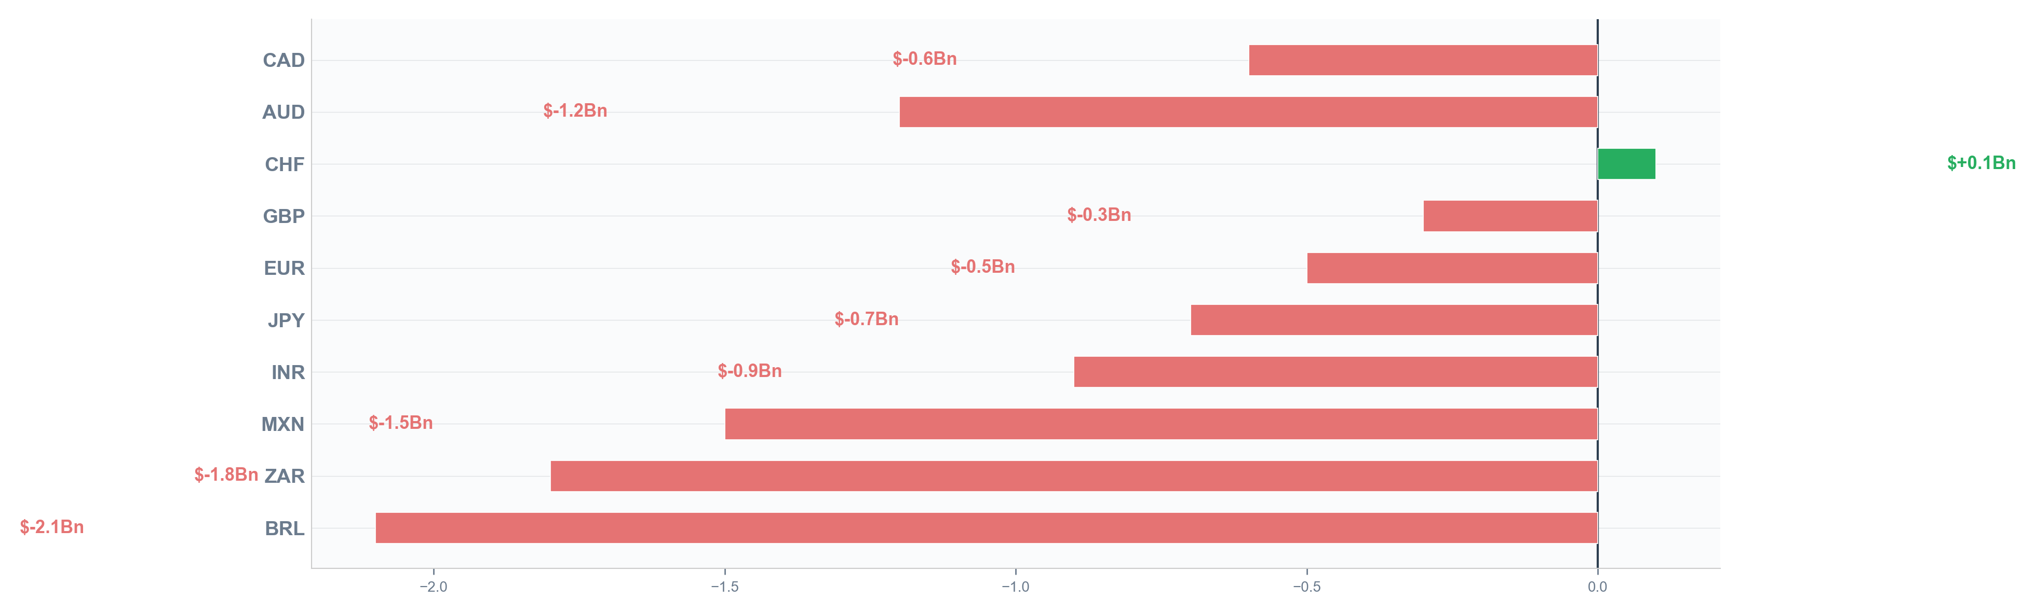
#GLOBALMARKETS WEEKLY WRAP-UP
3-7 February 2025
#fx
#fx #dollar #eurusd #yen #em
DXY rose 0.8% to 104.1. EUR/USD fell to 1.0780 testing the 200-day MA. But here is the contrarian angle: dollar strength driven by rate differentials is self-limiting. A strong dollar tightens financial conditions globally, slows US exports, and compresses EM growth — all of which eventually circle back to weaken the US economy itself. The dollar's rally is not a sign of strength; it is the market pricing in the end of synchronized global growth.
Source: Bloomberg, BIS data
Rossignoli & Partners
Page 6

Slide 11
#GLOBALMARKETS WEEKLY WRAP-UP
3-7 February 2025
#commodities
Commodity Snapshot: Diverging Signals
#gold #oil #copper #natgas
Rossignoli & Partners
Page 7

Slide 12
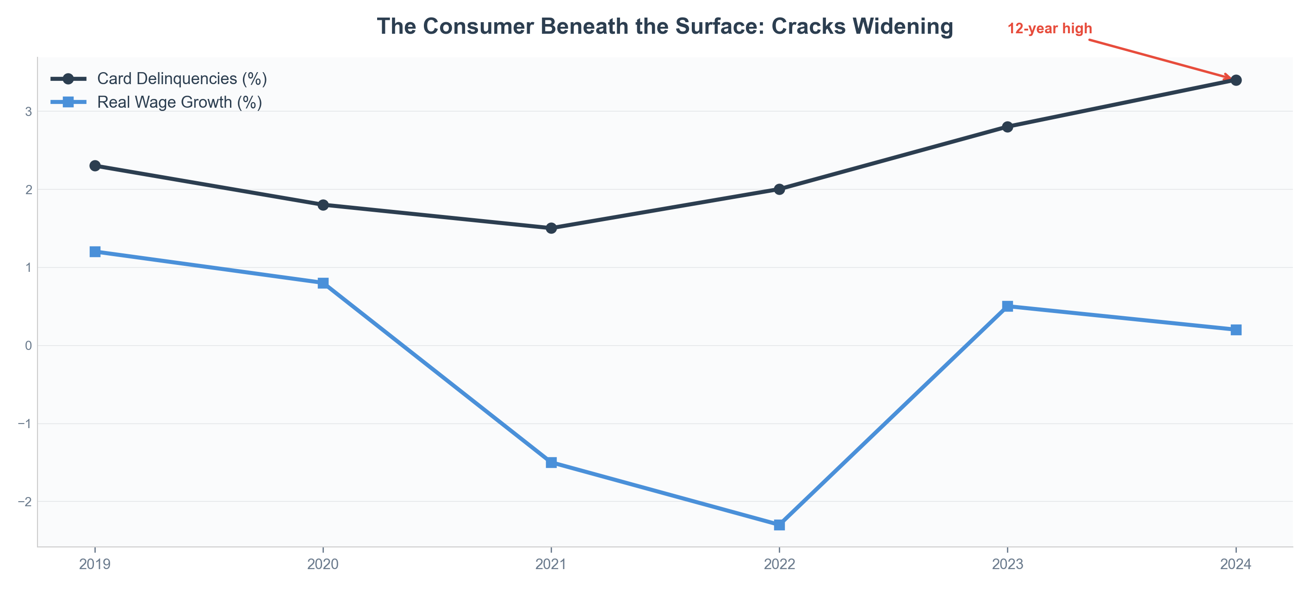
#GLOBALMARKETS WEEKLY WRAP-UP
3-7 February 2025
#macro
WHERE COULD WE BE WRONG?
#risks #contrarian #positioning
MYTH: 'The consumer is strong — employment at record highs.' REALITY: Employment is a lagging indicator. Real wages are decelerating. Credit card delinquencies are at 12-year highs. The 'strong consumer' is borrowing to spend — exactly 2006-2007. We could be wrong if AI productivity gains materialize faster than the historical 3-5 year lag. But we would rather be historically aware and modestly positioned than complacent and concentrated.
Source: Federal Reserve, BLS, Rossignoli & Partners
Rossignoli & Partners
Page 8

Slide 13
#GLOBALMARKETS WEEKLY WRAP-UP
3-7 February 2025
#macro
“
The market can remain irrational longer than you can remain solvent — but it cannot remain irrational longer than history.”
— Adapted from Keynes
Our positioning: Neutral equities with quality tilt. Overweight 7-10Y Treasuries. Underweight HY credit. Long gold as insurance. Short EUR/USD tactically.
Rossignoli & Partners
Page 9

Slide 14
#GLOBALMARKETS WEEKLY WRAP-UP
3-7 February 2025
Sources & Methodology
Bloomberg Terminal
Refinitiv Eikon
Federal Reserve Economic Data (FRED)
BIS Statistics
BofA Global Research (Flow Show)
Goldman Sachs (Top of Mind)
JPMorgan (Guide to the Markets)
SYZ Group (#GlobalMarkets)
S&P Global Market Intelligence
ICE BofA Index Data
CBOE VIX Data
Rossignoli & Partners proprietary models
This document is for informational purposes only and does not constitute investment advice. Past performance is not indicative of future results.
Rossignoli & Partners
Page 10

Slide 15
Rossignoli & Partners
Independent Market Intelligence
research@rossignolipartners.com
www.rossignolipartners.com
Have a great week-end!
This material is provided for informational purposes only.
© 2025 Rossignoli & Partners. All rights reserved.

