Slide 1
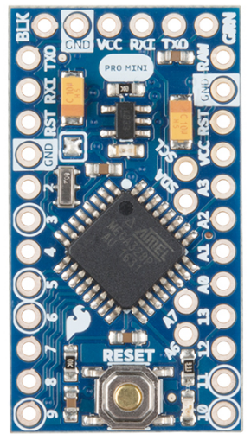
Arduino Pro Mini (3.3V)
Battery Voltage
3.3V Regulated
Photoresist 2
Photoresist 1
Servo1
Servo2
ADMP401 – AVD Pin
https://learn.sparkfun.com/tutorials/using-the-arduino-pro-mini-33v

Slide 2
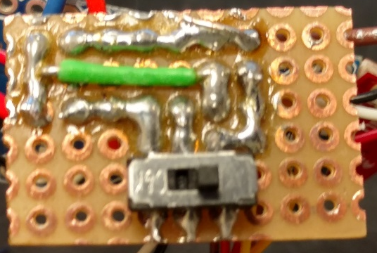
GND
3.3V Line
10kOhm
PR
10kOhm
PR
A5
A4

Slide 3
Batt in GND
GND
Arduino VCC
Not connected
On
Off
Batt V+
When switch is open
Batt V+

Slide 4
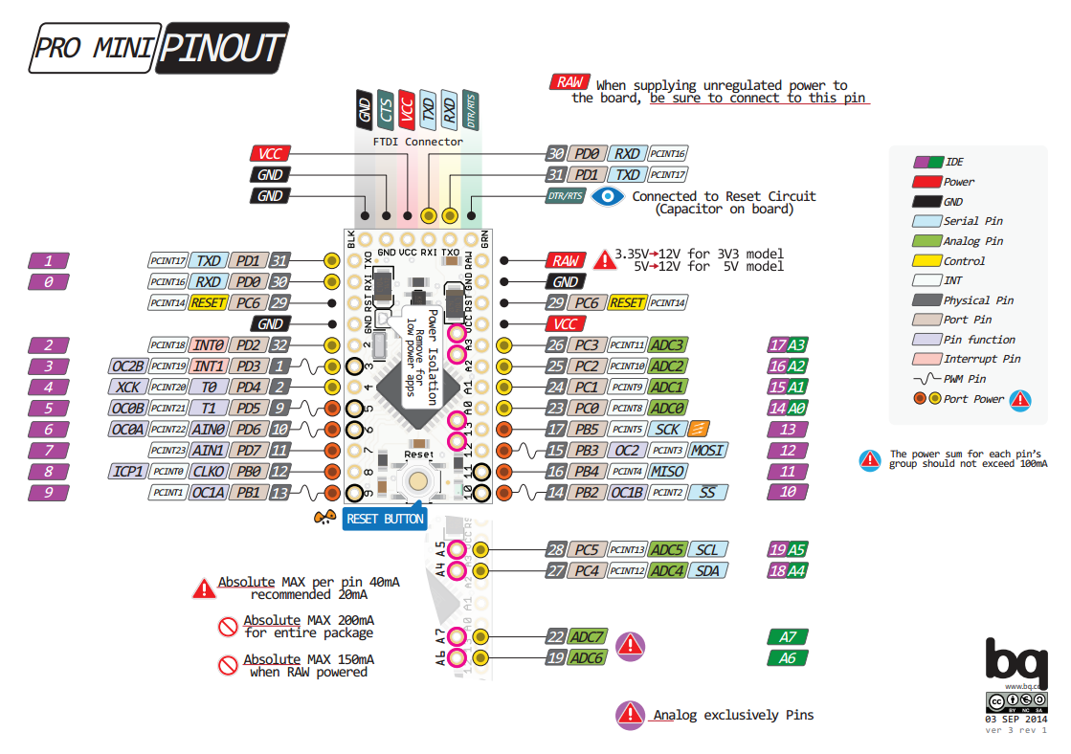
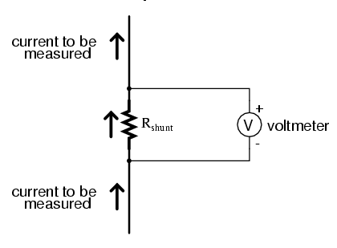
Stress sensing resistor
System GND
1ohm res
Servo GND Pin

Slide 5
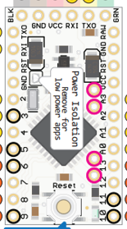
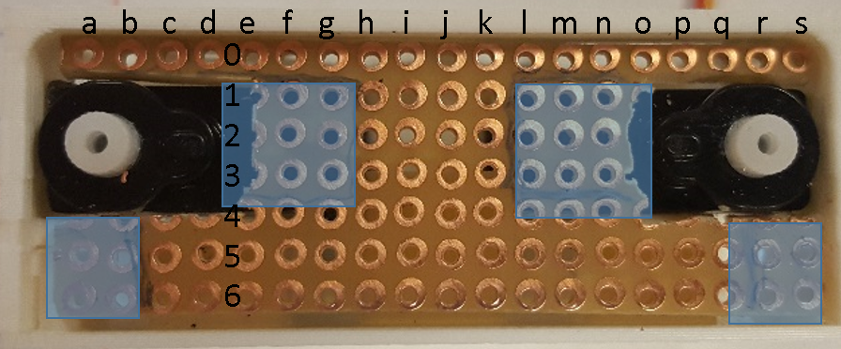
CLEAN SLIDE DON’T EDIT!!
Microphone
Analog
Microphone
Stress sensing
Random seed pin (empty)
FRONT
Power
Batt 3.3v pin
Microphone
Servo 1
Servo 2
Gnd
Stress sensing
Servo 1
Servo 2
Microphone
SERVO 1
SERVO 2
BACK

Slide 6
Microphone
(a0/5) = servo1 sig
(c0/3) = servo2 sig
(h0/A3) = stress
(g0/A2) = mic
(e0/A0)=light1
(f0/A1)=light2
Analog
Microphone
Stress sensing
Random seed pin (empty)
FRONT
Power
Batt 3.3v pin
Microphone
Servo 1
Servo 2
Gnd
Stress sensing
Servo 1
Servo 2
Microphone
GND
SERVO 1
SERVO 2
RAW
GND
RAW
BACK

Slide 7
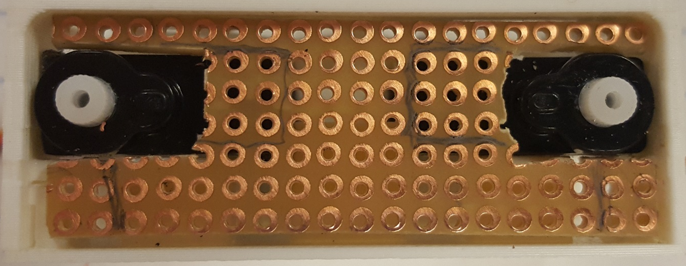
a
b
c
d
e
f
g
h
i
j
k
l
m
n
o
p
q
r
s
0
1
2
3
4
5
6

Slide 8
Mic.VCC = i4
Mic.GND = i5
Mic.AVD = i6
light1.VCC = (i2)
light1.GND = (k3)
light2. VCC = (i4)
light2.res = (j3)
Batt.pos = (m6)
Batt.neg = (l5)
Servo1.GND = h1
Servo2.GND = h2
Servo1.VCC = m1
Servo2.VCC = m2
(a0/5) = servo1 sig
(c0/3) = servo2 sig
(h0/A3) = stress
(g0/A2) = mic
(e0/A1)=light1
(f0/A5)=light2
Analog
Microphone
Stress sensing
Random seed pin (empty)
FRONT
Power
Batt 3.3v pin
Microphone
Servo 1
Servo 2
Gnd
Stress sensing
Servo 1
Servo 2
Microphone
GND
GND
RAW
1Ω-line
10kΩ
light1
RAW
SERVO 1
VCC
SERVO 2
MIC AVD
light2
A5
GND
1Ω
A1
SWITCH
GND
10kΩ
MIC
RAW
MIC AVD
GND
BACK

